Slide 1
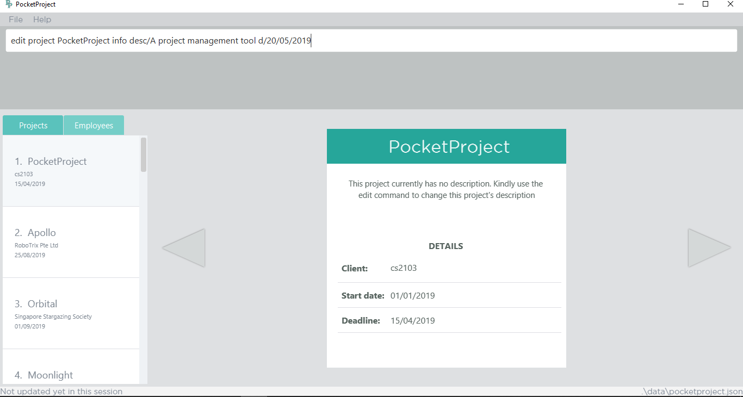
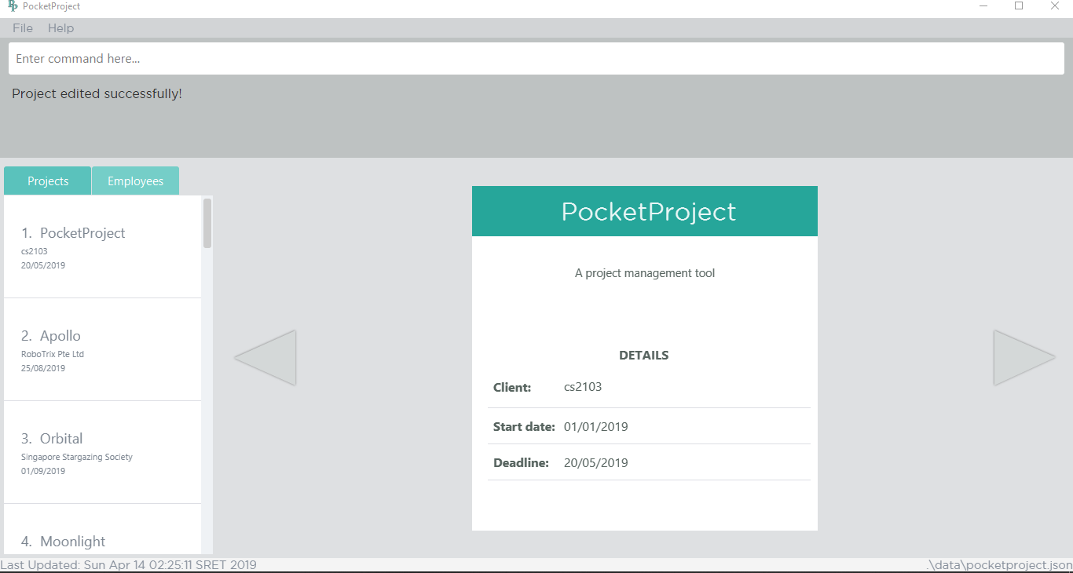

Slide 2
Before
After
The description is changed
The deadline is changed

Slide 3
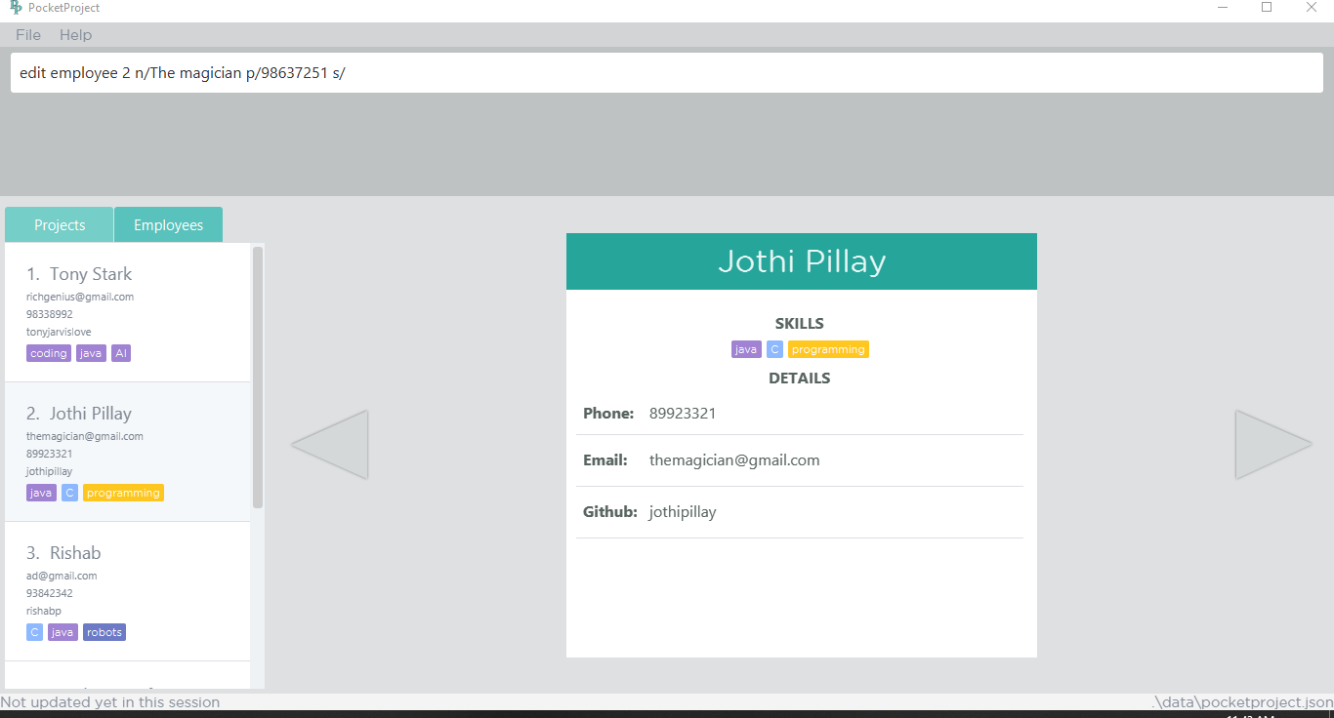
1. Type the command to edit name, phone and skill of the employee at index 2
2. The target employee at index 2 which will be edited when the command is entered.

Slide 4
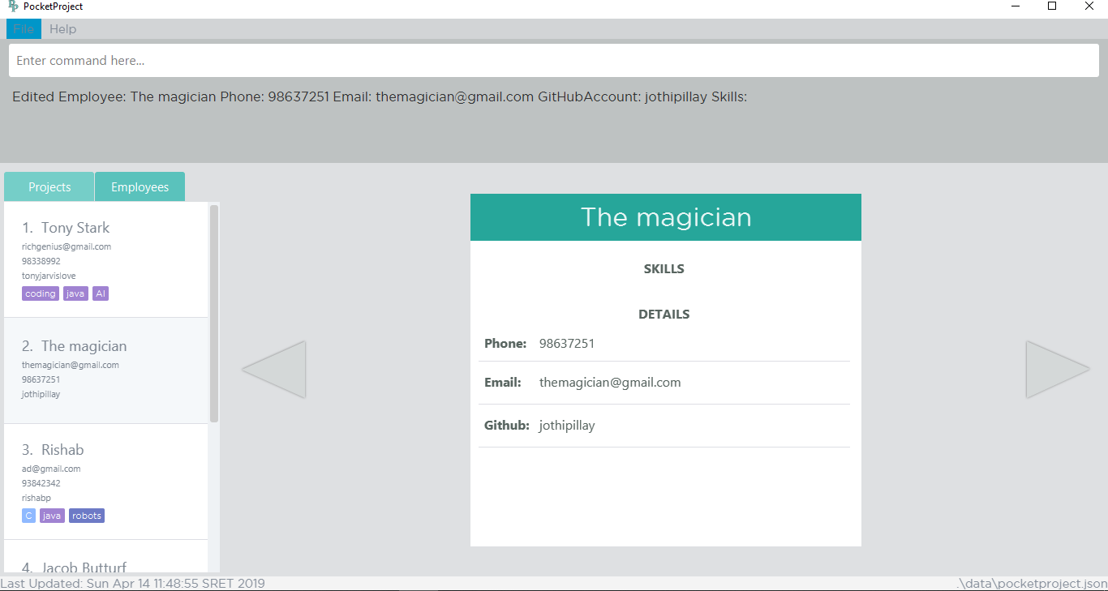
3. The success message will be shown
5. The changes are reflected on the detail panel as well.
4. The target employee’s information has been changed. Name changed from ‘Jothi Pillay’ to ‘The magician’ and the skills are removed.

Slide 5
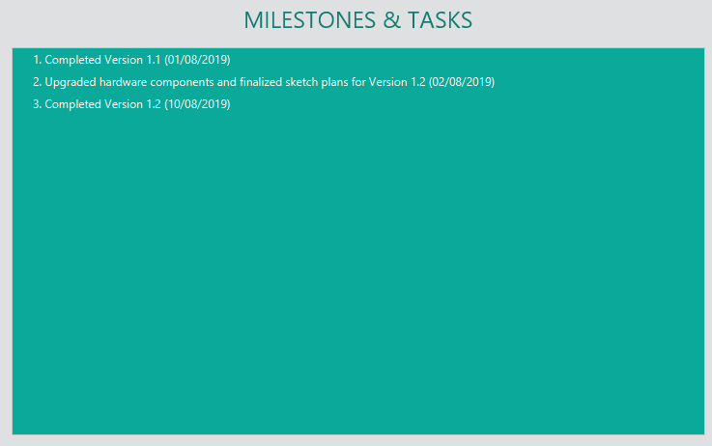
1. Type the command to edit the first milestone of Orbital
3. Target milestone to be edited
2. Target project to be edited

Slide 6

Before
After
The milestone at index 1 is edited to ‘Version 1.1 refactoring’. Since the milestone are sorted by date, the edited milestone with the new date has been shifted to index 2.

Slide 7
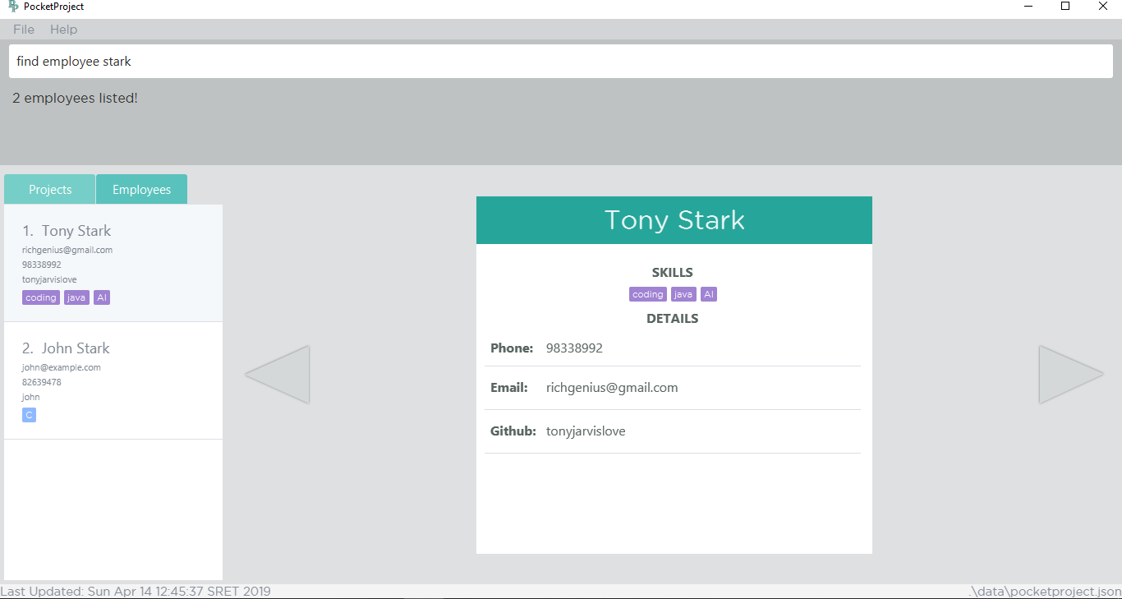
1. Type the command to find employees with ‘stark’ in their name
2. The success message with number of employees found is shown
3. The employees with ‘stark’ in their name that are found

Slide 8
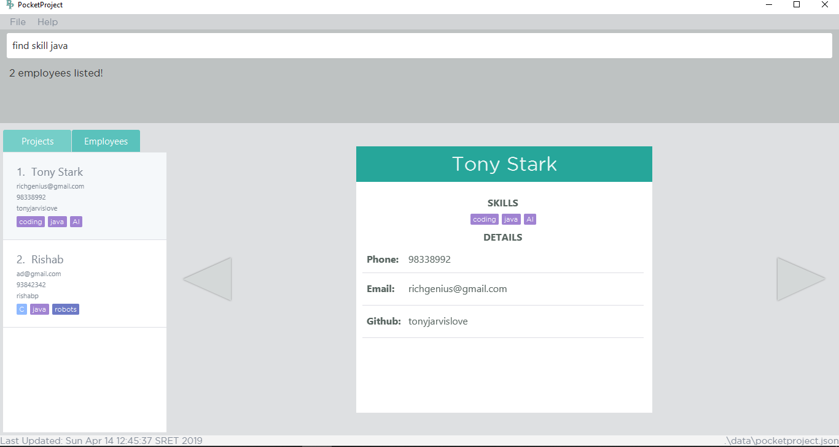
1. Type the command to find employees with skill java
2. The success message with number of employees found is shown
3. All the employees with ‘java’ skill are listed here

Slide 9
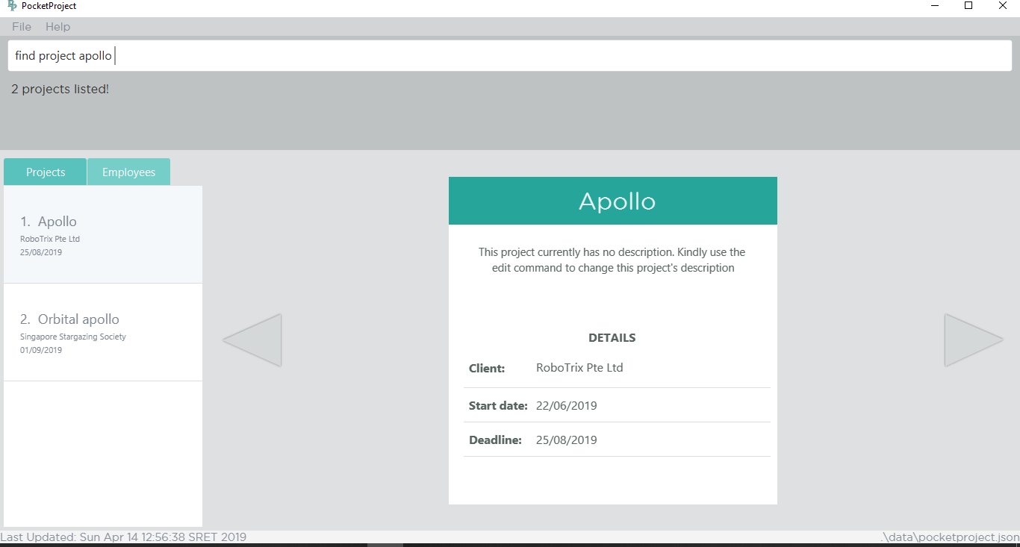
1. Type the command to find project with name apollo
2. The success message with number of projects found is shown
3. The projects with the word ‘Apollo’ in their project’s name are listed

Slide 10

1. Type the command to find project which contain the word management in the name, description or client
2. The success message with number of projects found is shown
3. The projects that contain the word management are found
Found in description

Slide 11

1. Type the command to find project with deadline before 31/05/2019 (current date is 14/04/2019)
2. The success message with number of projects found is shown
3. The projects with deadline before 31/05/2019

