Slide 1
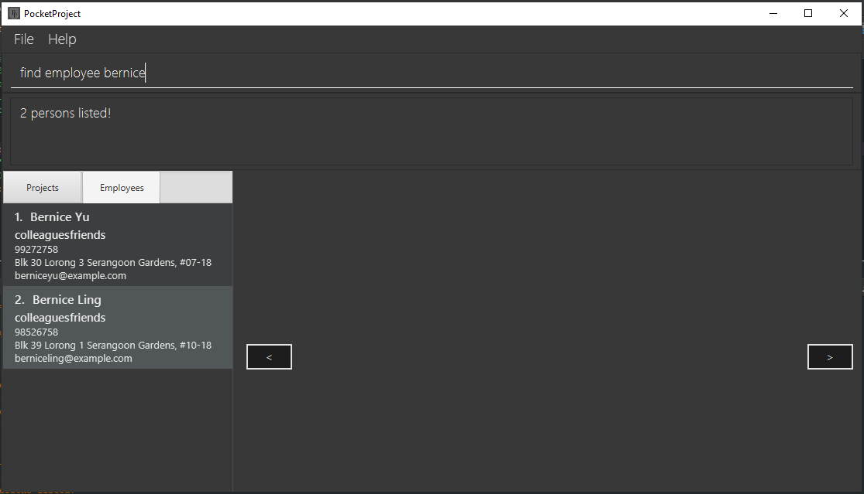
Search Result
Index of Bernice Yu is 1

