Slide 1
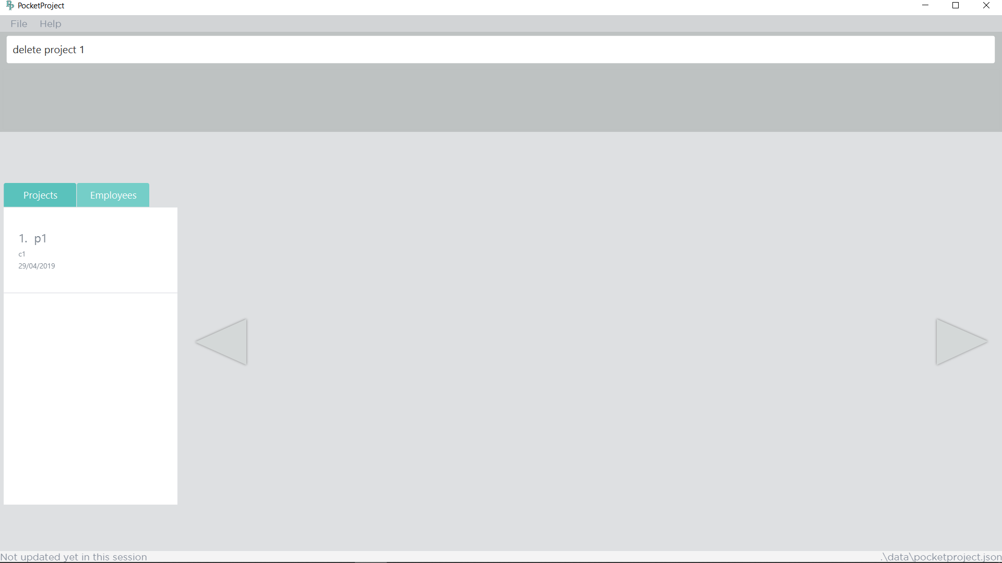
1. Type the command to delete a project
2. Identify target project from the list. For eg, target project is at index 1 of the list of projects.

Slide 2
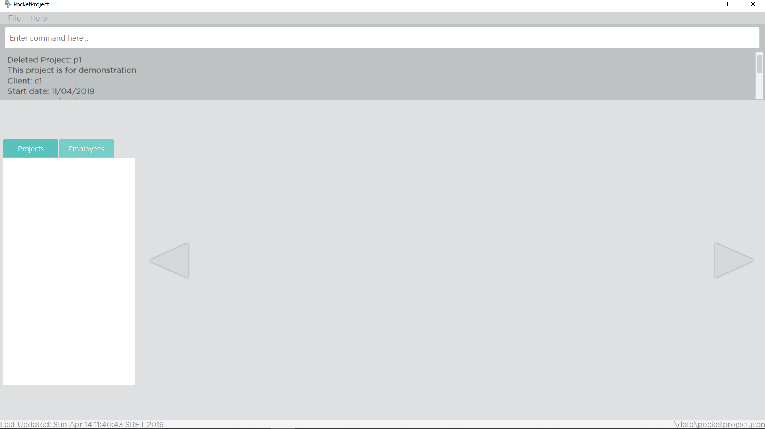
2. The details of the deleted project, p1, is shown here.
1. The project, p1, is deleted from the app.

Slide 3
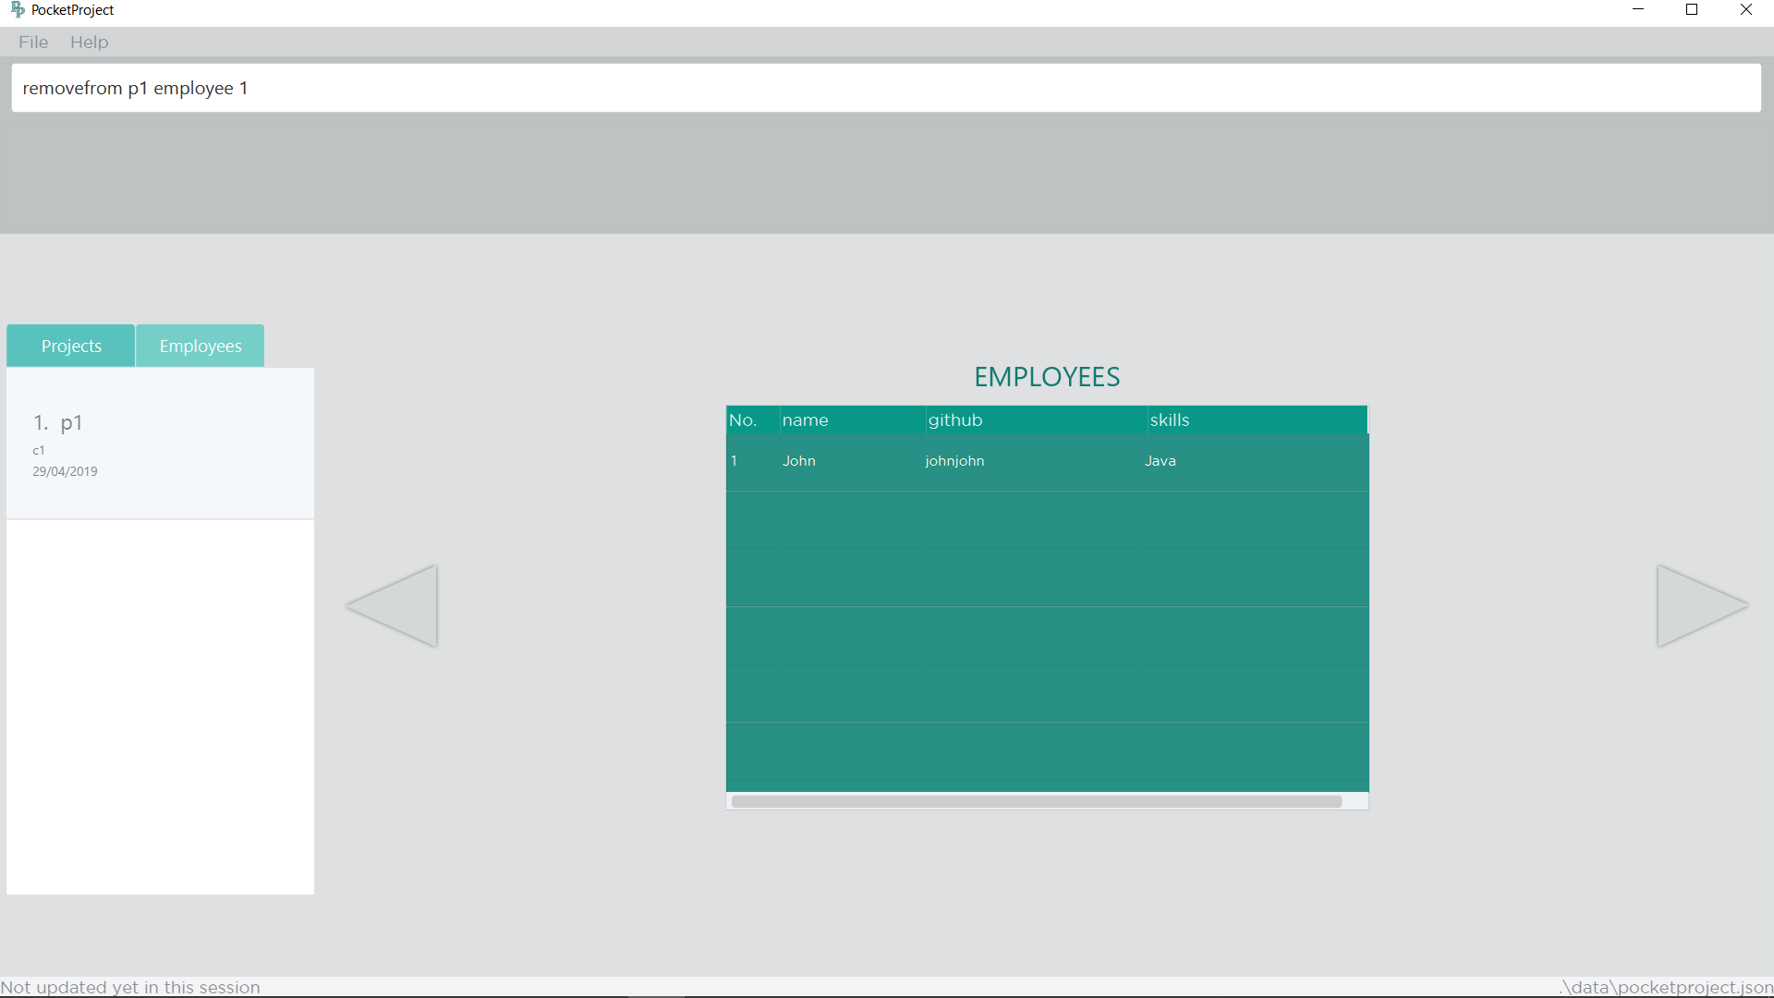
2. Type the command to remove the first employee in the project ‘p1’.
1. There is one employee named ‘John’ working on the project ‘p1’.

Slide 4
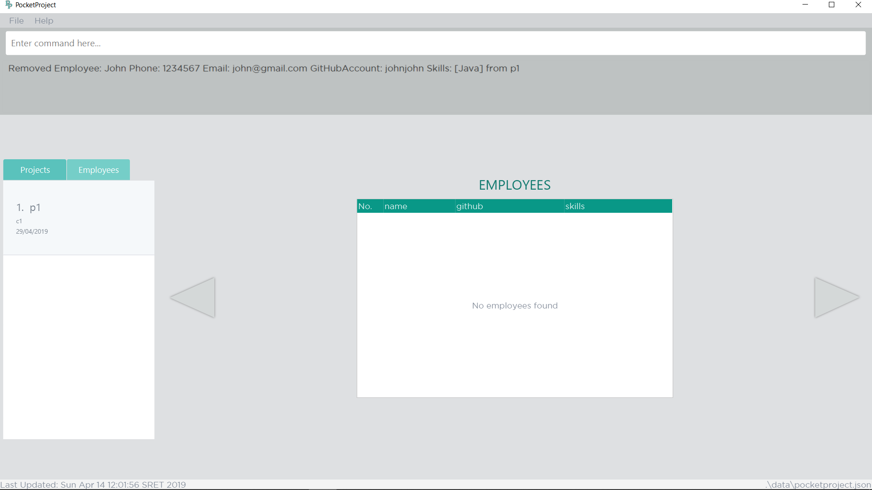
2. The details of the removed employee is shown.
1. The employee named ‘john’ is removed from the project.

