Slide 1
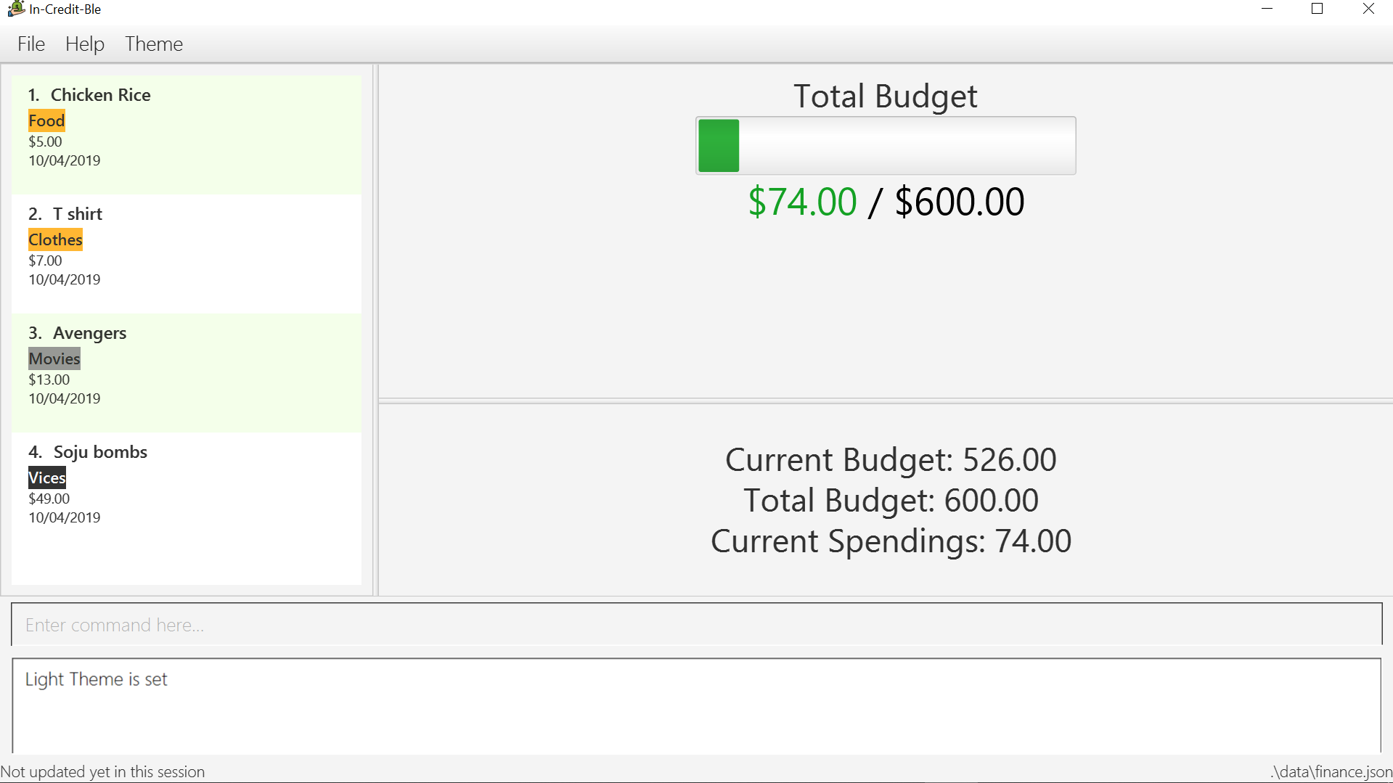
Menu Bar
Records List Panel
Budget Panel
Browser Panel
Command Box
Result Display
Status Bar Footer

Slide 2
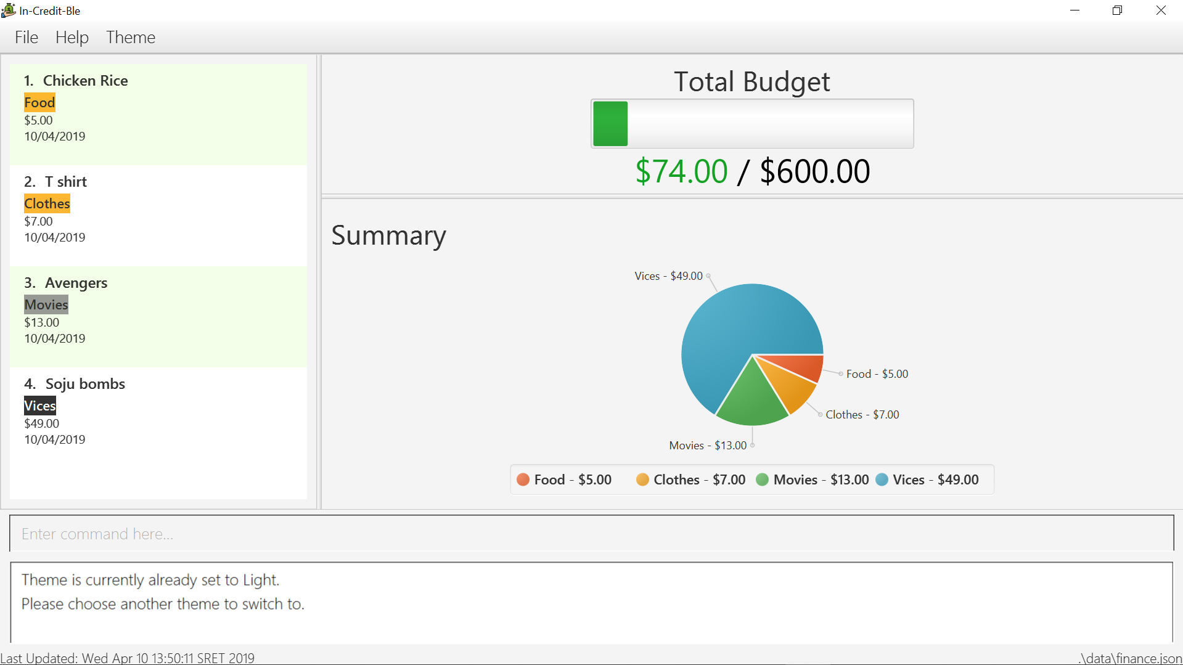
Menu Bar
Records List Panel
Budget Panel
Summary Panel
Command Box
Result Display
Status Bar Footer

