Slide 1
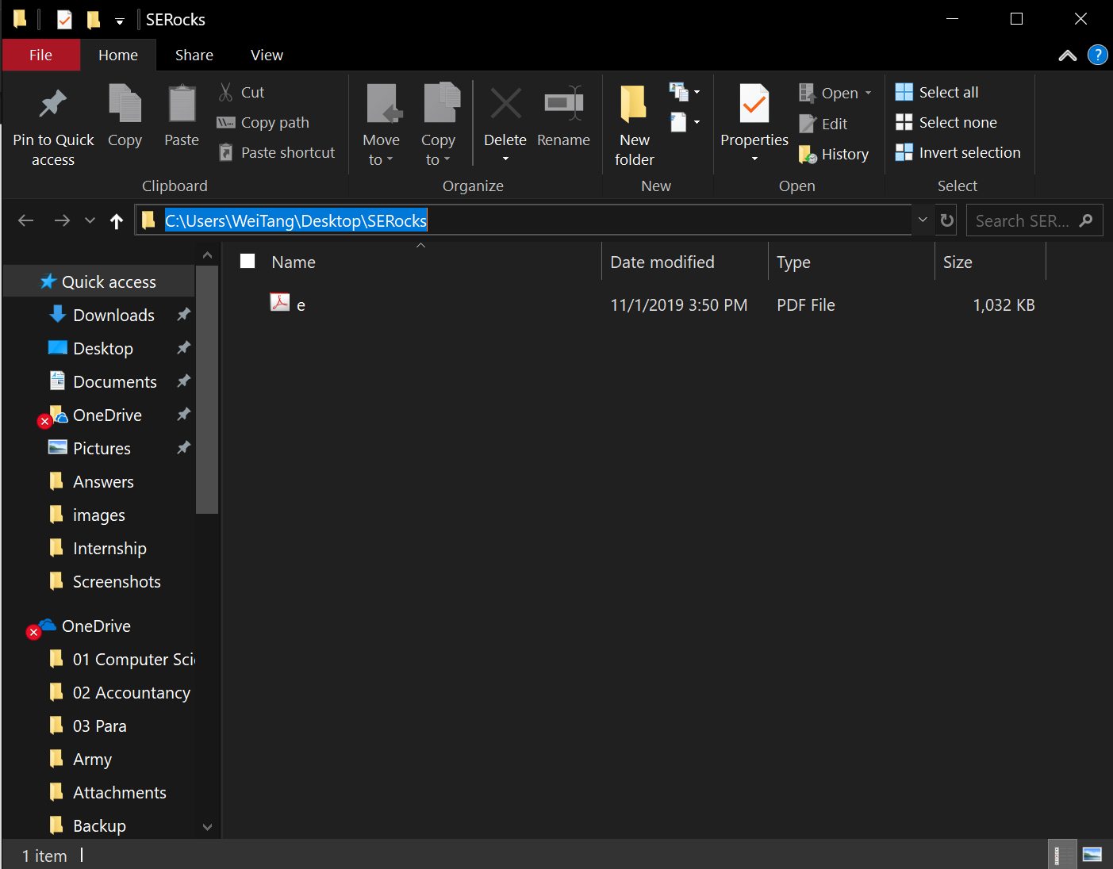
Click here and copy

Slide 2
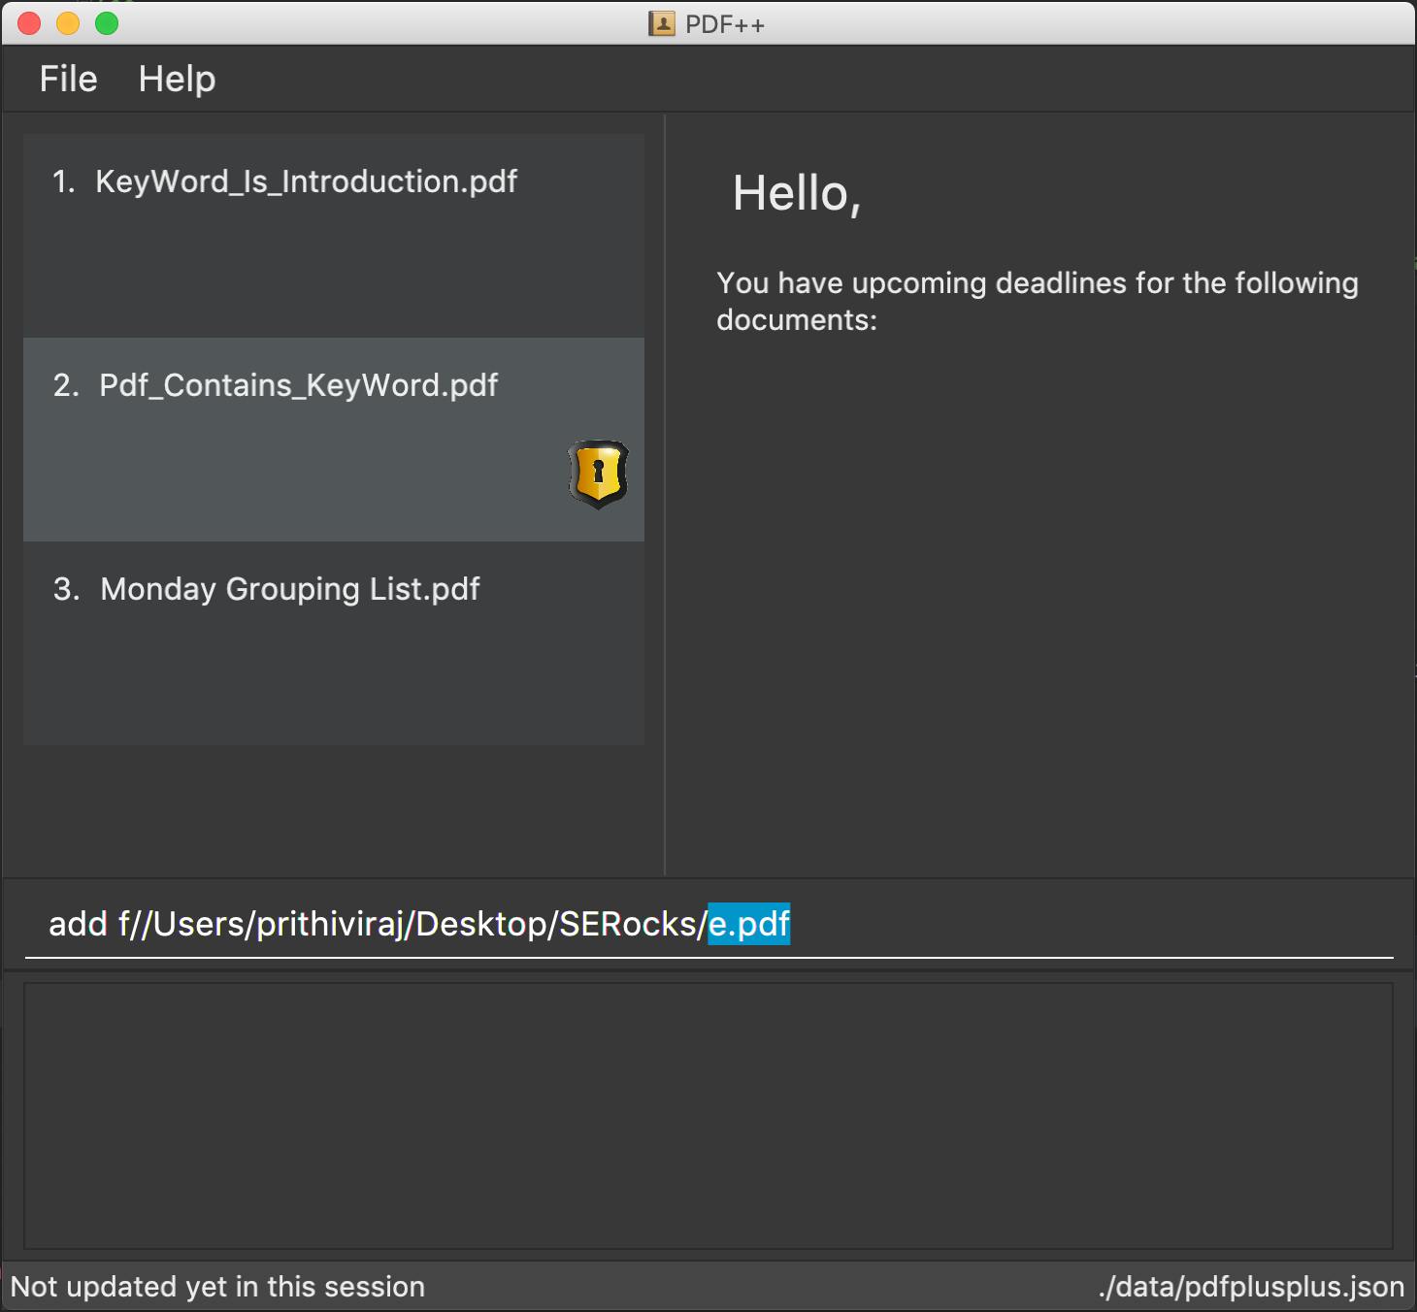
Enter the filename here

Slide 3
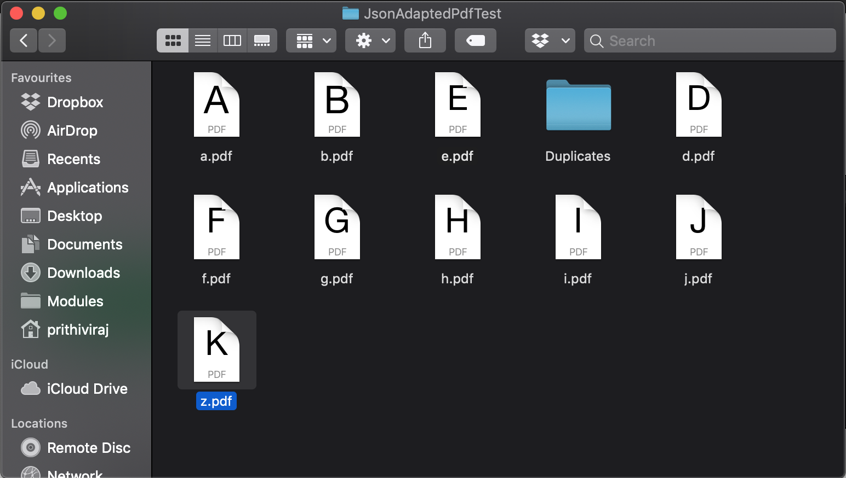
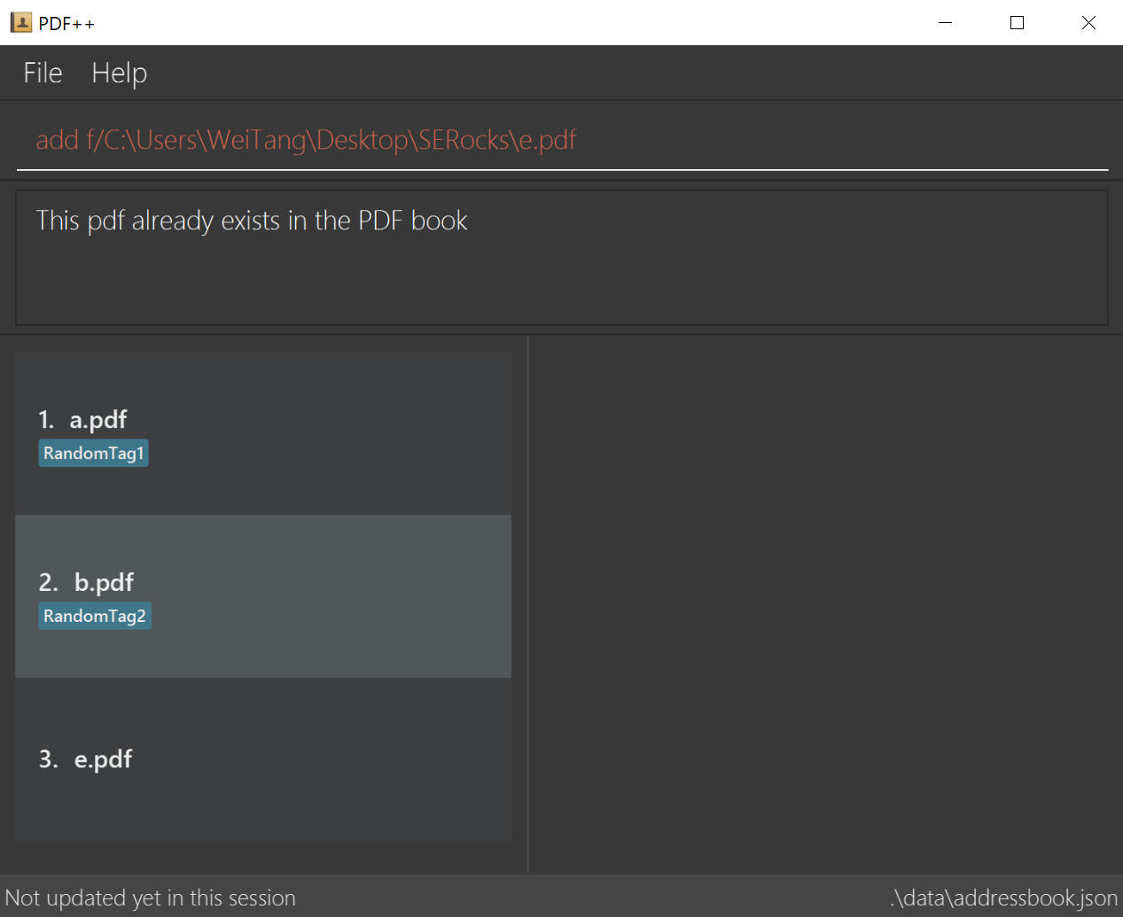
5
throw DuplicatePDF
exception
1
AddCommand
check directory
for e.pdf
2
file exists in directory
4
Duplicate found in PDF++
3
Check PDF++ for e.pdf

Slide 4
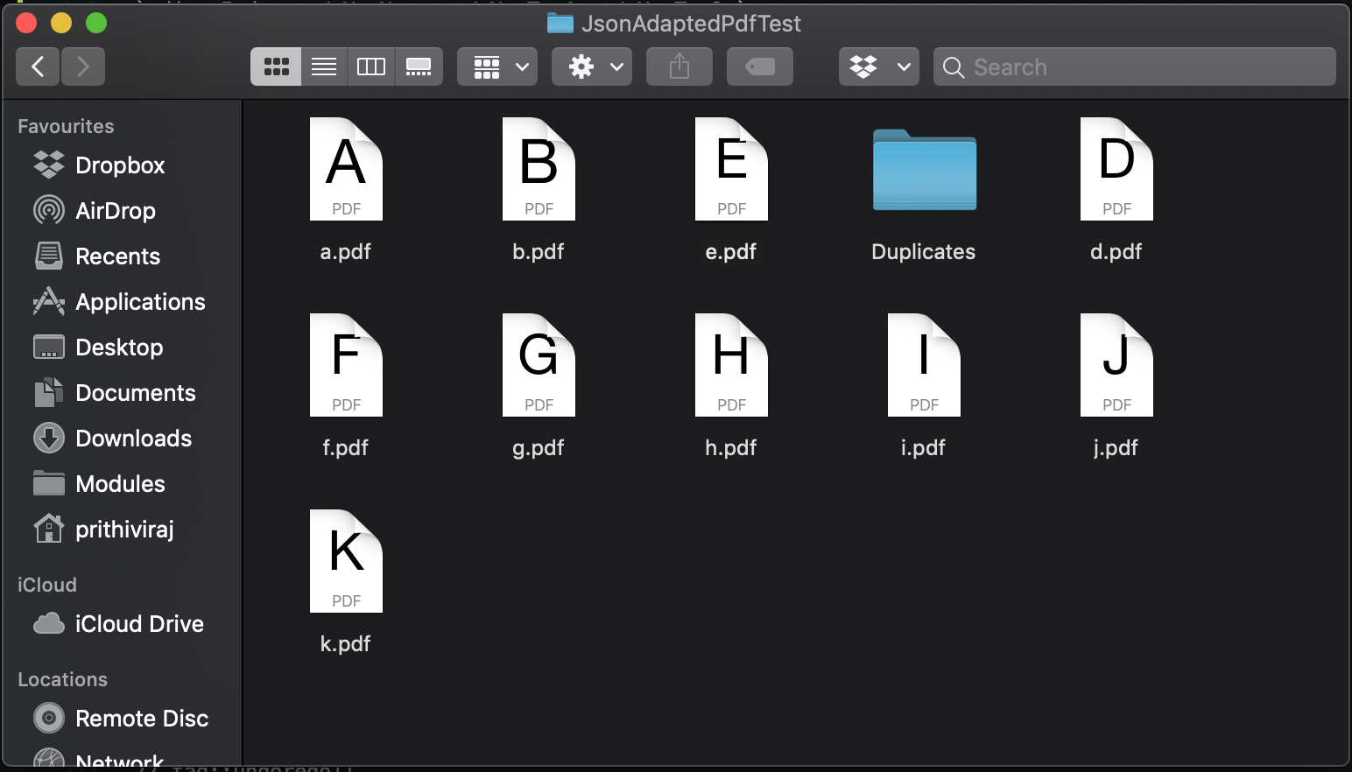
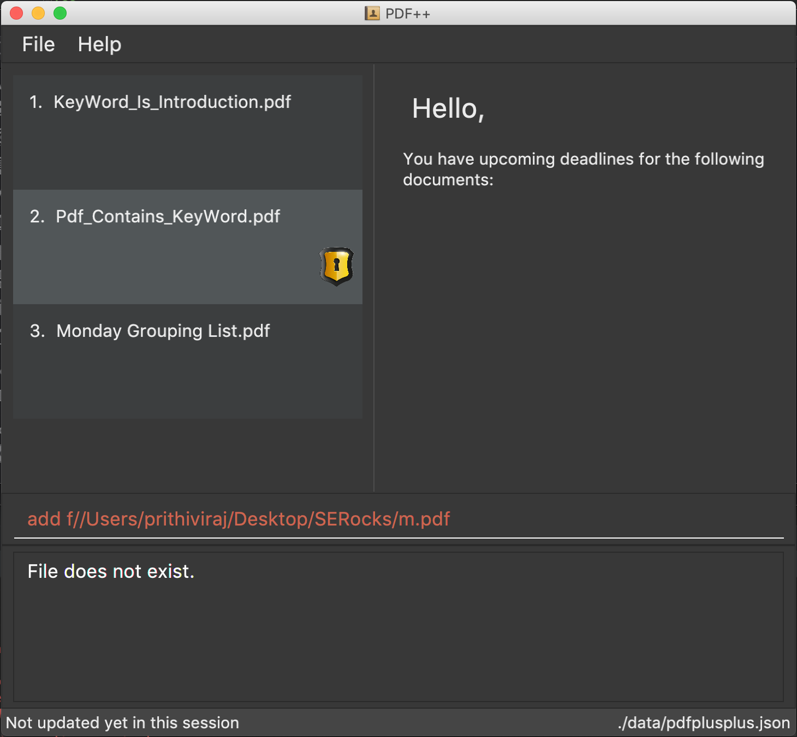
3
throw PDFNotFound
exception
1
AddCommand
check directory
for m.pdf
2
file does not exist

Slide 5
1
5
Proceed to add
AddCommand
check directory
for f.pdf
2
file exists in directory
4
No duplicate found in PDF++
3
Check PDF++ for e.pdf
PDF++

