Slide 1
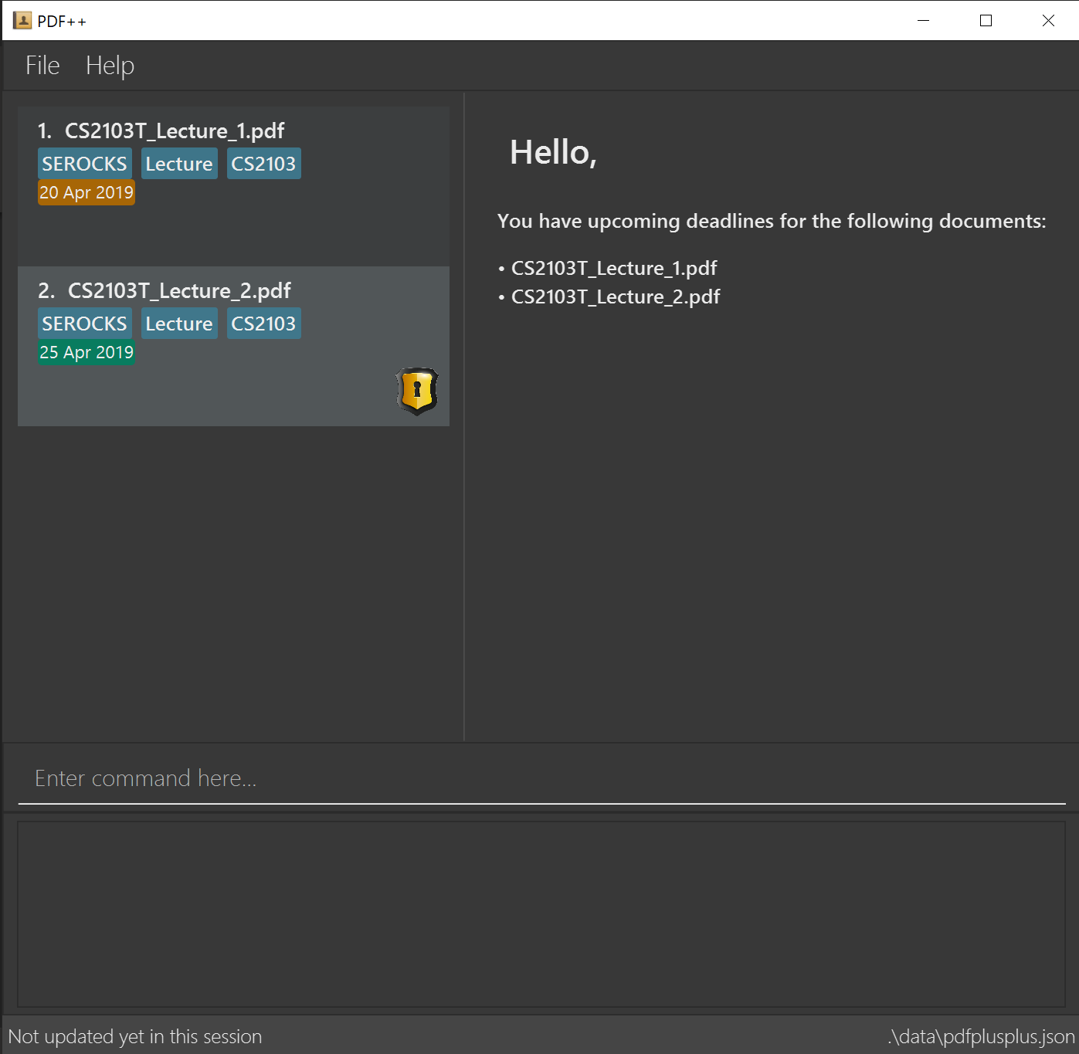

Slide 2
INDEX of the file you wish to decrypt

Slide 3
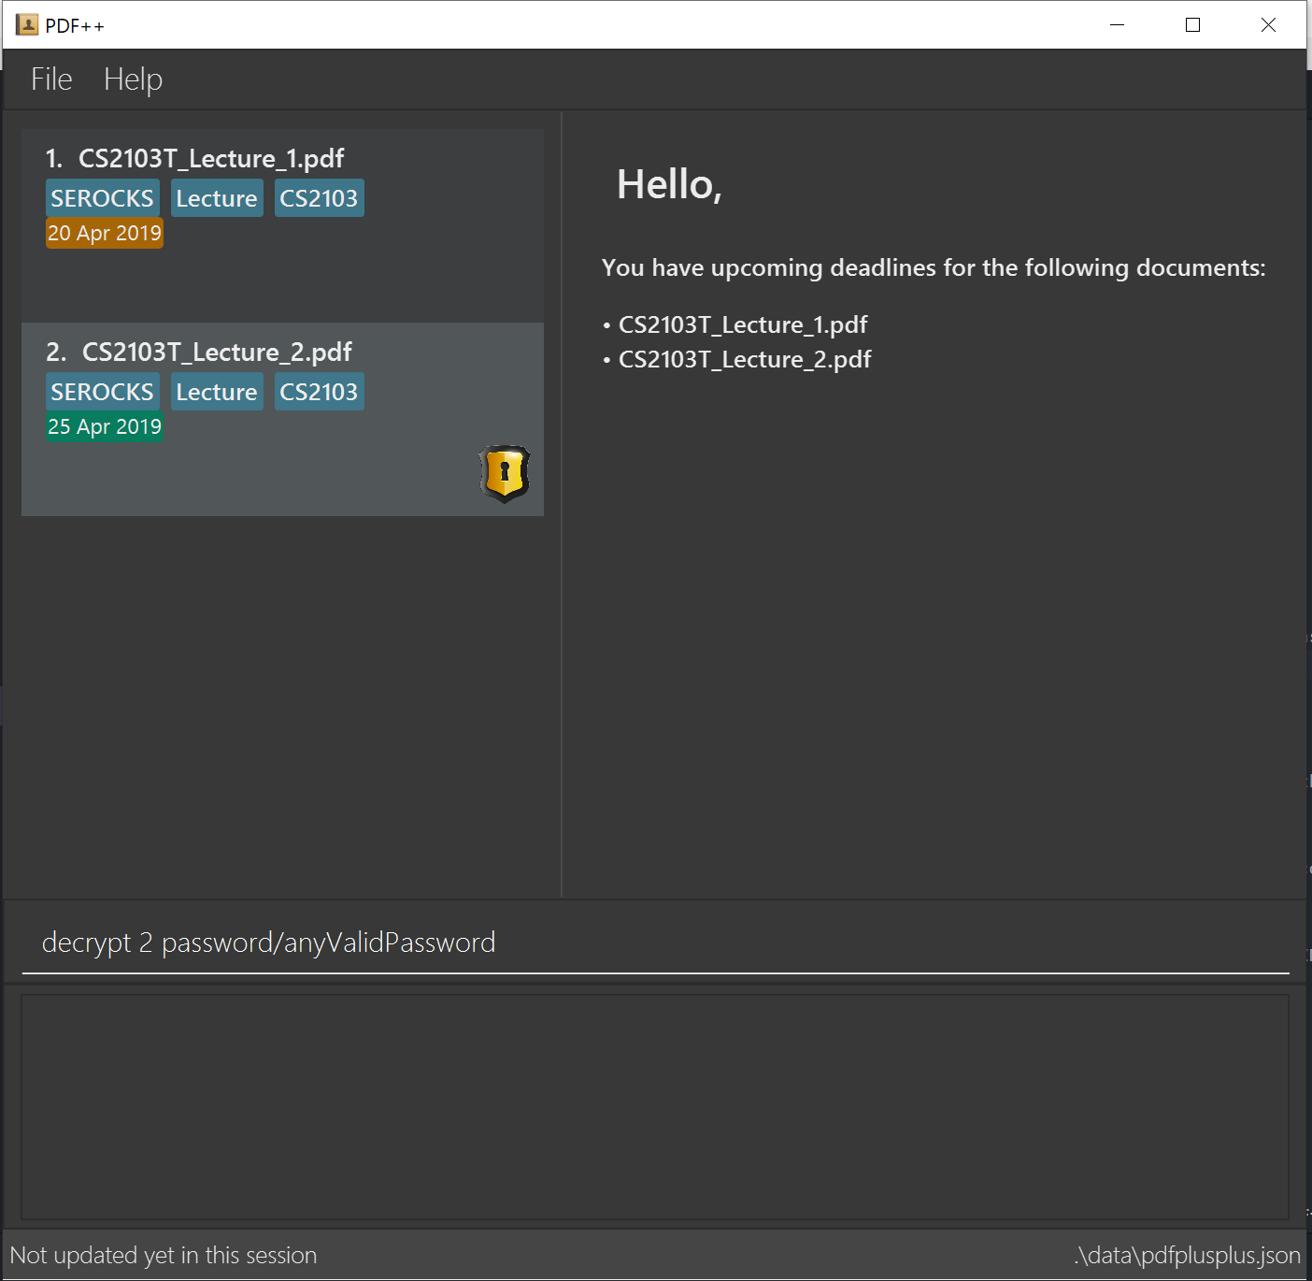
Format: decrypt INDEX password/PASSWORD

Slide 4
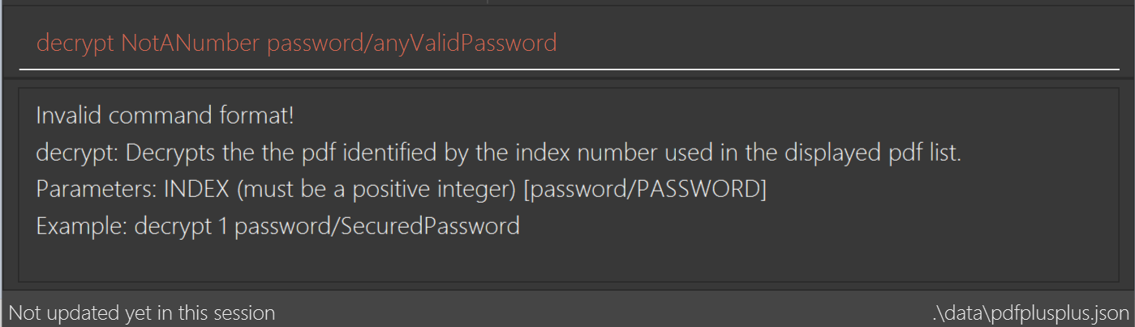
Not a number

Slide 5

Index is not within the range of number
of documents in PDF++.

Slide 6

Decryption on non-encrypted file

Slide 7

The password entered does not
match with the password of the
encrypted fail

Slide 8
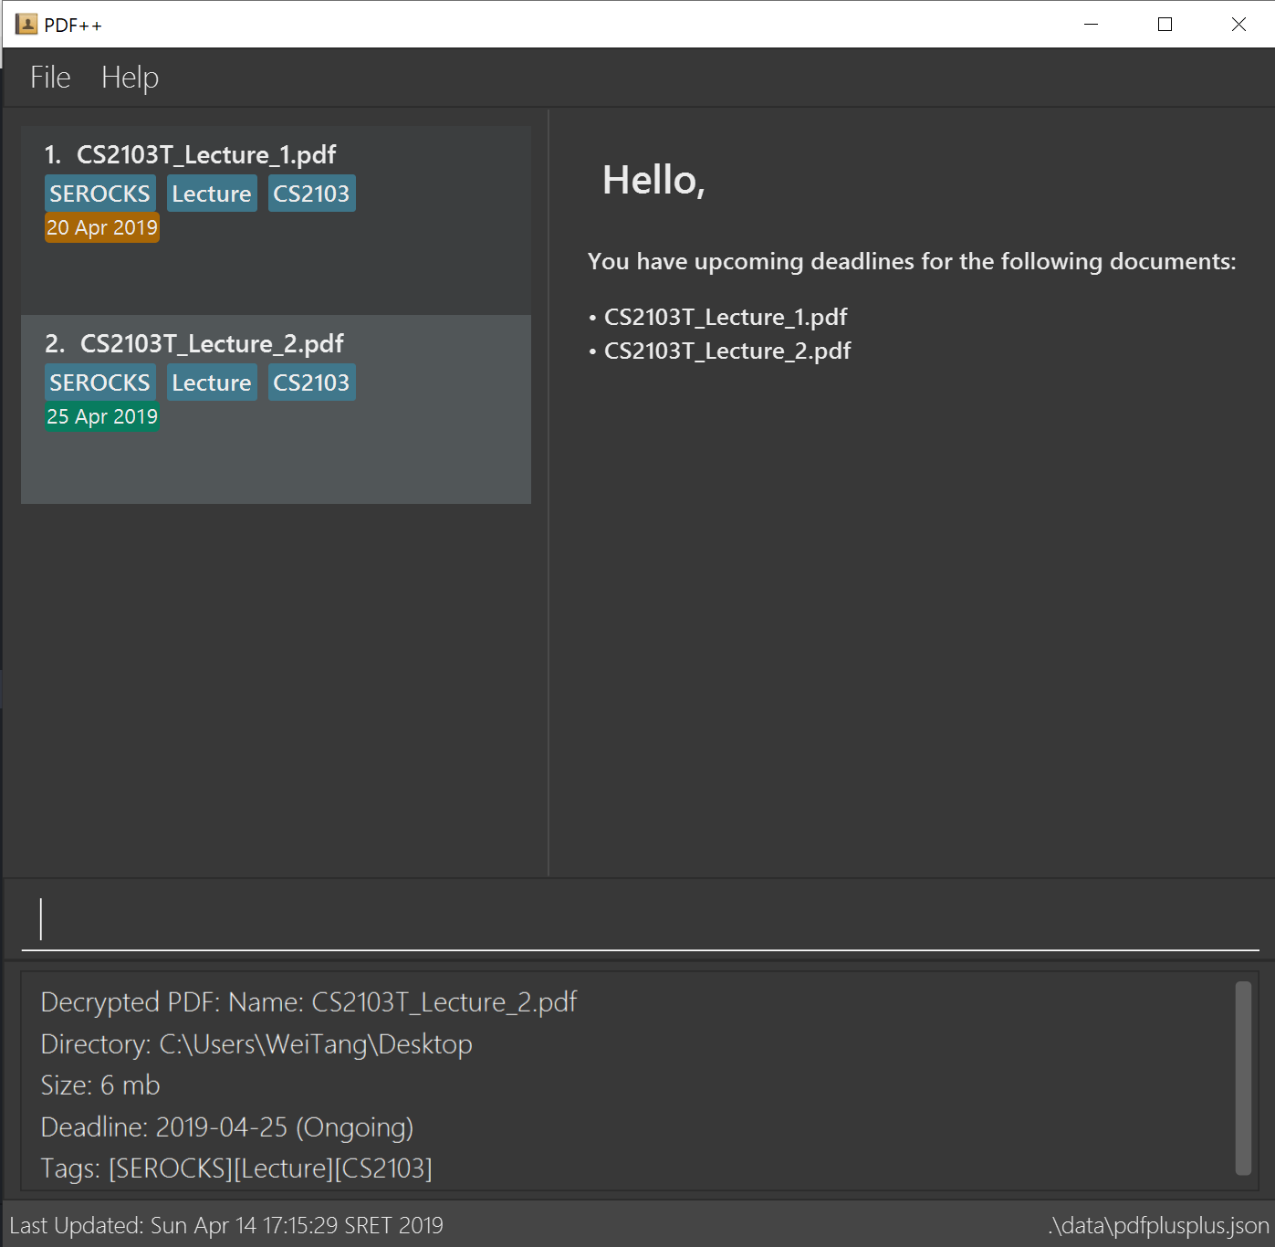
Upon successful decryption of file,
the lock icon disappears

Slide 9
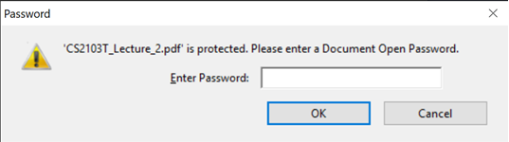

Slide 10
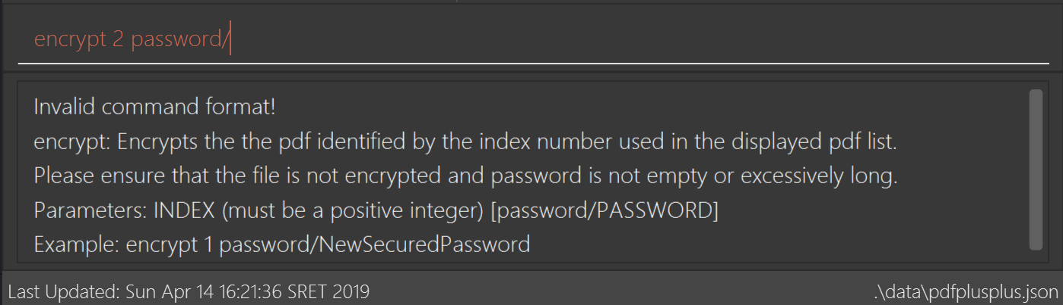
No password or space

