Slide 1
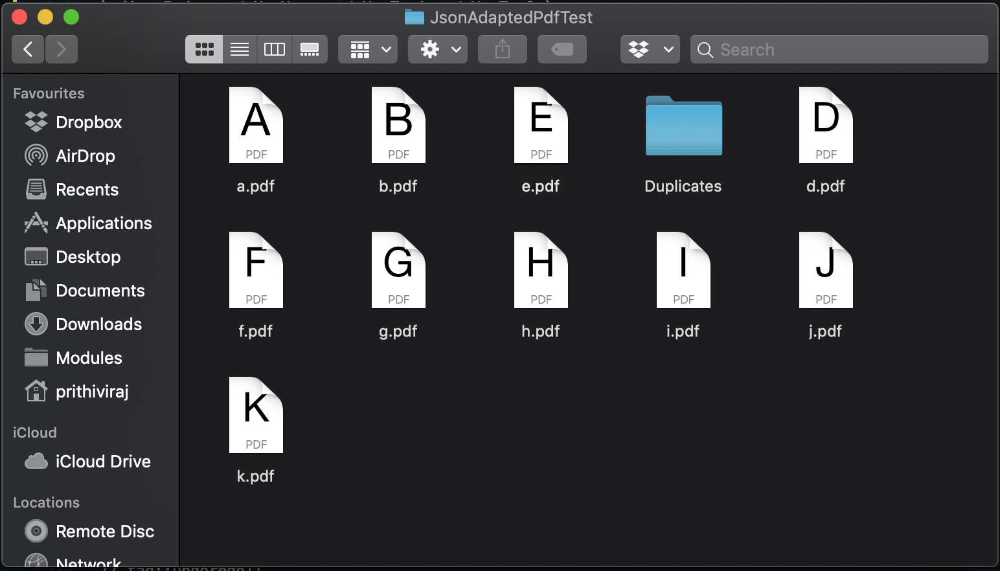
CASE 1: No Duplicate z.pdf
1
EditCommand
check directory
for z.pdf
2
file does not exist
3
proceed to edit

Slide 2
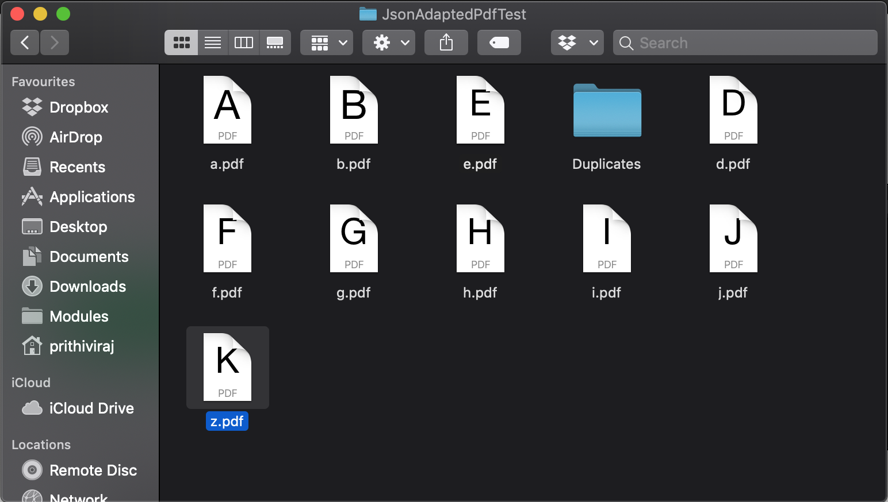
CASE 2: Duplicate z.pdf
3
throw DuplicatePDF
exception
1
EditCommand
check directory
for z.pdf
2
file exists

