Slide 1
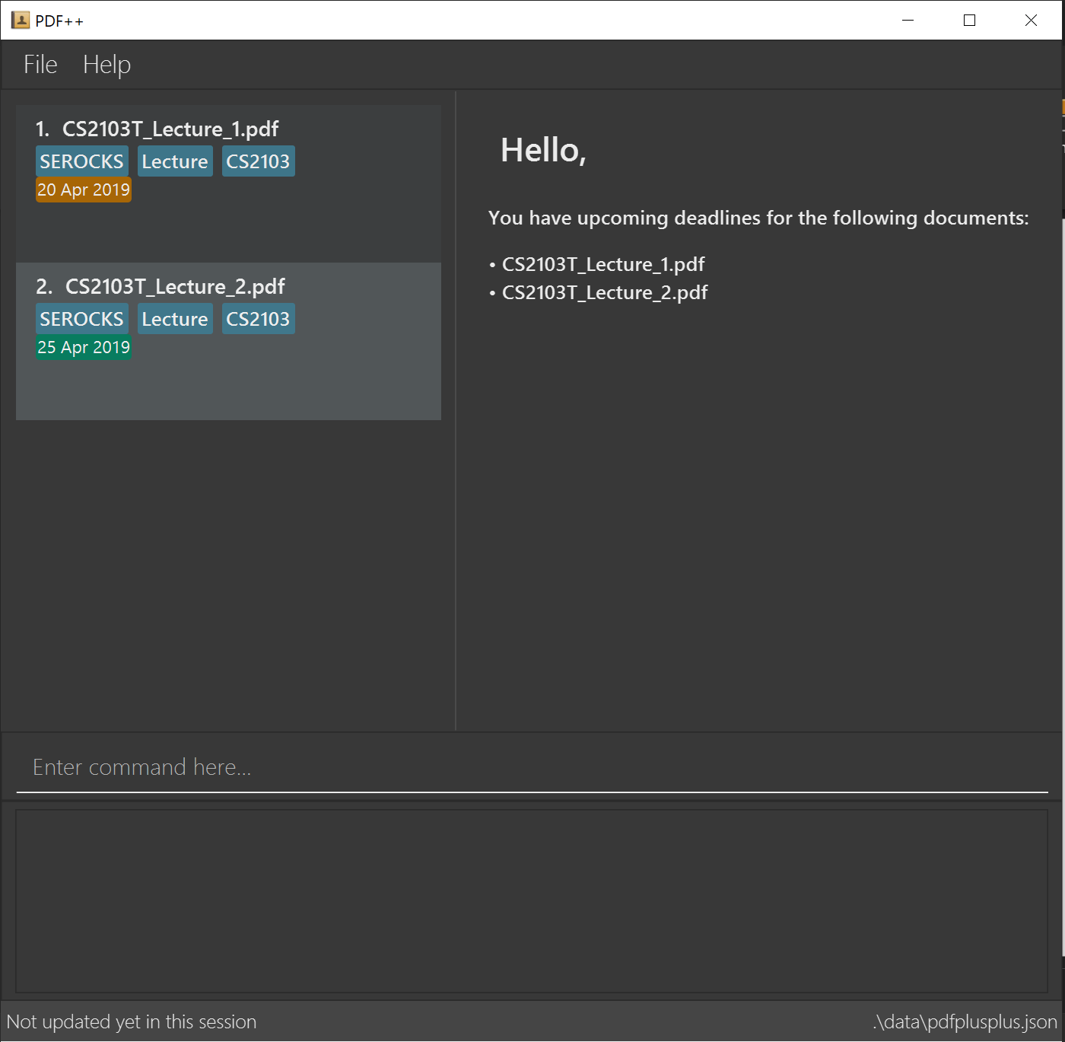

Slide 2
INDEX of the file you wish to encrypt

Slide 3
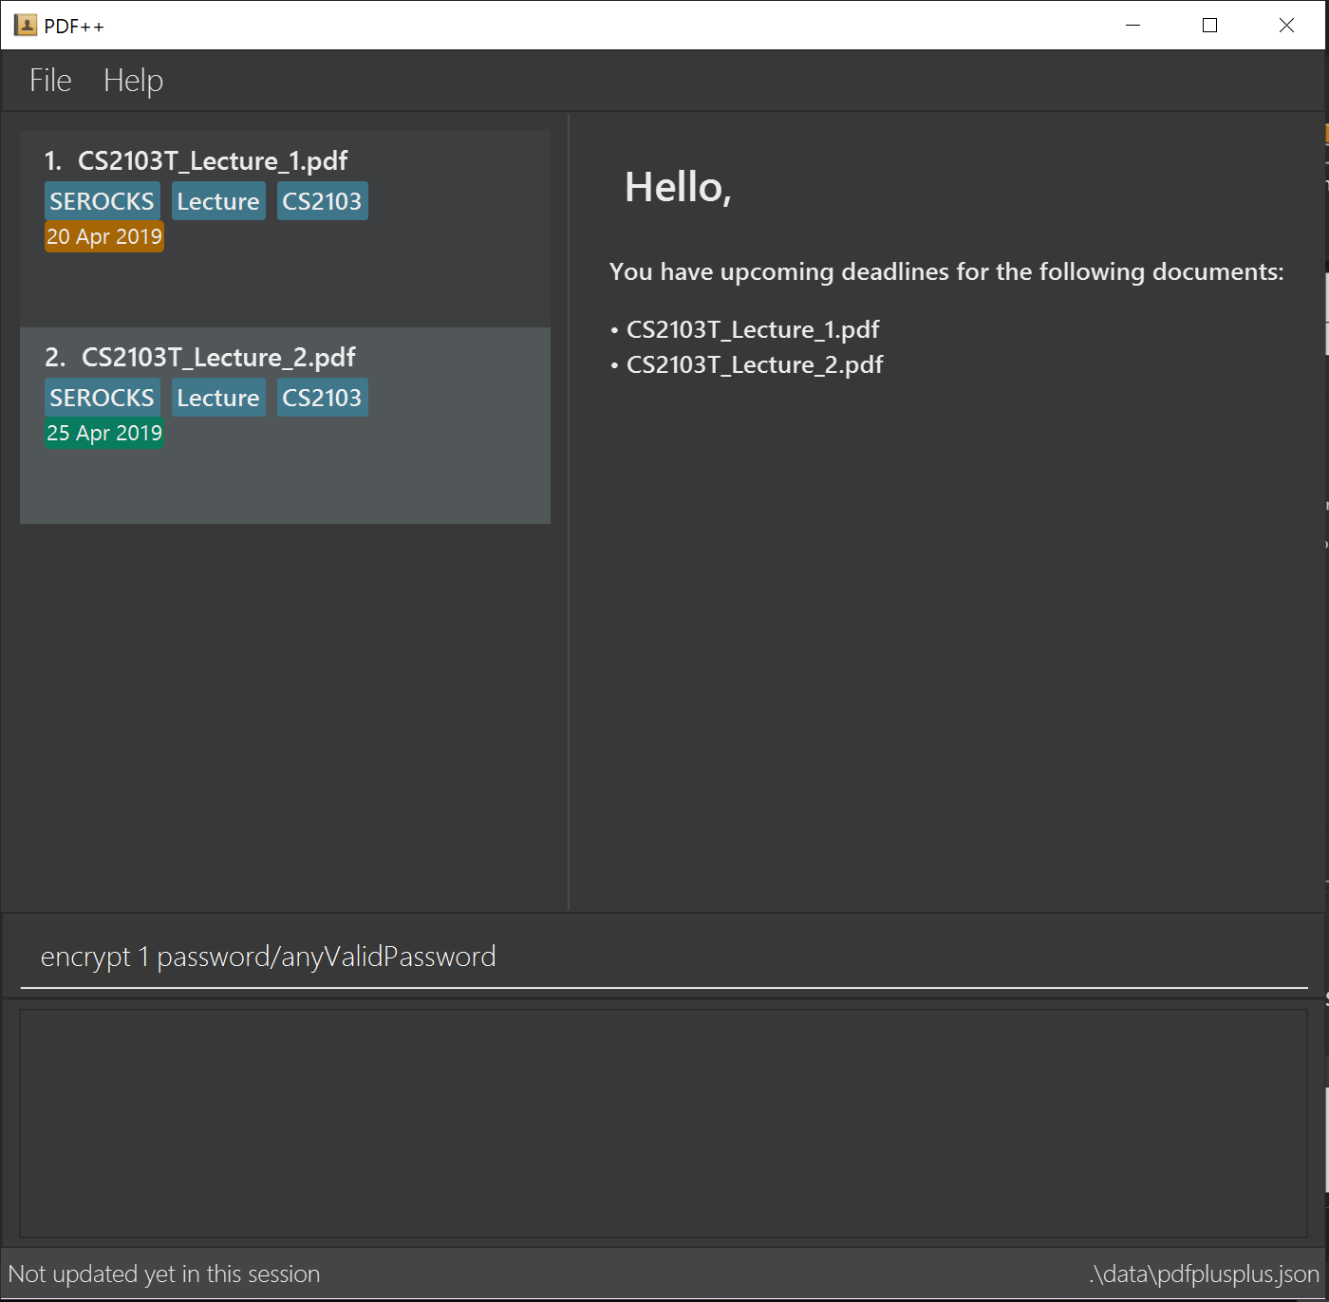
Format: encrypt INDEX password/PASSWORD

Slide 4


Not a number

Slide 5
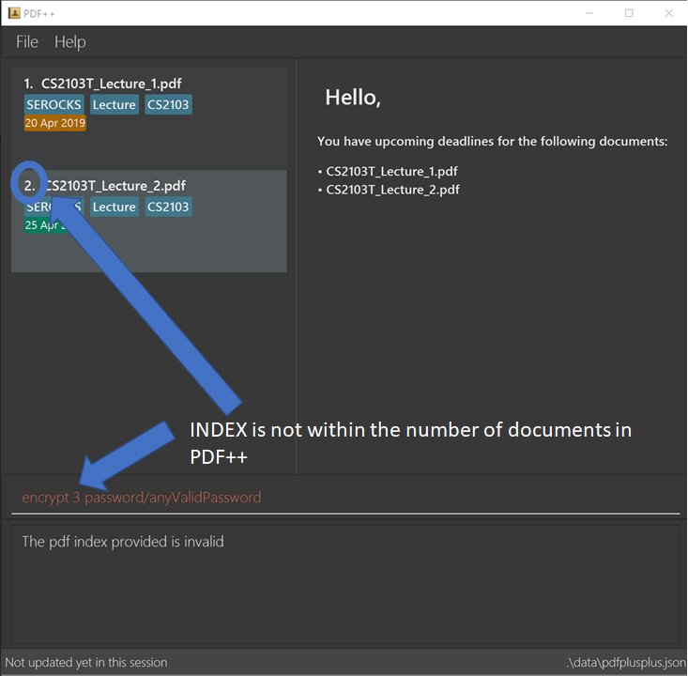

Slide 6
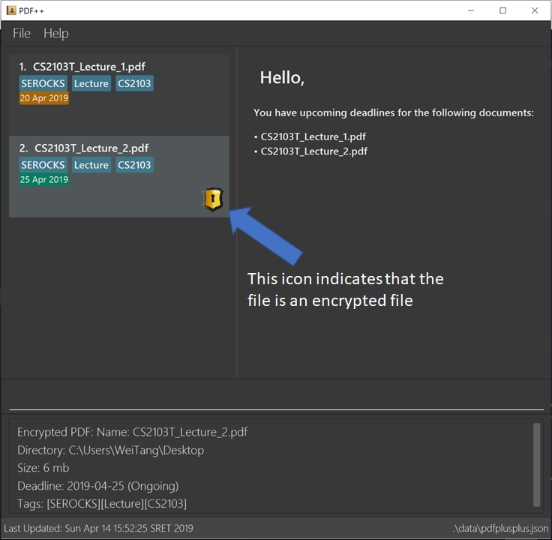

Slide 7


Slide 8

No password or space

