Slide 1
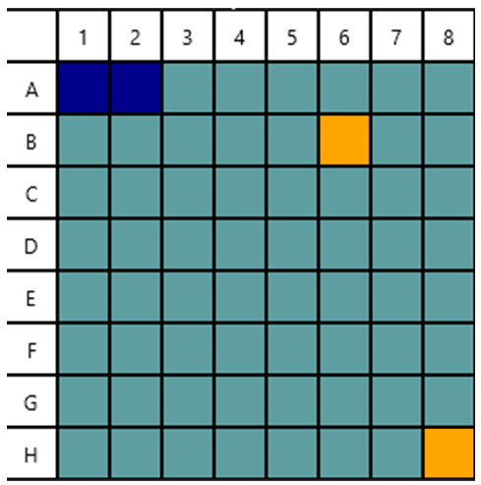


Cell containing part of a ship
Valid cardinal cells
invalid cardinal cells

