Slide 1
execute(“filter n/jurong a/east t/urgent”)
:LogicManager
parseCommand(“filter n/jurong a/east t/urgent”)
:EquipmentManagerParser
<<class>>
ArgumentTokenizer
Model
:Filter CommandParser
parse(“n/jurong a/east t/urgent”)
tokenize(“n/jurong a/east t/urgent”, “n/”, ”a/”, “t/”)
:ArgumentMultimap
getAllValues(“n/”)
getAllValues(“a/”)
getAllValues(“t/”)
:EquipmentContainsKeyWordPredicate
u
:FilterCommand
X
execute()
updateFilteredList(EquipmentContainsKeywordPredicate)
result
result

Slide 2
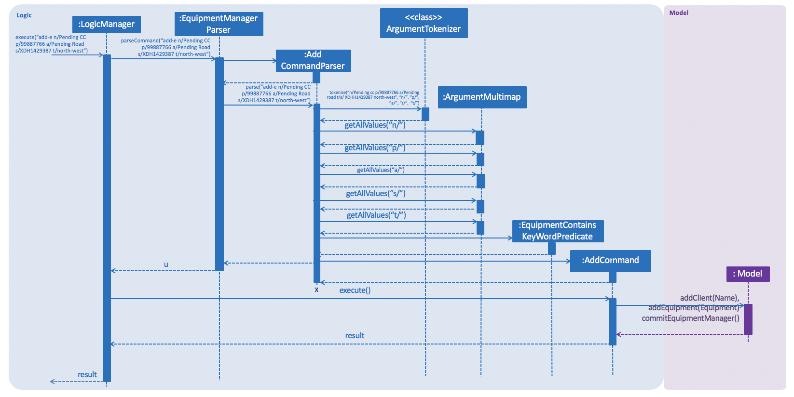

Slide 3
Model
Model
Logic
:LogicManager
:EquipmentManagerParser
<<class>>
ArgumentTokenizer
execute(“add-e n/Pending CC pm/01-05-2019 p/99887766 a/8 Pending Rd, Singapore 678295 s/XDH1429387 t/north-west”)
parseCommand(“add-e n/Pending CC pm/01-05-2019 p/99887766 a/8 Pending Rd, Singapore 678295 s/XDH1429387 t/north-west”)
:Add CommandParser
parse(“add-e n/Pending CC pm/01-05-2019 p/99887766 a/8 Pending Rd, Singapore 678295 s/XDH1429387 t/north-west”)
tokenize(“n/Pending CC pm/01-05-2019 p/99887766 a/8 Pending Rd, Singapore 678295 s/XDH1429387 t/north-west ”
,”n/”,”p/”,”pm/”,”a/”,”s/”,”t/”)
:ArgumentMultimap
getAllValues(“n/”)
getAllValues(“p/”)
getAllValues(“pm/”)
getAllValues(“a/”)
u
getAllValues(“s/”)
getAllValues(“t/”)
:AddCommand
: Model
X
execute()
addClient(Name)
addEquipment(Equipment)
result
result
commitEquipmentManager()

