Slide 1

Chapter 1 Introduction, Recursion
Divesh Aggarwal
School of Computing
Department of Computer Science

Slide 2
Administrative Remarks
Goal of this module: Design and Analysis of Algorithms
Proofs will be important
Textbook: Algorithms by Jeff Erickson (available online)
Excellent exercises – strongly recommended
Please read announcements regularly
Tutorials begin from Week 2 (We will discuss HW1)
Please participate in the forum conversation regularly

Slide 3
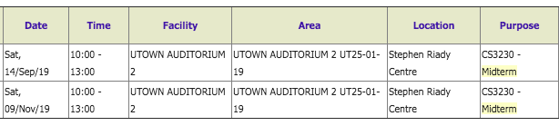
Administrative Remarks
Provide constructive feedback whenever possible
Email/forum/TAs
Don’t wait till the annual review – that will not benefit you
Send email to schedule an appointment whenever you wish
In any email to instructor, write CS3230 in the subject (without space)
Assignments don’t carry marks – you are still encouraged to submit
Midterm schedule is as follows

Slide 4
Reductions
Reduction is the single most common technique used
in designing algorithms.
Reducing one problem X to another problem Y means
to write an algorithm for X that uses an algorithm for Y
as a black box or subroutine.

Slide 5
Simplify and Delegate
Recursion is a particularly powerful kind of reduction, which can be described loosely as follows:
If the given instance of the problem can be solved directly, solve it directly.
Otherwise, reduce it to one or more simpler instances of the same problem.
Imagine that someone else is going to solve the simpler problems – Recursion Fairy

Slide 6
Recursion Fairy = Induction Hypothesis
Eventually, the recursive reductions must lead to an elementary base case that can be solved by some other method.
otherwise, the recursive algorithm will loop forever.
reduce to one or more smaller instances of the same problem

Slide 7
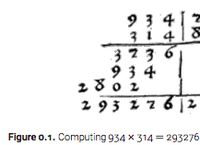
Example 1: Multiplication
The standard algorithm we studied in primary school

Slide 8
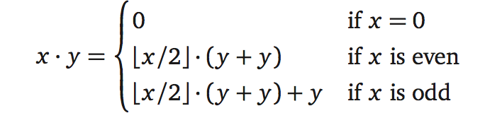
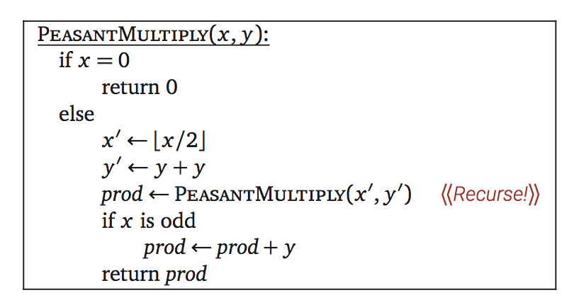
Example 1: Peasant Multiplication

Slide 9
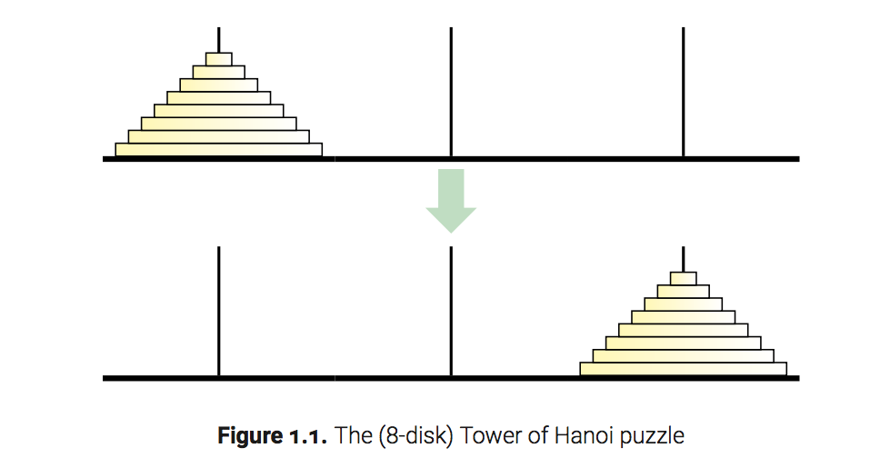
Example 2: Towers of Hanoi
How many moves does it require to transfer n disks of different sizes from peg 1 to peg 3 with the following rules
Move 1 disk at a time
Never place a larger disk on a smaller disk

Slide 10
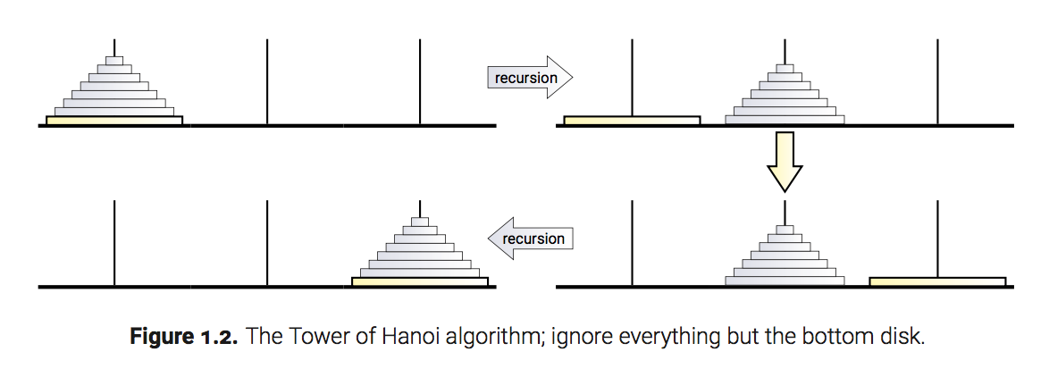
Towers of Hanoi: Recursive Solution
So now all we have to figure out is how to—
NO!! STOP!!
That’s it! We’re done!

Slide 11
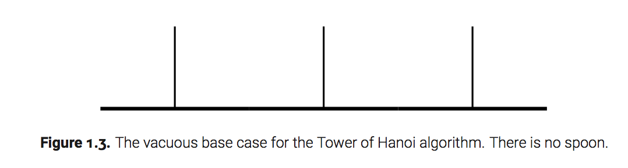
Recursive Solution; Base Case

Slide 12
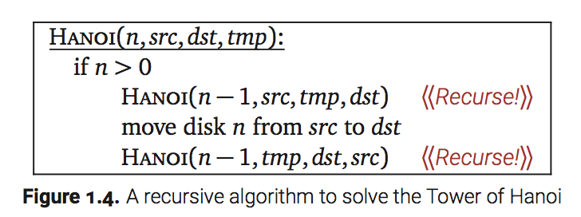

The Algorithm
Let T(n) denote the number of moves required to transfer n disks—the running time of our algorithm.
T (0) = 0
T (n) = 2T (n - 1) + 1

Slide 13
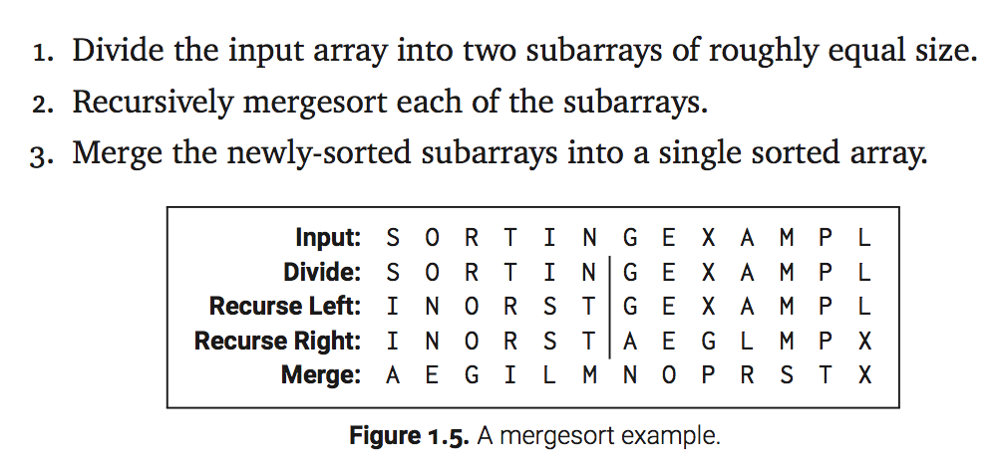
Example 3: MergeSort

Slide 14
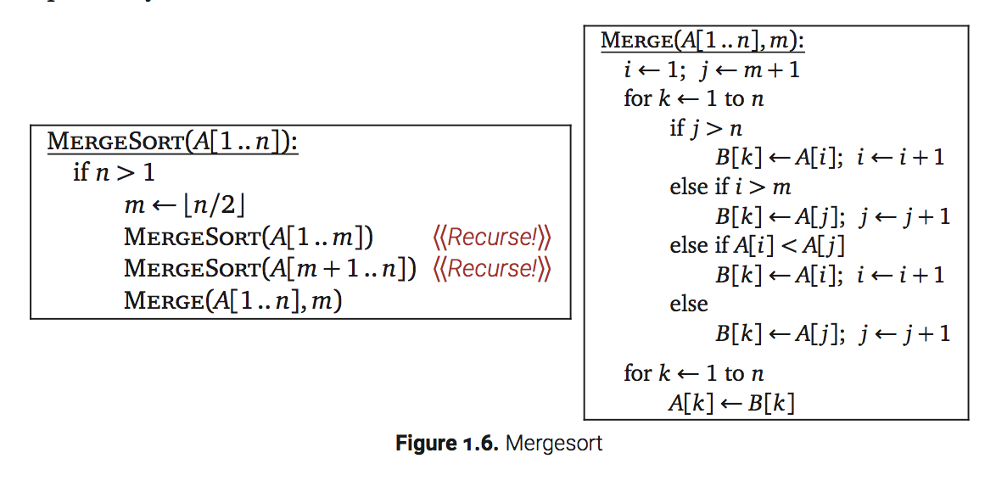
The Algorithm

Slide 15


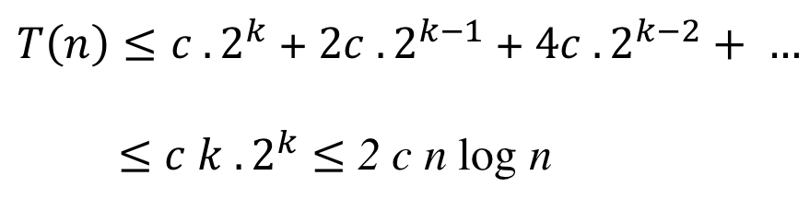

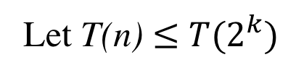
Analysis
$$2^{k−1}<n≤2^{k}$$
Let T(n) $≤$ $T(2^{k})$
$T(2^{k})$ $≤$ $T\left(2^{k−1}\right)+T\left(2^{k−1}\right)+{c . 2}^{k}$
$T\left(n\right)≤{c . 2}^{k}$ + ${2c . 2}^{k−1}$ + ${4c . 2}^{k−2}+ …$
$≤$ ${c k . 2}^{k}$ $≤$ 2 c n log n

Slide 16
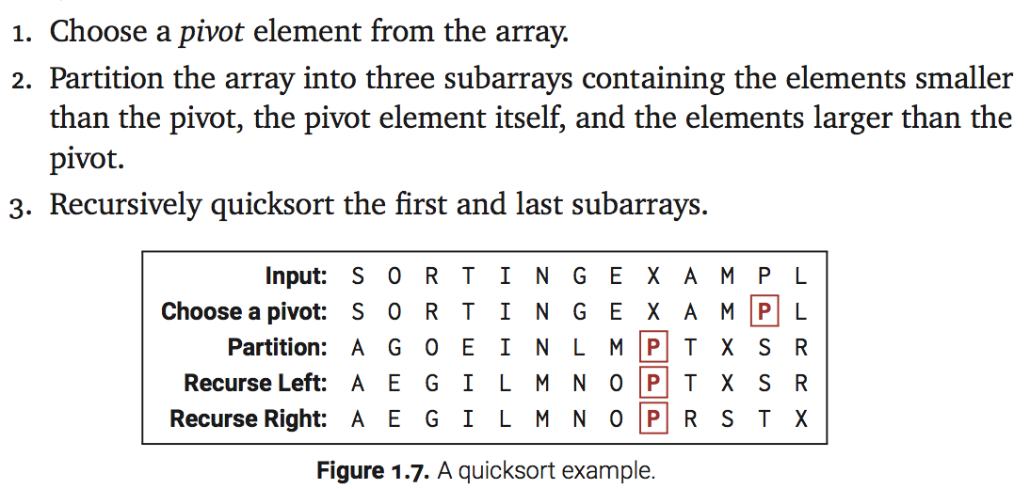
Example 4: QuickSort

Slide 17
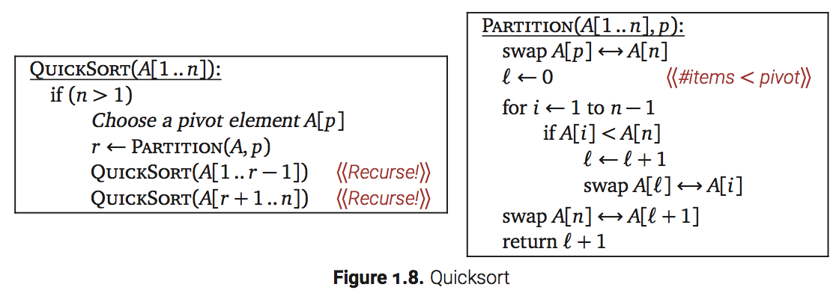
The Algorithm

Slide 18
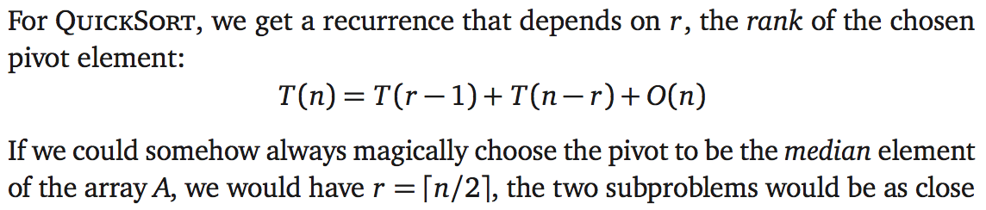
Analysis

Slide 19
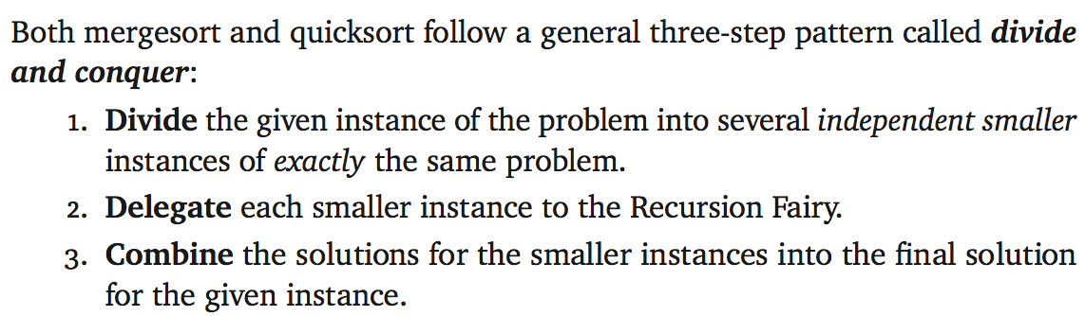
The Pattern

Slide 20

Recursion Trees
Recursion trees are a simple, general, pictorial tool for solving divide-and-conquer recurrences.
Imagine a divide-and-conquer algorithm that spends O( f (n)) time on non-recursive work, and then makes r recursive calls, each on a problem of size n/c
Up to constant factors:

Slide 21
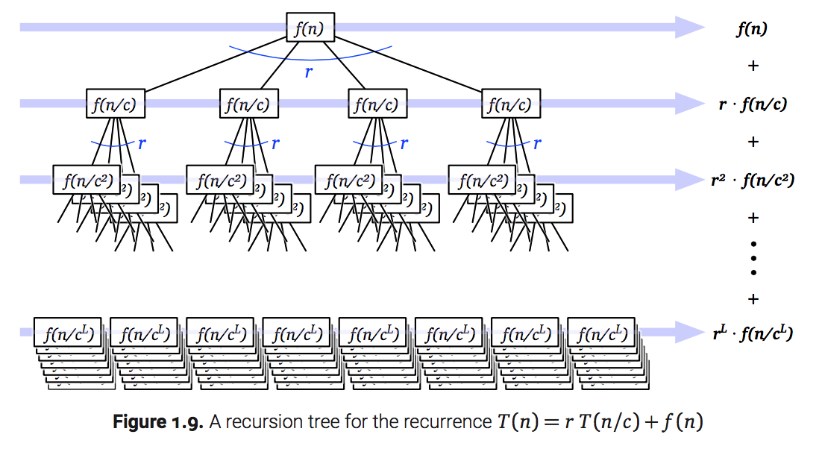
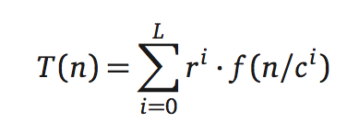

Recursion Trees

Slide 22
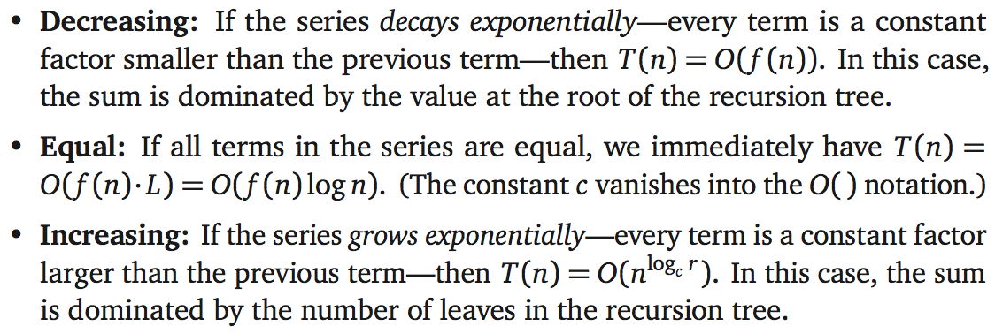
Three Common Cases

Slide 23

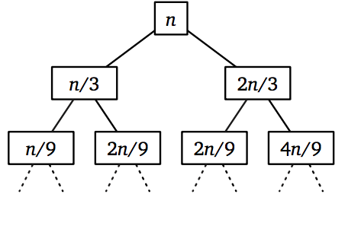
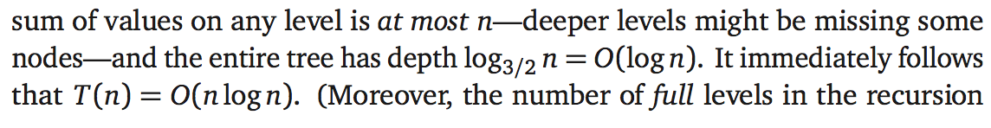
Example

Slide 24
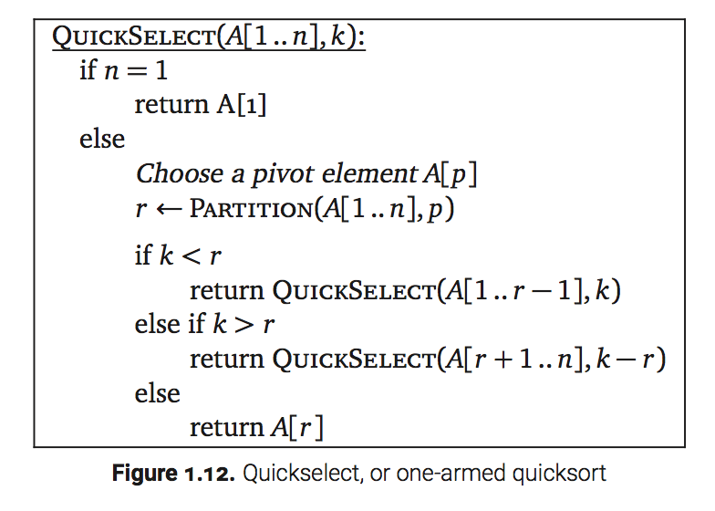
Example: Linear Time Selection
Selecting the k-th smallest element in an n-element array, given the array and the integer k as input, using a variant of an algorithm called quickselect or one-armed quicksort.

Slide 25
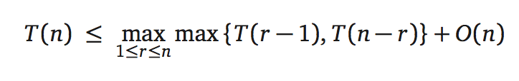
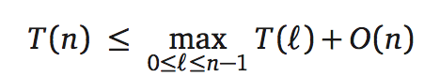
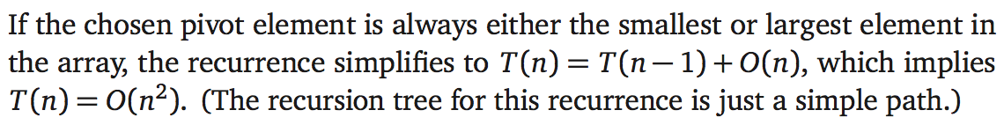
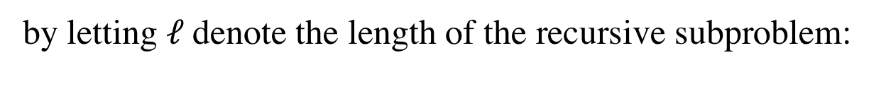
Analysis
The worst-case running time of QuickSelect obeys a recurrence
by letting $ℓ$denote the length of the recursive subproblem:

Slide 26
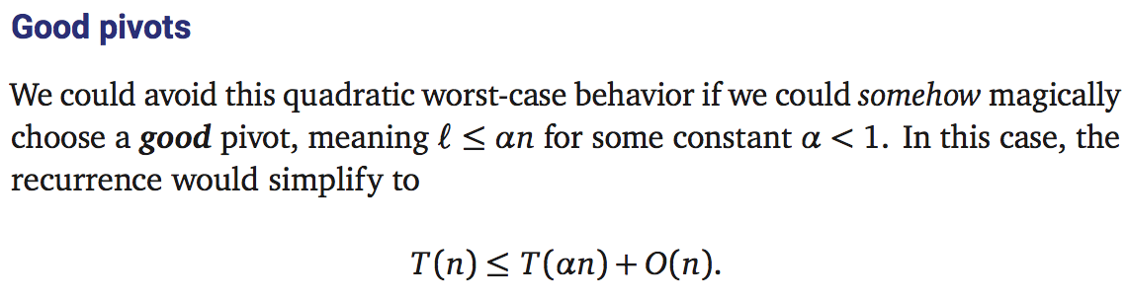

Slide 27
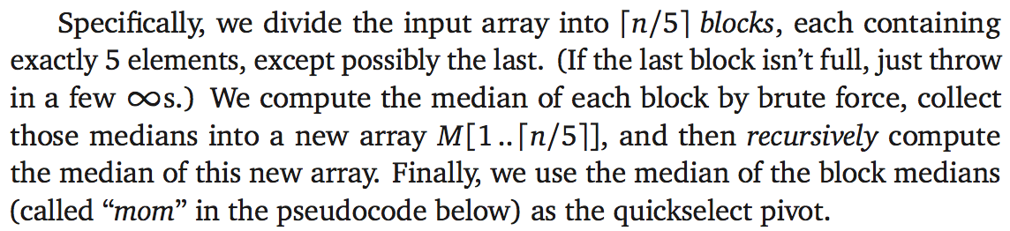
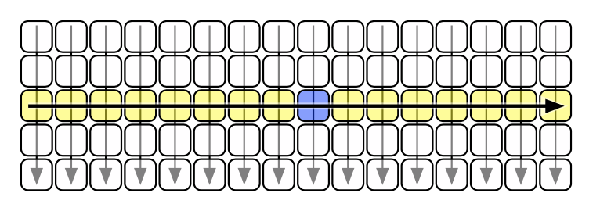
How to Choose a Good Pivot

Slide 28
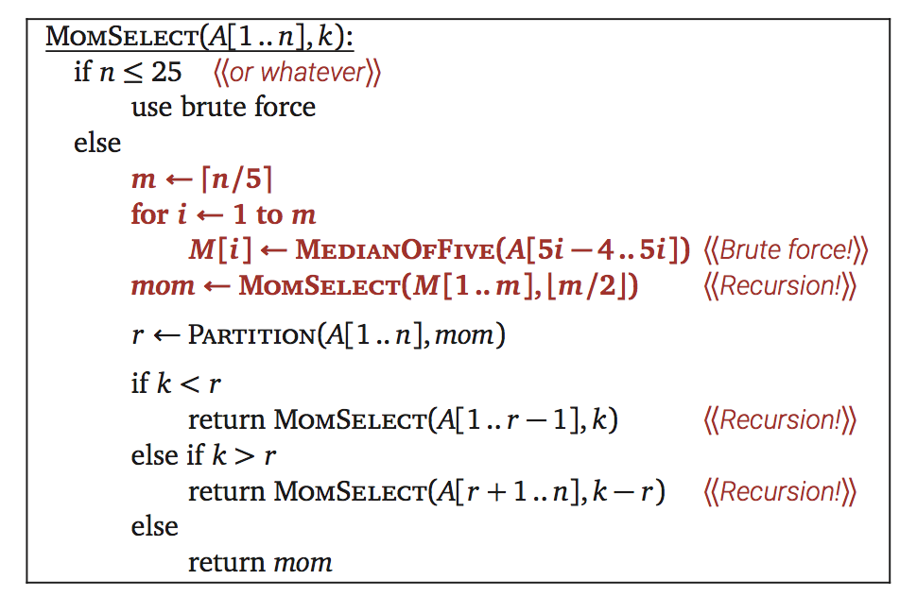
The Algorithm

Slide 29
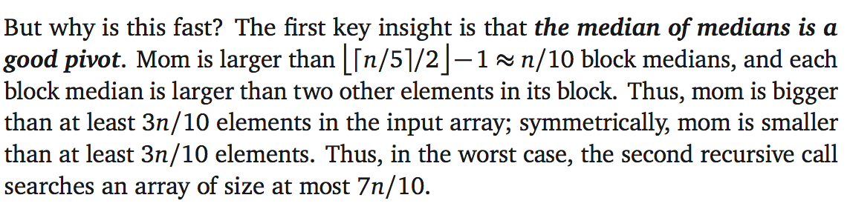
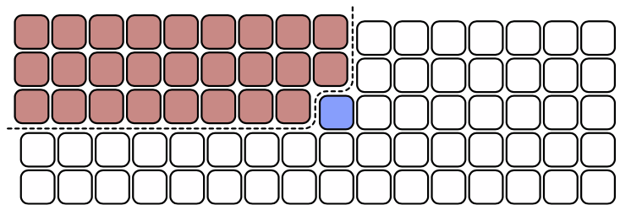

Analysis

Slide 30
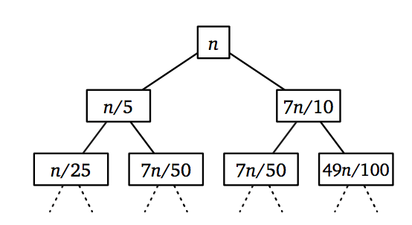
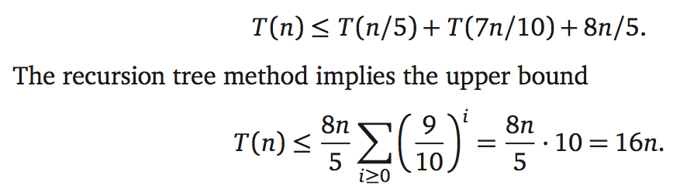
Recursion Tree for MOM-Algorithm

Slide 31
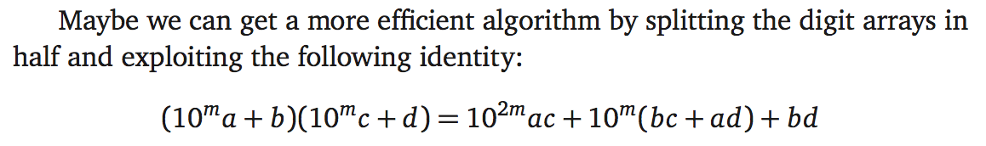
Example: Integer Multiplication
This recurrence immediately suggests the following divide-and-conquer algorithm to multiply two n-digit numbers x and y.

Slide 32
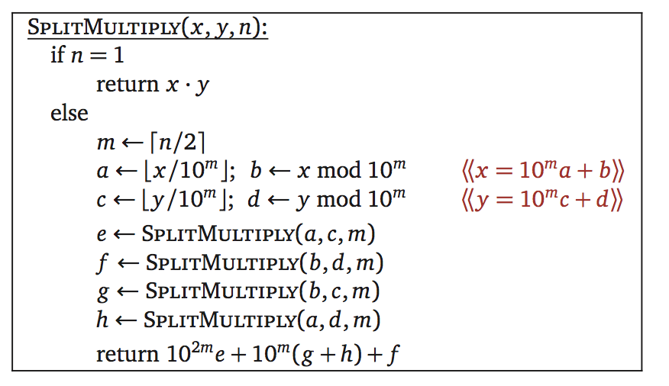


The Algorithm

Slide 33
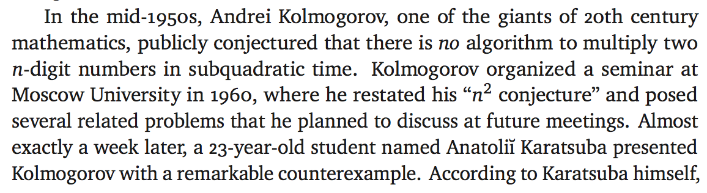
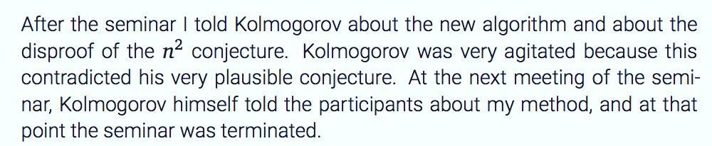
Karatsuba writes:

Slide 34

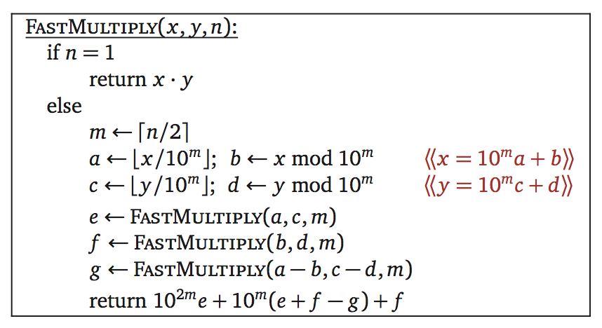
Karatsuba’s Algorithm

Slide 35



Analysis and Remarks
Karatsuba’s algorithm arguably launched the design and analysis of algorithms as a formal field of study.
Ultimately, this divide-and-conquer strategy led Gauss (yes, really) to the discovery of the Fast Fourier transform.
Finally, in 2019, David Harvey and Joris van der Hoeven published an algorithm that runs in O(n log n) time.

Slide 36
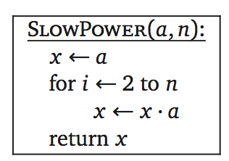
Exponentiation
Given a number a and a positive integer n, suppose we want to compute $a^{n}$.
Trivial algorithm:

Slide 37
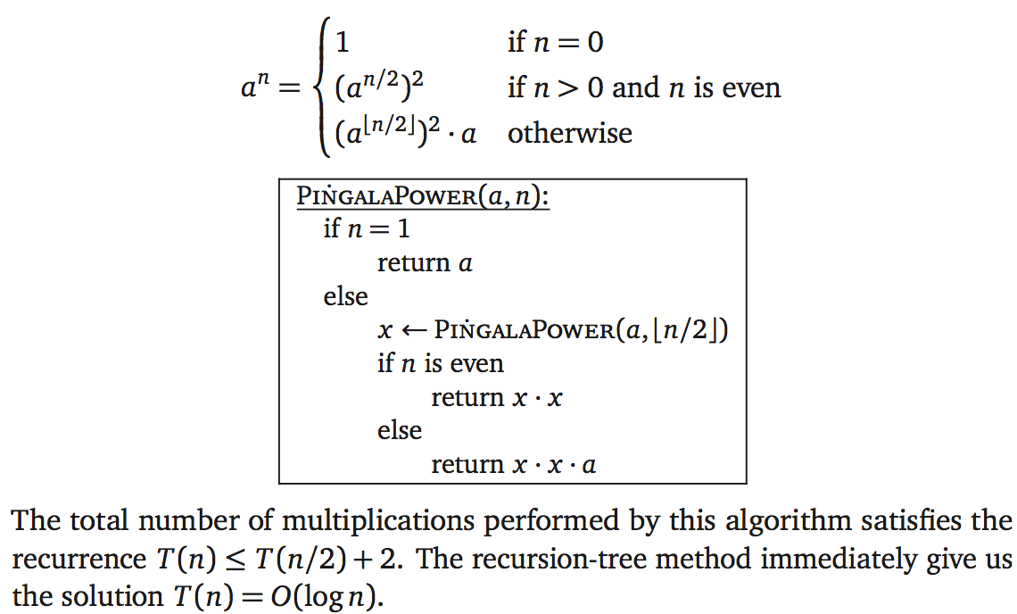
The Algorithm: Pingala Power

Slide 38
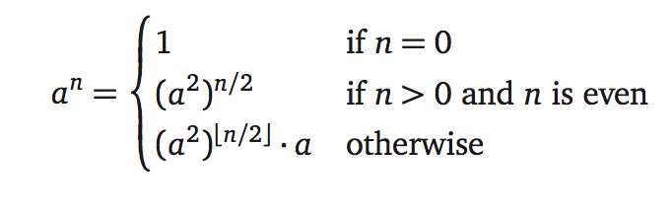
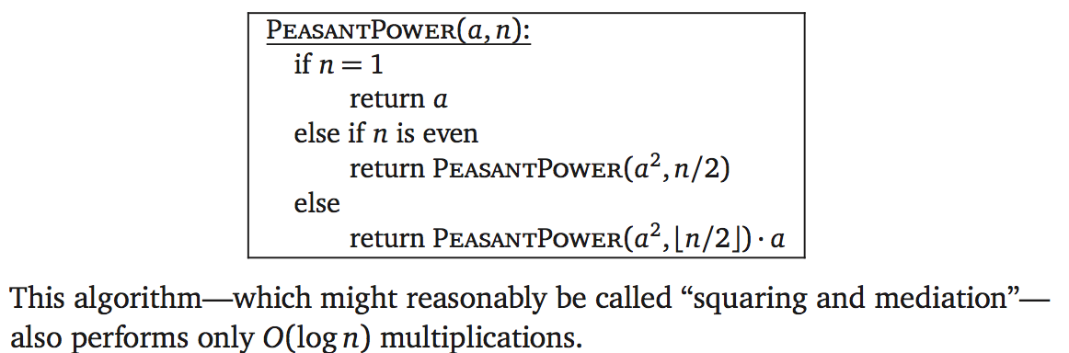
The Algorithm; Peasant Power

Slide 39
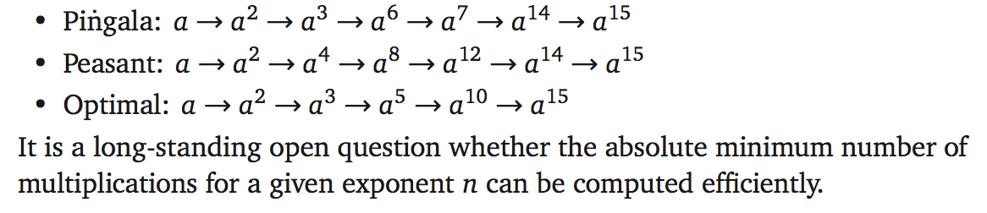
Minimum Number of Multiplications

Slide 40
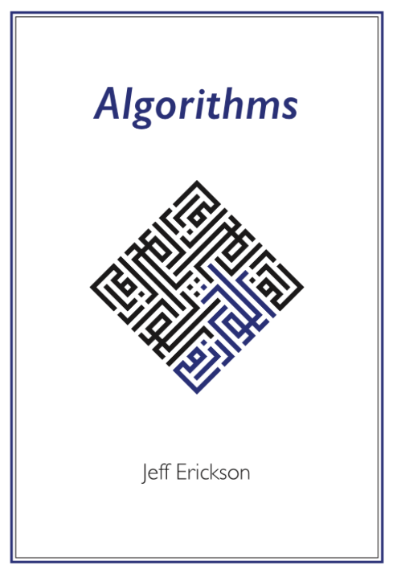

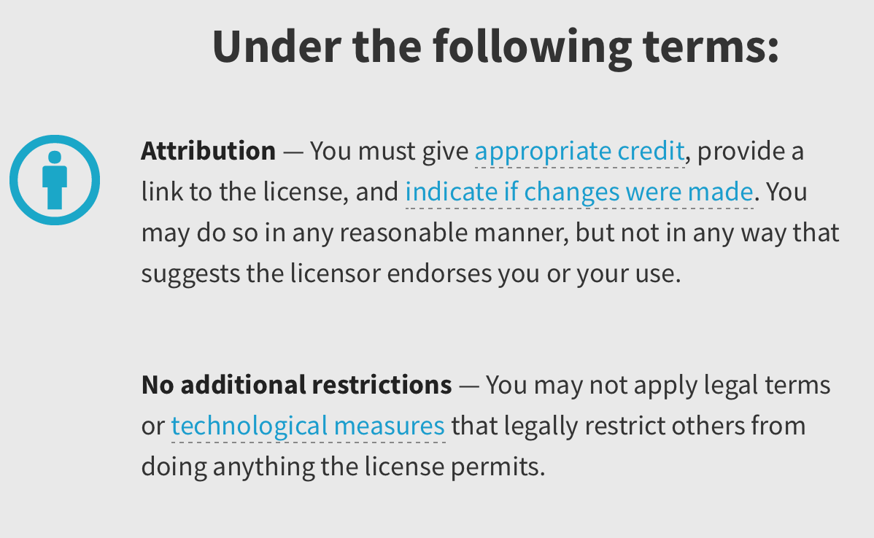
Credits
Slides are inspired and largely based on
Jeff Erickson’s book ‘Algorithms’.
They contain copy-paste portions of
the book.

