Slide 1
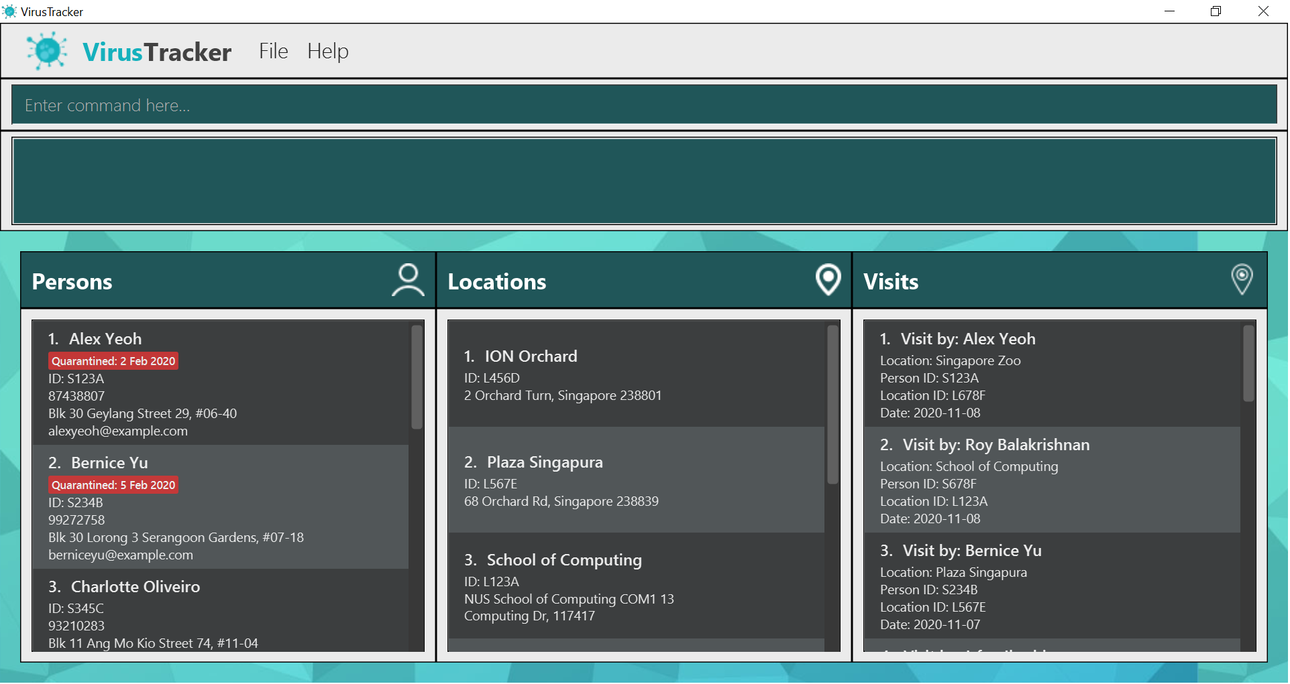
Toolbar | Command Box | Command Result | Persons List | Locations List | Visits List

