Slide 2
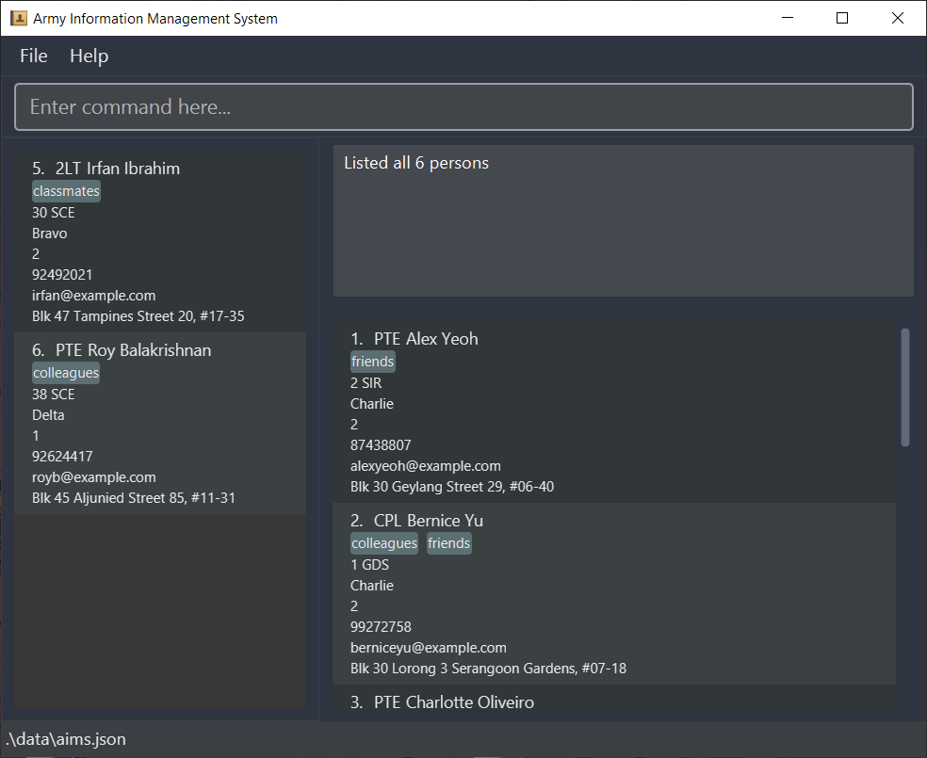
Menu bar
Command box
Message box
Favorites list
Main list
Location of data file

