Slide 1
IMPORTANCE OF
WRITING GOOD QUALITY CODE
CS3281
Ronak Lakhotia

Slide 3
WIIFY
Easier to read and follow.
Optimizes productivity level.
Makes it simpler for you to add new features to your product.

Slide 4
ROADMAP
1. What is clean code?
2. Why should you adopt good code quality practices?
3. How can we improve our code quality?

Slide 5
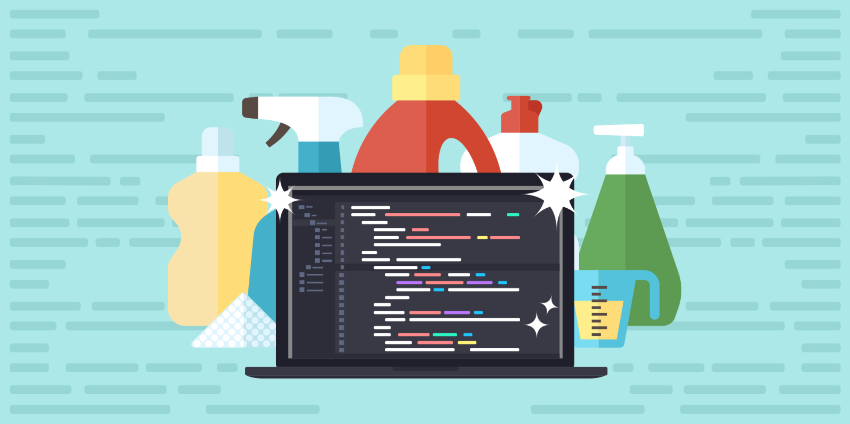
We’ve all heard the term “high code quality”, but what does it really mean?

Slide 6
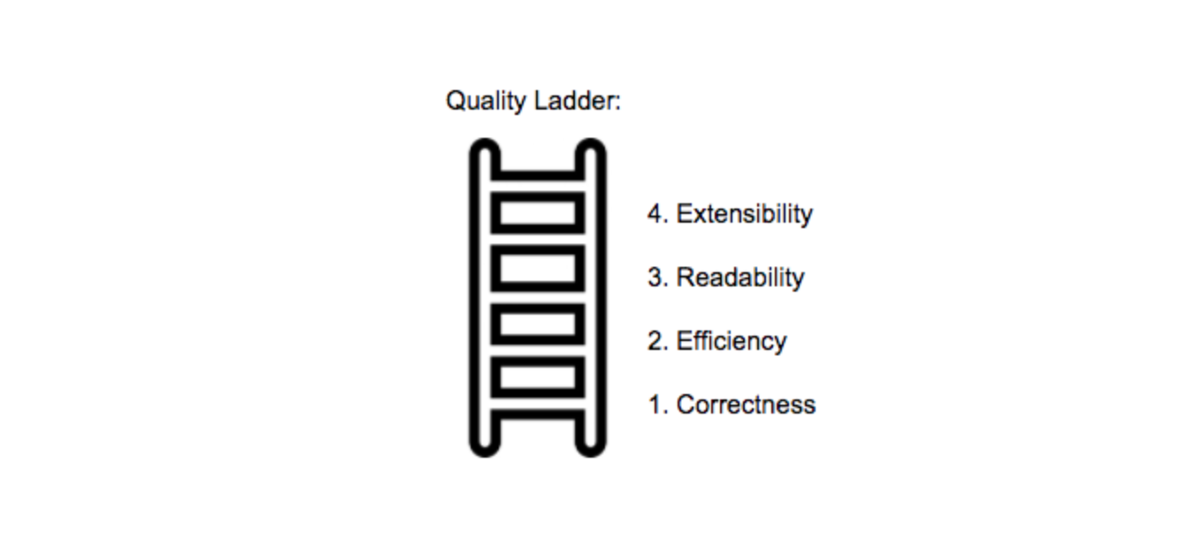
4. Efficiency
3. Extensibility
2. Readability
1. Correctness

Slide 7
ROADMAP
Clean code is :-
Easy to understand and maintain.
Well tested and extensible.
1. What is clean code?
2. Why should you adopt good code quality practices?
3. How can we improve our code quality?

Slide 8
YOUR CODE IS NOT
YOUR OWN !

Slide 9
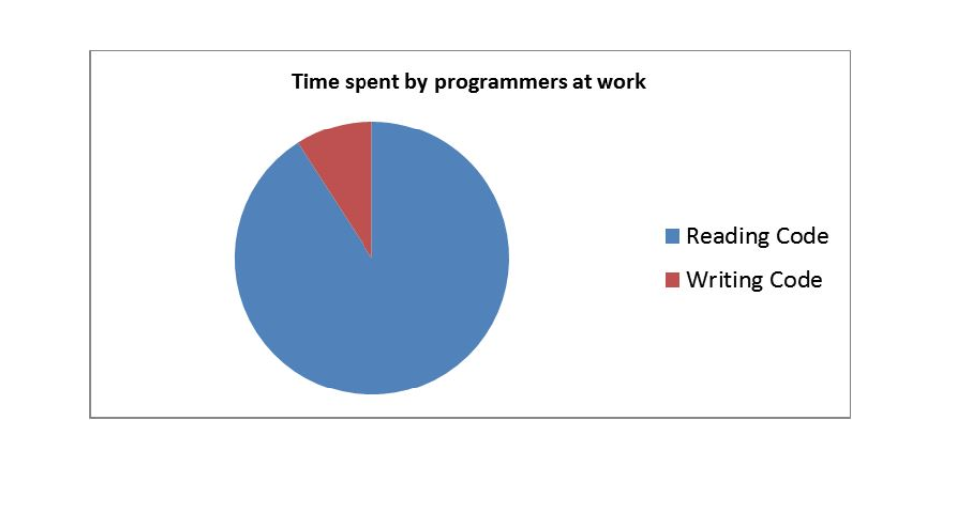

Slide 10
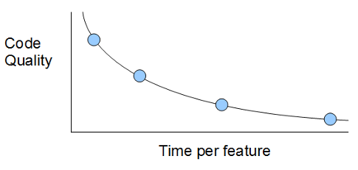
CODE QUALITY IS AN INVESTMENT
Lower development time.
Easily testable.
More robust.

Slide 11
ROADMAP
Clean code is :-
Easy to understand and maintain.
Well tested and extensible.
1. What is clean code?
2. Why should you adopt good code quality practices?
3. How can we improve our code quality?
High code quality ensures:-
Lower development time.
Increased productivity.
Robust software.

Slide 12
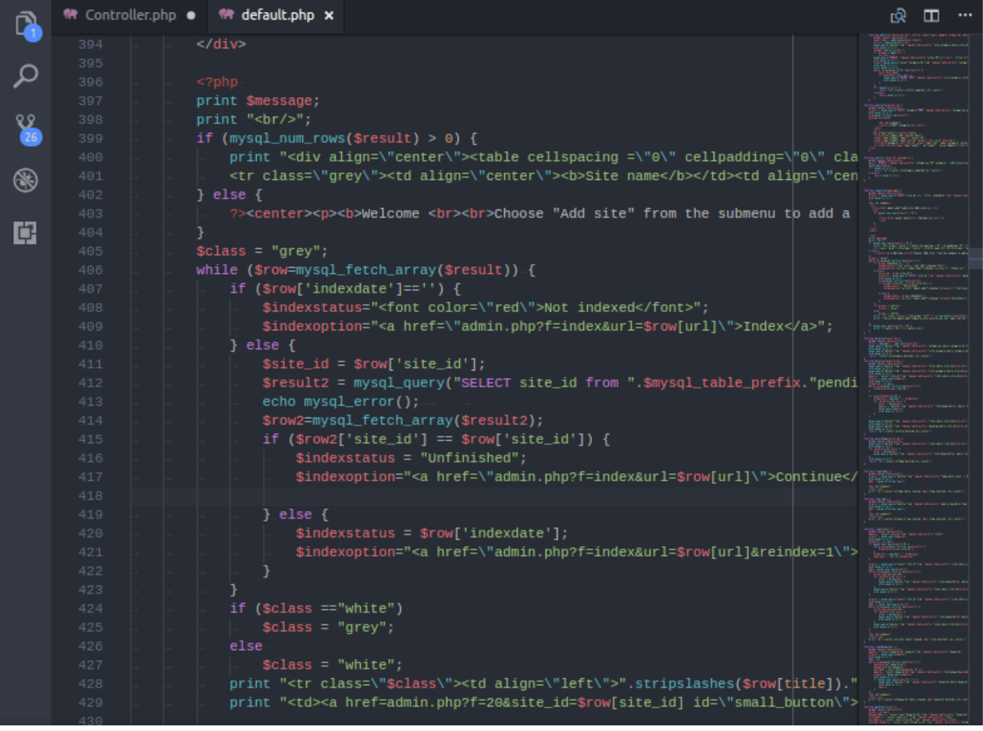

Slide 13
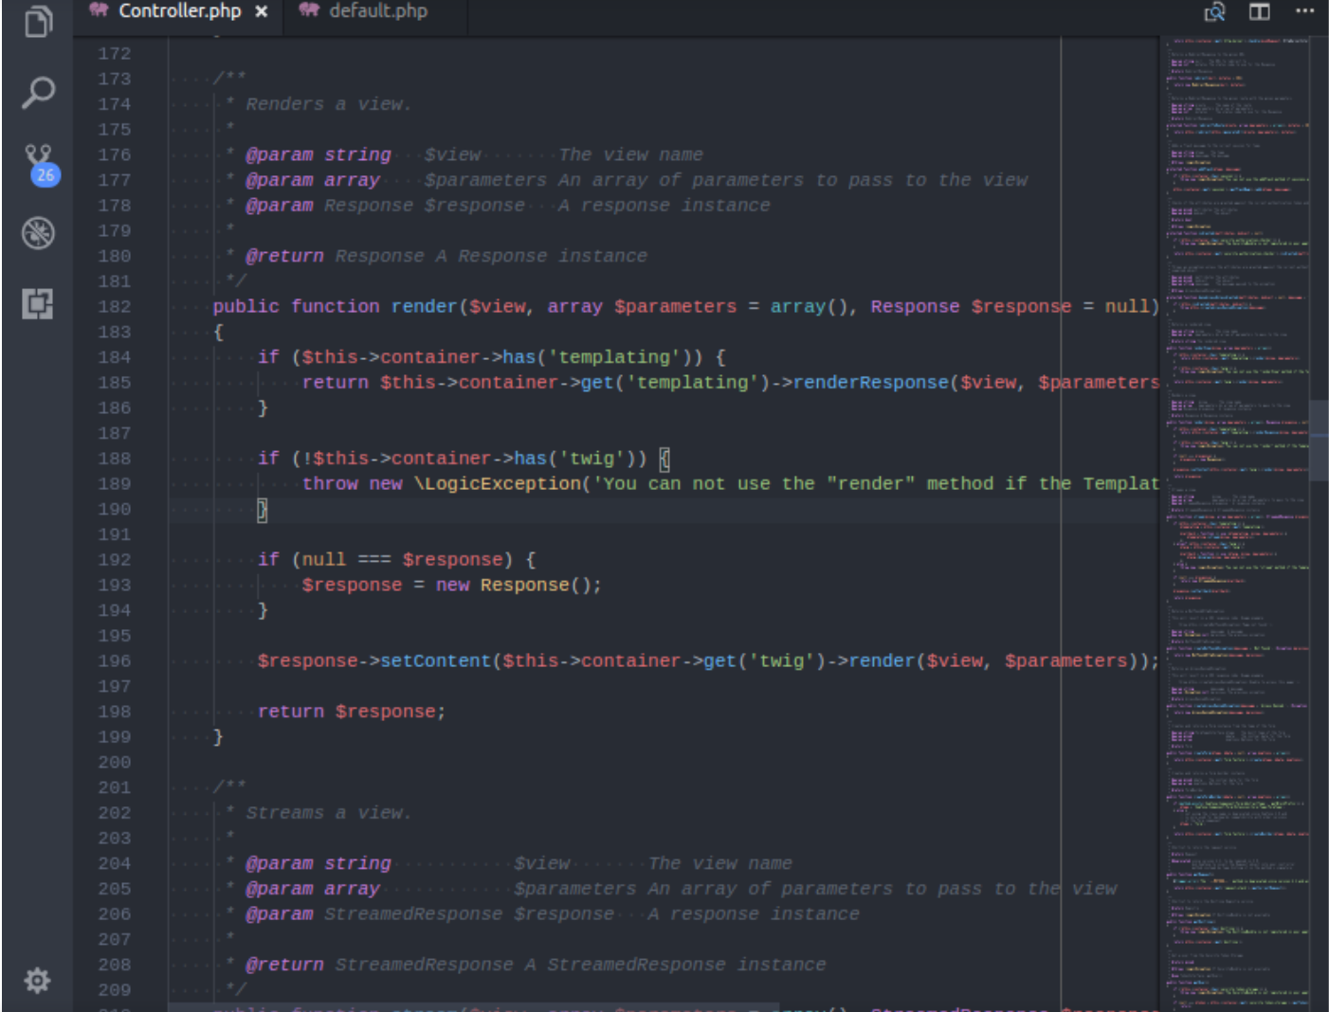

Slide 14
STATIC ANALYSIS TOOLS HELP IMPROVE CODE QUALITY
Analyzes source code without executing
Checks for quality, safety and security issues

Slide 15
AUTOMATED CODE REVIEW
Notes:
Codacy is an automated code analysis/quality tool that helps developers ship better software, faster. Integrate with your GitHub repositories to get quality analysis of every pull request inside GitHub.

Slide 16
Notes:
Something that’s less obvious, though, is that you’ll also end up spending less time managing technical debt. More specifically, the higher people rated the quality of their code, the time spent on bug fixing decreases almost logarithmically and more time spent on developing new features

Slide 17
RECAP OF KEY POINTS !
1. What is clean code?
2. Why should you adopt good code quality practices?
3. How can we improve our code quality?
Clean code is :-
Easy to understand and maintain.
Well tested and extensible.
High code quality ensures:-
Lower development time.
Increased productivity.
Robust software.
Ensure high code quality with:-
Static Analysis tools - codacy, checkstyle
Lowers cost of maintenance
Start adopting high code quality practices to become better software engineers!

