Slide 1
Beyond Static Analysis Tools
CS3281
Ronak Lakhotia
COM1-SR1 | 15th April

Slide 2
Have you ever used
ThreadSafe

Slide 3
Why should it matter to you?
Increases chances of getting internships
Faster onboarding process
Enforces optimal development practices

Slide 4
ROADMAP
What is ArchUnit?
What is ThreadSafe?
What is Spotbugs?
Why use these tools?

Slide 5
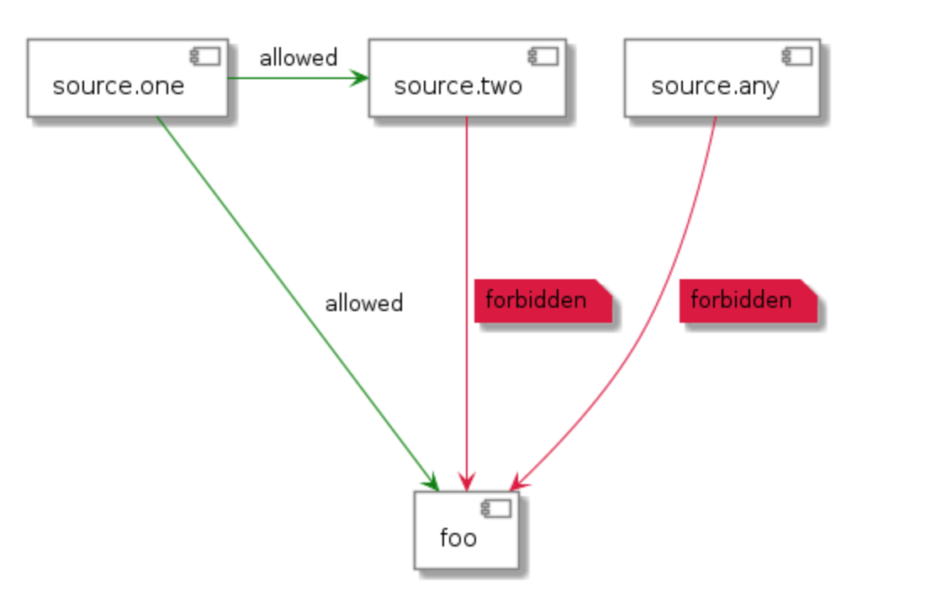
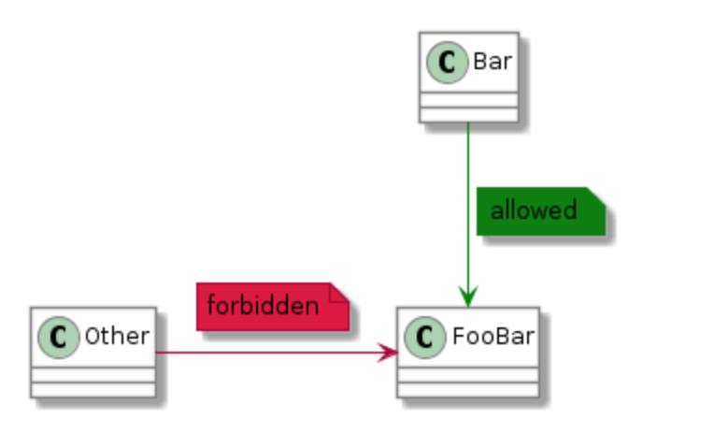
ArchUnit is used to Unit-Test the architecture (What?)
Checks for dependencies between components and layers
Package Dependency Class Dependency

Slide 6
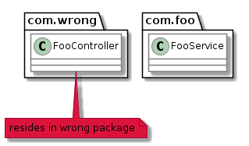
ArchUnit is used to Unit-Test the architecture (What?)
Enforces a layered architecture

Slide 7
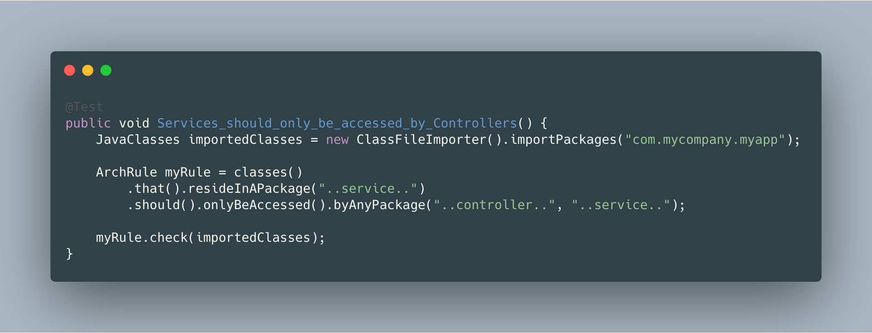
ArchUnit imposes constraints with the help of JUnit (How?)
Provides extended support for JUnit

Slide 8
ArchUnit is easy to use (Why?)
It is simple to integrate
It is extensible
- Define your own rules

Slide 9
ROADMAP
What is ArchUnit?
What is ThreadSafe?
What is Spotbugs?
Why use these tools?
KEY POINT: Tool to enhance architecture design of software.

Slide 10
ThreadSafe Finds Concurrency Problems (What?)
Detects synchronization and performance issues due to shared data

Slide 11
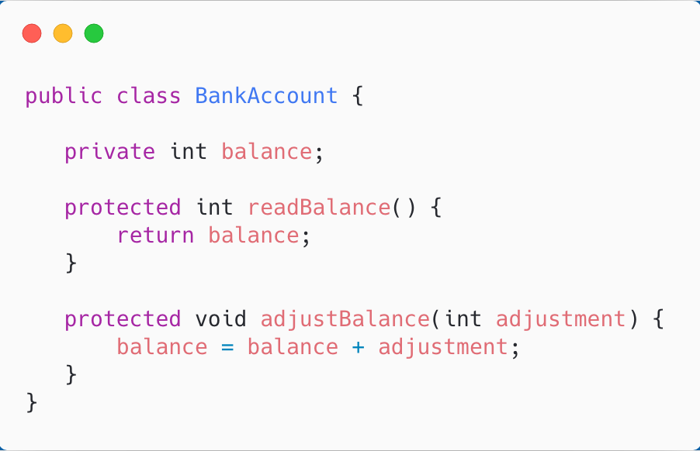
ThreadSafe Finds Concurrency problems
Discover defects that arise from interaction of methods and classes

Slide 12
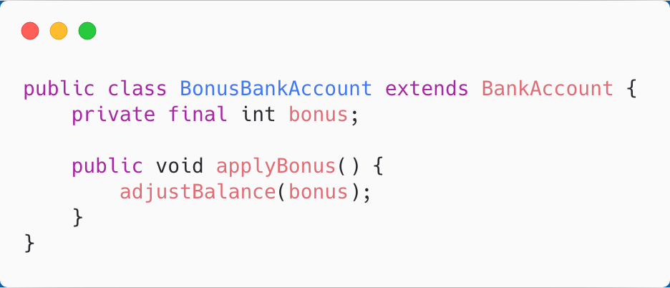
ThreadSafe Finds Concurrency problems
Discover defects that arise from interaction of methods and classes

Slide 13
ThreadSafe Finds Concurrency problems
Discover defects that arise from interaction of methods and classes

Slide 14
ROADMAP
What is ArchUnit?
What is ThreadSafe?
What is Spotbugs?
Why use these tools?
KEY POINT: Tool to enhance architecture design of software.
KEY POINT: Tool to diagnose bugs in multithreaded applications.

Slide 15
SpotBugs detects common bug patterns in Java code
Detects up to 400 error patterns

Slide 16
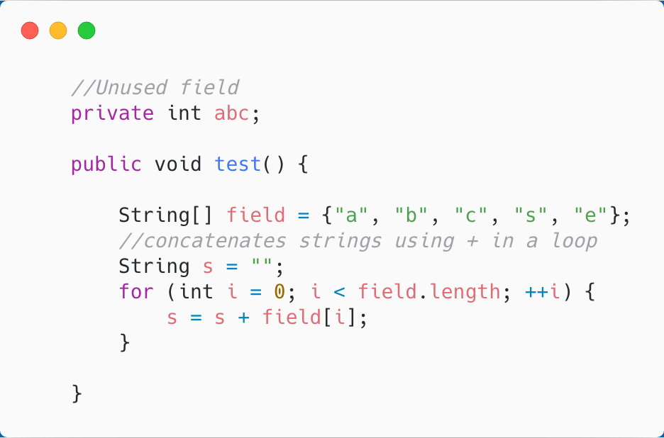
SpotBugs detects common bug patterns in Java code

Slide 17
SpotBugs is user friendly
It is extensible
Supported by most IDEs
Integrate third party plugins - Example

Slide 18
ROADMAP
What is ArchUnit?
What is ThreadSafe?
What is Spotbugs?
Why use these tools?
KEY POINT: Tool to enhance architecture design of software.
KEY POINT: Tool to diagnose synchronization defects in multithreaded applications.
KEY POINT: Tool to detect common bug patterns.

Slide 19
Why should you use these tools?
Highly focused functionalities as opposed to
Extended support by IDEs
Makes your software robust

Slide 20
RECAP!
KEY POINT: Tool to enhance architecture design of software.
Unit-test your architecture.
Easy to use and integrate
What is ArchUnit?
What is ThreadSafe?
What is Spotbugs?
Why use these tools?
KEY POINT: Tool to diagnose synchronization defects in multithreaded applications.
Finds concurrency bugs that are not easy to detect
KEY POINT: Tool to detect common bug patterns.
Detects over 400 bug patterns
It is user-friendly
KEY POINT: These tools enhance development workflow.
Email: ronak.lakhotia@u.nus.edu
Start using these tools in your next project!

Slide 21
Slide to document PUMA!
Intended Impact:
Know: What are the new static analysis tools in the Java development environment.
Believe: These tools can help you improve the design of your application.
Do: Start using these tools in your next project!
WIIFY: a) Having a knowledge of these tools shows employers you are aware of software design patterns.
b) Helps in the onboarding process especially when joining larger teams.
c) It will make you a better developer and more aware of your software constraints.
KEY POINTS: 1) ArchUnit is a tool to enhance the architecture of your project.
1 a) It can unit-test your architecture.
1 b) It is easy to use.
2) ThreadSafe detects concurrency bugs in multithreaded applications.
3) Spotbugs detects upto 400 common error patterns.
4) ArchUnit, ThreadSafe, Spotbugs improve the design and development workflow!
Call to Action: Start using these tools in your next project!
ROADMAP: 1) What is ArchUnit?
2) What is ThreadSafe?
3) What is Spotbugs?
4) Why should you use these tools?
PUNCH: We have all used Static Analysis Tools before and we can agree how these tools help us write high quality code. But have you ever thought of extending their functionalities? In the next few minutes I am going to talk to you about three such tools that will help you improve the design and architecture of your software.

