Slide 1
How MongoDB saves the day
Huang Chengyu
COM1-0204, 23 March 2023
Notes:
Good afternoon.

Slide 2
Imagine if you work in NUS IT ……
Name
Email
YourApp
Name: John Doe
Matric Number: A0123456A
Email: e0123456@u.nus.edu
Matric Number
Notes:
Imagine you are an engineer working in NUS IT. You need to design a new App to save and view student records. It needs to store 3 types of information for each student: name, email and matriculation number.

Slide 3
Imagine if you work in NUS IT ……
Name
CREATE DATABASE my_database;
USE my_database;
CREATE TABLE students(
matric VARCHAR(50) NOT NULL,
name VARCHAR(50) NOT NULL,
email VARCHAR(50) NOT NULL,
PRIMARY KEY(matric));
YourApp
Email
Matric Number
Notes:
This seems very easy to you. You decide to use SQL database as the most common option. You create the database and table, and start to insert rows into the table. This just feels like a piece of cake to you.

Slide 4
Imagine if you work in NUS IT ……
Sparse column?
Age
Nickname
Name
ALTER TABLE students
ADD …
INSERT ……
Refactor Database Access Layer Implementation ……
YourApp
Email
Matric Number
Modules
Languages
Storing list?
Notes:
Several days later, new requirements come to add more details for each student, including their age, possible nickname, list of modules they have taken, and list of languages they can speak. To handle this, you decide to use the ALTER command to add new columns to the table.
However, problems pop up.
You realize that certain columns such as nickname are missing for most students, resulting in sparse columns.
Aside from that, you need to store a list of modules and a list of languages for a student. However, most SQL distributions do not support storing list in a single column. You either need to create a joint table or use hacks such as string concatenation.
Either way, after tackling these, you again reinsert the records, and refactors the functions.

Slide 5
Notes:
Now you think, this is manageable, but maybe things can be done in a cleaner and simpler way.

Slide 6
Imagine if you work in NUS IT ……
Sparse column?
Age
Nickname
Lecturer
Name
Module Name
Deep coupling?
YourApp
Email
Module
Module Code
Matric Number
Modules
Languages
Students
Storing list?
Notes:
Several days later, new requirements come again to create a new table for modules, with lecturer, module name, module code, and list of students in the cohort. You try to solve it, but soon realize that the tables are now deeply coupled, and things will quickly become a mess. It may be doable, but not in the cleanest or easiest way. The workload is also too much for you alone.

Slide 7
Notes:
You soon get tired, and starts to give up.

Slide 8
This matters to you because …
Notes:
Although this is just an example, it matters to you because as the need for data is growing, we, as application developers, will need to deal with databases sooner or later. Regardless of whether it is in NUS OSS project, internships, or future career, a common problem is that business requirements for software are usually evolving rapidly. What works previously may not work in a new context, and the robustness against new requirements is crucial to an engineer like you.
That is how MongoDB comes into the picture. It provides a clean and efficient solution in dynamic context, and eventually saves the day for you.
This matters to you
Application developers like you will need to deal with databases sooner or later
It is crucial to stay robust against business requirements that are constantly evolving
MongoDB provides a clean and efficient solution

Slide 9
Roadmap
What is MongoDB
What MongoDB offers
Picking up MongoDB
Notes:
What is MongoDB?

Slide 10
Notes:
MongoDB is a document-oriented database program launched in 2007.

Slide 11
What is MongoDB
Table
Collection
matric | name | email | nickname
A0123456A | John Doe | e0123456 … | nick name 1
A0123458K | Tony Smith | e0123457 … | NULL
A0123457D | Jane Miller | e0123458 … | nick name 2
A0123459T | Susan Asher | e0123459 … | NULL
A0123456A | John Doe | e0123456 … | nick name 1
A0123458K | Tony Smith | e0123457 …
A0123457D | Jane Miller
nick name 2
A0123459T
e0123459 …
{
“matric”: “A0123456A”,
“name”: “John Doe”,
“email”: “e0123456 …”,
“nickname”: “nickname 1”
}
Notes:
In contrast to SQL, a collection in MongoDB, which is the counterpart of table, does not need to have a predefined schema. Additionally, a record in MongoDB is stored as a JSON-like document, instead of a structured row. This makes a MongoDB collection much more flexible than a table.

Slide 12
Roadmap
What is MongoDB
What MongoDB offers
Picking up MongoDB
Notes:
What MongoDB offers?

Slide 13
What MongoDB offers
Key Point 1:
MongoDB is flexible
I: Flexibility
II: Simplicity
III: Performance
Notes:
It offers flexibility, simplicity, and performance. Let’s start with the first key point. MongoDB is flexible.

Slide 14
MongoDB is flexible
Data type flexibility: List Storage
{
“matric”: “A0123456A”,
“name”: “John Doe”,
“email”: “e0123456 …”,
“languages”: [“English”, “German”, “Chinese”,
“Italian”, “Spanish”, “Malay”]
}
matric | name | email | languages
A0123456A | John Doe | e0123456 … | English;German;Chinese;Italian;Spanish;Malay
Notes:
At the core of MongoDB lies its data type flexibility. Previously, we see that there is no fixed schema for a collection, which allows documents in the same collection to have different fields. Actually, a document in MongoDB is almost as flexible as any JSON object. It can store a list in a field.
MongoDB is flexible
Documents in same collection can have different fields
It is possible to store a list in a field

Slide 15
MongoDB is flexible
Data type flexibility: Nested structure (If intended)
{
“matric”: “A0123456A”,
“name”: “John Doe”,
“email”: “e0123456 …”,
“languages”: [“English”, “German”, “Chinese”,
“Italian”, “Malay”],
“background”: {
“nationality”: “Singaporean”,
“attended_schools”: [
{
“school_name”: “JC”,
“addresses”: [
{
“country”: “Singapore”,
“street”: “street N”
},
{
“country”: “Singapore”,
“street”: “street M”
}
]
}
]
}
}
Student Table
School Table
Student Collection
Address Table
Notes:
It can also store highly nested data structures, if intended. The example document here contains 3 nesting layers to save the background of a student. To store the same information, SQL requires the creation of 2 more tables, which complicates things unnecessarily.
MongoDB is flexible
It can store highly nested structures, if intended

Slide 16
Data type flexibility helps to ……
Avoid coupling between collections
matric | name | email | module code | module name | lecturer
A0123456A | John Doe | e0123456 … | MA1101R | Linear Algebra | William
A0123456A | John Doe | e0123456 … | CS1231S | Discrete Structures | Tony
A0123456A | John Doe | e0123456 … | CS1101S | Programming Methodology I | Smith
A0123456A | John Doe | e0123456 … | MA1521 | Calculas for Computing | George
{
“matric”: “A0123456A”,
“name”: “John Doe”
“email”: “e0123456 …”,
“module_ids”: [ID_1, ID_2, ID_3, ID_4],
}
Module collection
MA1101R
CS1231S
CS1101S
MA1521
Multiple rows for a single student
Single document for a single student, with references
Notes:
Data type flexibility can have further implications. For example, if we do want to create a new entity for certain object, such as modules in the example here, MongoDB can achieve this with much less coupling than SQL. While SQL needs to keep multiple rows for a student that are coupled with modules, MongoDB only needs to keep 1 single document for the same student, and the modules taken can be saved as a reference list.
Data type flexibility can reduce coupling between collections
The associations among different collections can be expressed in a reference list

Slide 17
Go back to the previous example
Age
Nickname
Sparse column?
Solved
(No fixed schema)
Lecturer
Name
Deep coupling?
Solved
(Reference list)
Module Name
YourApp
Email
Module
Module Code
Matric Number
Modules
Languages
Students
Storing list?
Solved
(Support list storage)
Notes:
Now, if we go back to the original example, we will happily find that the problems faced previously can now be easily solved with the help of MongoDB.

Slide 18
What MongoDB offers
Storage flexibility
Key Point 1:
MongoDB is flexible
Key Point 2:
MongoDB is simple to use
Simplicity
Performance
Notes:
Let’s now look at simplicity. A key aspect of MongoDB is its simplicity of usage.

Slide 19
MongoDB is simple to use
Notes:
MongoDB supports a great variety of programming languages. Regardless of the specific language, MongoDB makes development simple and productive.
MongoDB is simple to use
It supports a great variety of programming languages, and makes development much more simple and productive

Slide 20
MongoDB is simple to use
Initialization is simple
CREATE TABLE students(
matric VARCHAR(50) NOT NULL,
name VARCHAR(50) NOT NULL,
email VARCHAR(50) NOT NULL,
PRIMARY KEY(matric));
db.createCollection(“students”, options)
or
db.students.insert({“name”:”John Doe”, “matric”: “A0123456A”})
Notes:
Firstly, database initialization is simple. In SQL, we need to define the schema in advance. In MongoDB, this is not necessary. In fact, you can even skip collection creation entirely. A new collection will be created on the fly when inserting the first document.
Initialization is simple
SQL needs schema definition
Initialization and creation in MongoDB do not require schema definition or even explicit declaration statement

Slide 21
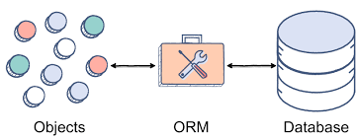
MongoDB is simple to use
API access is easy
BSON
Notes:
Secondly, accessing MongoDB collections is easy through its API. In SQL, heavy wrappers such as Object-relational mapping are needed to convert native objects to table rows. In MongoDB, everything is stored in BSON, a variant of JSON, and therefore, you can easily achieve the conversion with a BSON tag.
API access is easy
SQL requires heavy wrappers such as Object-relational mapping are needed to convert native objects to table rows
MongoDB allows conversion to be achieved with a BSON tag across different programming languages

Slide 22
MongoDB is simple to use
Query and write syntax is concise
SELECT * FROM
(SELECT *
FROM students
WHERE ……
GROUP BY *
) alias
GROUP BY ……
HAVING ……
ORDER BY ……
students.Find(bson.M{“languages”: bson.M{“$in”: []string{“English”, “German”}}})
students.Find(bson.M{“background.nationality”: bson.M{“$eq”: ”Singaporean”}})
Notes:
Thirdly, query and write syntax in MongoDB is concise. For query, instead of having to use more than 10 clauses to join tables and filter results, MongoDB query usually takes only 1 line. Moreover, complicated queries such as list filtering and nested queries can be easily done with specific tag and symbol.
Query and write syntax is concise
SQL query can involve more than 10 clauses to join tables and filter results
MongoDB query usually takes only 1 line, and complicated queries such as list filtering and nested queries can be easily done with specific tag and symbol

Slide 23
What MongoDB offers
Key Point 1:
MongoDB is flexible
Storage flexibility
Simplicity
Key Point 2:
MongoDB is simple to use
Performance
Key Point 3:
MongoDB gives strong performance
Notes:
Last but not least, another key point about MongoDB is that it gives strong performance.

Slide 24
MongoDB gives strong performance
Query is fast (If designed to be monolithic)
Student Table
School Table
Student Collection
Student
Schools
Addresses
Address Table
JOIN query
Single query
Notes:
Querying in MongoDB is usually faster than that in SQL. This is partly because SQL database often has multiple tables for different entities, which means the query needs to be joint across the tables. In MongoDB, necessary information can be centralized in a single document. This means only a single query is necessary, giving a performance boost.
Query is fast
SQL database often has multiple tables for different entities, and query needs to be joint across the tables
In MongoDB, necessary information can be centralized in a single document, and only a single query is necessary, giving a performance boost

Slide 25
MongoDB gives strong performance
Memory usage is small (Decoupling is effective)
matric | name | email | module code | module name | lecturer
A0123456A | John Doe | e0123456 … | MA1101R | Linear Algebra | William
A0123456A | John Doe | e0123456 … | CS1231S | Discrete Structures | Tony
A0123456A | John Doe | e0123456 … | CS1101S | Programming Methodology I | Smith
A0123456A | John Doe | e0123456 … | MA1521 | Calculas for Computing | George
{
“matric”: “A0123456A”,
“name”: “John Doe”
“email”: “e0123456 …”,
“module_ids”: [ID_1, ID_2, ID_3, ID_4],
}
Module collection
MA1101R
CS1231S
CS1101S
MA1521
Multiple rows for a single student
Single document for a single student, with references
Notes:
Additionally, when new entities are created, MongoDB can reduce the coupling in contrast to SQL. The number of records can also be reduced. This makes its memory usage small.
Memory usage is small
MongoDB can reduce the coupling between the entities in contrast to SQL, reducing the number of records and memory usage

Slide 26
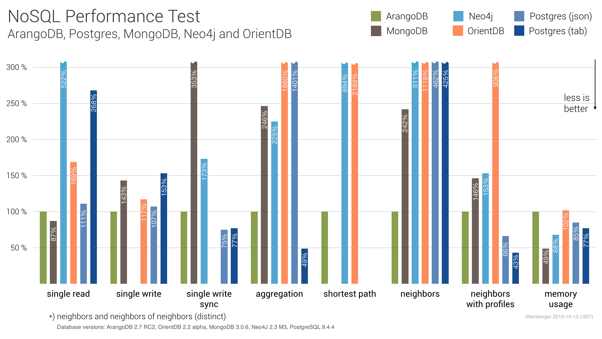
MongoDB gives strong performance
2 times faster in single read
36 percent less memory usage
Notes:
As a result of these, in the benchmark here, MongoDB achieves 2 times higher read speed and 36 percent more efficient memory usage compared to SQL.

Slide 27
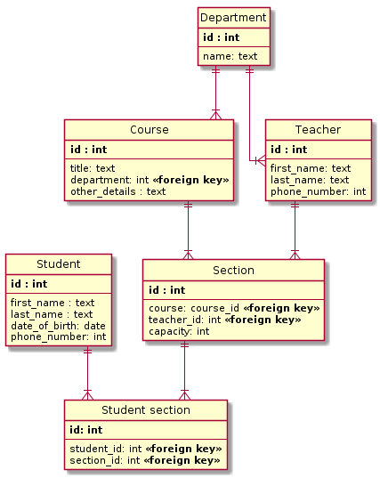
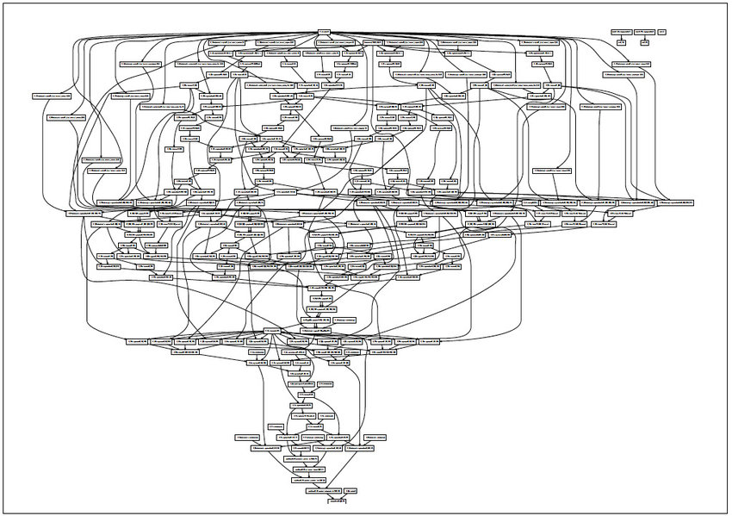
What MongoDB is not suitable for
Strongly Relational Data
Extremely Complex Query
Notes:
Indeed, there can be cases where MongoDB is not a suitable option compared with SQL. Firstly, if the relations between the objects to be stored need to be strictly imposed, then SQL is a more suitable choice. MongoDB does allow additional schema to be specified, but that will undermine its core benefits. Secondly, in many cases, MongoDB cannot handle extremely complex queries well. Compared with SQL, the efficiency of MongoDB in very complex queries still needs more optimization. These queries usually also involve joining different entities, while MongoDB does not have mature support for join operations at the moment.
There are cases where MongoDB is not a suitable option
Given records whose relations needs to be strictly imposed, SQL is a more suitable option, while achieving the same effect through adding additional schema in MongoDB undermines its core benefits
With extremely complex queries, MongoDB is not very efficient, and it does not have mature support for the needed join operations at the moment

Slide 28
Roadmap
Key Point 1:
MongoDB is flexible
Storage flexibility
What is MongoDB
What MongoDB offers
Picking up MongoDB
Simplicity
Key Point 2:
MongoDB is simple to use
Key Point 3:
MongoDB gives strong performance
Performance
Notes:
Let’s now talk about how to pick up MongoDB.

Slide 29
You may wonder
Despite being flexible, simple, and efficient, is it easy to pick up MongoDB?
Installation
Create and insert
use my_database
db.my_collection.insert({“name”:”my_name”})
Notes:
You may wonder, despite being flexible, simple, and efficient, is it easy to pick up MongoDB?
The answer is yes. MongoDB is an open source project. It is supported by an active community, with comprehensive documentation, tutorial resources, and visualization tools. Additionally, its installation and usage are quite simple, thanks to its design. It takes only 3 steps to install the tool, and 2 commands to do the first collection creation and document insertion.
MongoDB is easy to pick up
MongoDB is an open source project. It is supported by an active community, with comprehensive documentation, tutorial resources, and visualization tools
The installation and usage of MongoDB are quite simple

Slide 30
Roadmap
Key Point 1:
Data type flexibility for list and nested structures
Decouple efficiently
> MongoDB is flexible
Storage flexibility
What is MongoDB
Document-oriented database
JSON like document per record
No fixed schema for collection
What MongoDB offers
Picking up MongoDB
Easy to pick up
Simplicity
Key Point 2:
Simple Initialization
Simple API access, query, and write syntex
> MongoDB is simple to use
Key Point 3:
High query speed
Efficient memory usage
> MongoDB gives strong performance
Performance
Why not give it a try
Personal contact: e0376956@u.nus.edu
Notes:
In summary, MongoDB is a powerful tool. Although there are cases where SQL is a more suitable option, the flexibility, simplicity, and performance makes MongoDB robust against business requirements that are constantly evolving, and scalable as the size of database grows. Additionally, MongoDB is relatively easy to pick up.
Therefore, why not give it a try in your next project?
Thank you

Slide 31
Summary
Intended Impact
Know: The features and advantages of MongoDB compared with SQL
Believe: MongoDB is an ideal database tool for business requirements that are constantly evolving
Do: Start to learn MongoDB and use it in the next project
WIIFY: MongoDB helps you as a developer save time and effort when dealing with database that needs to handle constantly evolving business requirements.
Key points
MongoDB is flexible, especially for its data type flexibility
MongoDB is simple in terms of initialization, API access, and syntax
MongoDB gives a strong performance in time and space
Call-to-action: Try MongoDB in your next project
Roadmap:
What is MongoDB
What MongoDB offers
Picking up MongoDB
PUNCH: Example of creating a database to store a set of student records in NUS IT, how SQL causes complications, and how MongoDB provides a cleaner solution

