Slide 1
SICPy
Khooi Xin Zhe - A0228307H Ang Jun Jie - A0228577N

Slide 2

Outline
Overview
Implementation & Design
High-level overview
Custom SICPy parser
Pits & falls of ANTLR4
Common Python backend
Execution flow
SICPy sublanguages
Demo
Contributions
Future Enhancements
Journey Recap
Summary
SICPy

Slide 3
Overview
What to expect?

Slide 4
Overview
Objectives:
Series of sublanguages of Python – SICPy
Playground for SICPy – SICPy Academy
Project Scope:
Adapt Source §1-4 to SICPy
Linting functionalities (e.g., autocompletion/ syntax highlighting)
Notes:
Adapt Source §2, §3 and §4 to SICPy

Slide 5
Implementation & Design
What have we come up with?

Slide 6
High-level Overview
Building on top of existing infrastructures:
x-slang
x-frontend
SICPy specifications adapted from Source
Custom SICPy parsers to restrict the use of specific syntaxes depending on the sublanguage variant
Common Python backend for SICPy program execution

Slide 7
Custom SICPy Parser
Three-stage parser
Syntax analysis (ANTLR4)*
AST generation (Python AST - ASDL)
Syntax restriction (custom “evaluator” – parser_python.ts)
Design reasoning:
Syntactical errors flagged before execution
Fine-grained error messaging
* Currently disabled due to issues with the ANTLR4 Python3 grammar, see next slide.
Notes:
https://docs.python.org/3/library/ast.html
The Zephyr Abstract Syntax Description Lanuguage (ASDL) is a language designed to describe the tree-like data structures in compilers. Its main goal is to provide a method for compiler components written in different languages to interoperate. ASDL makes it easier for applications written in a variety of programming languages to communicate complex recursive data structures.

Slide 8
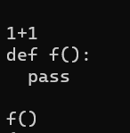
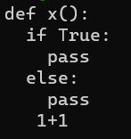

Pits & Falls of ANTLR4
ANTLR4 grammar designed for interactive use
If more than one “blocks” is passed to ANTLR4, only one is recognized…
Various attempts to fix the grammar has been carried out, but to no avail.
Related open GitHub issues (7):
1061, 1073, 1078, 1086, 1352, 1646, 1801
Example 2
(Pass???)
Example 1
Notes:
GitHub issues:
https://github.com/antlr/grammars-v4/issues/1061
https://github.com/antlr/grammars-v4/issues/1073
https://github.com/antlr/grammars-v4/issues/1078
https://github.com/antlr/grammars-v4/issues/1646
https://github.com/antlr/grammars-v4/issues/1801
https://github.com/antlr/grammars-v4/issues/1352
https://github.com/antlr/grammars-v4/issues/1086

Slide 9
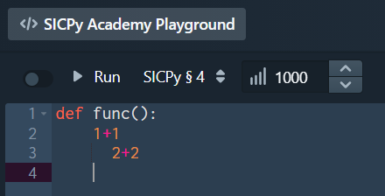
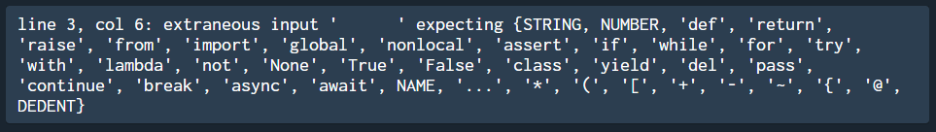
How it could have been…
Expected:
Notes:
GitHub issues:
https://github.com/antlr/grammars-v4/issues/1061
https://github.com/antlr/grammars-v4/issues/1073
https://github.com/antlr/grammars-v4/issues/1078
https://github.com/antlr/grammars-v4/issues/1646
https://github.com/antlr/grammars-v4/issues/1801
https://github.com/antlr/grammars-v4/issues/1352
https://github.com/antlr/grammars-v4/issues/1086

Slide 10
Common Python Backend
Plethora of options available:
Skulpt.js
Pypy.js
Brython
Pyodide.js
Selection criteria:
Fast (Web Assembly-based)
Well documented
Actively supported project (most recent commit – two days ago)
Recent Python version used (Python 3.8)
Extensibility (support for third party packages)
Notes:
https://hacks.mozilla.org/2019/04/pyodide-bringing-the-scientific-python-stack-to-the-browser/
Pyodide is an experimental project from Mozilla to create a full Python data science stack that runs entirely in the browser.

Slide 11
Execution Flow
code input
x-frontend
results
output
x-slang
Syntax Analysis ANTLR4*
AST Generation Python AST - ASDL
Syntax Restriction parser_python.ts
Pyodide.js
* Currently disabled and bypassed.
Notes:
// TODO: Draw diagram to show the execution flow from frontend

Slide 12
SICPy Sublanguages
SICPy §0
arithmetic & boolean expressions
SICPy §1
condition expressions
import statements
function declarations
function calls/ applications
declaration/ assignments
return statements
if-else statements
SICPy §2
lists
SICPy §3
loops (i.e., for, while)
continue, break, pass statements
list comprehension
SICPy §4*
dictionaries
tuples
exception handling
* SICPy §4 contains additions on top of Source §4

Slide 13
Demo and “evaluator” walkthrough syntax analyzer walkthrough
Try SICPy Academy via https://www.comp.nus.edu.sg/~khooixz/ (HTML redirect)

Slide 14
Contributions
What did we deliver?

Slide 15

Contributions
Recap on Deliverables:
Series of sublanguages of Python
Source §1 to SICPy (baseline goal)
Source §2 - 4 to SICPy (reach goal)
Playground for SICPy
Linting functionalities (reach goal)
What we have delivered:
SICPy §0 – 4
SICPy Academy
w/ basic autocompletion, syntax highlighting
Updated and revised ANTLR4 Python3 grammar from 3.6 to 3.8*
*While we failed to patch the Python3 grammar for ANTLR4, we did revise the grammar to reflect the changes for Python 3.8 during the process.
Notes:
// TODO: Animations

Slide 16
Future Enhancements
What else can be done?

Slide 17
Future Enhancements
Wrapping Pyodide.js in web workers
Frees up the main thread during program execution
Control program execution time
Sublanguage-specific linting functionalities
Only highlight valid syntaxes given the sublanguage
More robust autocompletion supporting dynamic imports (e.g., import math)
Improving error messaging to better fit with the context of the sublanguage
Further investigate ANTLR4 grammar issues

Slide 18
Journey Recap
How the project has been?

Slide 19
Journey Recap
First time working with web-related projects
Unfamiliar with various tools used in x-slang, x-frontend
ANTLR4 – source of surprises
Code available on grammars-v4 may not work
Visitor vs Walkers?
Applied ideas from the lab assignments to perform syntax restrictions while walking through the AST like an “evaluator” with a syntax analyzer.

Slide 20
Summary
Wrapping up!

Slide 21
Summary
SICPy as an adaptation of Source
SICPy Academy as a potential alternative for teaching Python
“For someone who is not yet a programmer, who wants to become a programmer, for those people Python is particularly easy to get.”
– Guido van Rossum, creator of the Python programming language

Slide 22
Q&A Found some bugs? Please let us know! Mail to: khooixz@comp.nus.edu.sg. ☺
Try SICPy Academy via https://www.comp.nus.edu.sg/~khooixz/ (HTML redirect)

