Slide 1
Examples for Resize Lab

Slide 2

A1
A1.1
B1
B1.1
A2
A2.1
A3
A3.1

Slide 3
Result after applying ‘stretch/shrink to align left’ with 2nd arrow as reference
A1
A1.1
B1
B1.1
A2
A2.1
A3
A3.1

Slide 4
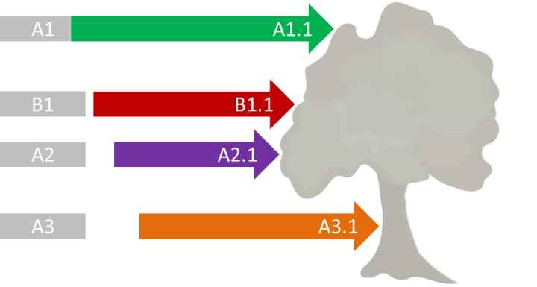
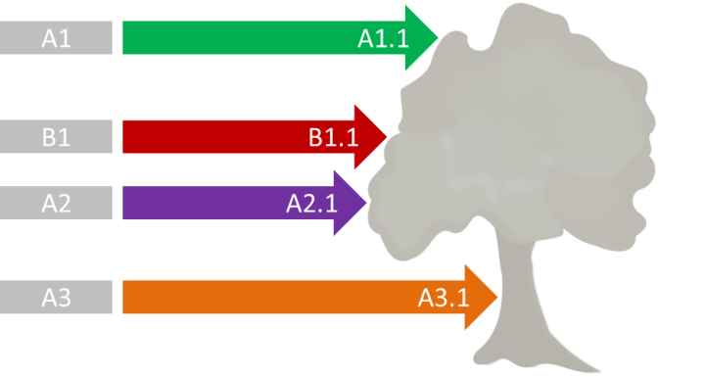


Slide 5

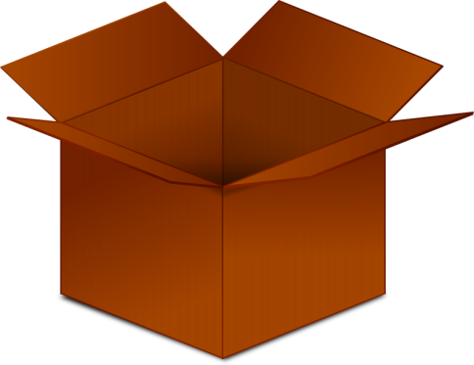

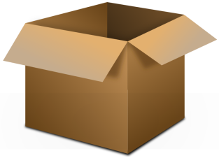



Result after applying ‘equalize both’, 3rd box as reference, bottom center anchor point

Slide 6
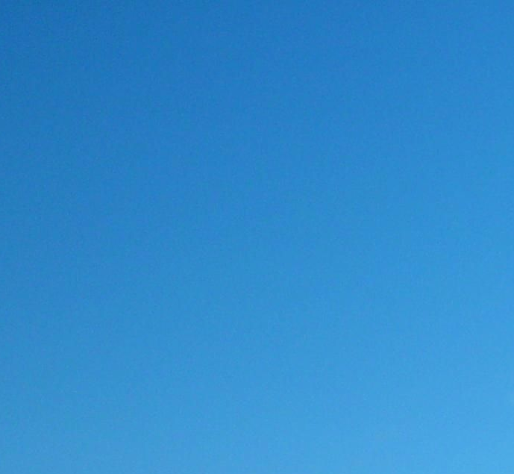

Slide 8
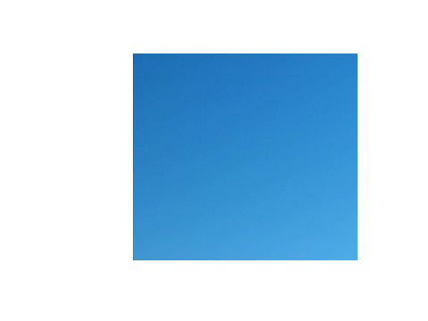
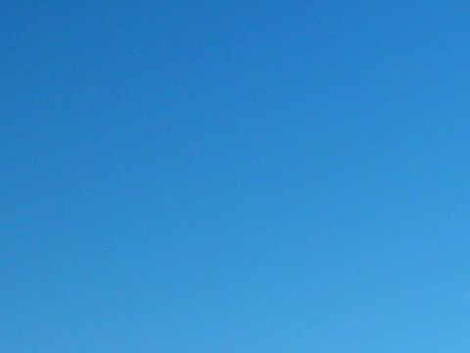
Picture with ‘fit to slide’ applied (without maintaining aspect ratio)

Slide 9
Adjust width to match height
Adjust height to match width

Slide 10
Adjust height slightly with bottom center anchor point

Slide 11
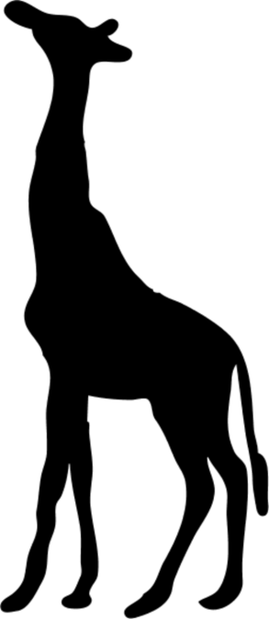
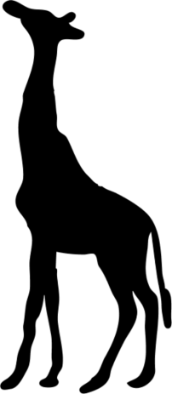
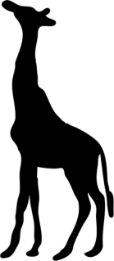
After applying ‘resize proportionally’ to height (while maintaining aspect ratio)
3911
4000
3000
2870
2000
1980
1000
1995
2005
2015
Giraffe population over the years

Slide 12
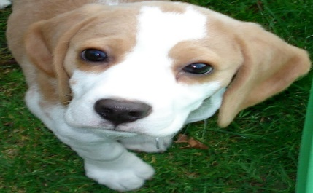




Results after resizing with ‘Maintain Aspect Ratio’
Notes:
Image taken from: https://upload.wikimedia.org/wikipedia/en/3/3a/Beagle_puppy.jpg

Slide 13
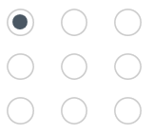
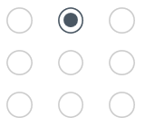
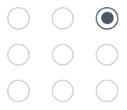
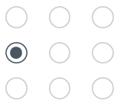
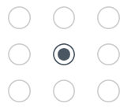
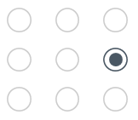
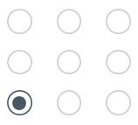
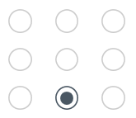
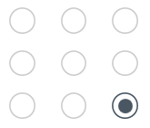
Results after resizing with different anchor points selected

Slide 14
Actual Height
Actual Width
Visual Height
Visual Width
Explanation of visual vs actual height and width

Slide 15


Results after resizing with visual and actual height and width

Slide 16
Results after resizing with visual and actual height and width

Slide 17

After applying ‘resize proportionally’ to area
3911
2870
1980
1995
2005
2015
Giraffe population over the years

Slide 18
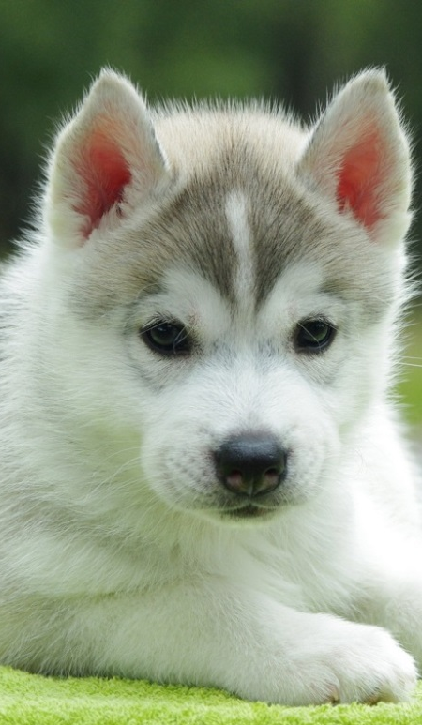
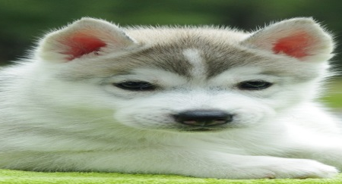

Un-squish height
Un-squish width

