Slide 1
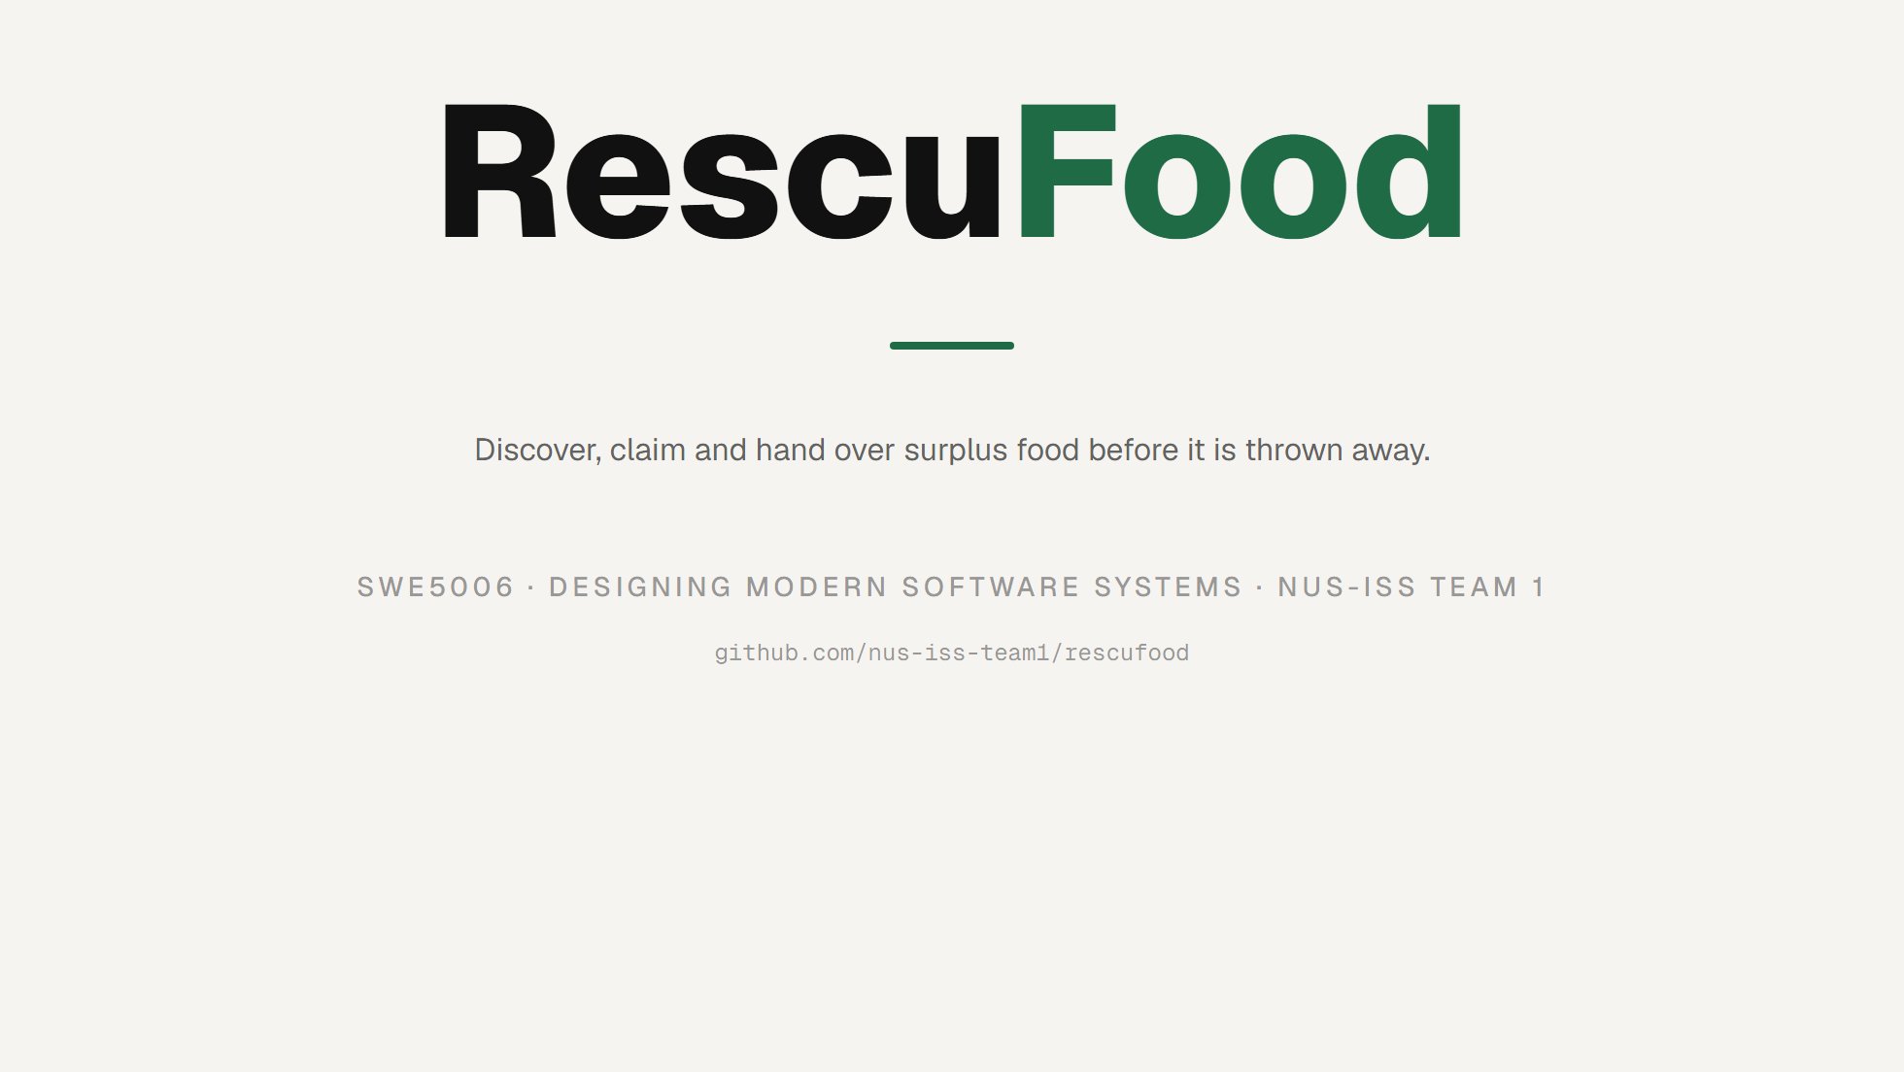
Notes:
TITLE
Hold here while people settle. One line: RescuFood is a real-time platform
that moves surplus food from the people who have it to the charities who
can use it, before it spoils. Over the next ~40 minutes we'll walk the
problem, how we ran the project, the design, the patterns that solved the
hard parts, our DevSecOps pipeline, and a live demo. Questions are welcome
inside each section.

Slide 2
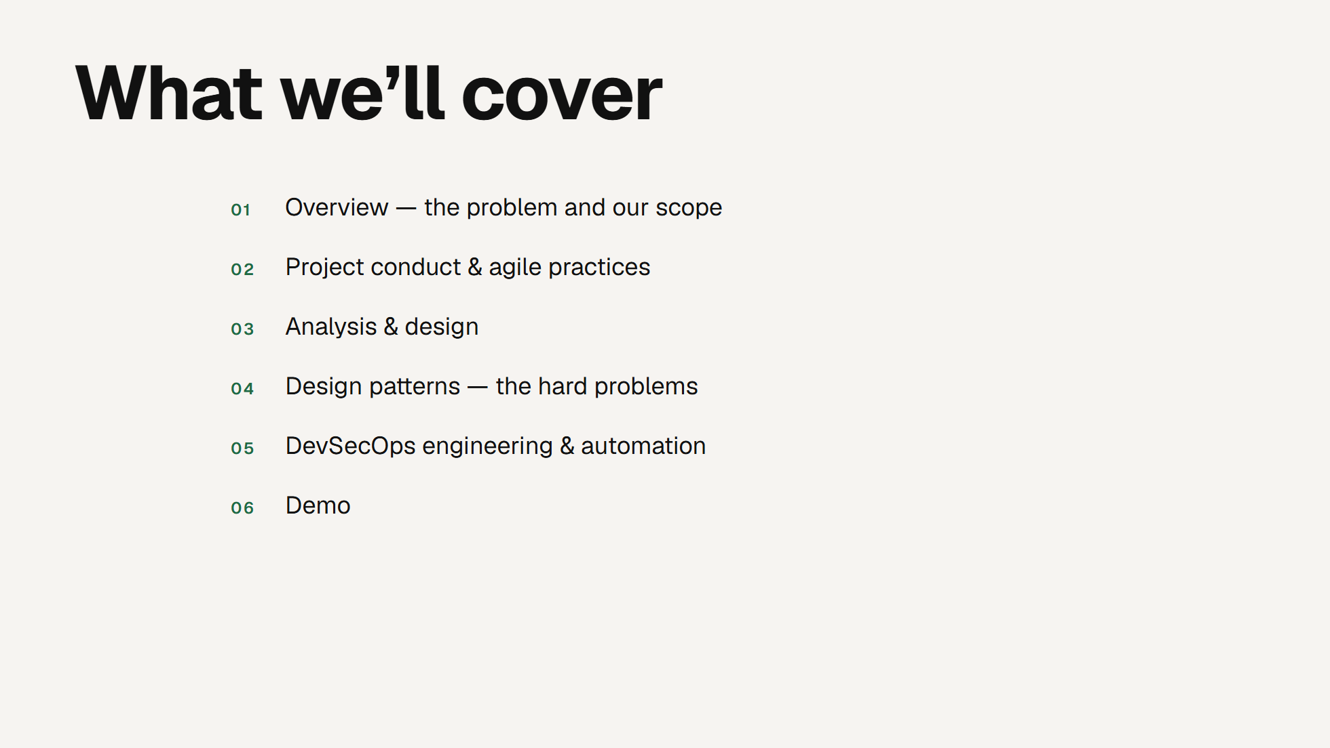
Notes:
AGENDA
Read the six markers once, quickly. This maps to the six segments the
graders expect. Tell them the timings are roughly: overview 3, conduct 6,
design 9, patterns 8, devsecops 7, demo 10 - Q&A folded into each. Then move.

Slide 3
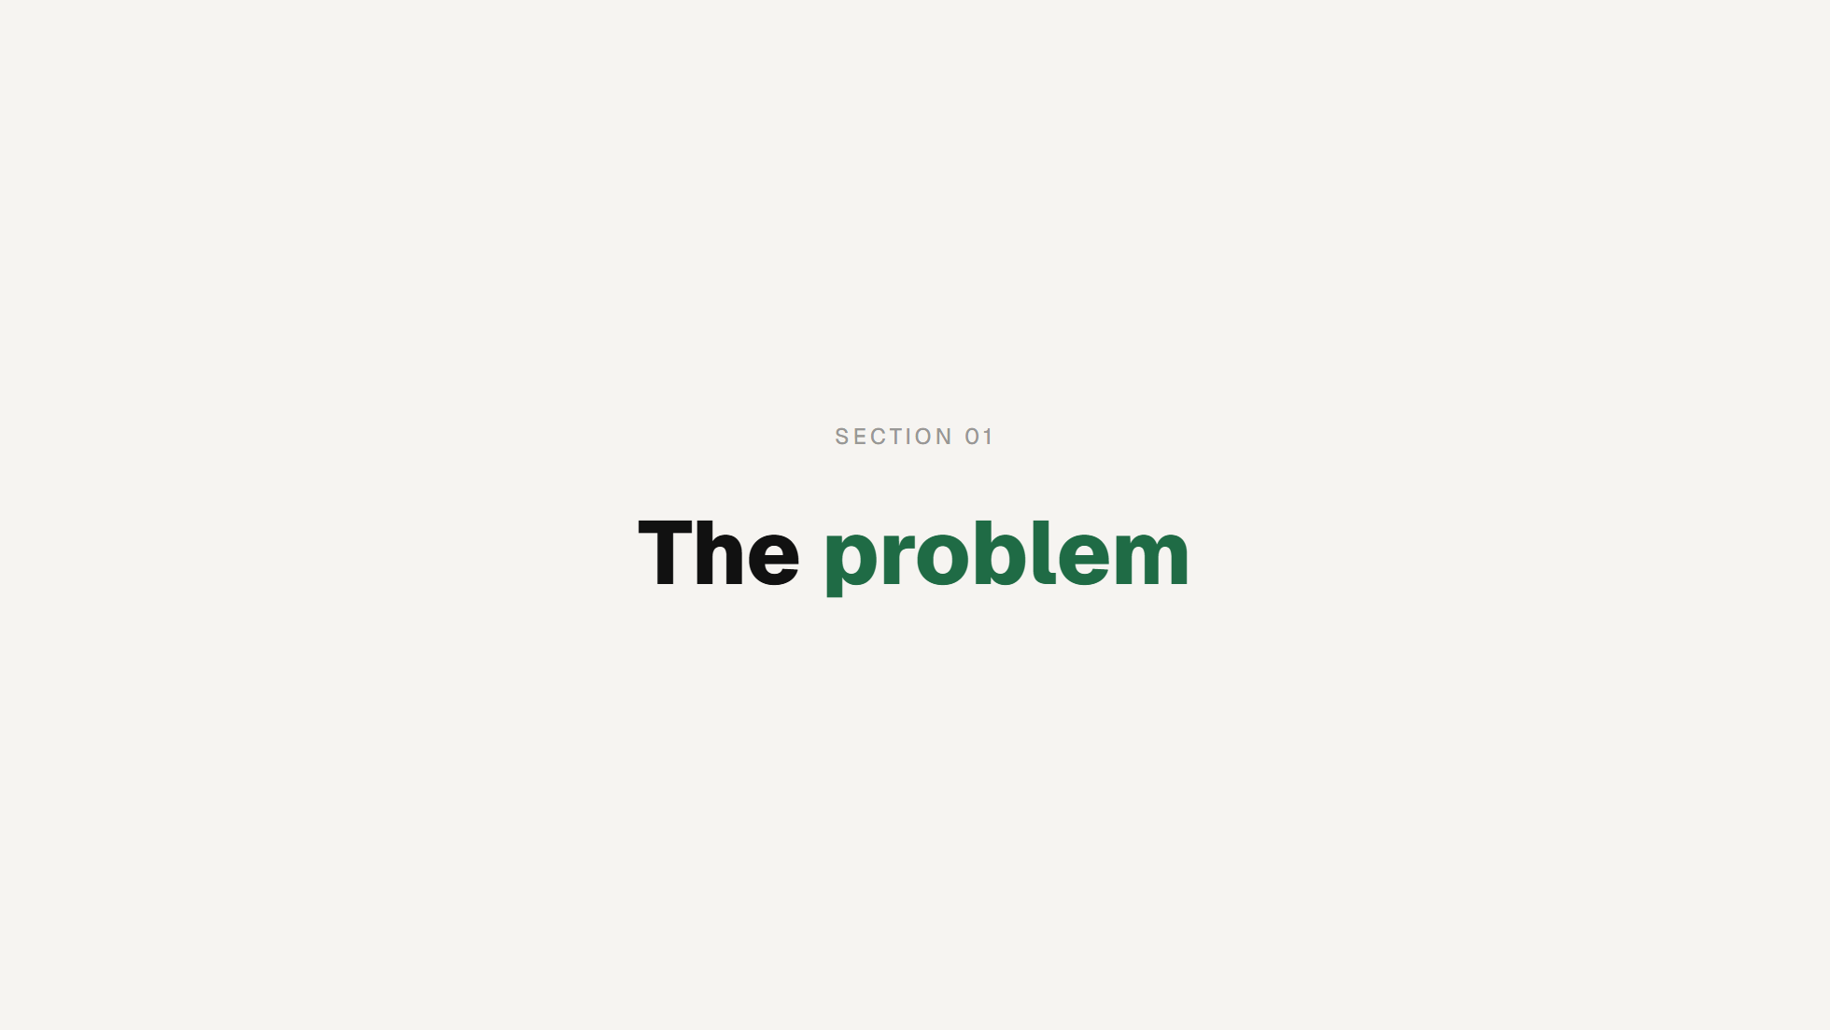
Notes:
SECTION MARKER
Say the title and move on. Marker, not a slide to talk over.

Slide 4
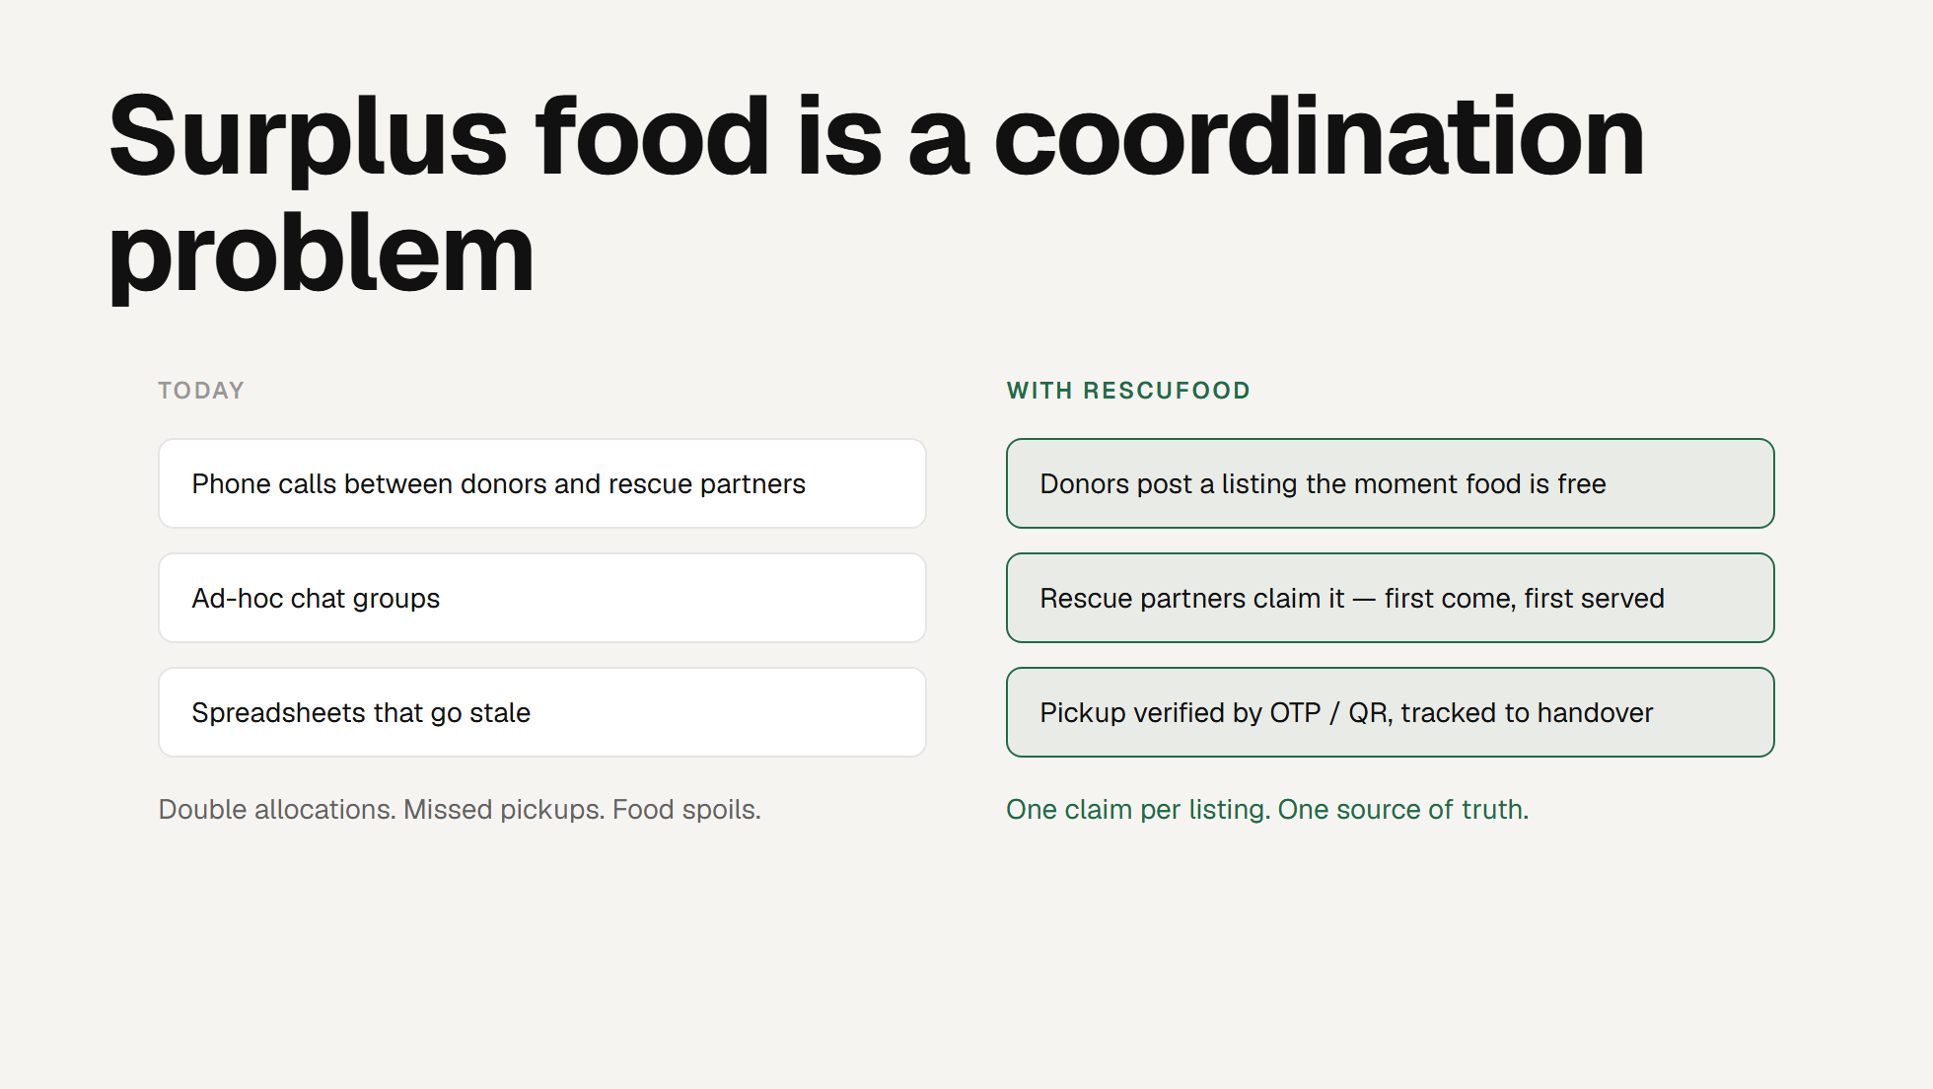
Notes:
THE PROBLEM
Surplus food is time-sensitive. A tray of bread is useful for a few hours,
then it's waste. The blocker is never goodwill - it's coordination. Donors
and rescue partners today rely on calls, chat groups and spreadsheets,
which means two partners show up for the same tray, or nobody shows up.
RescuFood makes the workflow digital and real-time. A donor posts a
listing the instant food becomes available; a rescue partner claims it on
a first-come-first-served basis; and the handover is verified and tracked.
The core promise is on the right: one claim per listing, one source of
truth. Hold that phrase - the whole design defends it.

Slide 5
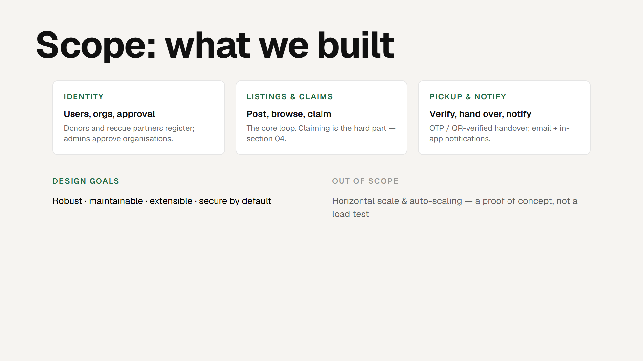
Notes:
SCOPE
Three capability areas. Identity: donors and rescue partners register, and
an admin approves organisations before they can transact - that approval
gate matters because a claim reserves real food. Listings and claims are
the core loop and the source of our most interesting design work, so I'll
defer the detail to section 4. Pickup and notify closes the loop: an
OTP/QR-verified handover, plus email and in-app notifications.
Design goals, bottom left, are the DMSS quality attributes - robustness,
maintainability, extensibility, security by default. Bottom right, the
honest boundary: this is a proof of concept, so horizontal scaling and
auto-scaling are deliberately out of scope. We optimised for correct and
maintainable, not for ten million users.

Slide 6
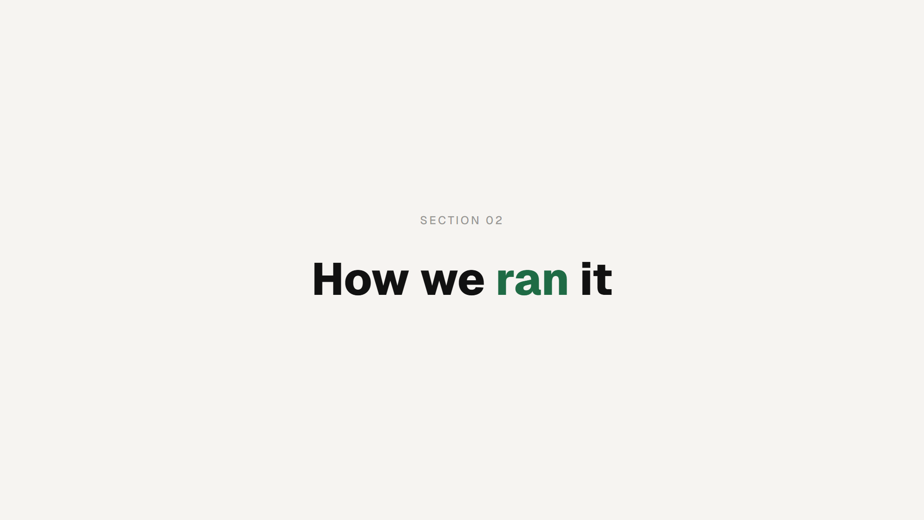
Notes:
SECTION MARKER

Slide 7
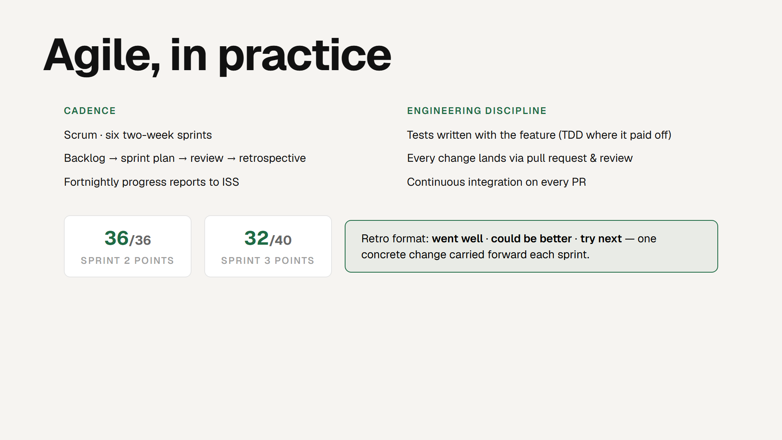
Notes:
AGILE PRACTICE
We ran Scrum over six two-week sprints - each starts from the backlog, gets
a sprint plan, and closes with a review and a retrospective. The fortnightly
progress reports ISS asked for fell straight out of that rhythm; we didn't
write them separately.
Top right is the engineering side of "essential practices for agile teams":
tests written alongside features, every change through a pull request and
review, and CI on every one of those PRs. Nothing reaches a branch without
going green first.
The numbers are real velocity from our burndowns - Sprint 2 closed 36 of 36
points, Sprint 3 closed 32 of 40, about 80%. We're being honest that not
every sprint hit 100%; the shortfall in Sprint 3 was the CDN and API Gateway
migration running long, and it carried into the next sprint.
The green box is our retrospective format. The point isn't the three
headings, it's that every sprint we carried exactly one concrete change
forward - PR automation after Sprint 1, tests-in-CI after Sprint 2. That's
how the pipeline in section 5 got as strict as it is.

Slide 8
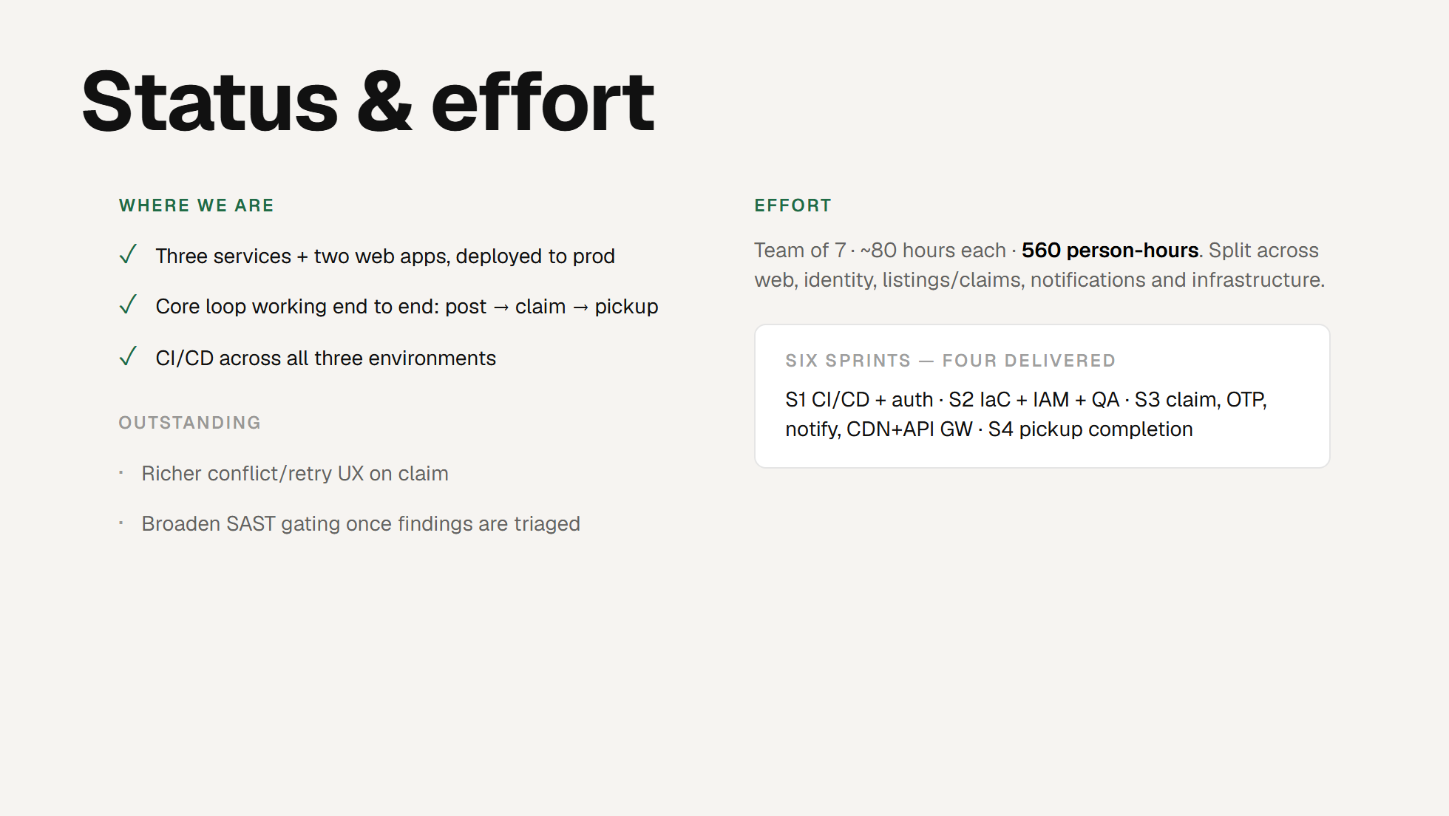
Notes:
STATUS & EFFORT
Quick and honest. Where we are: three backend services and two web apps are
deployed; the core loop works end to end; and CI/CD runs across all three
environments. Outstanding work is genuine but small - a richer conflict and
retry experience on the claim screen, and turning on fail-on-findings for
the security scanners once we've triaged the backlog. We chose not to block
the pipeline on untriaged findings rather than rubber-stamp them.
Effort: seven of us, about 80 hours each, so roughly 560 person-hours,
split across the areas listed. The plan is six two-week sprints; four are
delivered and evidenced. The one-liner traces the arc: Sprint 1 stood up
CI/CD and authentication, Sprint 2 the infrastructure-as-code, sandbox
environments, IAM and the first automated QA cases, Sprint 3 the
claim/reservation workflow, pickup OTP, notifications and the move from a
public load balancer to CDN plus API Gateway, and Sprint 4 pickup
completion. Name who owned what if asked.

Slide 9
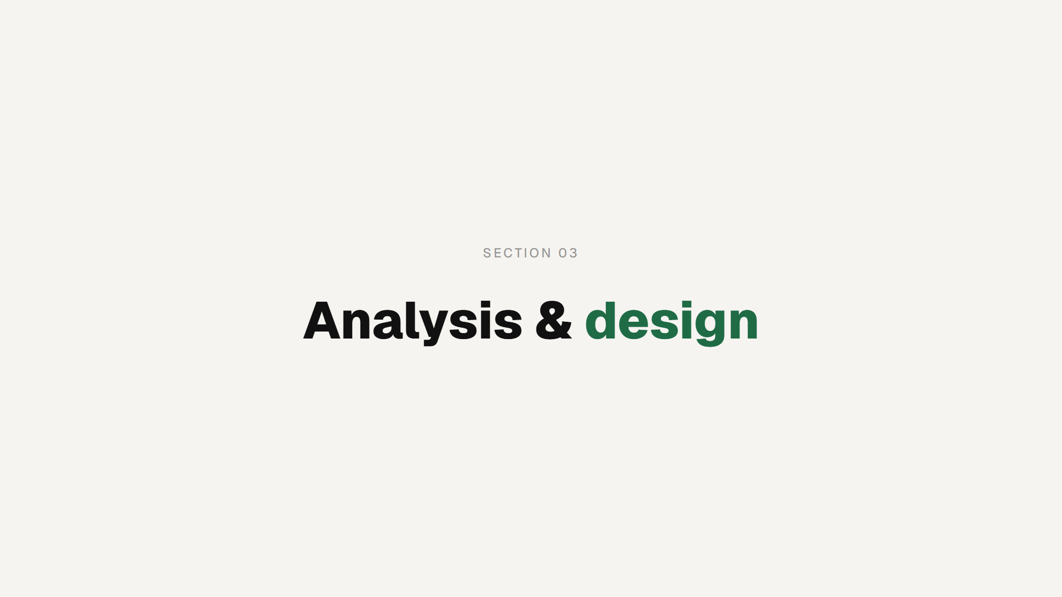
Notes:
SECTION MARKER

Slide 10
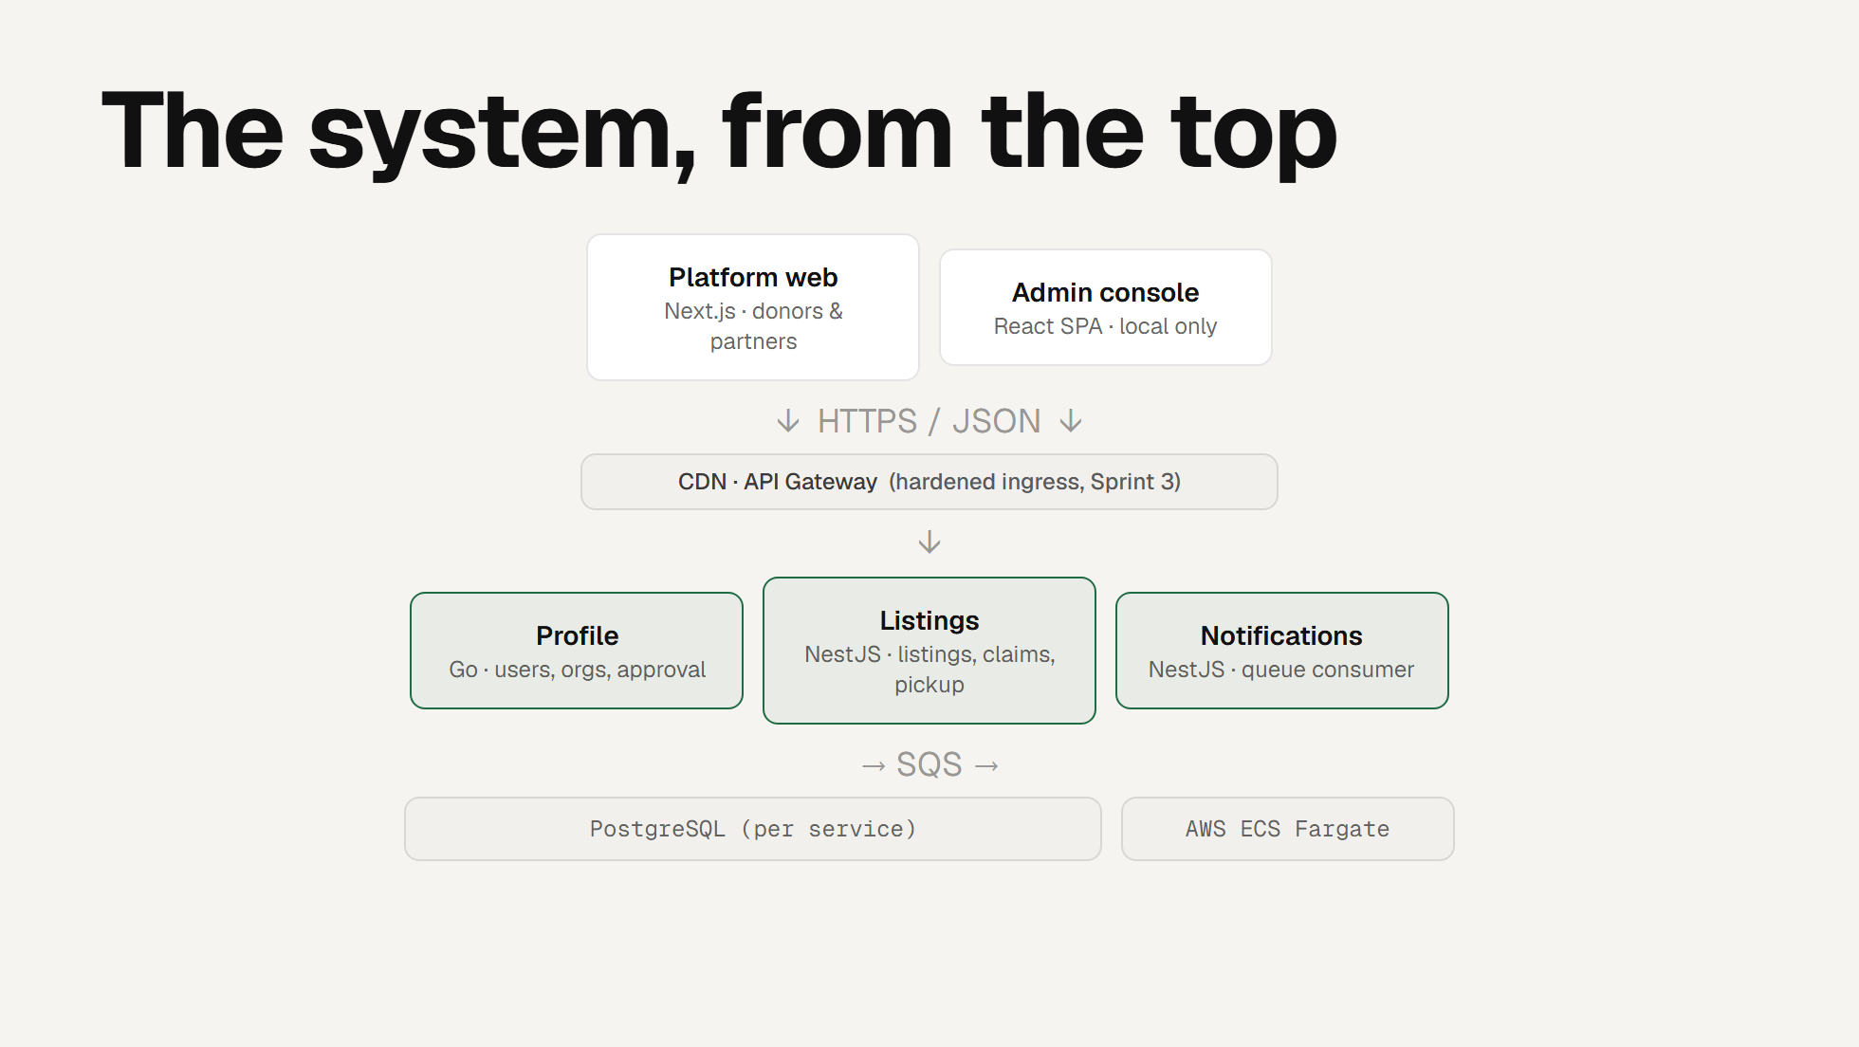
Notes:
ARCHITECTURE
Top-down, as the guidelines ask. Two front ends: the Next.js platform app
for donors and rescue partners, and a React admin console. One design
decision worth flagging - the console runs locally only (that's ADR-0001).
Deploying it would mean another Fargate task, load-balancer rule and
pipeline, for an audience that is just our team. The admin API stays
protected by an admin claim on the token, so keeping the UI local costs us
nothing in security. That's the kind of deliberate, documented trade-off
the module is looking for.
Everything talks over HTTPS and JSON, through a CDN and API Gateway. That
edge is itself a decision - in Sprint 2 the services sat behind a public
load balancer, and in Sprint 3 we moved the traffic path to CDN plus API
Gateway to harden the ingress. Architecture that adapted as we learned, not
frozen up front.
Behind it, three backend services: profile in Go owns identity and the
org-approval workflow; listings in NestJS owns the core loop and is where
the hard design lives; notifications in NestJS is a queue consumer. Services
don't call each other synchronously for
side-effects - listings emits an event onto SQS and notifications reacts.
That decoupling is deliberate: a slow email never blocks a claim.
Each service owns its own PostgreSQL - no shared database, so services stay
independently deployable. It all runs on ECS Fargate via CloudFormation.

Slide 11
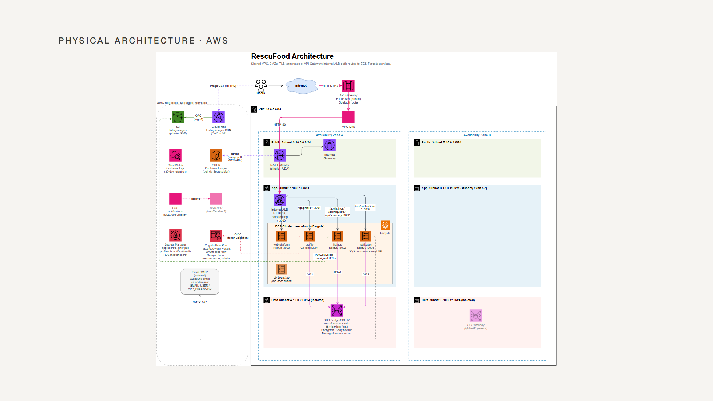
Notes:
PHYSICAL ARCHITECTURE
This is the deployment view - the logical picture from the last slide,
placed on real AWS. Walk it left to right, briefly; don't read every box.
Traffic enters through API Gateway, which terminates TLS, and crosses a VPC
Link into the VPC. Inside, an internal load balancer path-routes to the
Fargate services - /api/profile to profile, /api/listings and /api/requests
to listings, and so on. The services run across two availability zones.
Data sits in isolated subnets with no internet route: RDS PostgreSQL,
Multi-AZ per environment, encrypted with a managed master secret. Identity
is Cognito, with donor, rescue-partner and admin groups. Listing images go
to a private S3 bucket fronted by CloudFront. And the notifications path is
SQS with a dead-letter queue - the same decoupling we showed logically,
here in infrastructure.
The one thing to call out as honest: a single NAT gateway in AZ A - a
deliberate cost trade-off for a proof of concept, and the obvious first
change if this went to real production traffic.
If the SVG isn't in place yet: export infra-plan.drawio to slides/infra.svg
(VS Code Draw.io extension -> Export -> SVG), then this slide fills in.

Slide 12
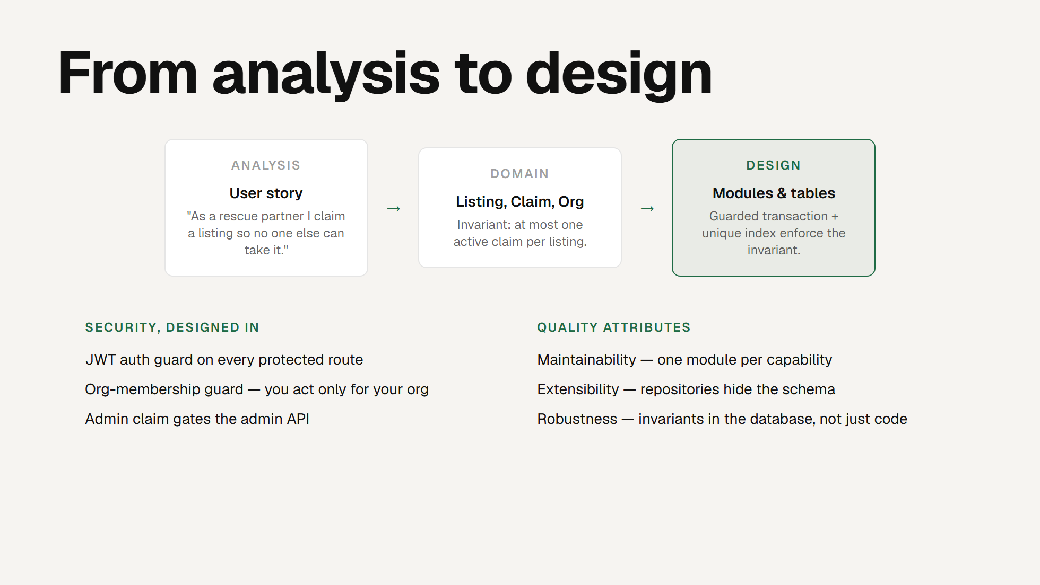
Notes:
ANALYSIS TO DESIGN
This is the transition DMSS cares about most - how a user story becomes a
design. Take the claim story on the left. In analysis it's one sentence.
We turn it into a domain model - Listing, Claim, Org - and the moment we
write that model we surface the invariant that defines the whole system:
at most one active claim per listing. Design is then the answer to "how do
we guarantee that invariant even under retries and races" - a guarded
transaction plus a unique index. Section 4 is that answer in full.
Security was designed in, not bolted on. Every protected route runs behind
a JWT auth guard; an org-membership guard ensures you can only act for your
own organisation; and the admin API is gated by an admin claim. On the
right, the quality attributes made concrete: a module per capability for
maintainability, repositories hiding the schema for extensibility, and -
the one I'd underline - invariants enforced in the database, not only in
application code. Code can have bugs; a unique index cannot be talked out
of its job.

Slide 13
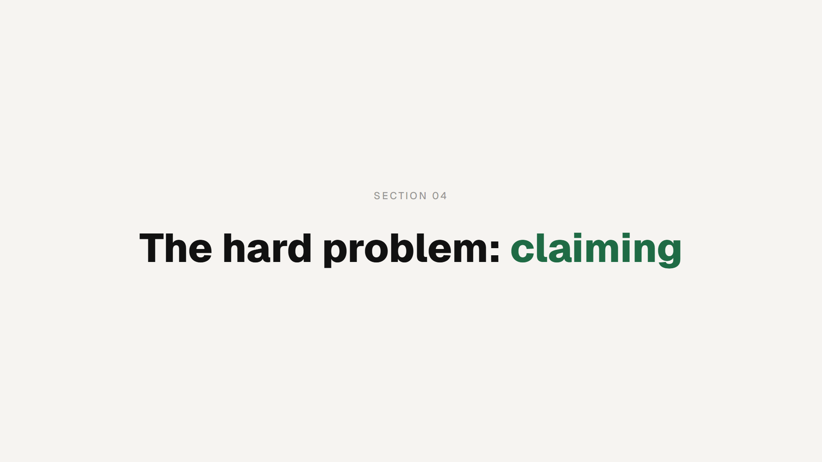
Notes:
SECTION MARKER
This is our centrepiece. The graders want "design problems solved by
applying patterns" - this is ours, end to end.

Slide 14
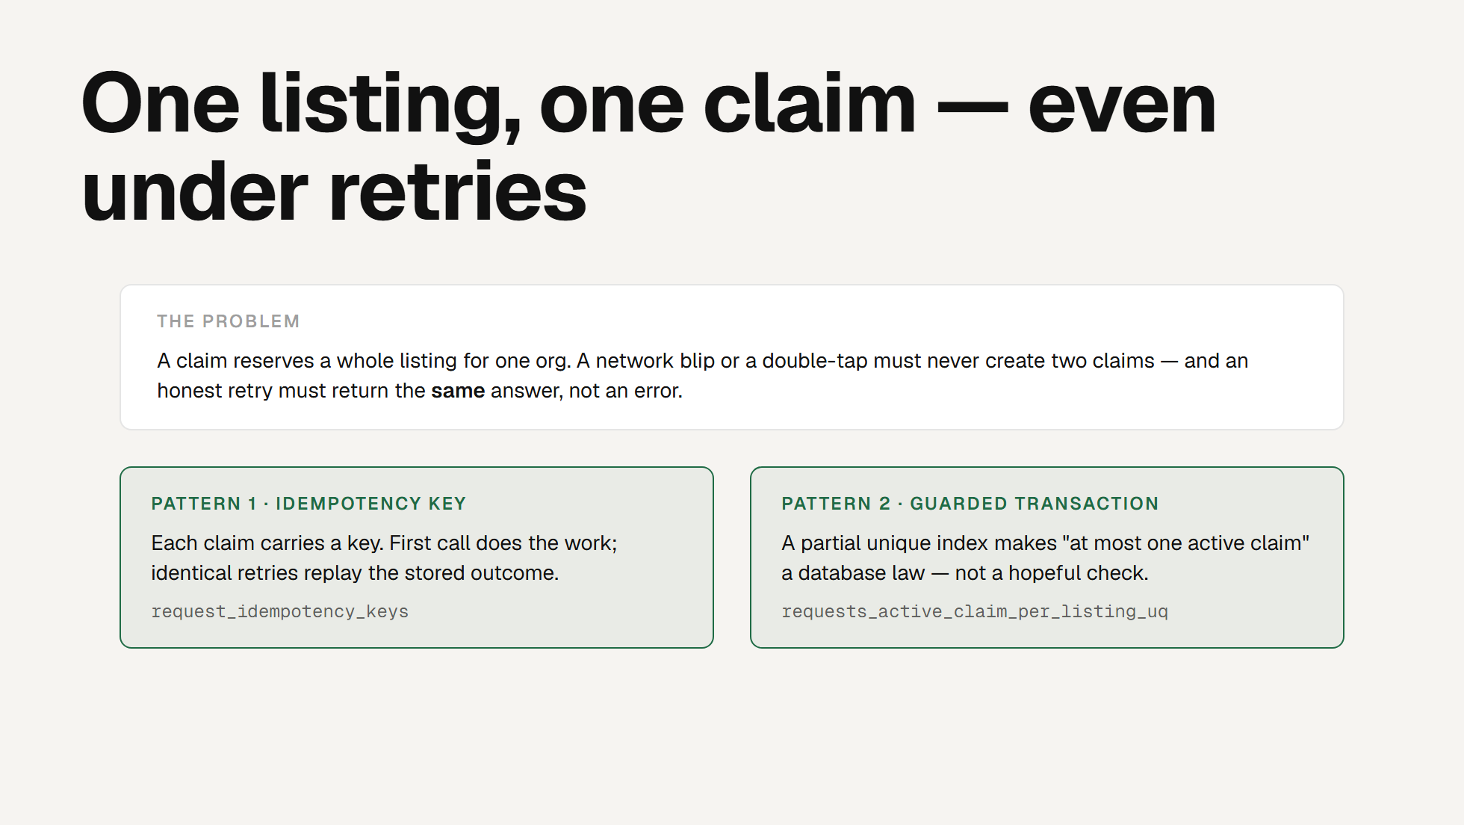
Notes:
THE HARD PROBLEM
Here's the problem stated plainly. A claim reserves an entire listing for
one organisation. Two things can go wrong: a network blip or a double-tap
could create two claims, and separately, an honest retry - the user's phone
resent the request - must come back with the same answer, not a confusing
error.
Two patterns, working together. Pattern one is an idempotency key: every
claim request carries a key, the first call does the real work, and an
identical retry replays the stored outcome instead of acting again. Pattern
two is a guarded transaction backed by a partial unique index, which makes
"at most one active claim per listing" a law the database enforces, not a
check we hope runs at the right time. The next slide shows how the key
handles each case.

Slide 15
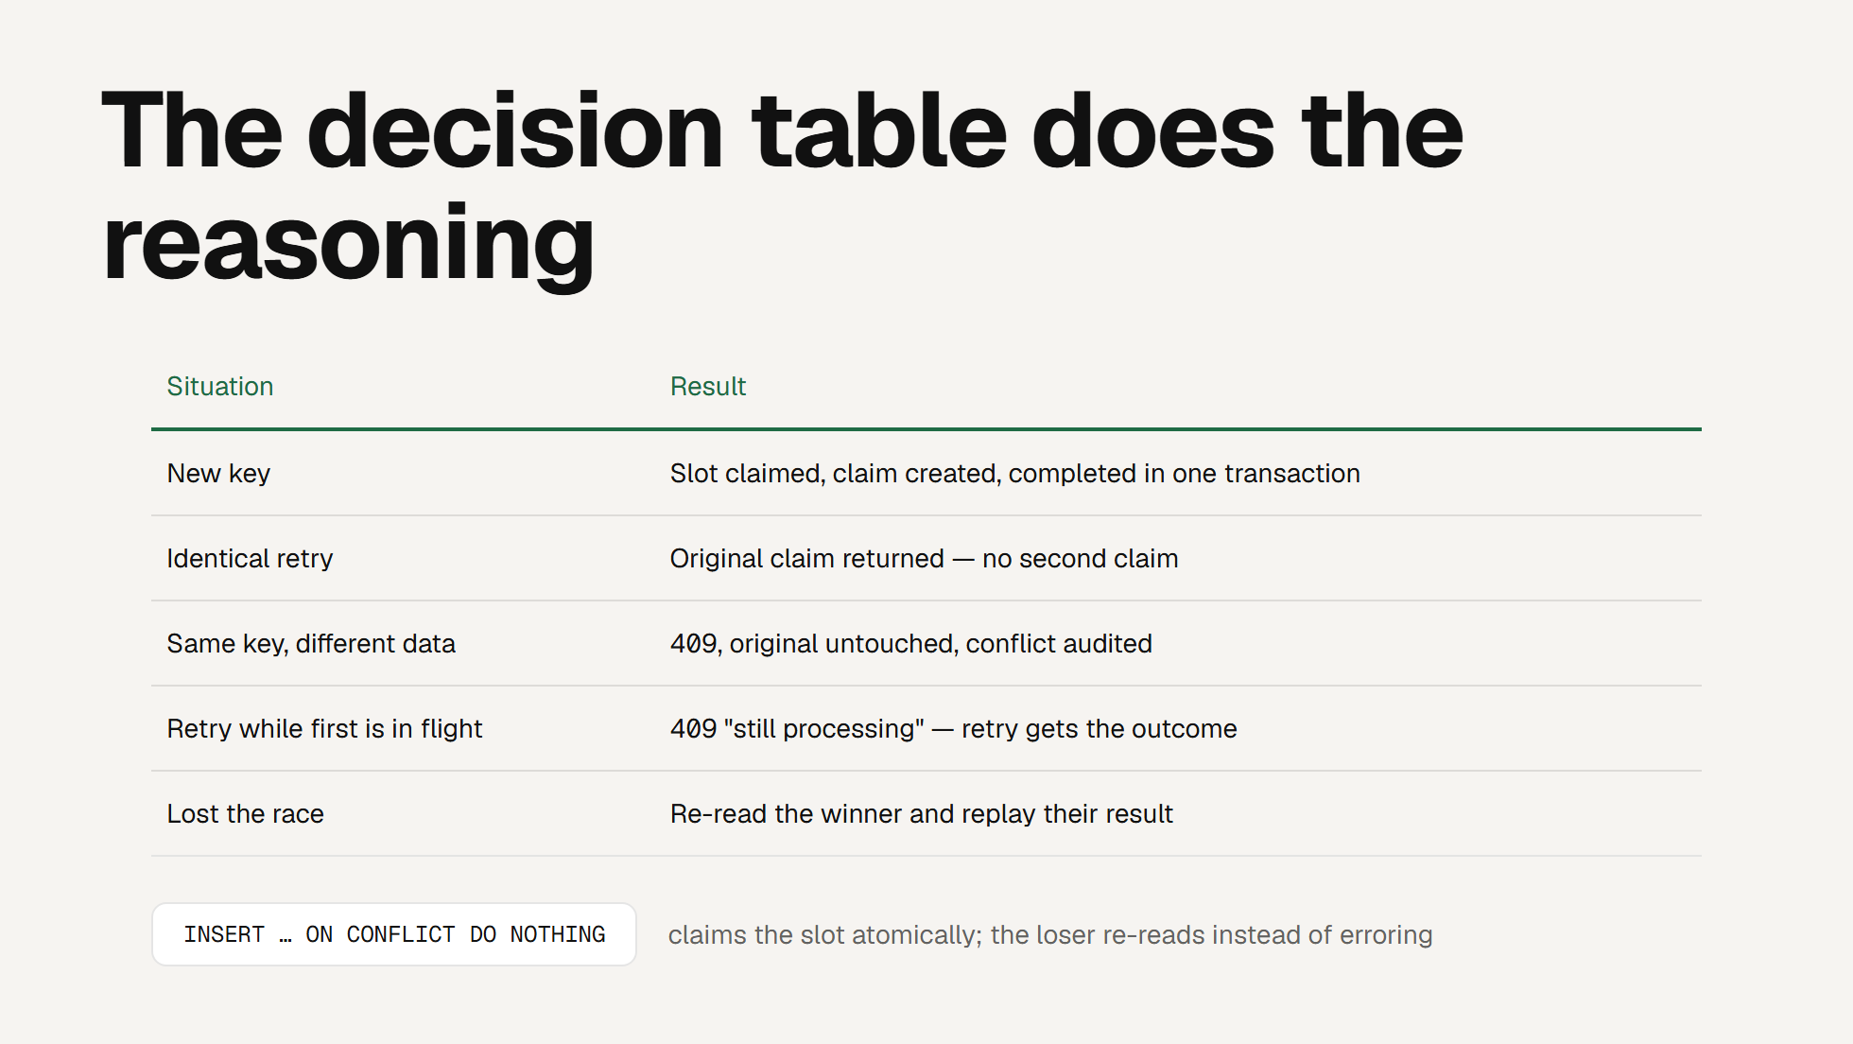
Notes:
DECISION TABLE
This table is the design - it's lifted straight from our ADR-0002. Each row
is a situation the claim path must survive, and the point is that every one
resolves to a defined, tested outcome. New key: everything commits in one
transaction - the slot, the claim and the audit row together. Identical
retry: you get the original claim back, no duplicate. Same key but different
data: that's a client bug, so we 409 and audit it rather than silently
doing the wrong thing. Retry while the first is still running: a 409 that
says "still processing", and the retry picks up the real outcome. And if two
requests race, exactly one wins the ON CONFLICT and the loser re-reads the
winner's result instead of throwing.
The bottom line is the mechanism: INSERT ... ON CONFLICT DO NOTHING claims
the slot atomically. No lock held across a request, no lost updates. This
is what "solving a design problem with a pattern" looks like in our system.

Slide 16
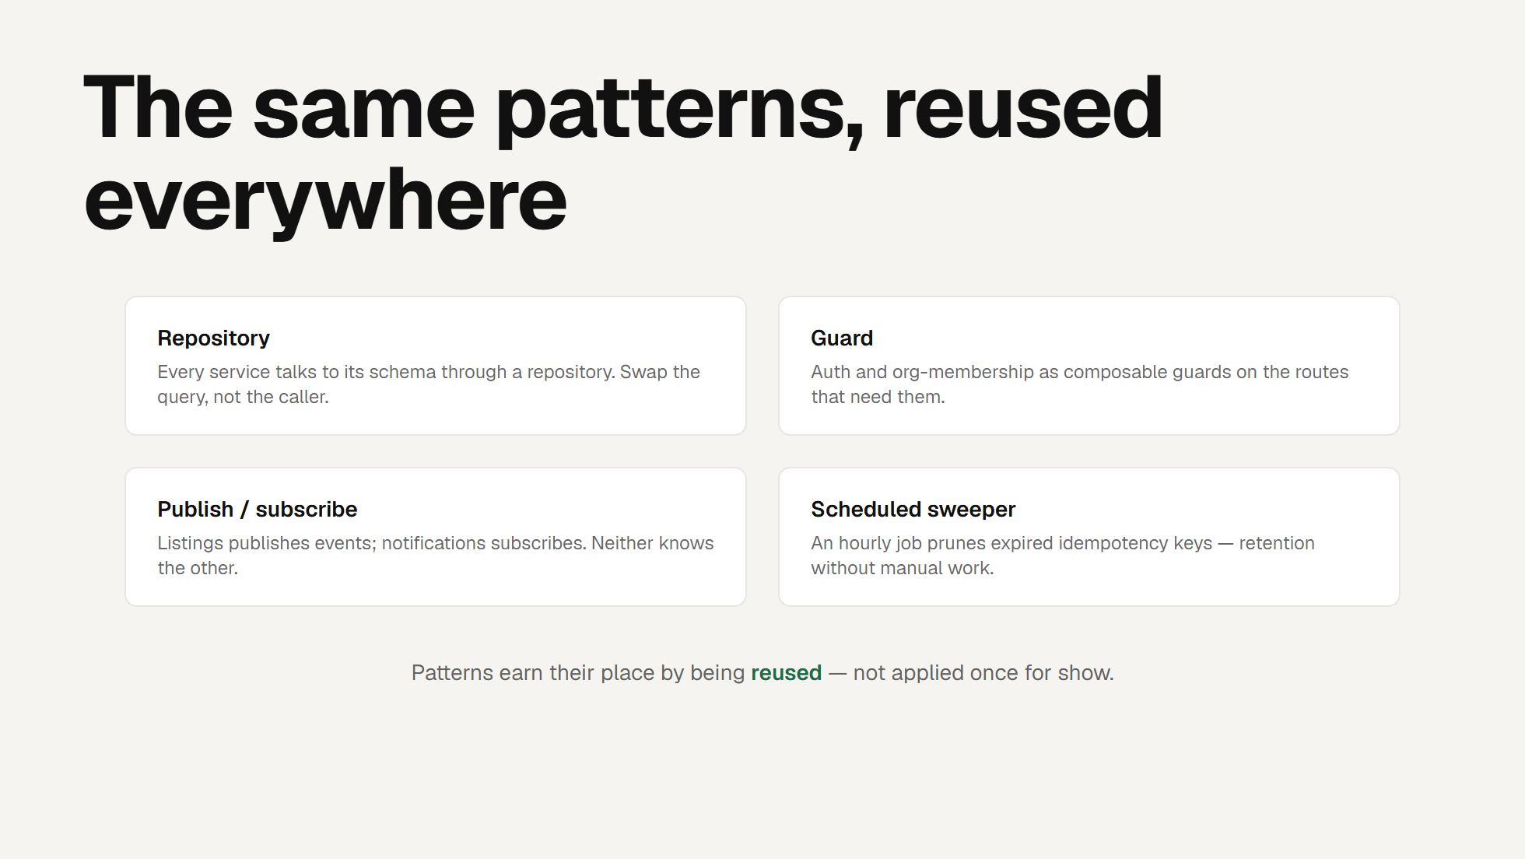
Notes:
PATTERNS REUSED
Design patterns count when they're reused, not name-dropped once. Four that
recur across the codebase. Repository: every service reaches its schema
through one, so we change a query without touching callers - that's our
extensibility story. Guard: authentication and org-membership are
composable guards dropped onto the routes that need them. Publish/subscribe:
listings publishes an event and notifications subscribes, and crucially
neither service knows the other exists - that's what let us add
notifications without touching the claim path. And a scheduled sweeper: an
hourly cron prunes expired idempotency keys, so retention is automatic.
The line at the bottom is the message for the graders: we applied patterns
where they solved a real problem and reused them, rather than sprinkling one
in to tick a box.

Slide 17
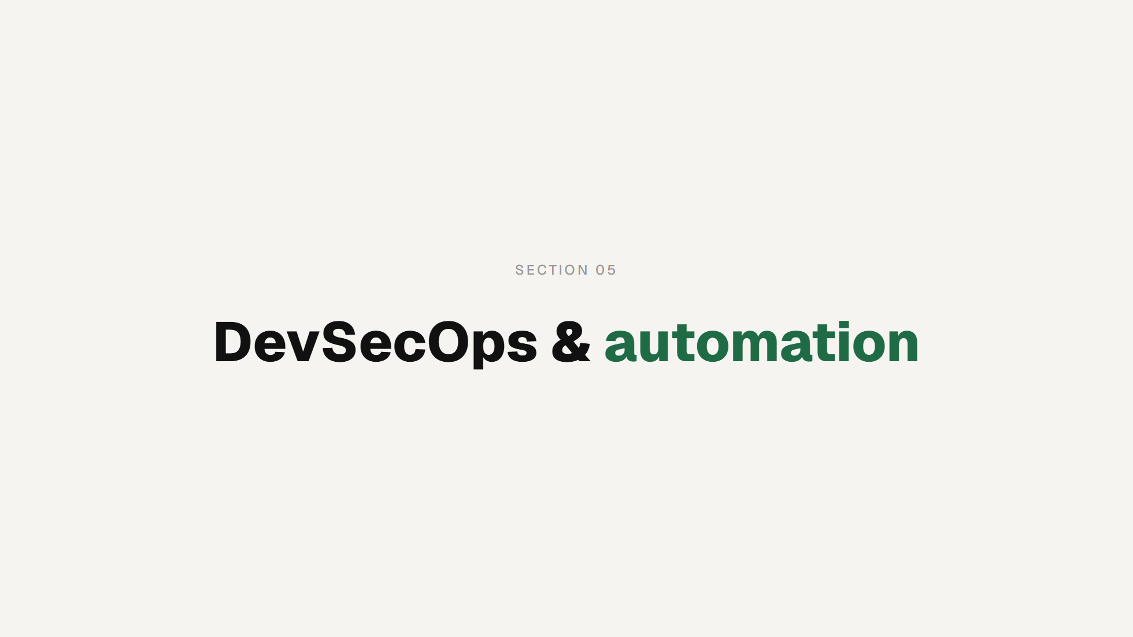
Notes:
SECTION MARKER

Slide 18
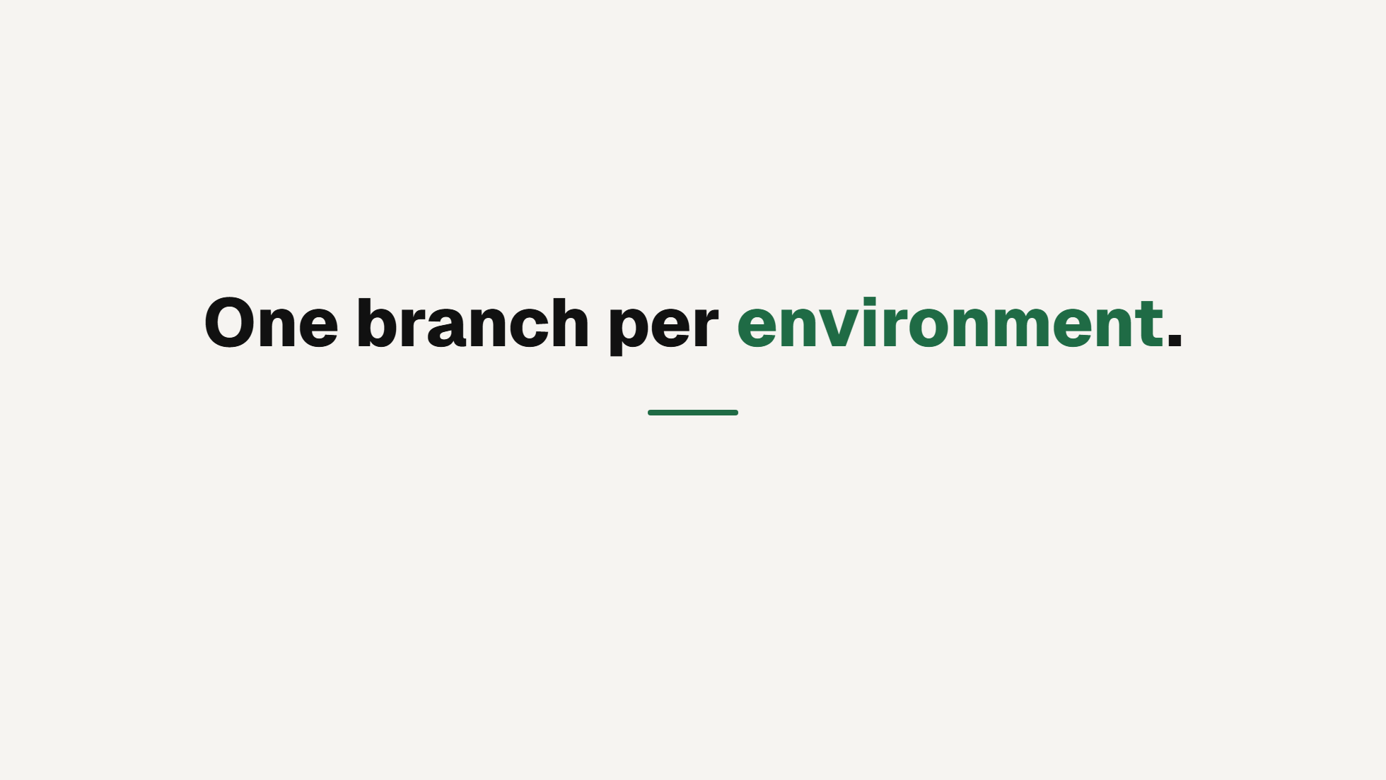
Notes:
THE RULE
Our whole delivery model follows from one sentence. We keep three
long-lived branches, and each owns exactly one deployed environment.
Click. That's the mental model. If you know which branch you're on, you
know what you're about to affect. There is no separate deploy procedure to
remember, because there isn't one.

Slide 19
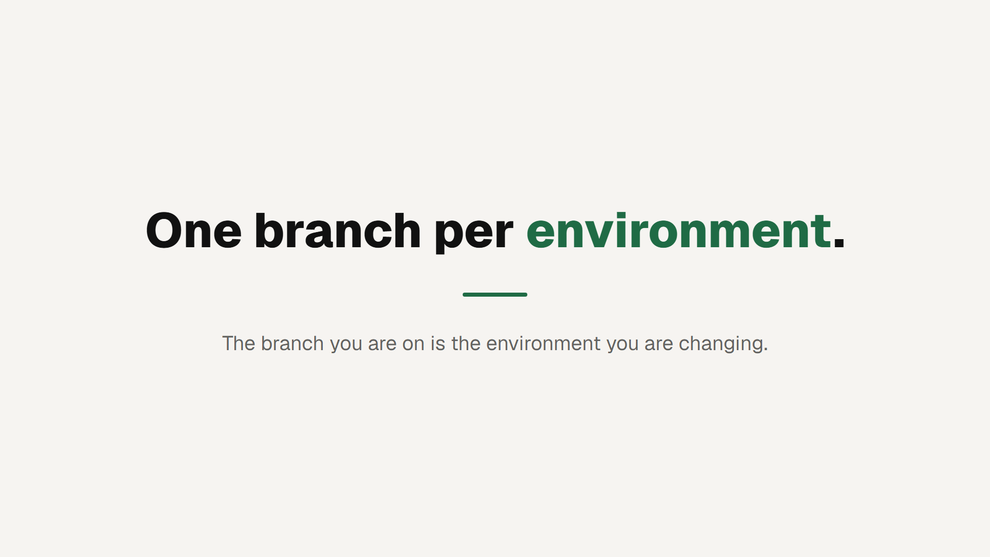
Notes:
THE RULE
Our whole delivery model follows from one sentence. We keep three
long-lived branches, and each owns exactly one deployed environment.
Click. That's the mental model. If you know which branch you're on, you
know what you're about to affect. There is no separate deploy procedure to
remember, because there isn't one.

Slide 20
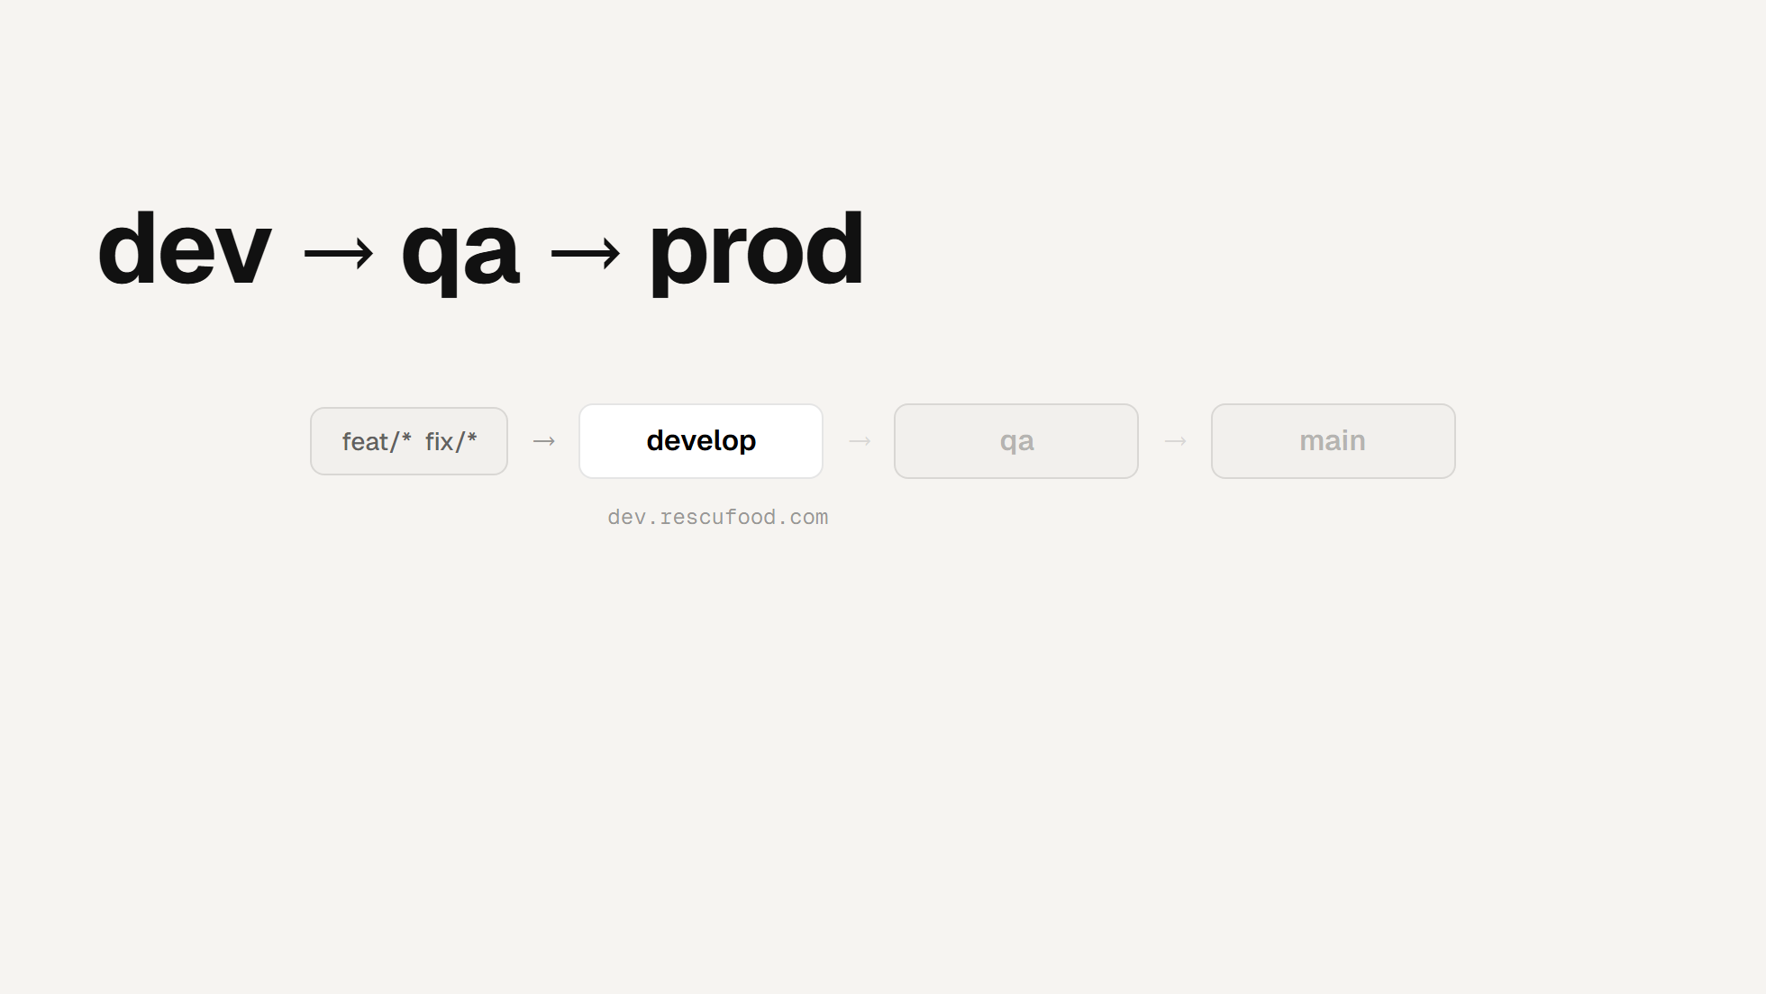
Notes:
THE PIPELINE
This is the branching strategy the brief asked us to make explicit. Work
starts on a feature or fix branch and merges into develop - the one place
day-to-day work lands. develop deploys to dev.rescufood.com.
Click. Promoting to qa is a merge from develop; it deploys qa.rescufood.com.
Nothing is rebuilt by hand, nothing cherry-picked.
Click. Promoting to prod is a merge from qa into main - same shape - and
main deploys rescufood.com. Three branches, three environments, one route
into each.
Click. Every arrow is a pull request that requires approval, so every
promotion between environments is reviewed.
Click. A promotion carries whatever accumulated since the last one - no
release branch assembled under pressure.
Click. Which makes that git diff the entire release note. If you want to
know what's about to ship to qa, you read that diff. Nothing else is
authoritative.

Slide 21
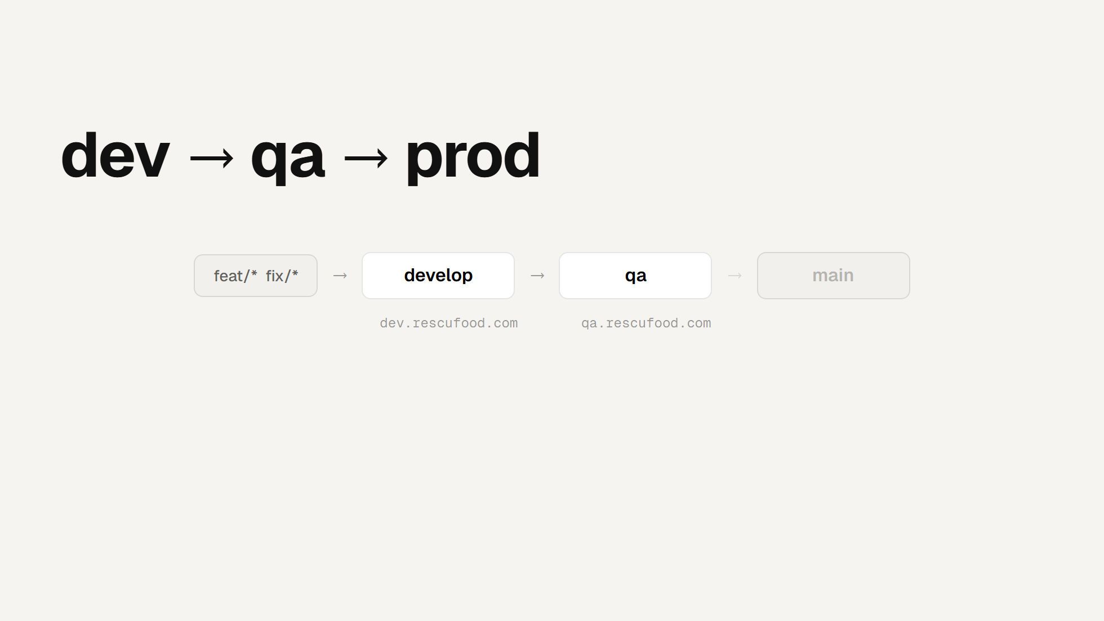
Notes:
THE PIPELINE
This is the branching strategy the brief asked us to make explicit. Work
starts on a feature or fix branch and merges into develop - the one place
day-to-day work lands. develop deploys to dev.rescufood.com.
Click. Promoting to qa is a merge from develop; it deploys qa.rescufood.com.
Nothing is rebuilt by hand, nothing cherry-picked.
Click. Promoting to prod is a merge from qa into main - same shape - and
main deploys rescufood.com. Three branches, three environments, one route
into each.
Click. Every arrow is a pull request that requires approval, so every
promotion between environments is reviewed.
Click. A promotion carries whatever accumulated since the last one - no
release branch assembled under pressure.
Click. Which makes that git diff the entire release note. If you want to
know what's about to ship to qa, you read that diff. Nothing else is
authoritative.

Slide 22
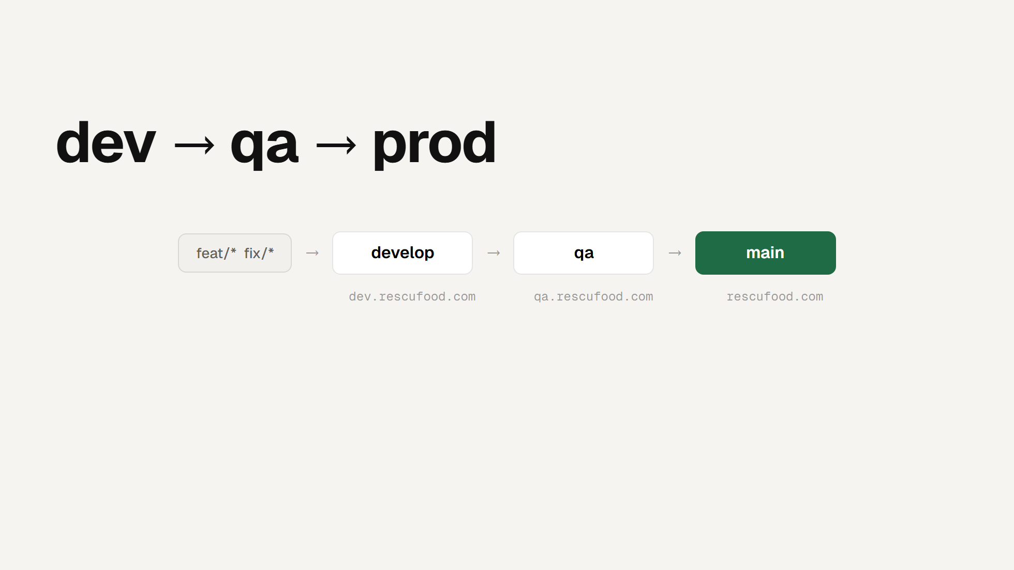
Notes:
THE PIPELINE
This is the branching strategy the brief asked us to make explicit. Work
starts on a feature or fix branch and merges into develop - the one place
day-to-day work lands. develop deploys to dev.rescufood.com.
Click. Promoting to qa is a merge from develop; it deploys qa.rescufood.com.
Nothing is rebuilt by hand, nothing cherry-picked.
Click. Promoting to prod is a merge from qa into main - same shape - and
main deploys rescufood.com. Three branches, three environments, one route
into each.
Click. Every arrow is a pull request that requires approval, so every
promotion between environments is reviewed.
Click. A promotion carries whatever accumulated since the last one - no
release branch assembled under pressure.
Click. Which makes that git diff the entire release note. If you want to
know what's about to ship to qa, you read that diff. Nothing else is
authoritative.

Slide 23
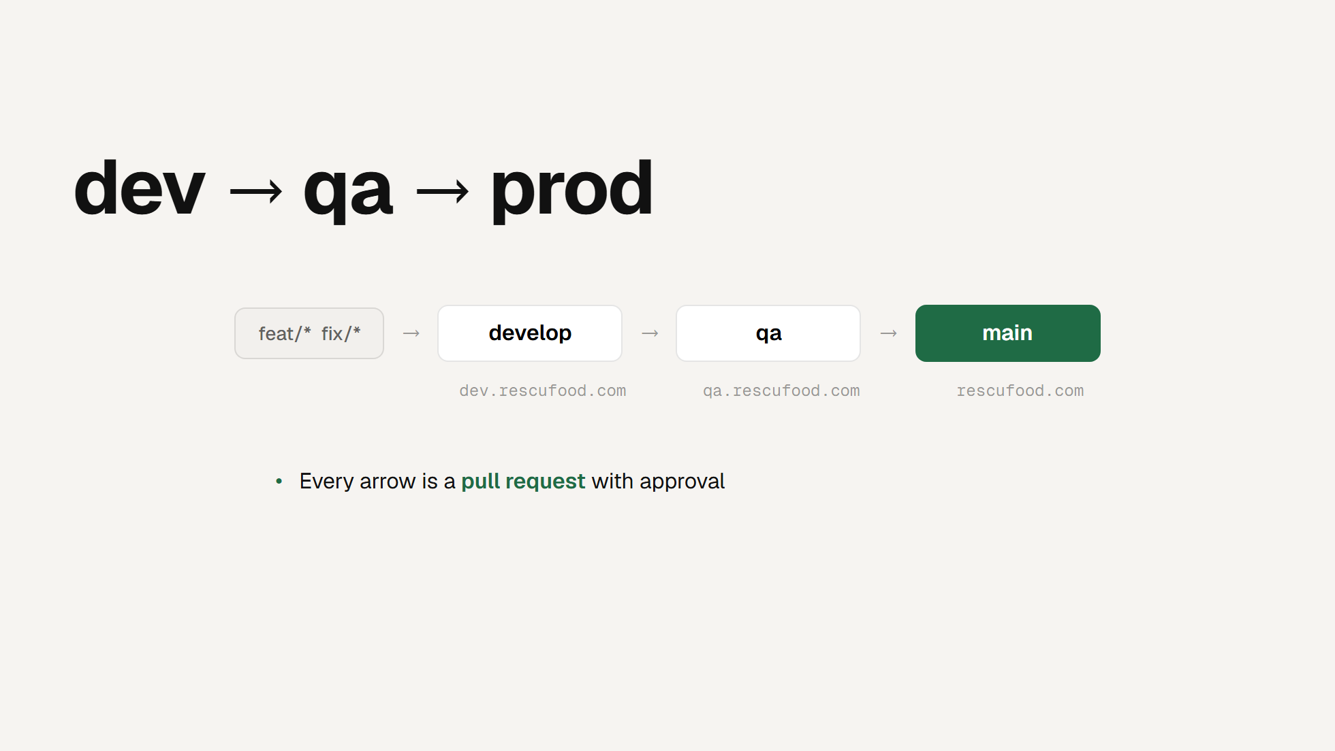
Notes:
THE PIPELINE
This is the branching strategy the brief asked us to make explicit. Work
starts on a feature or fix branch and merges into develop - the one place
day-to-day work lands. develop deploys to dev.rescufood.com.
Click. Promoting to qa is a merge from develop; it deploys qa.rescufood.com.
Nothing is rebuilt by hand, nothing cherry-picked.
Click. Promoting to prod is a merge from qa into main - same shape - and
main deploys rescufood.com. Three branches, three environments, one route
into each.
Click. Every arrow is a pull request that requires approval, so every
promotion between environments is reviewed.
Click. A promotion carries whatever accumulated since the last one - no
release branch assembled under pressure.
Click. Which makes that git diff the entire release note. If you want to
know what's about to ship to qa, you read that diff. Nothing else is
authoritative.

Slide 24
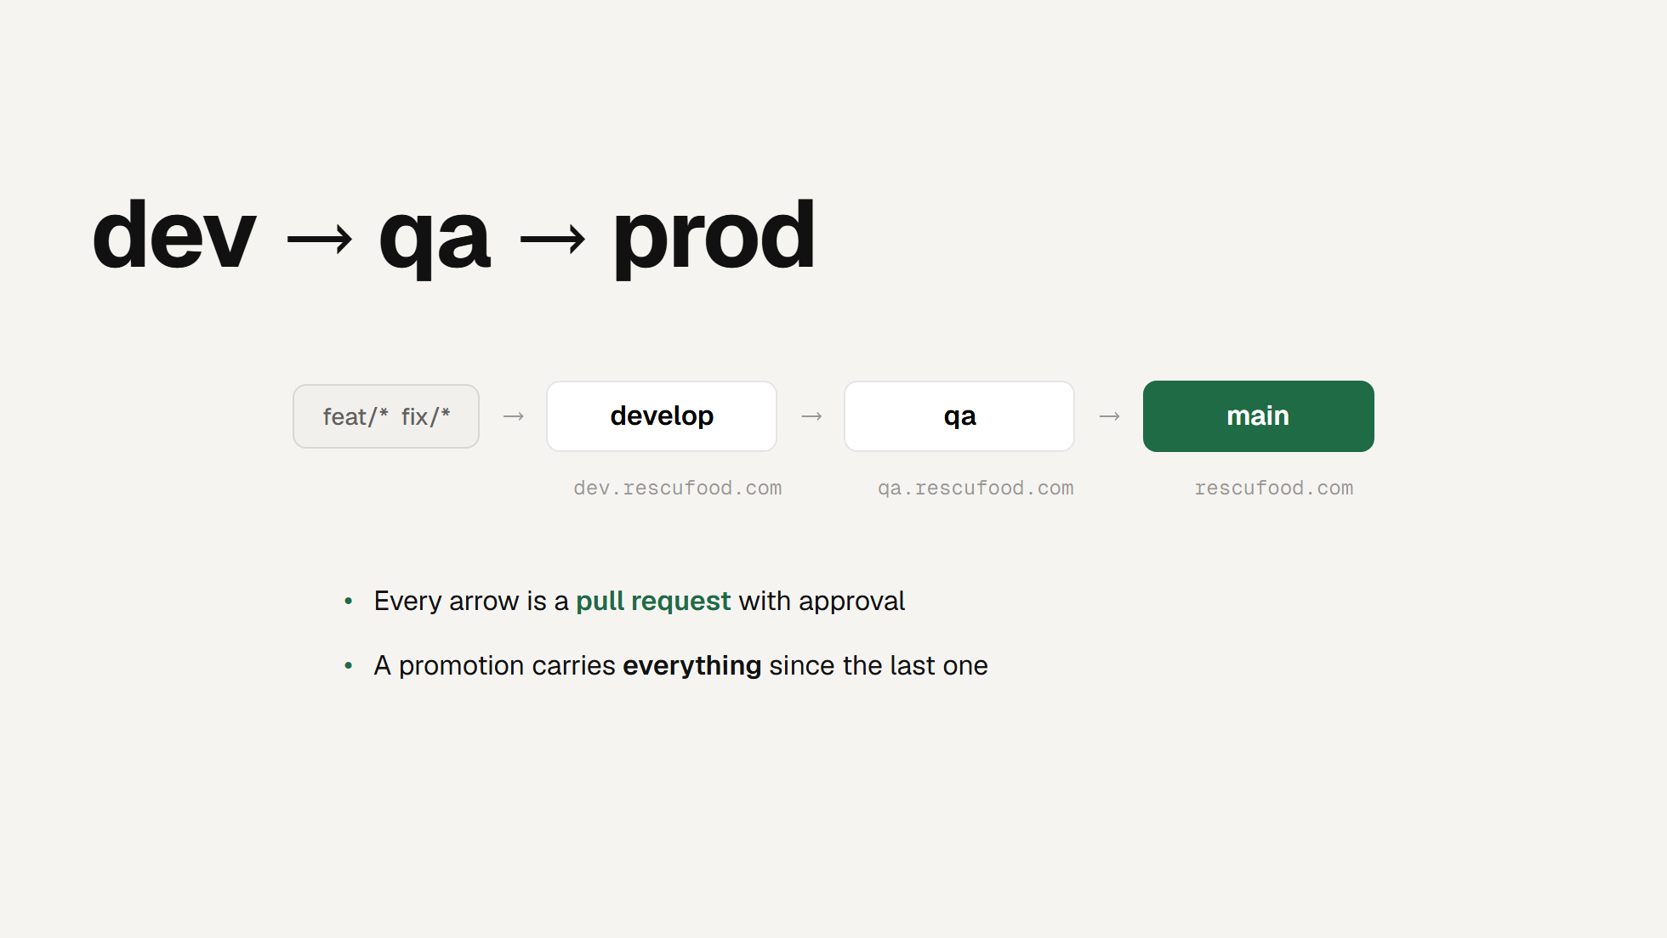
Notes:
THE PIPELINE
This is the branching strategy the brief asked us to make explicit. Work
starts on a feature or fix branch and merges into develop - the one place
day-to-day work lands. develop deploys to dev.rescufood.com.
Click. Promoting to qa is a merge from develop; it deploys qa.rescufood.com.
Nothing is rebuilt by hand, nothing cherry-picked.
Click. Promoting to prod is a merge from qa into main - same shape - and
main deploys rescufood.com. Three branches, three environments, one route
into each.
Click. Every arrow is a pull request that requires approval, so every
promotion between environments is reviewed.
Click. A promotion carries whatever accumulated since the last one - no
release branch assembled under pressure.
Click. Which makes that git diff the entire release note. If you want to
know what's about to ship to qa, you read that diff. Nothing else is
authoritative.

Slide 25
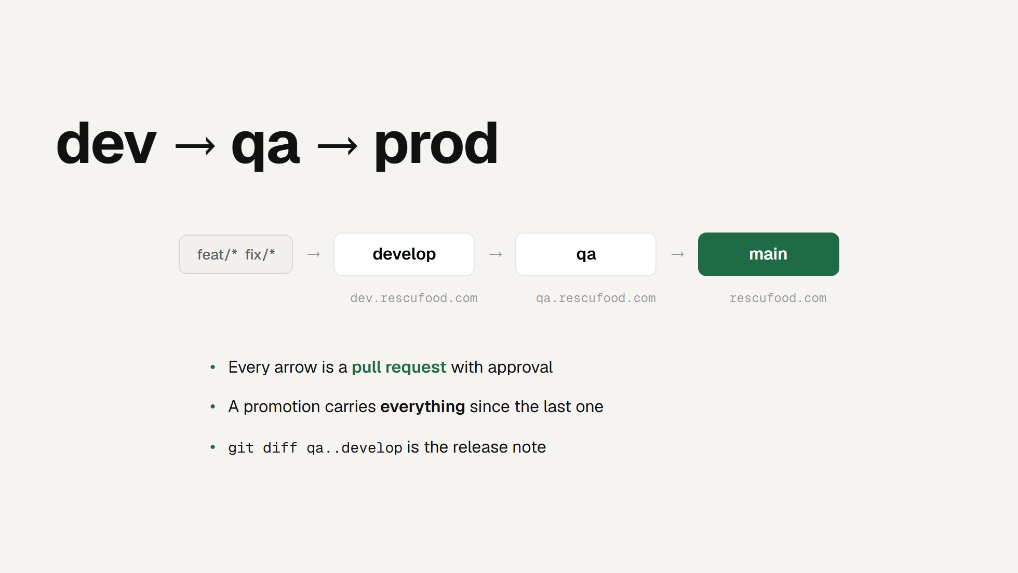
Notes:
THE PIPELINE
This is the branching strategy the brief asked us to make explicit. Work
starts on a feature or fix branch and merges into develop - the one place
day-to-day work lands. develop deploys to dev.rescufood.com.
Click. Promoting to qa is a merge from develop; it deploys qa.rescufood.com.
Nothing is rebuilt by hand, nothing cherry-picked.
Click. Promoting to prod is a merge from qa into main - same shape - and
main deploys rescufood.com. Three branches, three environments, one route
into each.
Click. Every arrow is a pull request that requires approval, so every
promotion between environments is reviewed.
Click. A promotion carries whatever accumulated since the last one - no
release branch assembled under pressure.
Click. Which makes that git diff the entire release note. If you want to
know what's about to ship to qa, you read that diff. Nothing else is
authoritative.

Slide 26
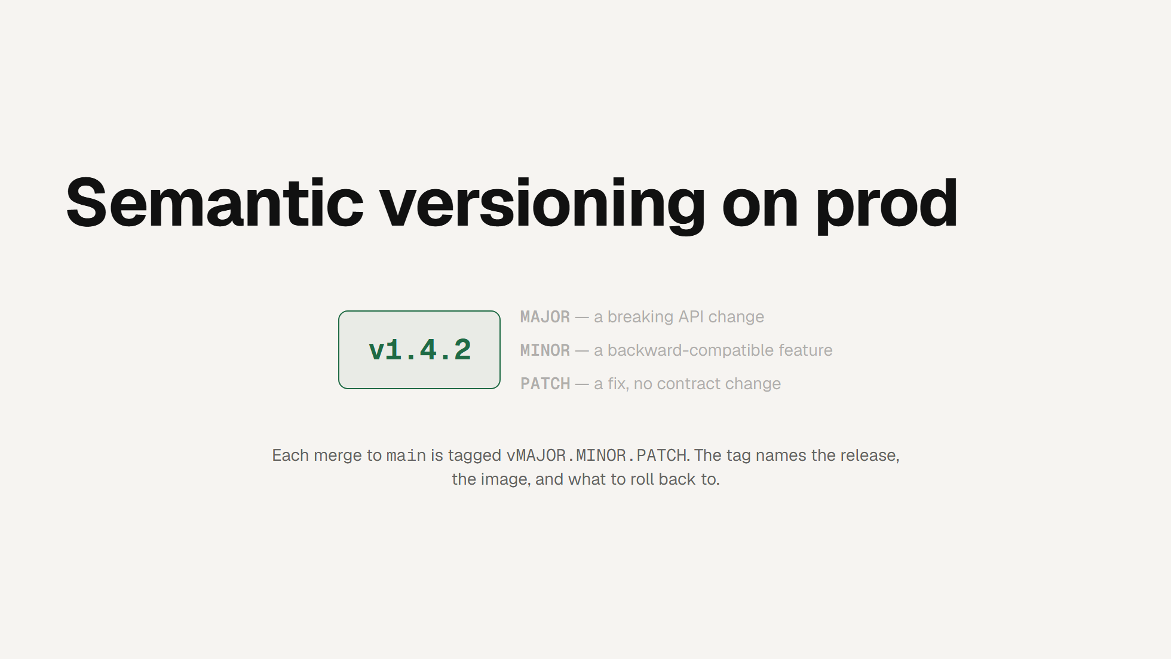
Notes:
SEMANTIC VERSIONING
Promotion tells you where code is; the version tells you what it is. Every
merge to main is tagged with a semantic version.
Click. MAJOR goes up on a breaking API change - anything that would force a
client to change.
Click. MINOR for a backward-compatible feature.
Click. PATCH for a fix that changes no contract.
The tag is the anchor for the release, the built image, and the rollback
target. If prod misbehaves, "roll back to v1.4.1" is unambiguous - no
guessing which commit was live. Versioning and the branch model answer two
different questions: which environment, and which release.

Slide 27

Notes:
SEMANTIC VERSIONING
Promotion tells you where code is; the version tells you what it is. Every
merge to main is tagged with a semantic version.
Click. MAJOR goes up on a breaking API change - anything that would force a
client to change.
Click. MINOR for a backward-compatible feature.
Click. PATCH for a fix that changes no contract.
The tag is the anchor for the release, the built image, and the rollback
target. If prod misbehaves, "roll back to v1.4.1" is unambiguous - no
guessing which commit was live. Versioning and the branch model answer two
different questions: which environment, and which release.

Slide 28
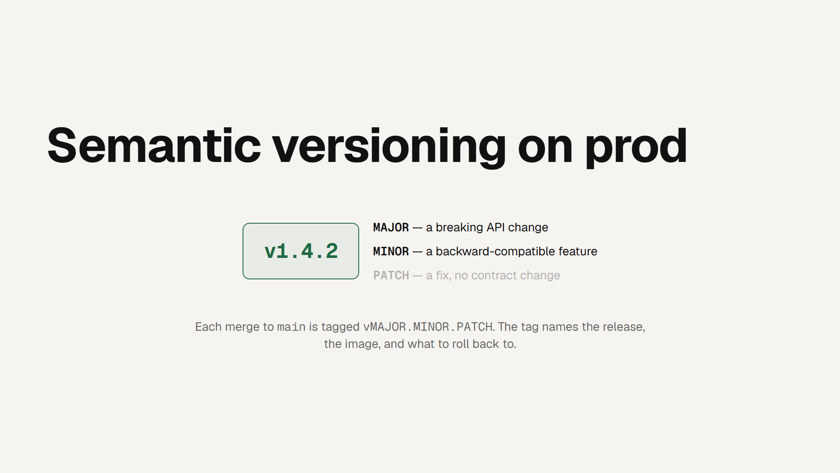
Notes:
SEMANTIC VERSIONING
Promotion tells you where code is; the version tells you what it is. Every
merge to main is tagged with a semantic version.
Click. MAJOR goes up on a breaking API change - anything that would force a
client to change.
Click. MINOR for a backward-compatible feature.
Click. PATCH for a fix that changes no contract.
The tag is the anchor for the release, the built image, and the rollback
target. If prod misbehaves, "roll back to v1.4.1" is unambiguous - no
guessing which commit was live. Versioning and the branch model answer two
different questions: which environment, and which release.

Slide 29
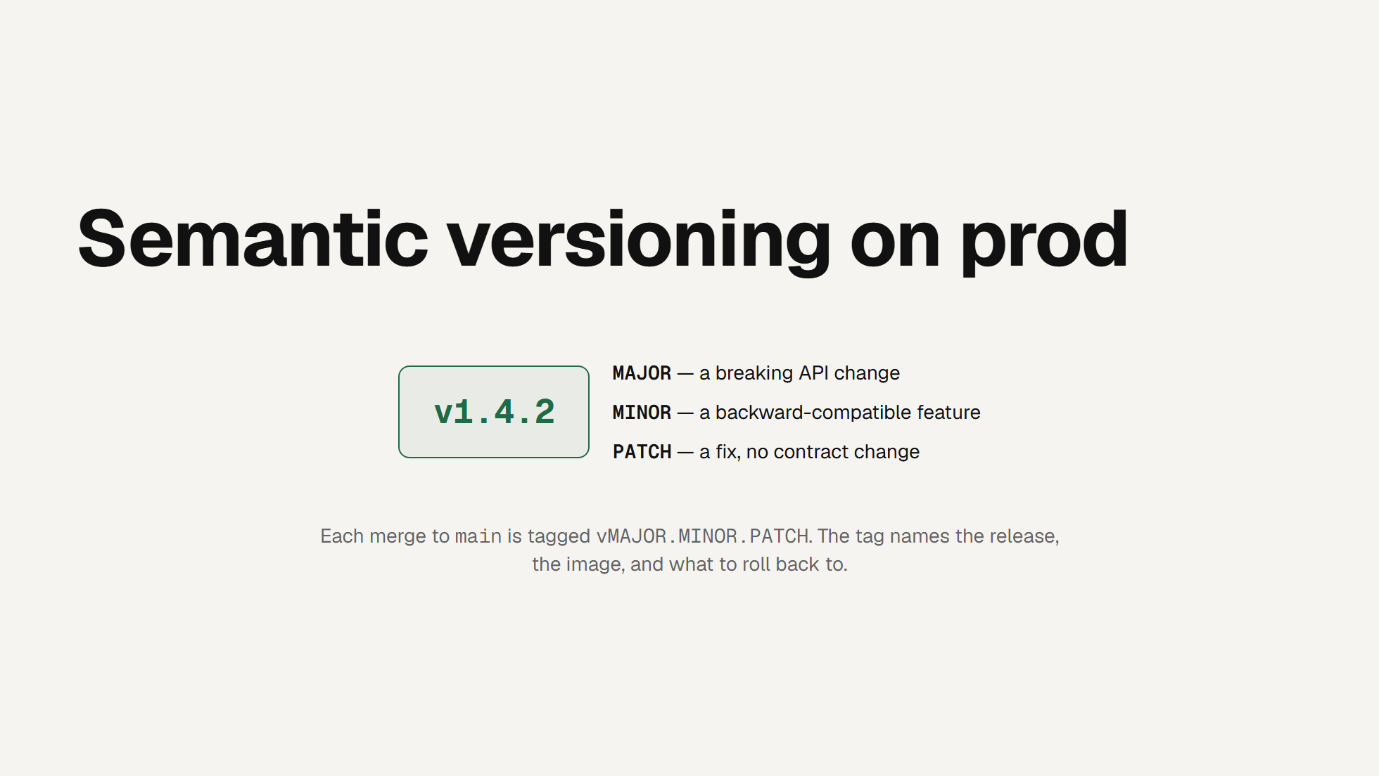
Notes:
SEMANTIC VERSIONING
Promotion tells you where code is; the version tells you what it is. Every
merge to main is tagged with a semantic version.
Click. MAJOR goes up on a breaking API change - anything that would force a
client to change.
Click. MINOR for a backward-compatible feature.
Click. PATCH for a fix that changes no contract.
The tag is the anchor for the release, the built image, and the rollback
target. If prod misbehaves, "roll back to v1.4.1" is unambiguous - no
guessing which commit was live. Versioning and the branch model answer two
different questions: which environment, and which release.

Slide 30
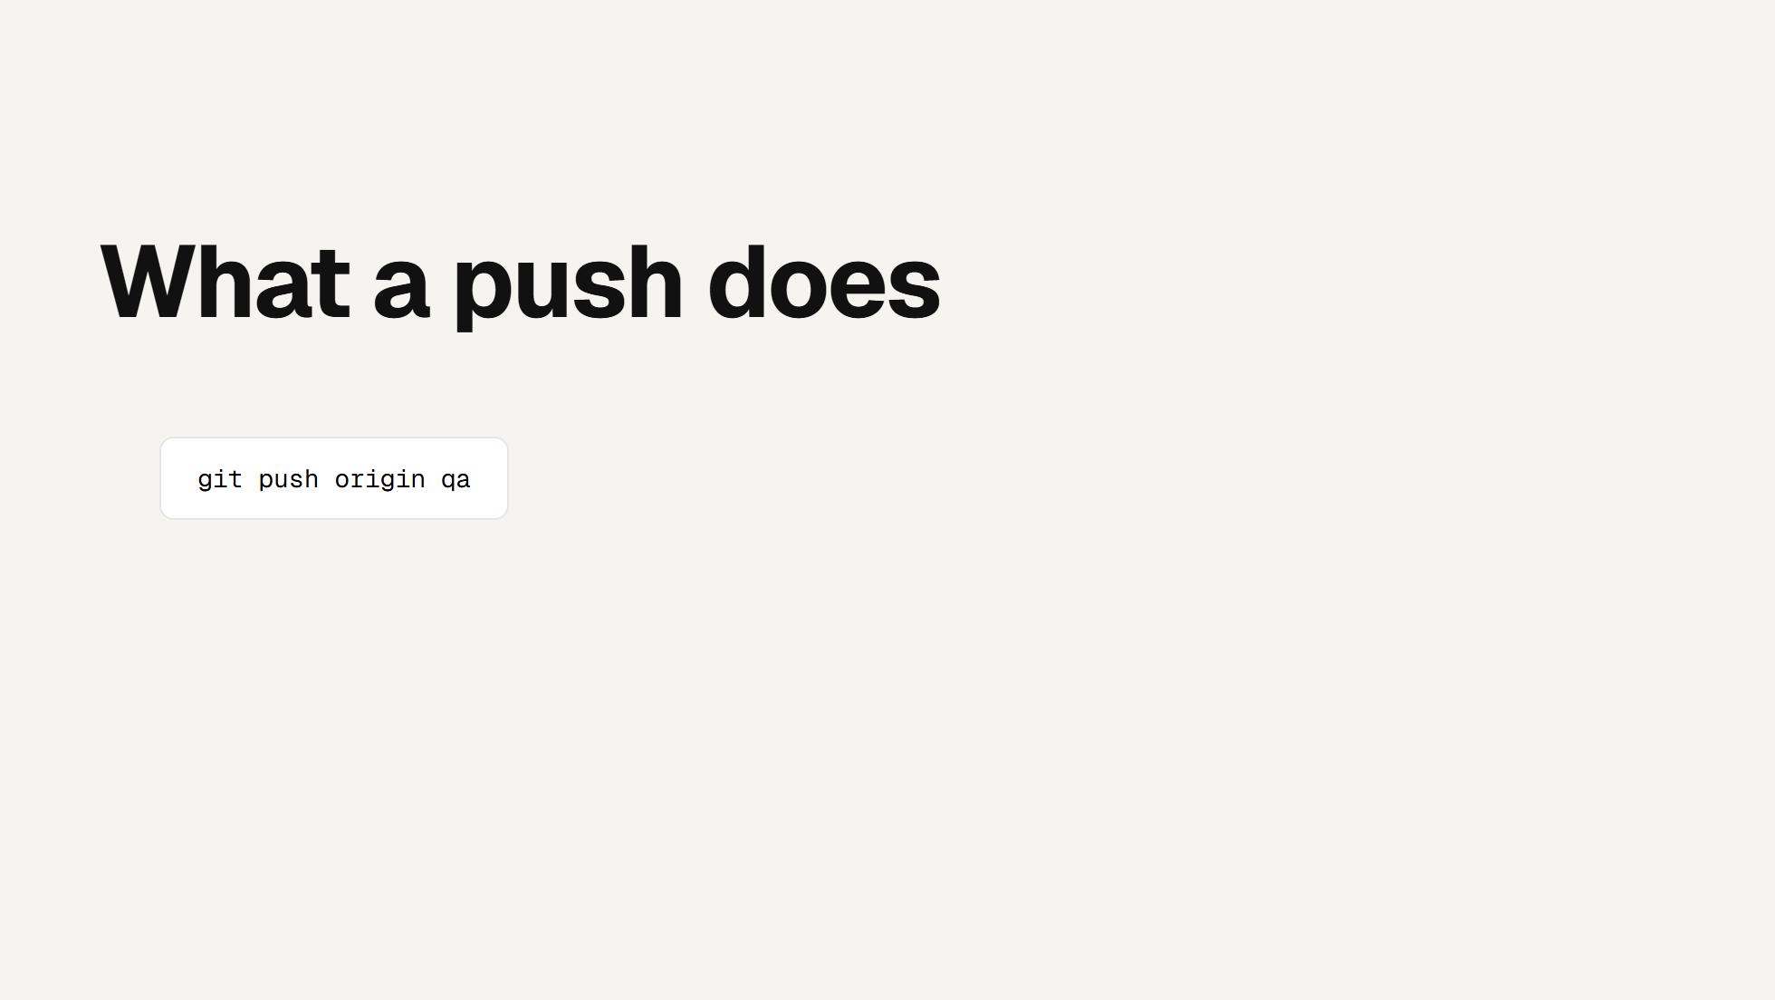
Notes:
WHAT A PUSH DOES
One push, three automatic consequences.
Click. Each service has a path filter, so a change under service/listings
rebuilds listings and nothing else - a one-line fix doesn't redeploy the
whole platform.
Click. The image is tagged for the environment, not the branch. Pushing to
main produces a prod tag, because the CloudFormation parameter files read
environment names - nobody has to remember that main means prod.
Click. The target cluster is derived from the branch inside the workflow.
There's no input to get wrong and no way for a qa push to touch prod; the
GitHub Environment resolves the same way, so credentials follow too.

Slide 31
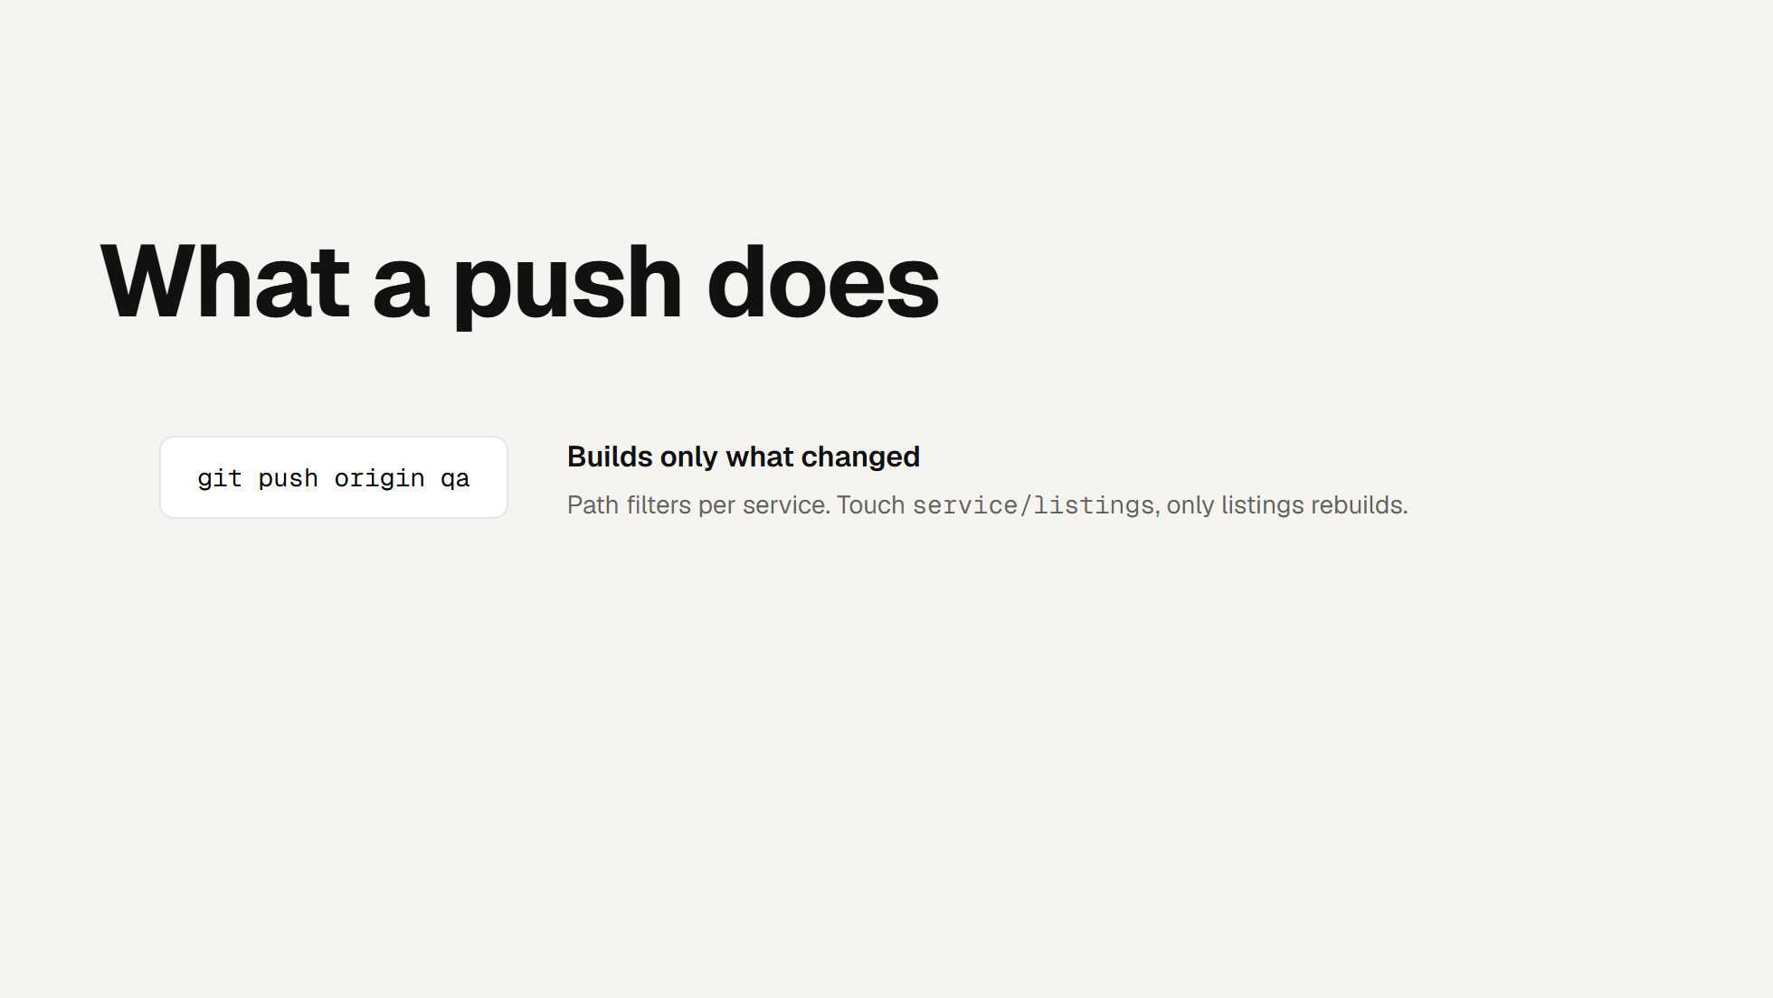
Notes:
WHAT A PUSH DOES
One push, three automatic consequences.
Click. Each service has a path filter, so a change under service/listings
rebuilds listings and nothing else - a one-line fix doesn't redeploy the
whole platform.
Click. The image is tagged for the environment, not the branch. Pushing to
main produces a prod tag, because the CloudFormation parameter files read
environment names - nobody has to remember that main means prod.
Click. The target cluster is derived from the branch inside the workflow.
There's no input to get wrong and no way for a qa push to touch prod; the
GitHub Environment resolves the same way, so credentials follow too.

Slide 32
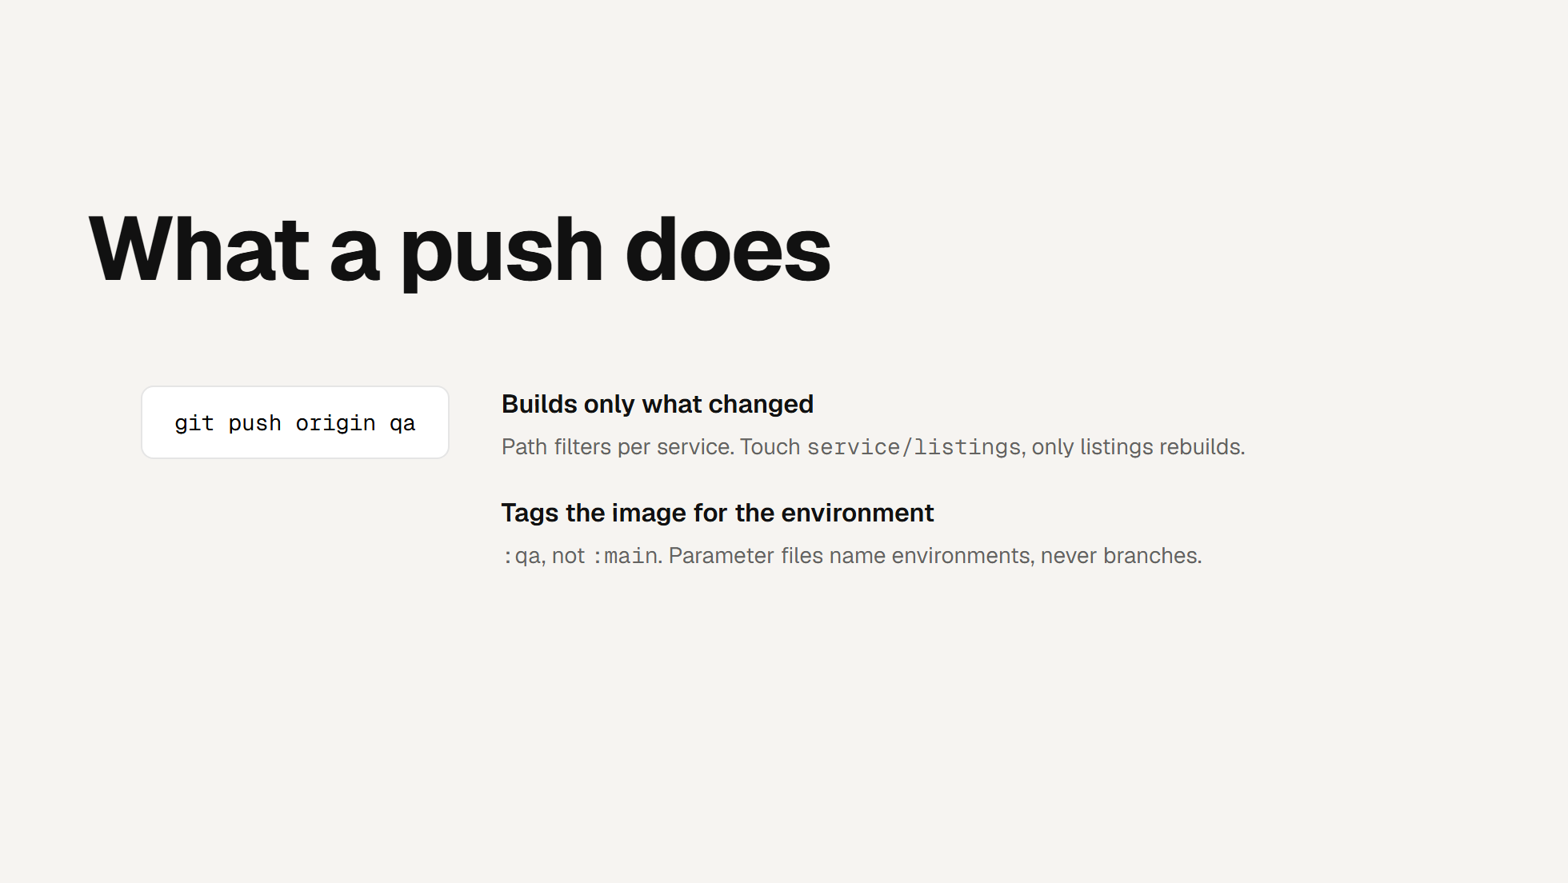
Notes:
WHAT A PUSH DOES
One push, three automatic consequences.
Click. Each service has a path filter, so a change under service/listings
rebuilds listings and nothing else - a one-line fix doesn't redeploy the
whole platform.
Click. The image is tagged for the environment, not the branch. Pushing to
main produces a prod tag, because the CloudFormation parameter files read
environment names - nobody has to remember that main means prod.
Click. The target cluster is derived from the branch inside the workflow.
There's no input to get wrong and no way for a qa push to touch prod; the
GitHub Environment resolves the same way, so credentials follow too.

Slide 33
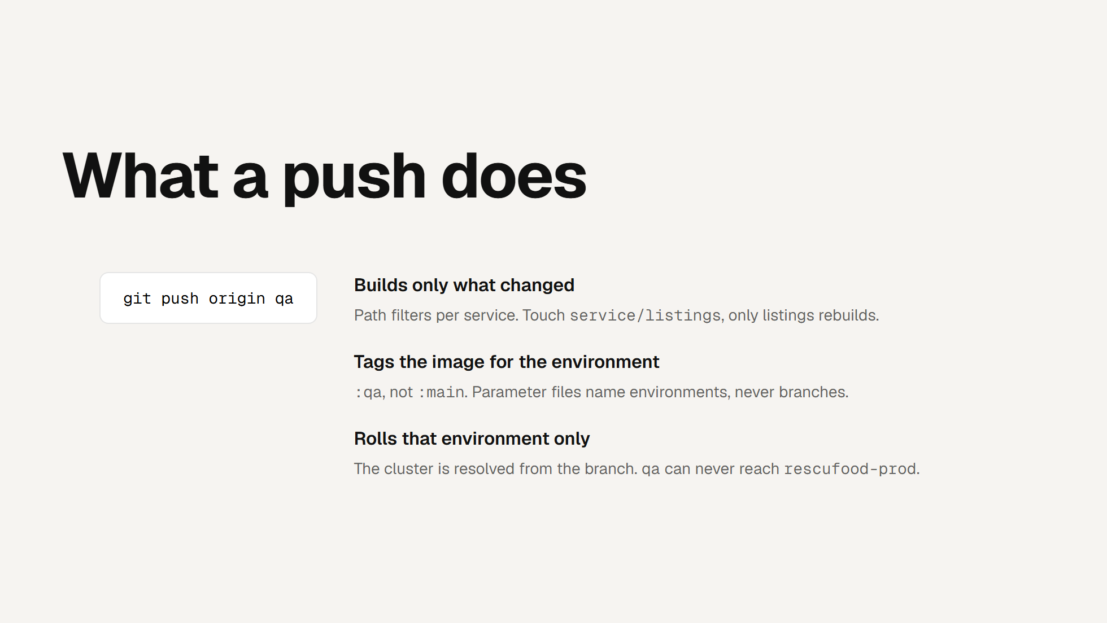
Notes:
WHAT A PUSH DOES
One push, three automatic consequences.
Click. Each service has a path filter, so a change under service/listings
rebuilds listings and nothing else - a one-line fix doesn't redeploy the
whole platform.
Click. The image is tagged for the environment, not the branch. Pushing to
main produces a prod tag, because the CloudFormation parameter files read
environment names - nobody has to remember that main means prod.
Click. The target cluster is derived from the branch inside the workflow.
There's no input to get wrong and no way for a qa push to touch prod; the
GitHub Environment resolves the same way, so credentials follow too.

Slide 34
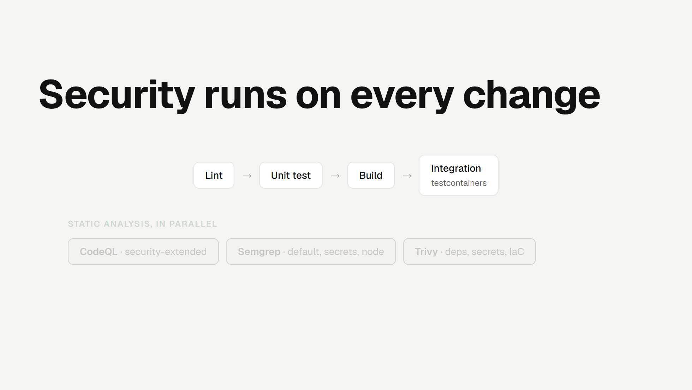
Notes:
SECURITY IN THE PIPELINE
This is the "Sec" in DevSecOps, and it's real, not a slide. Every PR runs
lint, unit tests, a build, and an integration suite - that last one spins
up a real Postgres with testcontainers, so we test against the actual
database, not a mock.
Click. In parallel, three static-analysis tools. CodeQL on the
security-extended query set. Semgrep with the default, secrets and Node
rule sets. Trivy scanning dependencies, secrets and infrastructure-as-code
misconfiguration. Three tools because they catch different things.
Click. Every finding uploads to GitHub code scanning as SARIF, so it shows
up right on the pull request - the reviewer sees security findings next to
the diff. We run report-only for now and will gate once the backlog is
triaged; that's a deliberate call, not an oversight.
Click. And promoting to qa additionally runs the Playwright end-to-end
suite against the deployed environment - a green qa is evidence the real
site works, not just that a local build passed.

Slide 35
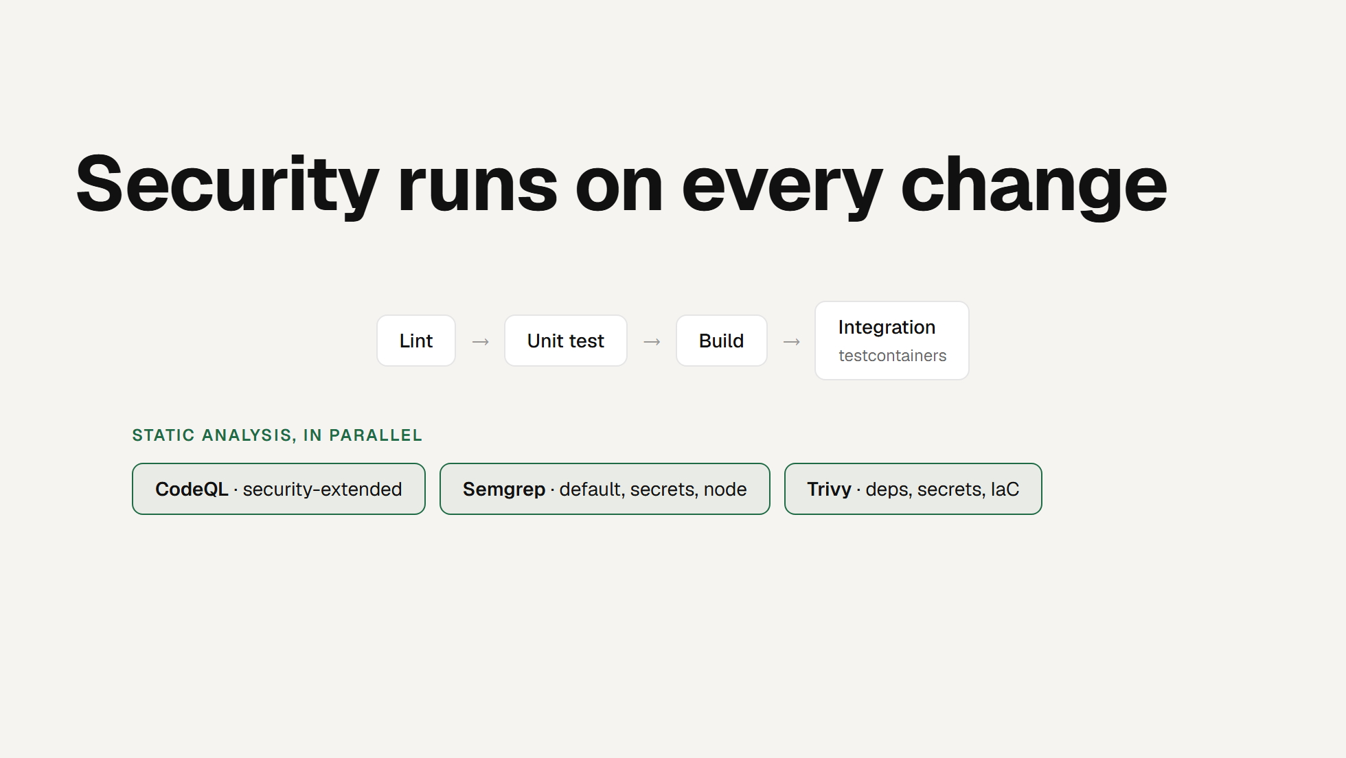
Notes:
SECURITY IN THE PIPELINE
This is the "Sec" in DevSecOps, and it's real, not a slide. Every PR runs
lint, unit tests, a build, and an integration suite - that last one spins
up a real Postgres with testcontainers, so we test against the actual
database, not a mock.
Click. In parallel, three static-analysis tools. CodeQL on the
security-extended query set. Semgrep with the default, secrets and Node
rule sets. Trivy scanning dependencies, secrets and infrastructure-as-code
misconfiguration. Three tools because they catch different things.
Click. Every finding uploads to GitHub code scanning as SARIF, so it shows
up right on the pull request - the reviewer sees security findings next to
the diff. We run report-only for now and will gate once the backlog is
triaged; that's a deliberate call, not an oversight.
Click. And promoting to qa additionally runs the Playwright end-to-end
suite against the deployed environment - a green qa is evidence the real
site works, not just that a local build passed.

Slide 36

Notes:
SECURITY IN THE PIPELINE
This is the "Sec" in DevSecOps, and it's real, not a slide. Every PR runs
lint, unit tests, a build, and an integration suite - that last one spins
up a real Postgres with testcontainers, so we test against the actual
database, not a mock.
Click. In parallel, three static-analysis tools. CodeQL on the
security-extended query set. Semgrep with the default, secrets and Node
rule sets. Trivy scanning dependencies, secrets and infrastructure-as-code
misconfiguration. Three tools because they catch different things.
Click. Every finding uploads to GitHub code scanning as SARIF, so it shows
up right on the pull request - the reviewer sees security findings next to
the diff. We run report-only for now and will gate once the backlog is
triaged; that's a deliberate call, not an oversight.
Click. And promoting to qa additionally runs the Playwright end-to-end
suite against the deployed environment - a green qa is evidence the real
site works, not just that a local build passed.

Slide 37
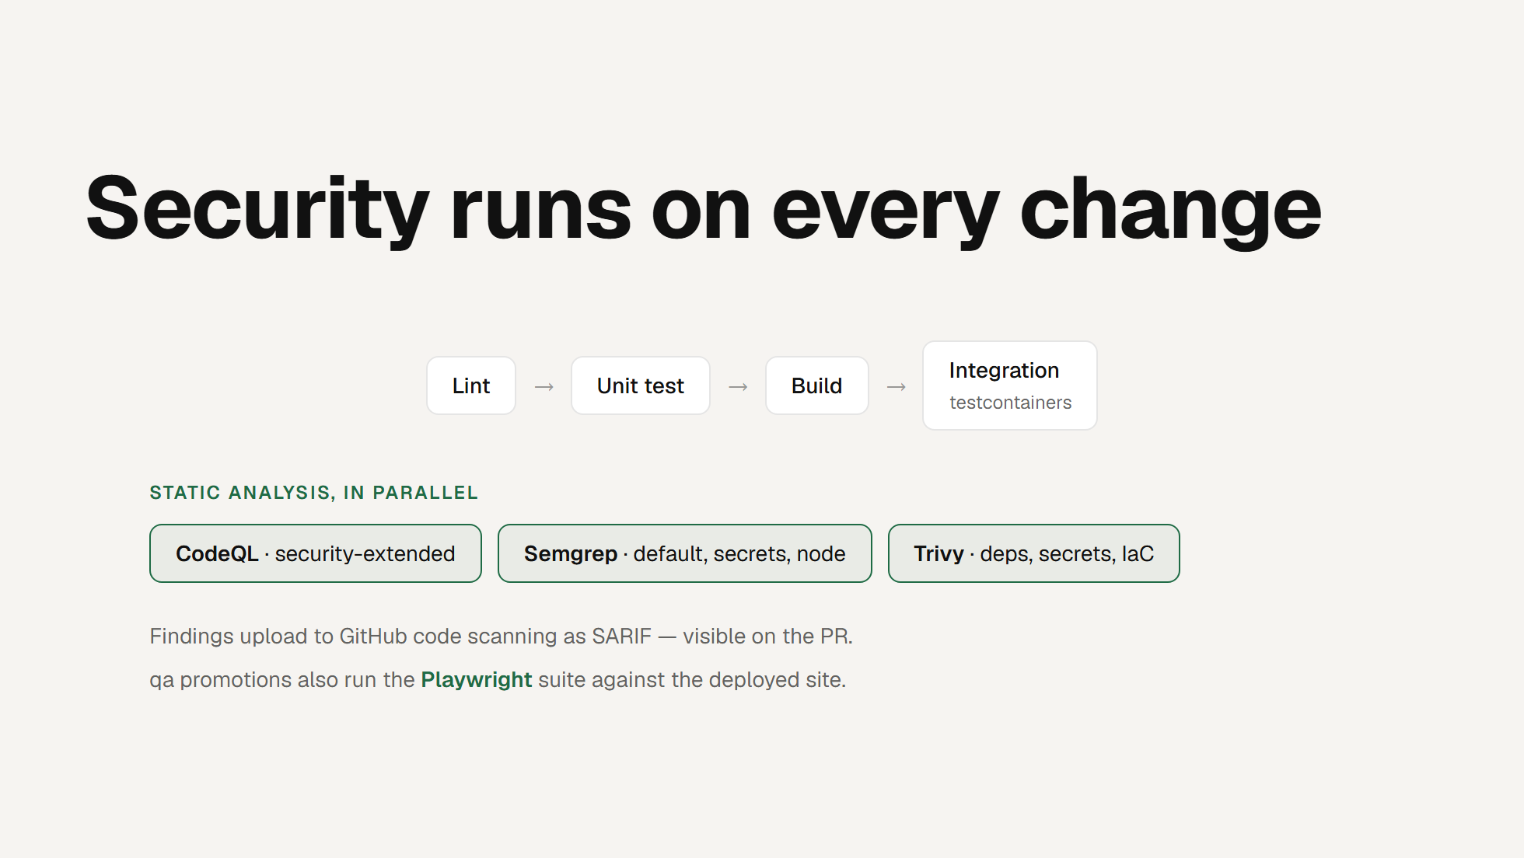
Notes:
SECURITY IN THE PIPELINE
This is the "Sec" in DevSecOps, and it's real, not a slide. Every PR runs
lint, unit tests, a build, and an integration suite - that last one spins
up a real Postgres with testcontainers, so we test against the actual
database, not a mock.
Click. In parallel, three static-analysis tools. CodeQL on the
security-extended query set. Semgrep with the default, secrets and Node
rule sets. Trivy scanning dependencies, secrets and infrastructure-as-code
misconfiguration. Three tools because they catch different things.
Click. Every finding uploads to GitHub code scanning as SARIF, so it shows
up right on the pull request - the reviewer sees security findings next to
the diff. We run report-only for now and will gate once the backlog is
triaged; that's a deliberate call, not an oversight.
Click. And promoting to qa additionally runs the Playwright end-to-end
suite against the deployed environment - a green qa is evidence the real
site works, not just that a local build passed.

Slide 38
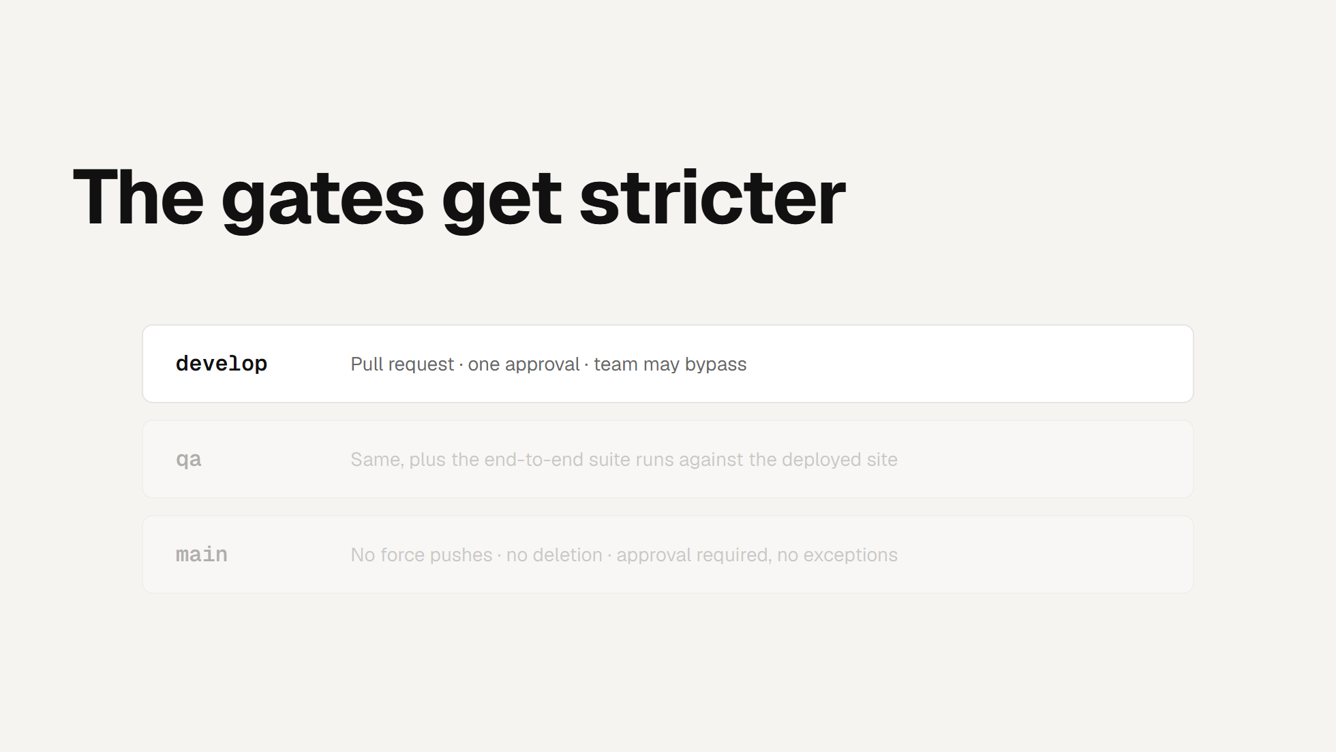
Notes:
THE GATES
Same rule set on all three branches, tightened as you move right. Deletion
and force pushes are blocked everywhere.
Click. qa adds the real signal - the Playwright suite runs against the
deployed environment after every promotion, not against a local build. A
green qa is evidence, not a hope.
Click. main is the one branch with no bypass. Prod can't be force-pushed
and can't be merged without a review, including of the author's own change.
If that feels inconvenient, that's the point.
Worth saying out loud: we learned this the hard way. A change that passed
typecheck, lint and build still took dev down. The environment in front of
prod is what caught the second attempt - which is exactly why the approval
flow tightens as the blast radius grows.

Slide 39
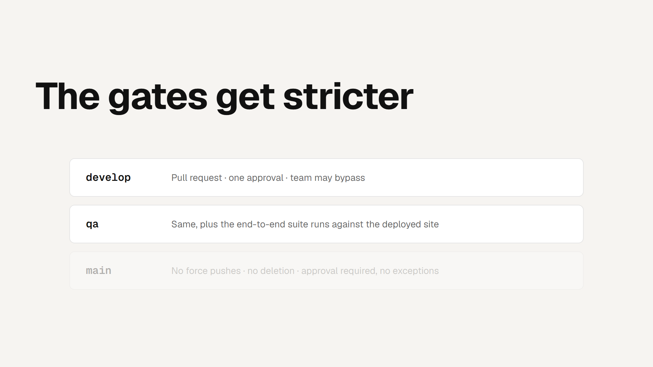
Notes:
THE GATES
Same rule set on all three branches, tightened as you move right. Deletion
and force pushes are blocked everywhere.
Click. qa adds the real signal - the Playwright suite runs against the
deployed environment after every promotion, not against a local build. A
green qa is evidence, not a hope.
Click. main is the one branch with no bypass. Prod can't be force-pushed
and can't be merged without a review, including of the author's own change.
If that feels inconvenient, that's the point.
Worth saying out loud: we learned this the hard way. A change that passed
typecheck, lint and build still took dev down. The environment in front of
prod is what caught the second attempt - which is exactly why the approval
flow tightens as the blast radius grows.

Slide 40
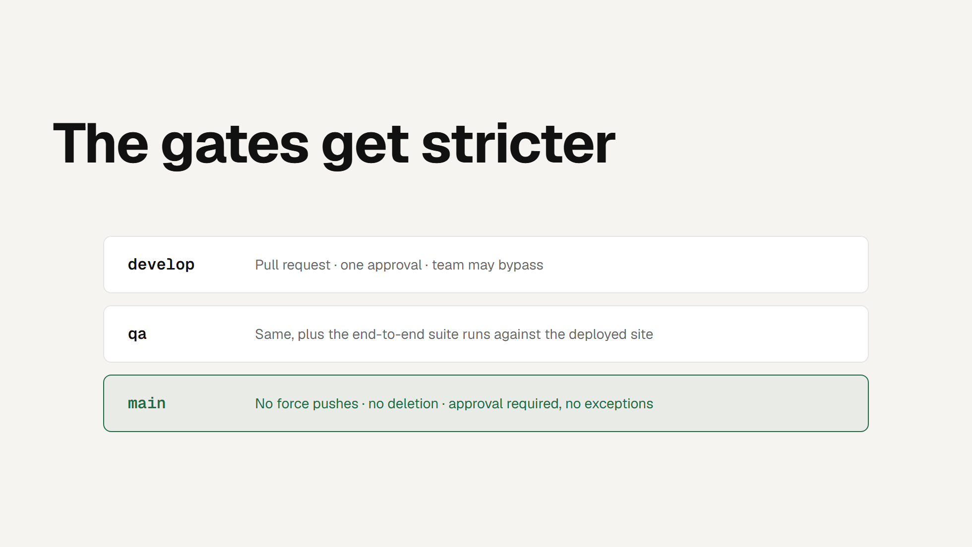
Notes:
THE GATES
Same rule set on all three branches, tightened as you move right. Deletion
and force pushes are blocked everywhere.
Click. qa adds the real signal - the Playwright suite runs against the
deployed environment after every promotion, not against a local build. A
green qa is evidence, not a hope.
Click. main is the one branch with no bypass. Prod can't be force-pushed
and can't be merged without a review, including of the author's own change.
If that feels inconvenient, that's the point.
Worth saying out loud: we learned this the hard way. A change that passed
typecheck, lint and build still took dev down. The environment in front of
prod is what caught the second attempt - which is exactly why the approval
flow tightens as the blast radius grows.

Slide 41
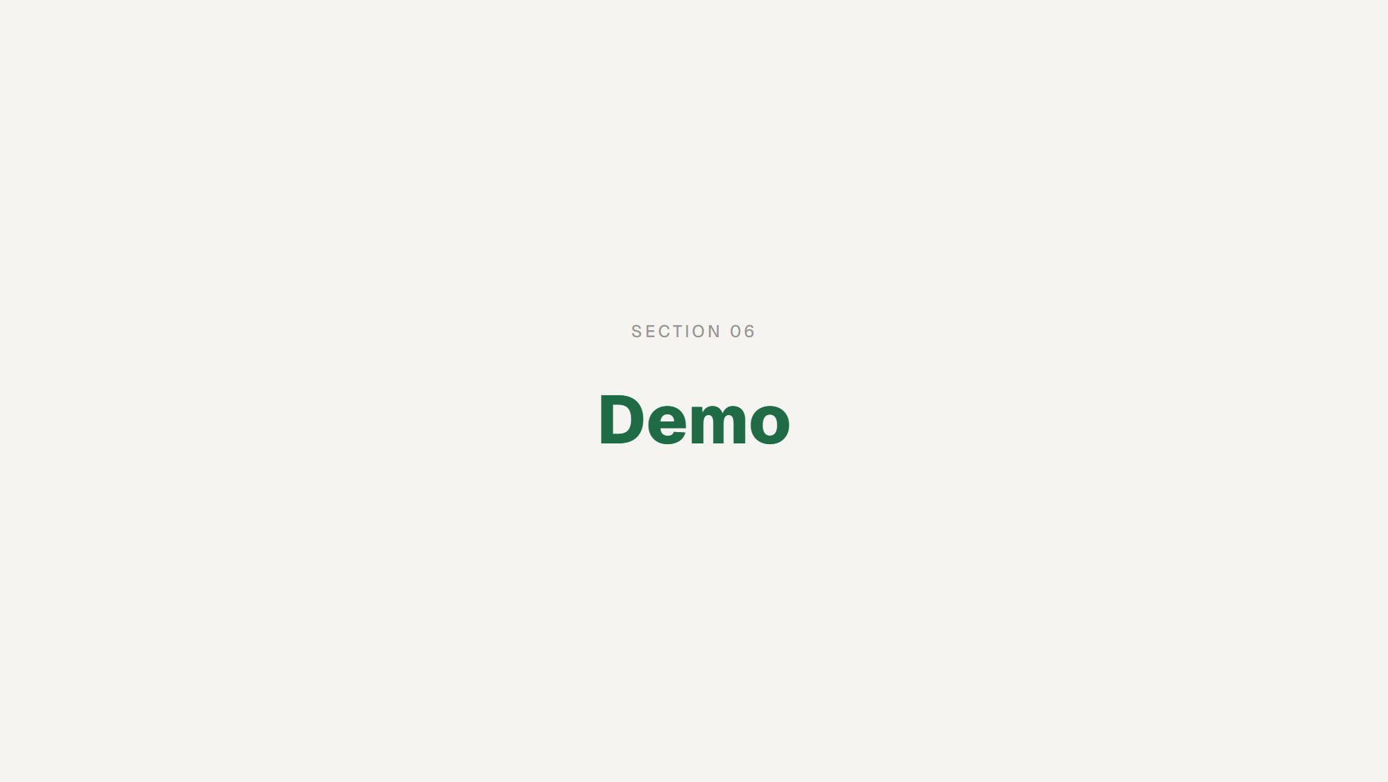
Notes:
SECTION MARKER
Switch to the live environment now. Have qa.rescufood.com open and logged
in on two browser profiles (a donor and a rescue partner) before you get
here, so there's no fumbling.

Slide 42
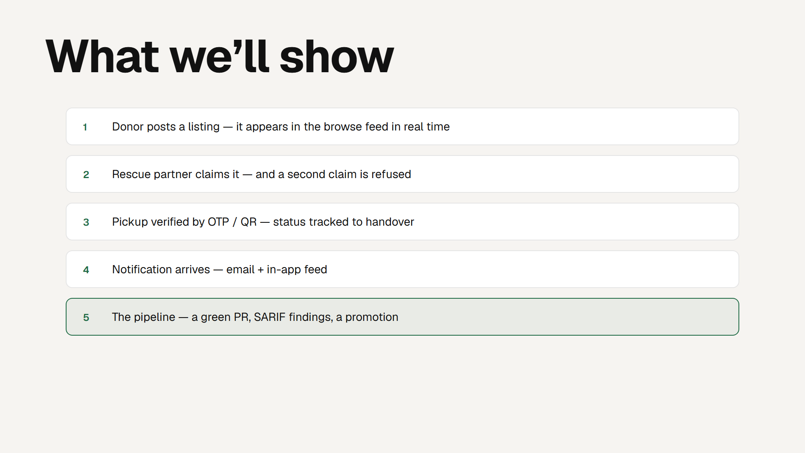
Notes:
DEMO SCRIPT
Narrate the running system, don't read this list. Drive the core loop on
qa: donor posts, the listing shows up live in the partner's feed. Partner
claims it - then try to claim from the second browser and show the refusal.
That refusal is the idempotency and unique-index work from section 4 doing
its job in front of them; call that back explicitly.
Then verify pickup with the OTP or QR code and show the status advance, and
show the notification landing both as email and in the in-app feed - that's
the pub/sub path.
Finish on the pipeline: open a real pull request, show a green check, show
the SARIF security findings attached to the PR, and show a promotion. Tie
it back - this is the same pipeline every one of our changes went through.
Keep a screen recording ready as a fallback if the network misbehaves.

Slide 43
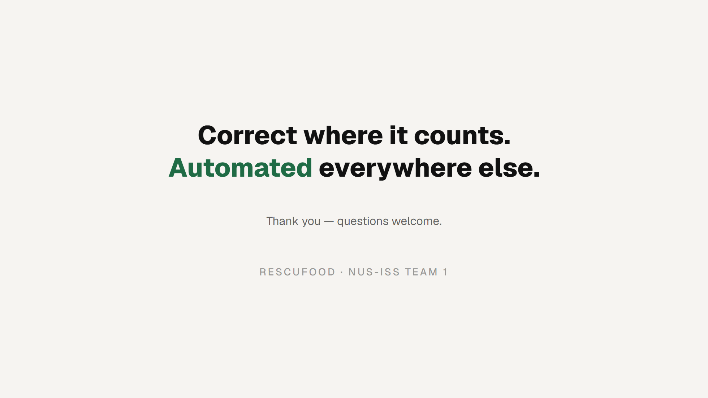
Notes:
CLOSE
Land the two ideas the deck was built around. Where correctness mattered -
the claim - we pushed the invariant down into the database and designed the
retry behaviour deliberately. Everywhere else, we automated: one route into
each environment, security on every change, versioned releases. Then open
the floor. If Q&A time was folded into sections, invite any remaining
questions here.

