Slide 1

“Beyond” the PhD thesis
Prof. Abhik Roychoudhury
National University of Singapore
abhik@nus.edu.sg
https://abhikrc.com

Slide 2





VIEW
OF PhD
Process
Outcome
Skills
Mindset

Slide 3




Attributes of PhD
PhD
Develops a Mindset
(on the way)
Requires / grows skills
(as result)
Pleasant Outcomes
(on the way)
There is a process
I … (good PhD)
I … (excellent PhD)
I … (secret ingredient)

Slide 4
Things cannot change in 1 day
Commensurate with a
process oriented view.
Learn
Focus
Articulate
Fish model of PhD
4

Slide 5
OBVIOUS
SKILLS
Reading a paper (state-of-the-art) and quickly judging a contribution
Compare the contributions of each paper
Chart the growth of a research area
Identify emerging research trends
Involves pro-actively looking outside, and doing so analytically
Learn
Focus
Articulate
Fish model of PhD
5

Slide 6
Initiative & Interest
FIRST
ATTRIBUTE
Learn
Focus
Articulate
NUS Outstanding Grad Mentor Public Lecture, 2025

Slide 7
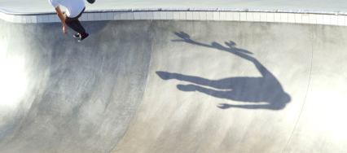
LESS
OBVIOUS SKILLS
Choosing the right problems at the right time
Choosing from a known set of problems
Why will it be impactful if you study it now?
What technical skills and background are needed, AND
Why you are the right person right now to tackle this problem?
Looking inside yourself: reflection
7

Slide 8
Introspection & Intuition
SECOND
ATTRIBUTE
Looking inside
Learn
Focus
Articulate

Slide 9

LEAST
OBVIOUS SKILLS
Develop clarity about research contribution
Research paper, degree, x number of citations??
Contribution is how we progress the field
It is Qualitative in nature, as opposed to quantitative
Making space for others to contribute
Beyond high quality problem solving
9

Slide 10
GO BEYOND
“HOT” TOPICS
A “hot” topic in 2025 may not be so in 2030.
“
”
If you see a bandwagon, it’s too late.
PhD length
1995
Internet!
2000
Lot of
Networking PhDs
Go beyond hot areas
Go beyond technical contributions
Conceptual contributions chart directions
Help create hot areas from cool ones, using??
10

Slide 11
CONTRIBUTIONS
& ATTRIBUTES
Contributions
Attributes
“Utilitarian” Contribution
Technical Contribution
Conceptual Contribution
Initiative & Interest
Introspection & Intuition
Imagination
11

Slide 12



MENTORING: ENCOURAGING
SUCH ATTRIBUTES
< <
Papers < Placement < Discussions
Output < Outcome < Experience
But, how to achieve it?
Supervision
<<
Advising

Slide 13
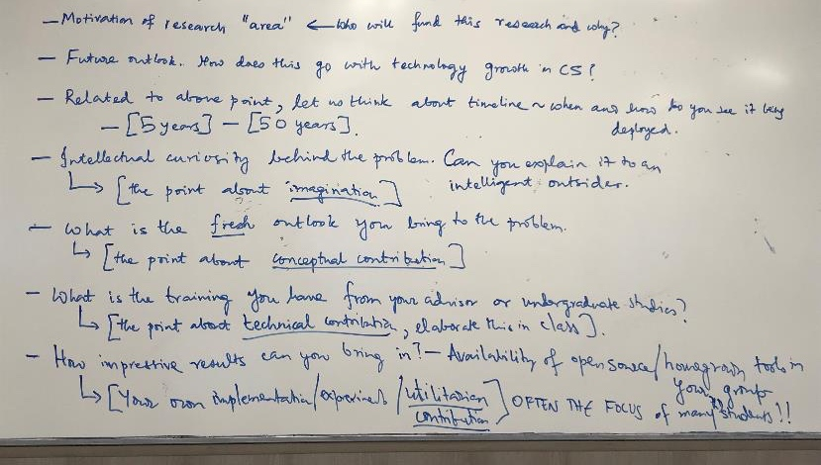
2.
DISCUSSION BLAST
FROM PAST ~10 YR AGO
13

Slide 14
3 case studies
Optane / SalesForce / Thinking Machines Corp
Novelty of research – cutting edge
Usability of product – fitting into workflows
Movement on market needs – discussion on agents
Details of competition – pricing you out
Unit price – set properly from your end – pricing model
Investment needed to build in stages – and available investors.

