Slide 1

“Beyond” the PhD Thesis
Prof. Abhik Roychoudhury
National University of Singapore
abhik@nus.edu.sg
https://abhikrc.com

Slide 2





View of PhD
Process
Outcome
Skills
Mindset
2

Slide 3




Attributes of PhD
PhD
Develops a Mindset
(on the way)
Requires / grows skills
(as result)
Pleasant Outcomes
(on the way)
There is a process
I … (good PhD)
I … (excellent PhD)
I … (secret ingredient)
3

Slide 4
Things Cannot Change in 1 Day
Commensurate with a
process oriented view.
Learn
Focus
Articulate
Fish model of PhD
4

Slide 5
Obvious Skills
Reading a paper (state-of-the-art) and quickly judging a contribution
Compare the contributions of each paper
Chart the growth of a research area
Identify emerging research trends
Involves pro-actively looking outside, and doing so analytically
Learn
Focus
Articulate
Fish model of PhD
5

Slide 6
Initiative & Interest
First Attribute
Learn
Focus
Articulate
6

Slide 7
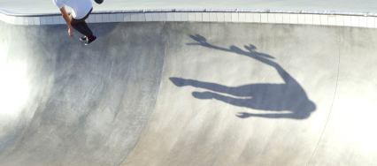
Less Obvious Skills
Choosing the right problems at the right time
Choosing from a known set of problems
Why will it be impactful if you study it now?
What technical skills and background are needed, AND
Why you are the right person right now to tackle this problem?
Looking inside yourself: reflection
7

Slide 8
Introspection & Intuition
Second Attribute
Looking inside
Learn
Focus
Articulate
8

Slide 9

Least Obvious Skills
Develop clarity about research contribution
Research paper, degree, x number of citations??
Contribution is how we progress the field
It is Qualitative in nature, as opposed to quantitative
Making space for others to contribute
Beyond high quality problem solving
9

Slide 10
Go Beyond “Hot” Topics
A “hot” topic in 2025 may not be so in 2030.
“
”
If you see a bandwagon, it’s too late.
PhD length
1995
Internet!
2000
Lot of
Networking PhDs
Go beyond hot areas
Go beyond technical contributions
Conceptual contributions chart directions
Help create hot areas from cool ones, using??
10

Slide 11
Contributions & Attributes
Contributions
Attributes
“Utilitarian” Contribution
Technical Contribution
Conceptual Contribution
Initiative & Interest
Introspection & Intuition
Imagination
11

Slide 12



Mentoring: Encouraging Such Attributes
< <
Papers < Placement < Discussions
Output < Outcome < Experience
But, how to achieve it?
Supervision
<<
Advising
12

Slide 13
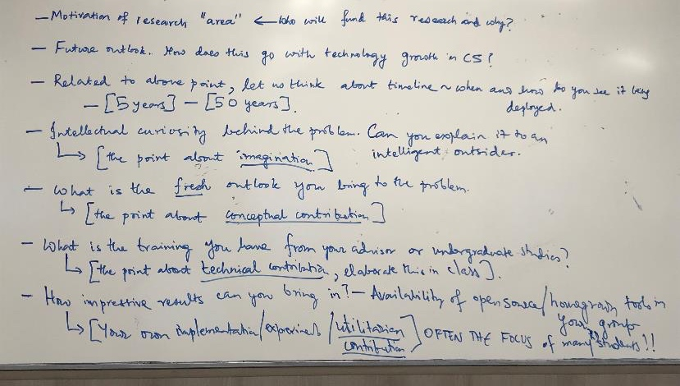
Discussion Blast From Past ~10 Yr Ago
13

Slide 14
Translation
Each research community goes in waves
Interest in a technology often reduces.
Translation over a period of time can sustain that interest.
Translation can also move the area into other directions over a longer time e.g. decades
Why a certain topic is not translated?
14

Slide 15

Lack of Translation
Little bit of a story of start-up success
Why is a start-up not successful
Not enough investment
Steady marketing blitz
…
Alternate ways of doing it
Inferior technology
…
Falls through the cracks.
Need investment for translation, may not be in funds. This is the nuanced aspect.
15

Slide 16
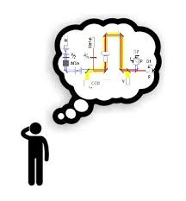
Research Topic
Who would be interested?
Who would fund it, if they had 1B?
Only a thought experiment
Does not preclude theoretical research
Level of interest in a topic in research community is not necessarily linked translation.
Time-line for deployment
5-50 years
Thought experiment only
16

Slide 17
Course Schedule
First Half:
W1: Fish model of PhD - placing of innovation with respect to research
W2: Discussion by students on their PhD - give suggestions about the role of innovation.
W3: The ideation process in general - imagination - and its modified role in innovation.
W4: Discussion by students on their ideation process - and suggestions about innovation.
W5: Example of successful AI driven innovation - AutoCodeRover.
W6: Discussion by students on what role AI can play in innovation of their deep tech PhD
<Recess week>
17

Slide 18
Course Schedule
Second Half:
W7: Funding model - visit by VCs
W8: NUS well being day
W9: NUS Enterprise staff share his vision as venture architect
W10: Meet each student team outside class to get their sharing pitch
W11: Sharing by successful academic entrepreneur / innovation guru
W12: Pitch by students
W13: Group exercise: meet in class and craft a joint report together.
18

