Slide 1
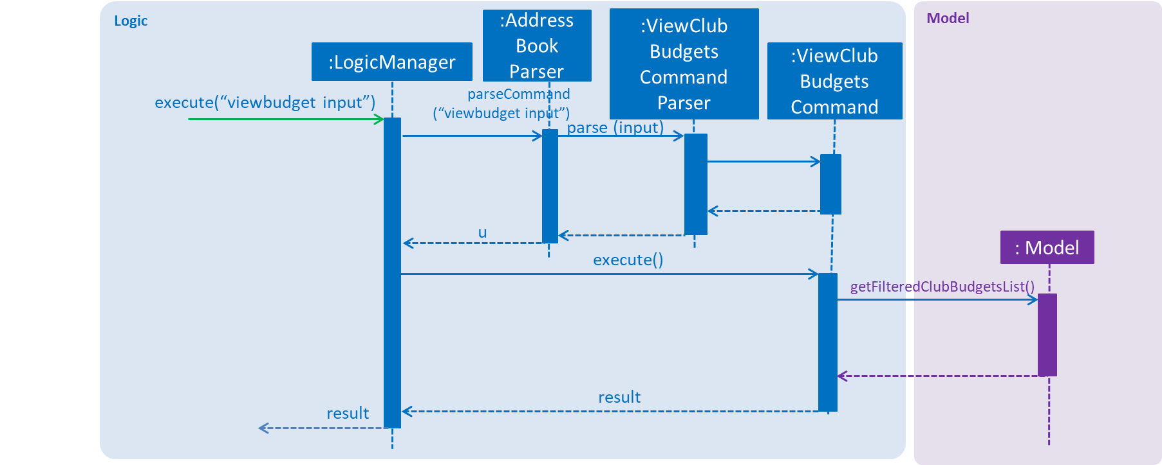
Logic
Model
:Address
Book
Parser
:ViewClub
Budgets
Command
Parser
:LogicManager
:ViewClub
Budgets
Command
execute(“viewbudget input”)
parseCommand
(“viewbudget input”)
parse (input)
u
: Model
execute()
getFilteredClubBudgetsList()
result
result

