Slide 1
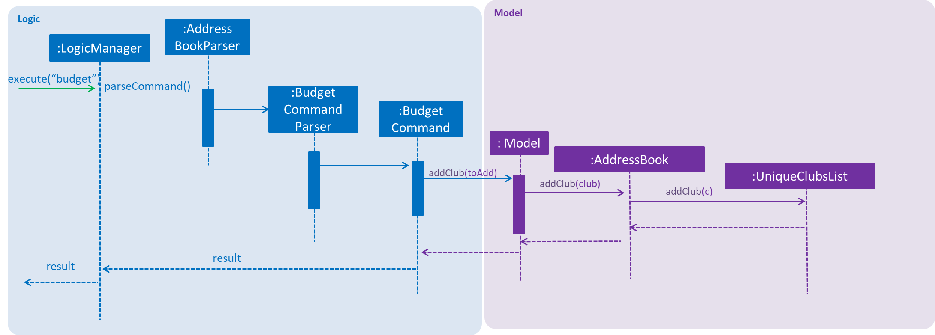
Logic
Model
:Address
BookParser
:LogicManager
execute(“budget”)
parseCommand()
:Budget
Command
Parser
:Budget
Command
: Model
:AddressBook
addClub(toAdd)
:UniqueClubsList
addClub(club)
addClub(c)
result
result

