Slide 1
Interactive Data Analytics Tool (IDAT)
By Wu Wenfeng
28 Feb 2015
Notes:
Good afternoon , everyone! I am glad to introduce our work to you. It is called Interactive Data Analytics Tool, IDAT for short.

Slide 2
Background
Business Intelligence (BI) is very important in enterprises
Detect significant events
Identify business trends
Turn data into actionable information
… …
All these above need Data Analysis
Notes:
First of all, why we need this tool ? As we all know, now it is information age or big data age. Everyday, people create a lot of information, and store them inside different types of data. In enterprises, huge amount of data are accumulated and stored in the data warehouse. Increasing day after day. If we can make best use of them, they can be precious treasure, if not, they are just rubbish and electricity consumer.
So business intelligence is very important. We need dive into the data pool and find valuable things. Such as detect significant events, Identify business trends , turn data into actionable information and so on.
And all these above need data analysis.

Slide 3
Data analysis
Extract significant information form data and transform them into diverse tables and charts.
DATA
 | A | B | C
x | 5 | 6 | 4
y | 4 | 5 | 5
Notes:
Generally speaking, data analysis is extracting significant information from data and transform them into diverse tables and charts. See, we have line chart, column chart and pie chart.

Slide 4
How do data transform to chart in enterprises?
1
2
3
4
5
Raw data
Structured data
model data
Statistics result
chart
DB
Modeling
Structuring
DB
Filtering
Statistics
 | A | B
x | 1 | 3
y | 2 | 2
z | 3 | 1
excel
Integrating
Correcting
Aggregating
Visualizing
OR
OR
log
excel
web
Notes:
Let’s go deeper. What exactly happen in enterprises? And how to transform data to chart?
Here is a simple workflow. You see, there are five states.
The first state is raw data. Data is stored in different places and in different formats. Such as database, excel file, log file, or even in a website. Some data is well defined and structured, but some isn’t. such as log data.
The second state is structured data. After structuring and integrating, raw data become structured data and store in the same place and in a unified format . This step need hard work. We have to discover significant data from various places ,write script to structure and transmit data. Finally integrate them into a database or just a excel file.
To go to the Third state, We need to do some filtering and correcting and modeling. After all this method , the data will have a schema, such as star schema. and out of noise. At this state, the data is ready for analysis. Then we use SQL queries or some analytics tool to do some statistics and aggregating . After that ,we got the result we want. But it is in a table form and hard to read and understand.
At last, we do some visualizing and comes out a beautiful chart.
So this is the five states when data transform to chart. Every step need proficient skill of different programing language.

Slide 5
Let’s focus on statistics and visualization
Data is clean
No noise, no error
Data is modeled
Structured
May be star schema
Abstract as a Data cube
Statistics
 | A | B
x | 1 | 3
y | 2 | 2
z | 3 | 1
Aggregating
Visualizing
OR
Notes:
And our IDAT tool is mostly concerning about visualization. So today, let’s focus on the last three states.
The data we get here is clean and modeled. It has no noise, no error and well structured.

Slide 6
A diagnostic data example
Data model
Stored in mysql database, table name is diagnosis.
People
Alice : Medical Expert (ME)
Bob : Data Analyst (DA)
column | User Id | Gender | disease | Age | year | month | day | Region
type | String | Male/ Female | String (Icd9 code) | Integer | integer | integer | integer | string
Notes:
To know better about this visualization work. Let’s see a diagnostic data example.
There is a simplified data model. The data is stored in mysql database , table name is diagnosis. We can see the table definition. …
Also, in this example we have two people. Alice and Bob. Alice is a medical expert and Bob is a data analyst.

Slide 7


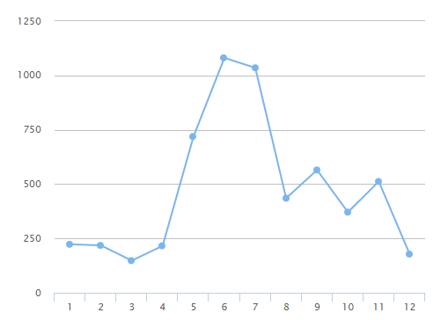
Scene 1:
I want to see disease dengue’s total diagnosis records amount in 2013, by month.
OK!
Select month, count(*) from diagnosis where disease = ‘061’ and year = 2013, group by month
Alice
month | 1 | 2 | 3 | 4 | 5 | 6 | 7 | 8 | 9 | 10 | 11 | 12
Count(*) | 223 | 218 | 148 | 216 | 719 | 1081 | 1035 | 435 | 565 | 371 | 512 | 102
Here!
Thank you !
Bob
Notes:
Here is scene 1.
Alice get a question, so she ask Bob for help. Let’s see what’s her question.
Bob get the question. And he writes a sql query. Execute it and get a result. Then he draws a chart.

Slide 8
Scene 2:
I want find some kind of diseases that male is more susceptible than female, and learn more detail about them.
Hi, Bob. Can you help me find some diseases that
male is more susceptible than female ?
Alice
OK
Select disease, gender, count(*) from diagnosis group by disease, gender
…Here may goes some programing to find the top n diseases that meet the requirement. …
Bob
Notes:
Scene 2 is more complicated.
Alice has a idea in her mind.
…

Slide 9
Scene 2:
I’ve found disease A, B, C, D meet your requirements.
Disease | Male | Female
A | 15532 | 6223
B | 4322 | 2332
C | 5663 | 2345
D | 9883 | 3012
Bob
Alice
OK, disease A is very interesting. I want to see details about it . What about diagnostic time.
Notes:
So bob found 4 diseases that male is more susceptible than female. And give the result to Alice.
…

Slide 10
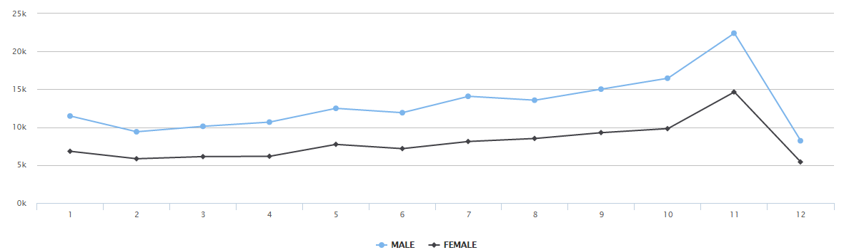
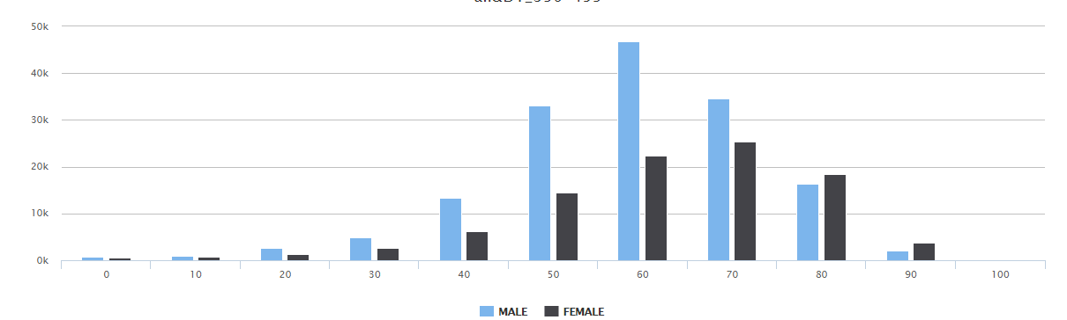
Scene 2:
Nothing special, what about age?
Bob
Alice
Notes:
We can see ,that male’s diagnostic time is same with female.
So Alice think it is not interesting, and want to see age details.
We can see that male’s age distribution is quite different from female. Male’s peak age is about 60 while female’s peak age is 70.

Slide 11
Scene 2:
Hmm, It’s very interesting, seems that men and women differ in peak age. Probably that’s why women live longer!
Well, that’s..
Well , let’s see what happens with disease B .
Alice
OK.
... …
… …
Bob
… …

Slide 12
A diagnosis data example
Expert in medical, but has no database or programing knowledge.
We got two roles:
Business Expert (业务专家) : Alice
Data Analyst : Bob
And two kind of questions
Determined : Scene 1
Well defined, little interactive.
Explorative : Scene 2
Undetermined, need a lot of explorative actions. Need Alice’s experience to determine what to do next.
Expert in data analysis, but can’t find valuable information lied in data.
Notes:
In the example, we got two roles. Business expert and data analyst. Alice is business expert. Bob is data analyst.
And two kind of questions. Determined and explorative.
In scene 1, the question is determined. Alice know quite well about what she wants to see. And the question is well defined. She just tell Bob the question and get the result. There is no further interaction between Alice and Bob.
In scene 2, Alice doesn’t know what disease she really wants to see. It depends on what Bob find. Only if she sees the midway result, can she know what to see next. This is like an exploration in the data warehouse. It needs Alice’s business experience and Bob’s database skills.

Slide 13
A diagnosis data example
For determined questions
Well supported by many data analysis tools: excel, tableau, power point
For explorative questions
More needs
data size become more and more big
data model become more sophisticated, e.g. hundreds of attributes to be concerned,
business experts’ experience is more important.
No mature products.
So we develop IDAT to meet this requirement
Notes:
For determined questions, there are a lot data analysis tools in the market meet the requirements. Such as excel, tableau, and even the power point that I use now.
But for explorative questions, there is no mature products in the market. Actually, As data size become more and more big , data model becomes more and more sophisticated, people come up more questions need exploration. And business experts’ experience is more important, So we need to enable business experts interact with charts.
That’s why we develop IDAT.

Slide 14
IDAT( Interactive Data Analysis Tool)
The visualization part of OLAP system(Epic)
Providing interactive operation on OLAP Data Cube
BS(Browser & Server) mode
No software installation
Easy access
Objective
Let business experts with no database background explore data easily by interacting with charts.
Notes:
IDAT is not a individual product. It is the visualization part of OLAP system. It provide interactive operations on OLAP Data Cube.
It use BS mode. So client don’t need install software and can access easily.
It’s objective is to help business experts who has no database background to explore data easily by interacting with charts.

Slide 15
Software structure
Browser
visulisation
visulisation
Server
IDAT Sever
OLAP
OLAP System
Script
Data crawler & adapter
Raw data
DB
excel
log
web
Notes:
Here is the whole OLAP system’s software structure.
At the bottom is raw data. And we use script to import and adapt raw data into our OLAP system. So data can be changed automatically and dynamically.
The IDAT installed in a server as a web service, It communicate with OLAP System to get data. And end user can access to the service via a browser.

Slide 16
Demonstration
Notes:
So next, let’s see how we solve the two questions above with the help of IDAT.

Slide 17
Q & A

Slide 18
Difference between IDAT, tableau and excel
 | IDAT | Tableau | Excel
Interactive ability | Powerful | Weak | No
DA requirement | No programing | Little programing | Little programing
Big Data capability | Yes | Yes | No
Target User | BA&DA | DA&BA | DA
Target Enterprise | Medium & Small | Big | Small

Slide 19
传统数据分析流程
BA
1
8
DA
提出问题
历史数据分析，趋势预测，异常数据监测等
分析问题，确定所需数据
明确知道问题所涉及到的相关数据
定位数据，明晰数据格式
确定数据存储位置及存储格式，获得数据
结构化，并整合数据为统一格式
将不同存储位置，不同格式，的数据提取出来，整合成统一格式，需要脚本编程、SQL等基础，可能由DA执行
去除冗余，歧义，错误数据
对数据意义有深刻认识，处理数据时需要一定编程能力，可能由ITS执行
观察数据，提出猜想，为数据建模
分析数据特征，提取有意义数据集，并导入相关数据分析软件（tablau，excel等）
统计分析，生成报表
通过数据分析软件，进行统计计算，生成报表，需掌握软件使用技能
分析报表，得出结论或提出新的问题
能从报表中获取有用信息，分析原因，得出结论
ITS
7
2
6
5
5
3
4
4

Slide 20
特点及问题
数据分析员要求较高
一般企业，无数据分析员角色，或能力不足(举例，医院，财政厅)
查找数据，预处理数据的代价很高
分布式存储，且存储方式，存储格式不相同（log文件，excel，关系型数据库，HDFS）。
静态数据迁移，重复计算，工作量大
ITS交付给DA的预处理数据，以及DA交付给BA的报表都是静态数据。
当原始数据发生改变时，需重新进行处理计算，生成报表。
BA无法与报表进行交互。
BA对DA及ITS依赖极大
无大数据处理能力
DA编程技术有限、软件处理能力有限
一般采取取样分析的方式，结果偏差大

