Slide 1
Interactive Data Analytics Tool (IDAT)
Wu Wenfeng, Fan Ju, David
2 March,2015
Notes:
Good afternoon , everyone! I am glad to introduce our recent work to you. It is called Interactive Data Analytics Tool, IDAT for short.

Slide 2


Data need analytics
Data
Data
Analytics
Notes:
As we all know, now it is information age or big data age. Everyday, people create a lot of information, and store them inside different types of data. In enterprises, huge amount of data are accumulated and stored in the data warehouse. Increasing day after day. If we can make best use of them, they can be precious treasure, if not, they are just rubbish and electricity consumer.
So data need analytics.

Slide 3

Data analytics
What? Extract significant information form data and draw conclusions
DATA
Making better business decisions
Identifying business problems
Boosting profits
Notes:
Generally speaking, data analytics is extracting significant information from data and draw conclusions about them. For example , identifying business trends. or detecting significant event. In the first chart, we can see there is an ascending trend in sales. In the second chart, product B has a better sale than product A in Quarter 2. which is quite abnormal.
So why we need data analytics? There are many benefits we can get. For example. Data analytics help enterprises identifying business problems. And provide valuable information to make better business decisions. The most important thing is it can boost profits.

Slide 4
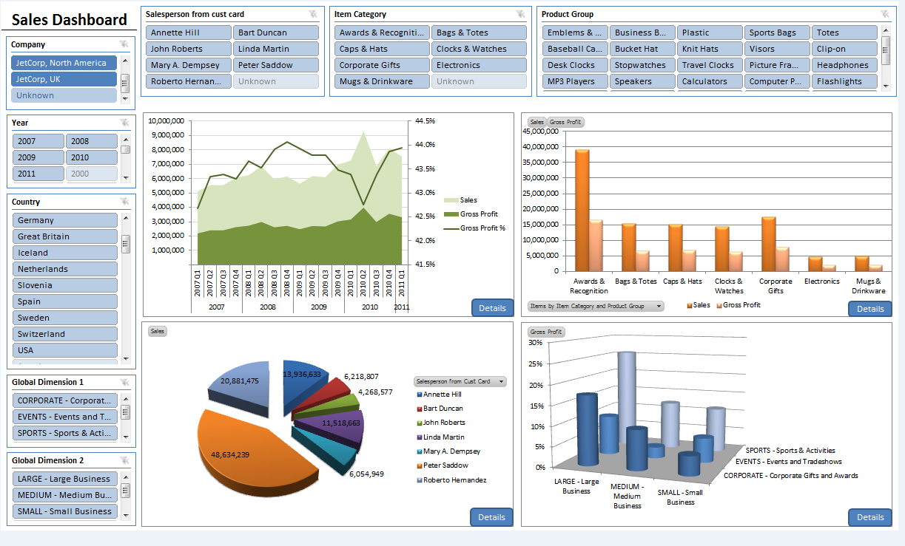
Traditional Visualization
Dashboard report
Characteristics:
Pre-defined
static
Process:
Ask question
Analyze data
Generate report
Notes:
Visualization is a very important part of data analytics. Traditional visualization formation is dashboard report consists of different types of charts. Like line chart, pie chart or column chart.
Pre-defined and unchangeable are the most two important characteristics of dashboard report. The X-axis dimension , Y-axis measure are all pre-defined, we can’t change them.
And the analyzing progress is generally divide into three steps. Ask question, analyze data then generate report.

Slide 5
New challenge
Progress:
Ask question
Explorative questions are more and more popular and can’t be well solved.
While the overall sales are increasing, which products in which country have great deficits?
Which diseases are more susceptible to males than females?
Why did some products have deficits? Because they have improper price? Because they are unattractive to young people?
Make hypothesis
Adjust conditions
Analyze data
NO
Generate report
Satisfied
YES
Next example shows how it works.
Draw conclusion
Notes:
However , it comes a new challenge. Not all questions can be solve through that simple three steps. The explorative questions are more complicated and can’t been solved. For example, ….
The progress to solve explorative questions looks like this:
we begin with a question, then, we make a hypothesis and set some conditions. Then analyze data and generated a report. When we get a report, we test if it meet our requirements. If so, we draw the conclusion, if not, we will go back to make a new hypothesis, adjust the conditions and repeat the progress again.
Let’s see an example to show how it works.

Slide 6
A diagnostic data example
Data model
Stored in mysql database, table name is diagnosis.
People
Alice : Medical Expert (ME)
Bob : Data Analyst (DA)
column | User Id | Gender | disease | Age | year | month | day | Region
type | String | Male/ Female | String (Icd9 code) | Integer | integer | integer | integer | string
Notes:
This is a diagnostic data example.
I have simplified the data model. The data is stored in mysql database , table name is diagnosis. We can see the table definition. …
Also, in this example there are two people. Alice and Bob. Alice is a medical expert and Bob is a data analyst.

Slide 7


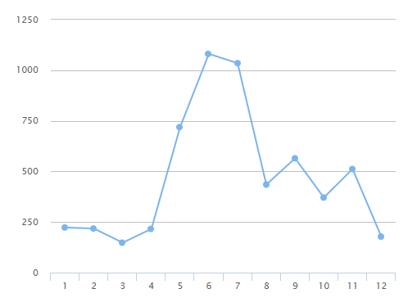
Scene 1: traditional question
I want to see disease dengue’s total diagnosis records amount in 2013, by month.
OK!
Select month, count(*) from diagnosis where disease = ‘061’ and year = 2013, group by month
Alice
month | 1 | 2 | 3 | 4 | 5 | 6 | 7 | 8 | 9 | 10 | 11 | 12
Count(*) | 223 | 218 | 148 | 216 | 719 | 1081 | 1035 | 435 | 565 | 371 | 512 | 102
Medical Expert
Here!
Thank you !
Bob
Data Analyst
Notes:
Here is scene 1.
Alice gets a question, so she asks Bob for help. Let’s see what’s her question.
Bob gets the question. And he knows disease dengue’s icd9 code is 061. so he writes a sql query. Execute it and get a result. Then he draws a chart. Send it to Alice.
The question is well defined and very clear, so everything goes well.

Slide 8
Scene 2: explorative question
I want find some kind of diseases that male is more susceptible than female, and learn more detail about them.
Hi, Bob. Can you help me find some diseases that
more susceptible to males than females ?
Alice
Medical Expert
OK
Select disease, gender, count(*) from diagnosis group by disease, gender
…Here may goes some programing to find the top n diseases that meet the requirement. …
Bob
Data Analyst
Notes:
Scene 2 is more complicated.
Alice has a idea in her mind.
…

Slide 9
Scene 2:
I’ve found disease A, B, C, D meet your requirements.
Disease | Male | Female
A | 15532 | 6223
B | 4322 | 2332
C | 5663 | 2345
D | 9883 | 3012
Bob
Data Analyst
OK, disease A is very interesting. I want to see details about it . What about diagnostic time.
Alice
Medical Expert
Notes:
So bob found 4 diseases that male is more susceptible than female. And give the result to Alice.
…

Slide 10
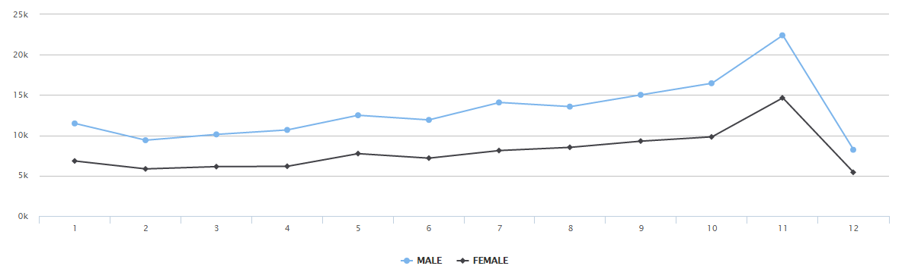
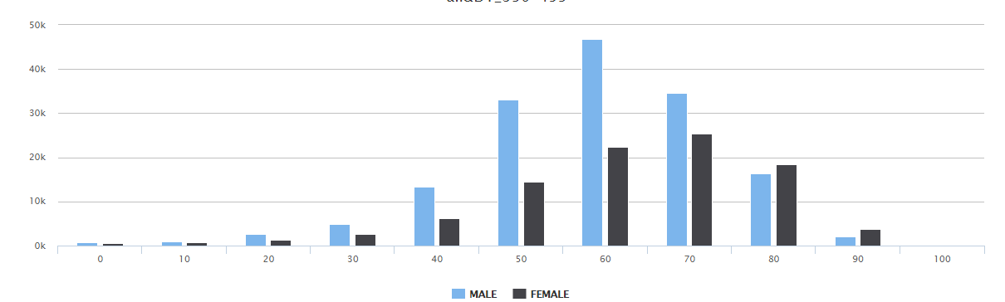
Scene 2:
Hmm, not interesting, what about age?
Bob
Data Analyst
Alice
Medical Expert
Notes:
We can see ,that male’s diagnostic time is quite same with female.
So Alice think it is not interesting, and want to see age details.
We can see that male’s age distribution is quite different from female. Male’s peak age is about 60 while female’s peak age is 70.

Slide 11
Scene 2:
Hmm, It’s very interesting, seems that men and women differ in peak age. Maybe that’s why women live longer!
Well, that’s..
Well , let’s see what happens with disease B .
Alice
Medical Expert
OK.
... …
… …
Bob
… …
Data Analyst

Slide 12
A diagnostic data example
Expert in medical, but has no database or programing knowledge.
Scene 1
question is determined and well defined, every thing goes well.
Scene 2
Question is undetermined, need a lot of explorative actions. Need Alice’s experience to determine what to do next.
So Alice and Bob work alternately. And they communicate a lot .
Expert in data analysis, but can’t find valuable information lied in data.
Notes:
In the example, we got two roles. Business expert and data analyst. Alice is business expert. Bob is data analyst.
And two kind of questions. Determined and explorative.
In scene 1, the question is determined. Alice know quite well about what she wants to see. And the question is well defined. She just tell Bob the question and get the result. There is no further interaction between Alice and Bob.
In scene 2, Alice doesn’t know what disease she really wants to see. It depends on what Bob find. Only if she sees the midway result, can she know what to see next. This is like an exploration in the data warehouse. It needs Alice’s business experience and Bob’s database skills.

Slide 13
A diagnostic data example
Ask question
Need business
experience
Make hypothesis
Change condition
Need Database and
Programing skills
Analyze data
NO
Generate report
Satisfied
YES
Draw conclusion
Notes:
Let’s focus on explorative questions.
The first two steps and the last two steps need business experience. Which Alice good at. While the middle two steps need database and programing skills, only bob can do it.
Because none of them can solve the problem alone, they need a lot of communication and that takes a lot of time.

Slide 14
A diagnostic data example
Now I just need prepare data for IDAT
Ask question
Make hypothesis
Change condition
Analyze data
IDAT
Great! Now I can explore data all by myself.
Make this two step automated
NO
Generate report
Satisfied
YES
Draw conclusion
Notes:
That’s why we develop IDAT.
We develop IDAT to make what bob does become automated and need no programing. So Alice can explore data all by herself. While Bob just need to prepare data for IDAT and do some routine maintains.

Slide 15
IDAT( Interactive Data Analysis Tool)
Let’s see how IDAT solve this two questions in the above example:
Disease dengue’s total diagnosis records amount in 2013, show by month.
Find some kind of diseases that male is more susceptible than female, and learn more detail about them.
Demonstration
Notes:
Here is some features of IDAT.

Slide 16
Software structure
Browser
visulisation
visulisation
IDAT
Server
IDAT Sever
OLAP
OLAP System
Script
Data crawler & adapter
Raw data
DB
excel
log
web
Notes:
Here is the whole OLAP system’s software structure.
At the bottom is raw data. And we use script to import and adapt raw data into our OLAP system. So data can be changed automatically and dynamically.
The IDAT installed in a server as a web service, It communicate with OLAP System to get data. And end user can access to the service via a browser.

Slide 17
Q & A

Slide 18
Comparison with Tableau
IDAT focus on helping user with no database skills explore data more efficiently. While Tableau focus on helping data analyst generate various and colorful charts.
Notes:
We don’t want to replace tableau, which is a great data analytics software in industry.

Slide 19
Data analytics progress in enterprises
1
2
3
4
5
Raw data
Structured data
model data
Statistics result
chart
DB
Modeling
Structuring
DB
Filtering
Statistics
 | A | B
x | 1 | 3
y | 2 | 2
z | 3 | 1
excel
Integrating
Correcting
Aggregating
Visualizing
OR
OR
log
excel
web
Notes:
Last data analytics is not only visualization. It include many work.
Here is a simple workflow. You see, there are five states.
The first state is raw data. Data is stored in different places and in different formats. Such as database, excel file, log file, or even in a website. Some data is well defined and structured, but some isn’t. such as log data.
The second state is structured data. After structuring and integrating, raw data become structured data and store in the same place and in a unified format . This step need hard work. We have to discover significant data from various places ,write script to structure and transmit data. Finally integrate them into a database or just a excel file.
To go to the Third state, We need to do some filtering and correcting and modeling. After all this method , the data will have a schema, such as star schema. and out of noise. At this state, the data is ready for analysis. Then we use SQL queries or some analytics tool to do some statistics and aggregating . After that ,we got the result we want. But it is in a table form and hard to read and understand.
At last, we do some visualizing and comes out a beautiful chart.
So this is the five states when data transform to chart. Every step need proficient skill of different programing language.

Slide 20
Difference between IDAT, tableau and excel
 | IDAT | Tableau | Excel
Interactive ability | Powerful | Weak | No
DA requirement | No programing | Little programing | Little programing
Big Data capability | Yes | Yes | No
Target User | BA&DA | DA&BA | DA
Target Enterprise | Medium & Small | Big | Small

Slide 21
传统数据分析流程
BA
1
8
DA
提出问题
历史数据分析，趋势预测，异常数据监测等
分析问题，确定所需数据
明确知道问题所涉及到的相关数据
定位数据，明晰数据格式
确定数据存储位置及存储格式，获得数据
结构化，并整合数据为统一格式
将不同存储位置，不同格式，的数据提取出来，整合成统一格式，需要脚本编程、SQL等基础，可能由DA执行
去除冗余，歧义，错误数据
对数据意义有深刻认识，处理数据时需要一定编程能力，可能由ITS执行
观察数据，提出猜想，为数据建模
分析数据特征，提取有意义数据集，并导入相关数据分析软件（tablau，excel等）
统计分析，生成报表
通过数据分析软件，进行统计计算，生成报表，需掌握软件使用技能
分析报表，得出结论或提出新的问题
能从报表中获取有用信息，分析原因，得出结论
ITS
7
2
6
5
5
3
4
4

Slide 22
特点及问题
数据分析员要求较高
一般企业，无数据分析员角色，或能力不足(举例，医院，财政厅)
查找数据，预处理数据的代价很高
分布式存储，且存储方式，存储格式不相同（log文件，excel，关系型数据库，HDFS）。
静态数据迁移，重复计算，工作量大
ITS交付给DA的预处理数据，以及DA交付给BA的报表都是静态数据。
当原始数据发生改变时，需重新进行处理计算，生成报表。
BA无法与报表进行交互。
BA对DA及ITS依赖极大
无大数据处理能力
DA编程技术有限、软件处理能力有限
一般采取取样分析的方式，结果偏差大

