Slide 1
Developing A Web-Based Software System
A Tutorial
12/10/2014

Slide 2
Overview of Steps
Step 1: Analysis
Making clarification of the requirements
Step 2: Design
Designing the workflow
Designing the web page layout
Designing the interaction process
Step 3: Implementation
Implement function by function

Slide 3
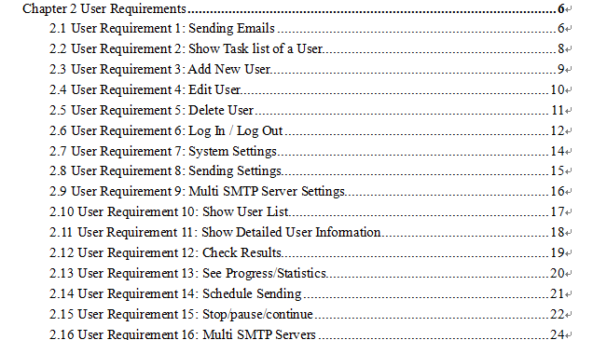
List all the requirements
List the requirements one by one, e.g.,

Slide 4
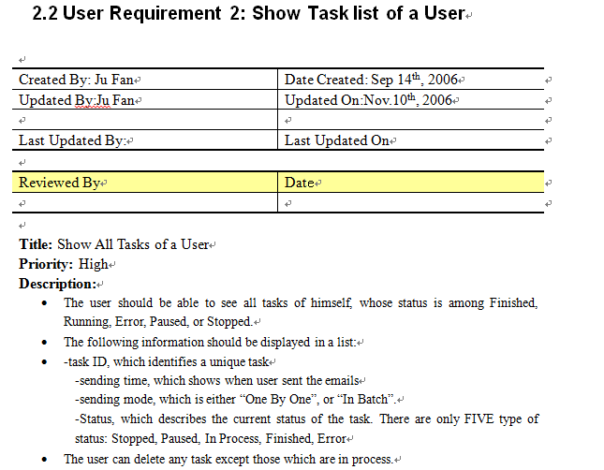
Specify each requirement
Title
Update Log
Description

Slide 5
Specify each requirement (cont.d)
Sequence Diagram
Making clarification of the sequence of actions

Slide 6
Design the screen flow

Slide 7
Design screens
Screen name (See screen flow) | File name | Function
(Only for demo) | index.html | Main page of the demo.
login_screen | login.html (For administrator) login_u.html(For user) | This page allow user to input the username and password to enter the system.
userList_screen | admin.html | The main page of the administrator.
userInfo_screen | detail.html | This page show detailed information of normal user.
add_screen | add.html | This page is responsible for adding new users.
edit_screen | edit.html | This page is used for administrator to edit user’s information.
systemSetting_screen | setting.html | This page is responsible for the administrator to do the system settings.

Slide 8
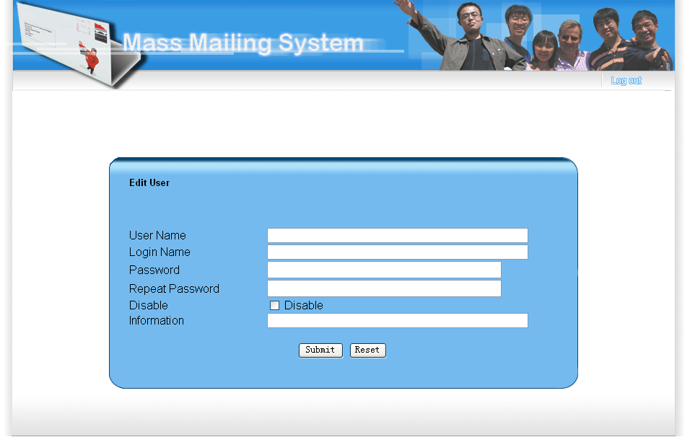
Design screen layout

Slide 9
Design interactive sequence

Slide 10
Design classes

Slide 11
Design implementation standard
Format of code
Programmer should indent the code by “TAB”. “{“and “}” should be located in a new line.
Class definition
…

Slide 12
Implementation
Function name | Desciption
sendmail | This is the main function of this module, other module call this function to start the process. The argument is given on next section.
Initialize_sending | Prepare the sending process.
open_email_list_file | Open the email list file and return the reference. Argument: The path of email list file.
get_next_email_addresses | Get next email address to send from email list file. The function its process depend on the mode of sending. Arguemnt: Sending_mode Batch_size Children_num-1 Email_list_ref(The reference of email list file reference) Return: The string of email address (one or more)

Slide 13
Tips
How to draw the diagrams
Downloading Microsoft Visio
Documentation
Refer to the examples

Slide 14
Schedule
Finish a version of Analysis document and Design document before the 15th Dec
Kelvin: will leave from 11th – 16th
Emm: 14th – 17th
22nd Dec
Version Control: Github

