Slide 1
BLUESTOCK FINTECH
Mutual Fund Analytics Platform
Capstone Project · Final Presentation
Anushka Nair · June 2026 · 7-Day Analytics Sprint

Slide 2
Problem & Objective
Why Bluestock Mutual Fund Analytics?
The Problem
Our Objectives
› India's MF industry grew to ₹68L Crore AUM — but retail investors lack analytical tools
› Ingest & clean 10 datasets → SQLite star-schema database
› AUM data, NAV history, SIP flows, and investor demographics sit in siloed CSV files
› Compute 12+ performance metrics (CAGR, Sharpe, Alpha, VaR…)
› Fund advisors need risk-adjusted metrics (Sharpe, Alpha) — not just raw returns
› Build 4-page interactive dashboard for fund comparison
› No unified dashboard exists for small retail investors to compare 40+ schemes
› Develop fund recommendation engine by investor risk profile
› Package into reproducible, documented GitHub repository
Dataset: 40 schemes | 5 years NAV | 32,778 transactions | 10 CSV files

Slide 3
Data Sources & Architecture
10 datasets → SQLite Star Schema
Raw Data Sources (10 CSVs)
SQLite Star Schema (8 tables)
› nav_data.csv — 64,320 daily NAV records
› dim_fund — 40 funds (central dimension)
› fund_master.csv — 40 scheme metadata
› fact_nav — 64K+ daily NAV rows
› performance_data.csv — returns, Sharpe, Alpha
› fact_performance — metrics per fund
› aum_data.csv — monthly AUM by AMC
› fact_aum, fact_transactions, fact_portfolio
› sip_industry.csv — monthly SIP inflow data
› fact_benchmark — 6 index time series
› dim_date — calendar dimension
64,320
32,778
8
40
NAV Rows
Transactions
DB Tables
Schemes

Slide 4
ETL Pipeline Architecture
Automated Extract → Transform → Load
Extract
Clean
Load
Analyse
10 CSV files from data/raw/ AMFI API for live NAV
→
Handle NaN, fix dtypes Standardise date formats
→
SQLite via SQLAlchemy Export clean CSVs
→
Metrics, Charts, Reports via scripts/
Single command: python run_pipeline.py — ETL + metrics + reports in < 5 minutes
Pipeline Properties
› Idempotent — safe to rerun; drops and recreates all tables
› Live NAV refresh via AMFI public API (scripts/live_nav_fetch.py)
› Full audit trail in outputs/ — all CSVs reproducible from raw data

Slide 5
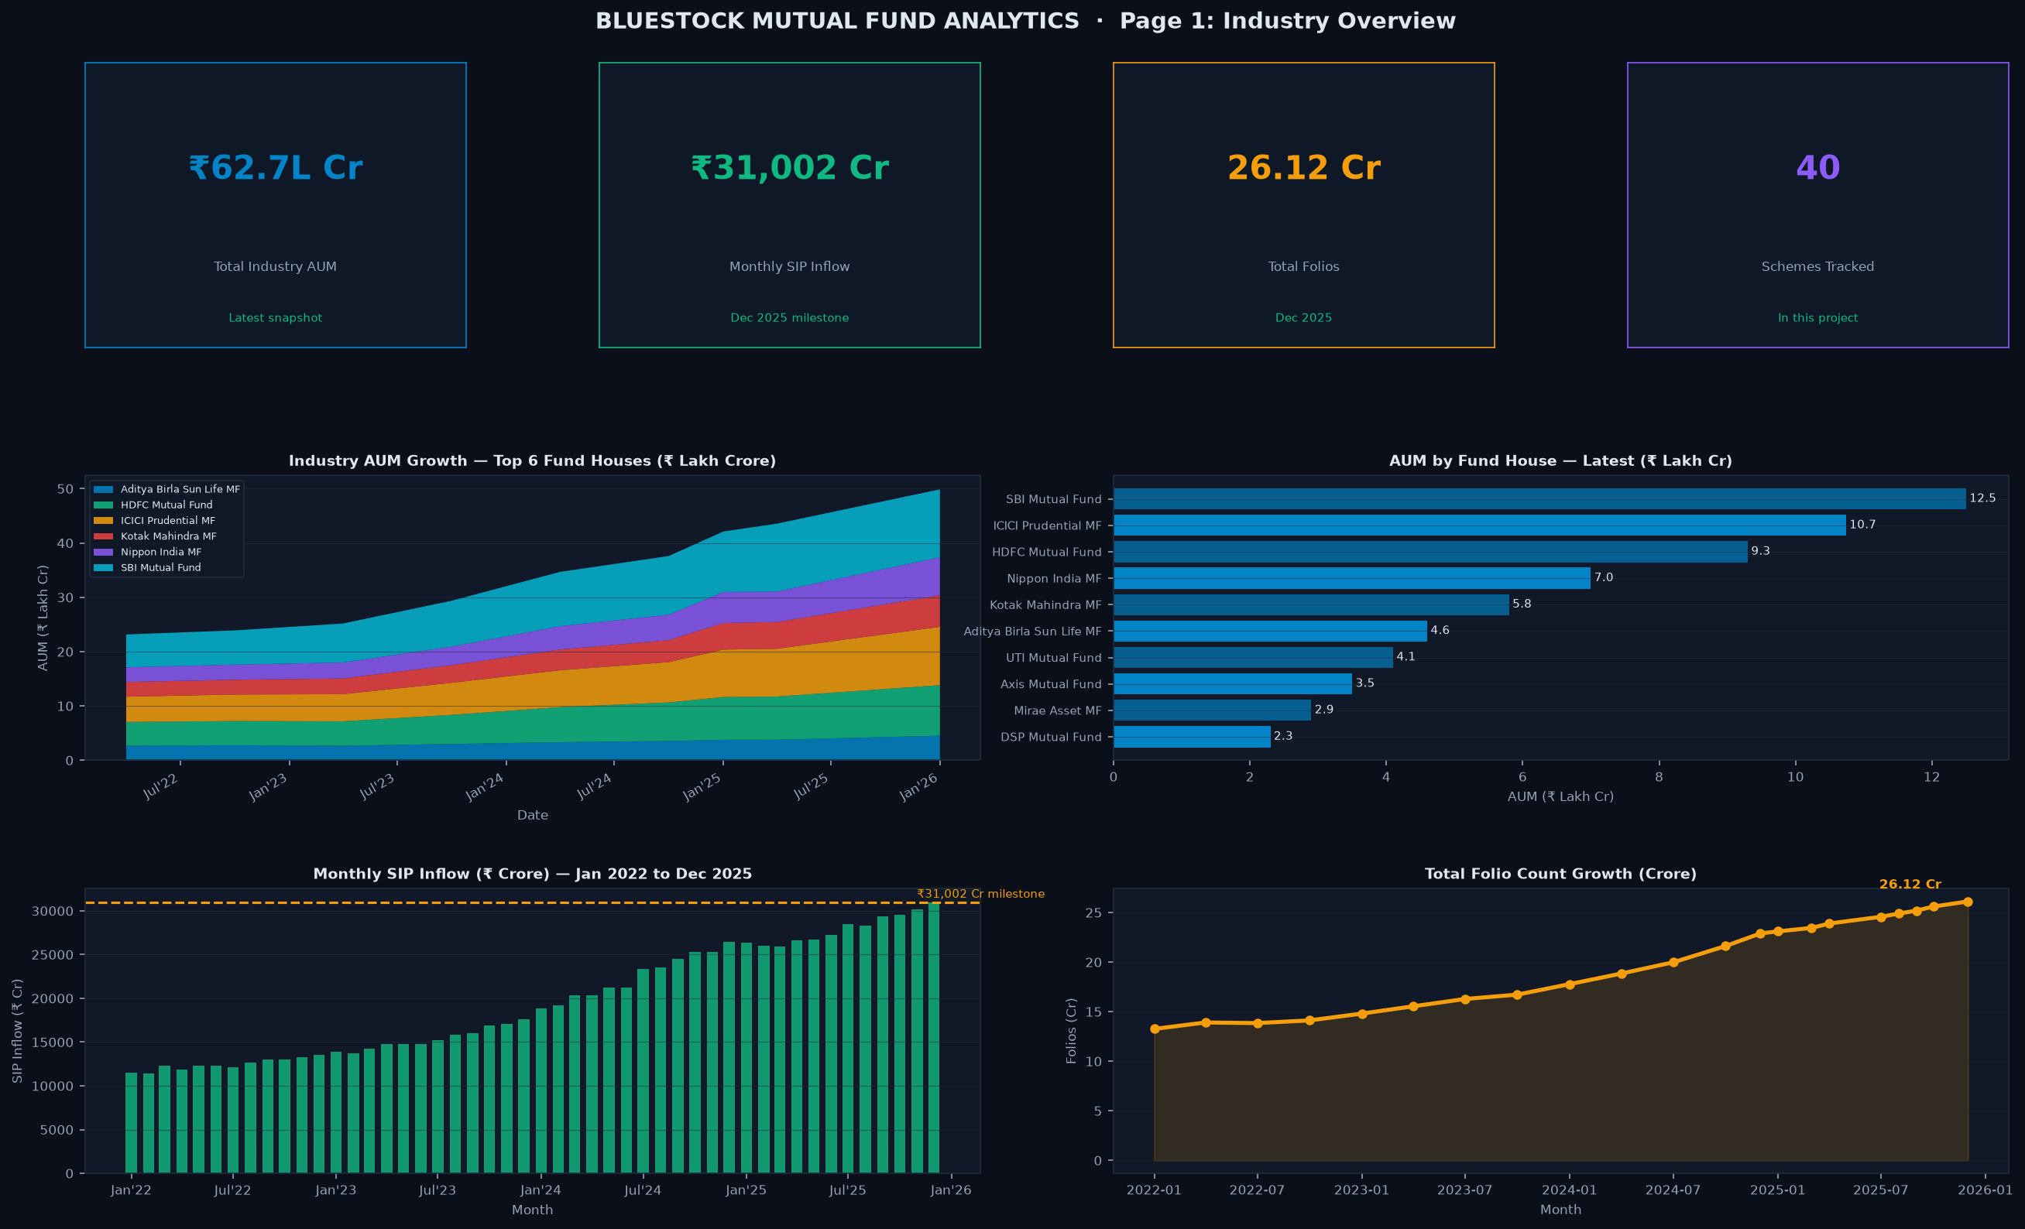
EDA Highlights — Industry Overview
22 publication-quality charts generated

Slide 6
EDA Highlights — Key Insights
10 data-driven findings from exploratory analysis
Industry Trends
Investor Insights
› Industry AUM grew 84% — ₹37L Cr (2022) → ₹68L Cr (2025)
› Maharashtra + Karnataka + Delhi = 60%+ of investment value
› SIP inflow grew 181% — ₹11,035 Cr → ₹31,002 Cr
› Age 25–35: highest SIP participation & ticket size
› Folio count doubled: 13.2 Cr → 26.1 Cr
› SIP vs Nifty 50 correlation: r > 0.85
› Mid Cap & Small Cap: highest 3yr CAGR (18–23%)
› Expense ratio range: 0.05% (ETF) to 2.5% (Regular equity)
› Direct plans outperform Regular by 1–2% per annum
› T30 cities drive 73% of total investment value

Slide 7
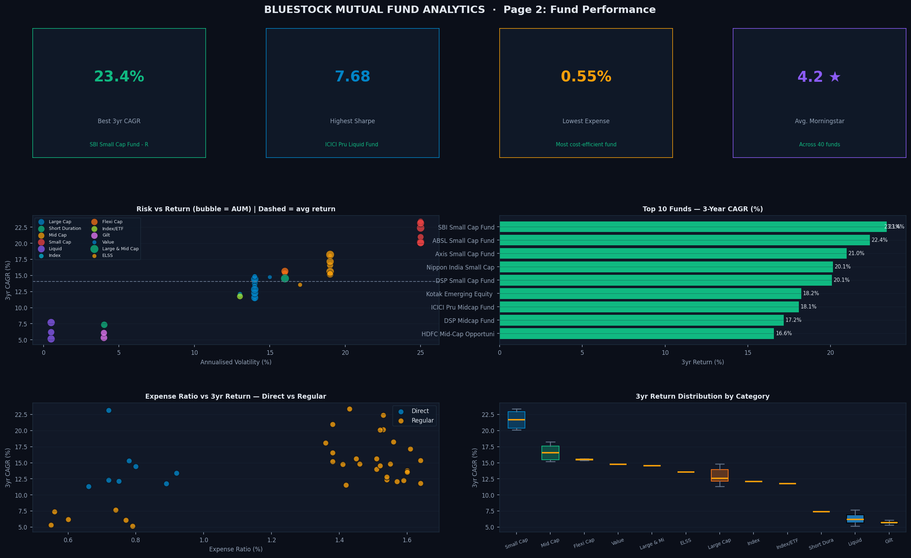
Performance Analytics — Top Funds
Composite scorecard across 6 risk-adjusted metrics

Slide 8
Risk Metrics — VaR, Sharpe, Alpha
Day 4 + Day 6 quantitative risk analysis
85.12
1.07
−28.7%
31.5%
Top Composite Score (ICICI Midcap)
Best Sharpe Ratio (Mirae Large Cap)
Worst Max Drawdown (SBI Small Cap)
Best Alpha % (SBI Small Cap)
Metrics Computed (12 total)
Key Findings
› Sharpe = (Return − Rf) / Volatility | Rf = 6.5%
› Mid Cap funds: best risk-adjusted returns (Sharpe 0.8–1.0)
› Sortino uses only downside deviation (risk asymmetry)
› Liquid funds: near-zero VaR but low absolute returns
› Alpha via OLS regression vs assigned benchmark index
› Direct plans: alpha 0.5–2% higher than Regular counterparts
› VaR 95% = 5th percentile of daily return distribution
› CVaR 95% = mean loss below VaR threshold (expected shortfall)
› Max Drawdown = peak-to-trough decline in NAV history

Slide 9
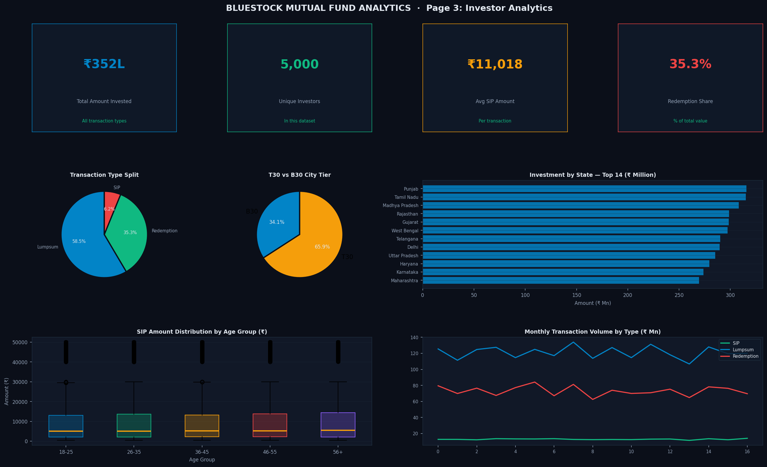
Dashboard — Investor Analytics
Page 3: Transaction flows, demographics, geography

Slide 10
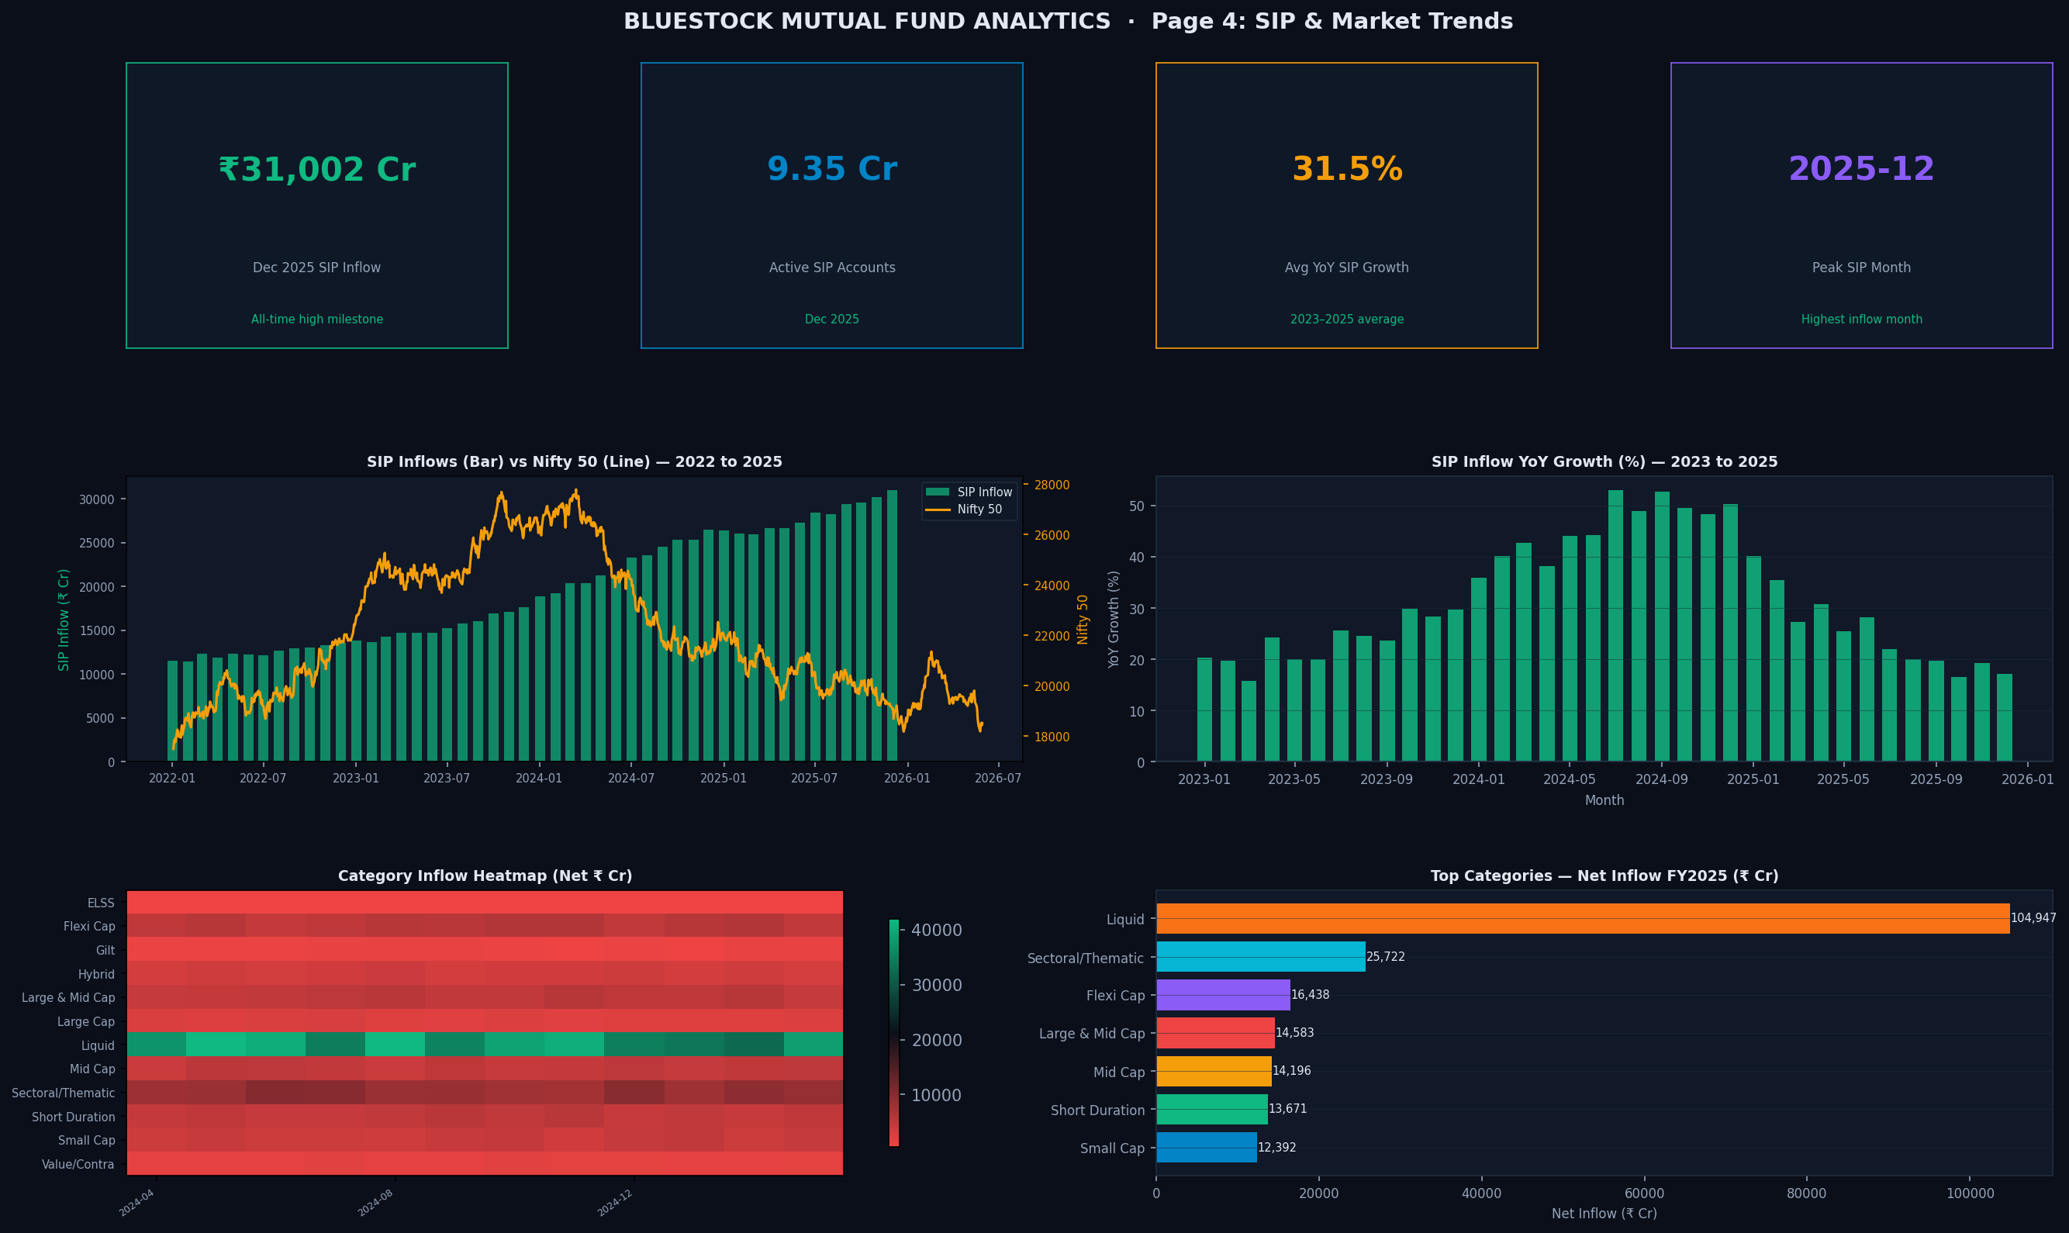
Dashboard — SIP & Market Trends
Page 4: SIP vs Nifty, category heatmap, FY25 flows

Slide 11
Key Findings & Recommendations
Data-driven insights for investors and advisors
Top 5 Findings
Recommendations
› ICICI Pru Midcap leads composite scorecard (85.12) — best risk-adjusted returns
› Align fund selection with risk grade (Low/Moderate/High) using recommender.py
› SIP financialisation is systemic: 181% inflow growth over 4 years
› Mandate Direct plans for cost-conscious retail investors
› Direct plans compound 18–30% more wealth over 10 years vs Regular
› Implement SIP auto-debit + reminder systems to reduce dropout
› Small Cap VaR can exceed 4% daily — unsuitable for < 5yr horizon
› Diversify across AMCs to reduce single-manager concentration
› SIP continuity gap analysis reveals 99%+ investors need retention intervention
› Use VaR/CVaR as risk disclosure metric alongside standard deviation

Slide 12
Thank You
Bluestock Mutual Fund Analytics Capstone
GitHub:
github.com/nush1729/bluestock_mf_capstone
Tech Stack:
Python · Pandas · Matplotlib · SQLite · ReportLab
Days:
7 days · 10 datasets · 40 funds · 12+ metrics

