Slide 1

Introduction to OpenMC
Khondokar Nushaer Abrar
B.Sc. In Nuclear Engineering
University of Dhaka

Slide 2
Learning Outcomes
Introduction to Monte-Carlo Methods
Difference between deterministic and Probabilistic methods
Examples
Monte-Carlo Particle Transport Methodology
OpenMC basic structure

Slide 3
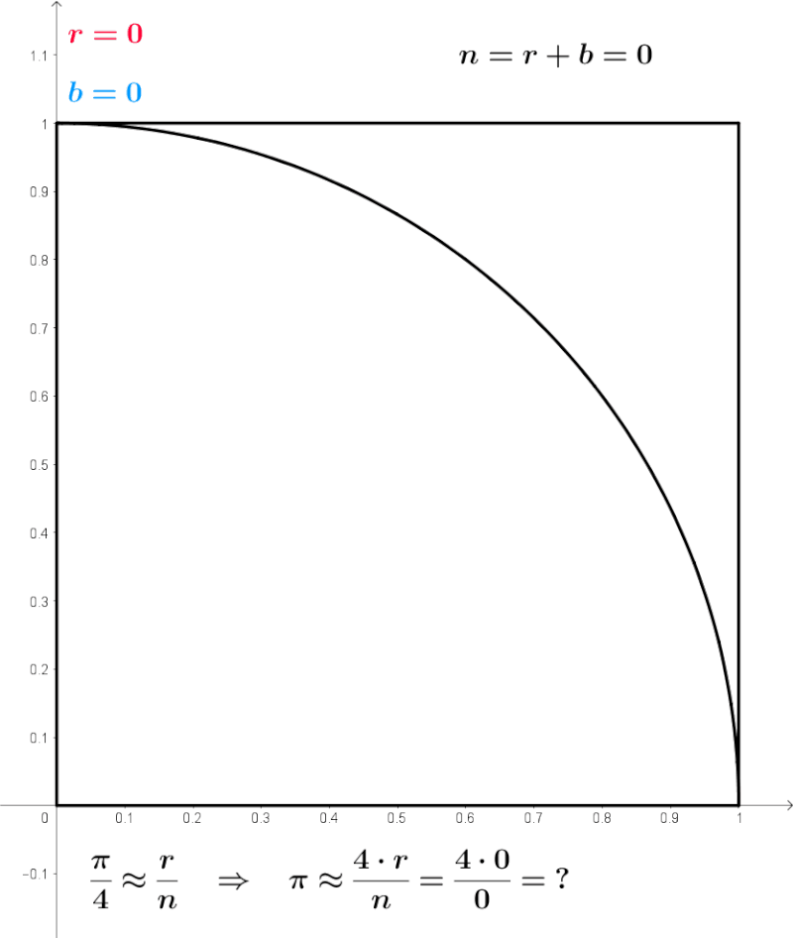
What is Monte-Carlo
An Algorithm
Uses Random Sampling to solve complex problems that may be deterministic in nature
Provides an estimated solution close to the actual solution

Slide 4
Examples for Relevance
Calculating Pi
Calculating finite Integrals
  Deterministic method
  Monte Carlo

Slide 5
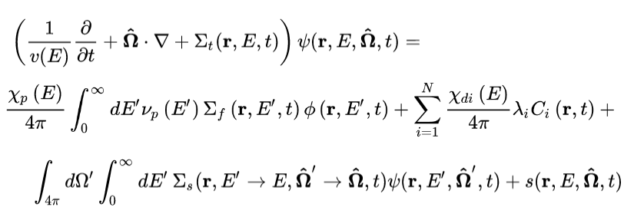
Monte-Carlo Particle Transport Code
A program that solves the neutron transport equation through random sampling
*For more information, look up any reactor physics book or wikipedia

Slide 6
Common Codes
Methodology
Define Materials
Define Geometry
Set simulation parameters
Specify Tallies
Run simulation
Analyze results
MCNP
SERPENT
GEANT4
OpenMC

Slide 7
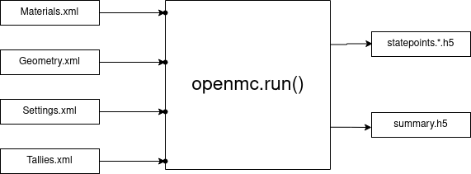
How does OpenMC work?
Input
Output

Slide 8
Installation Prerequisites
Multi-core(thread) Processor
At least 8GB Ram
100 GB space (safe)
Ubuntu, MacOS or any Linux-based OS (better)
Windows with Docker or WSL (creates problems)
Elementary Python Knowledge

Slide 9
Installation process
Install Anaconda
Create environment
Install OpenMC
Install Jupyter notebook
Install Vscode (optional)
Download cross-section files

Slide 10
Tasks
Install OpenMC
Review the scripts
Useful Links
https://docs.openmc.org/en/stable/quickinstall.html
https://openmc.org/official-data-libraries/ (download endf VIII.0)

