Slide 1


SINGLE RESPONSIBILITY PRINCIPLE
MiSSUnDERSTOOD and UNDERESTIMATED
Nodirbek Usmanov
https://linkedin.com/in/nodirbek-usmanov
nodirbek@befico.de

Slide 2
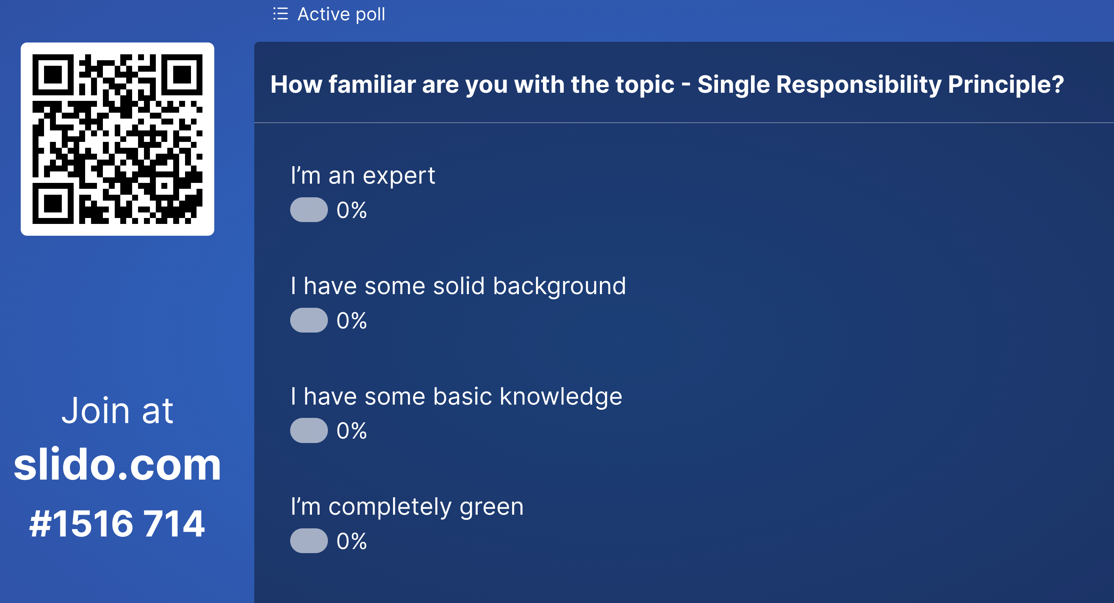
INTRO

Slide 3
Single Responsibility PRINCiPLE
“A class should have only one reason to change.”
Robert C. Martin,“Agile Software Development: Principles, Patterns, and Practices”, 2002

Slide 4

Single Responsibility PRINCiPLE
Is one of the simplest of the principles, and one of the hardest to get

Slide 5
Single Responsibility PRINCiPLE (SRP)
“In context of SRP, we define
a responsibility
to be
a reason for change.”
Robert C. Martin,“Agile Software Development: Principles, Patterns, and Practices”, 2002

Slide 6
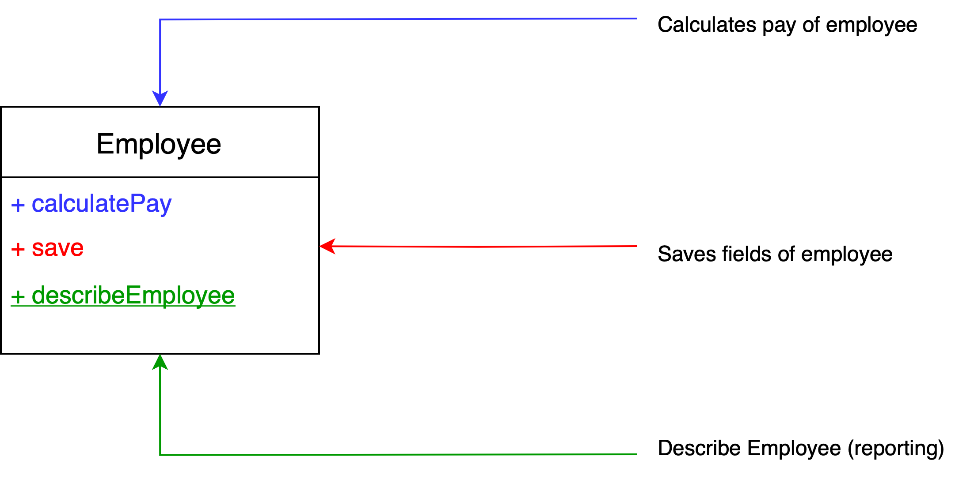
Single Responsibility Principle
“A class should have only one reason to change.” - Robert C. Martin
class OrderService {
fun sendEmail (): = { … }
fun findById (): Order = { … }
fun generateInvoice (): Invoice = { … }
}

Slide 7
Responsibility
How many responsibilities does this class have?
class OrderService {
fun sendEmail (): = { … }
fun findById (): Order = { … }
fun generateInvoice (): Invoice = { … }
}

Slide 8
Responsibility
How many responsibilities does this class have? 3
class OrderService {
fun sendEmail (): = { … }
fun findById (): Order = { … }
fun generateInvoice (): Invoice = { … }
}

Slide 9
CONCLUSION – VIOLATES SRP
The class knows about
  business rules
  databases
  reports and formatting
Responsibilities > 1
Each of these responsibilities will cause
the employee class to use other classes
in the system.
class OrderService {
fun sendEmail (): = { … }
fun findById (): Order = { … }
fun generateInvoice (): Invoice = { … }
}

Slide 10
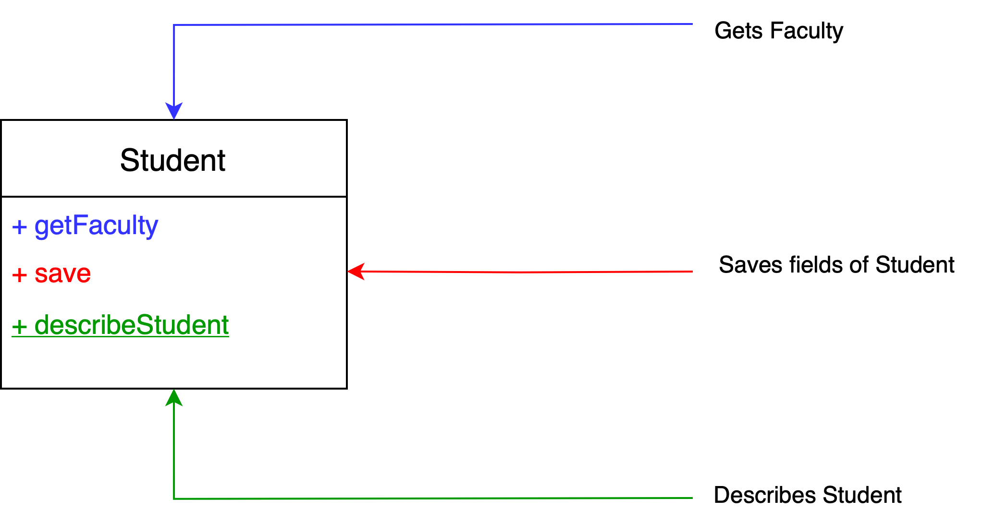
Responsibility
How many responsibilities does this class have?
class OrderService {
fun sendEmail (): = { … }
fun findById (): Order = { … }
fun generateInvoice (): Invoice = { … }
}

Slide 11
Responsibility
How many responsibilities does this class have? 3
class OrderService {
fun sendEmail (): = { … }
fun findById (): Order = { … }
fun generateInvoice (): Invoice = { … }
}

Slide 12
Responsibility
Let us add a new function to the class.
How many responsibilities does this class have?
+ findById - Finds a student by id
class OrderService {
fun sendEmail (): = { … }
fun findById (): Order = { … }
fun generateInvoice (): Invoice = { … }
}

Slide 13
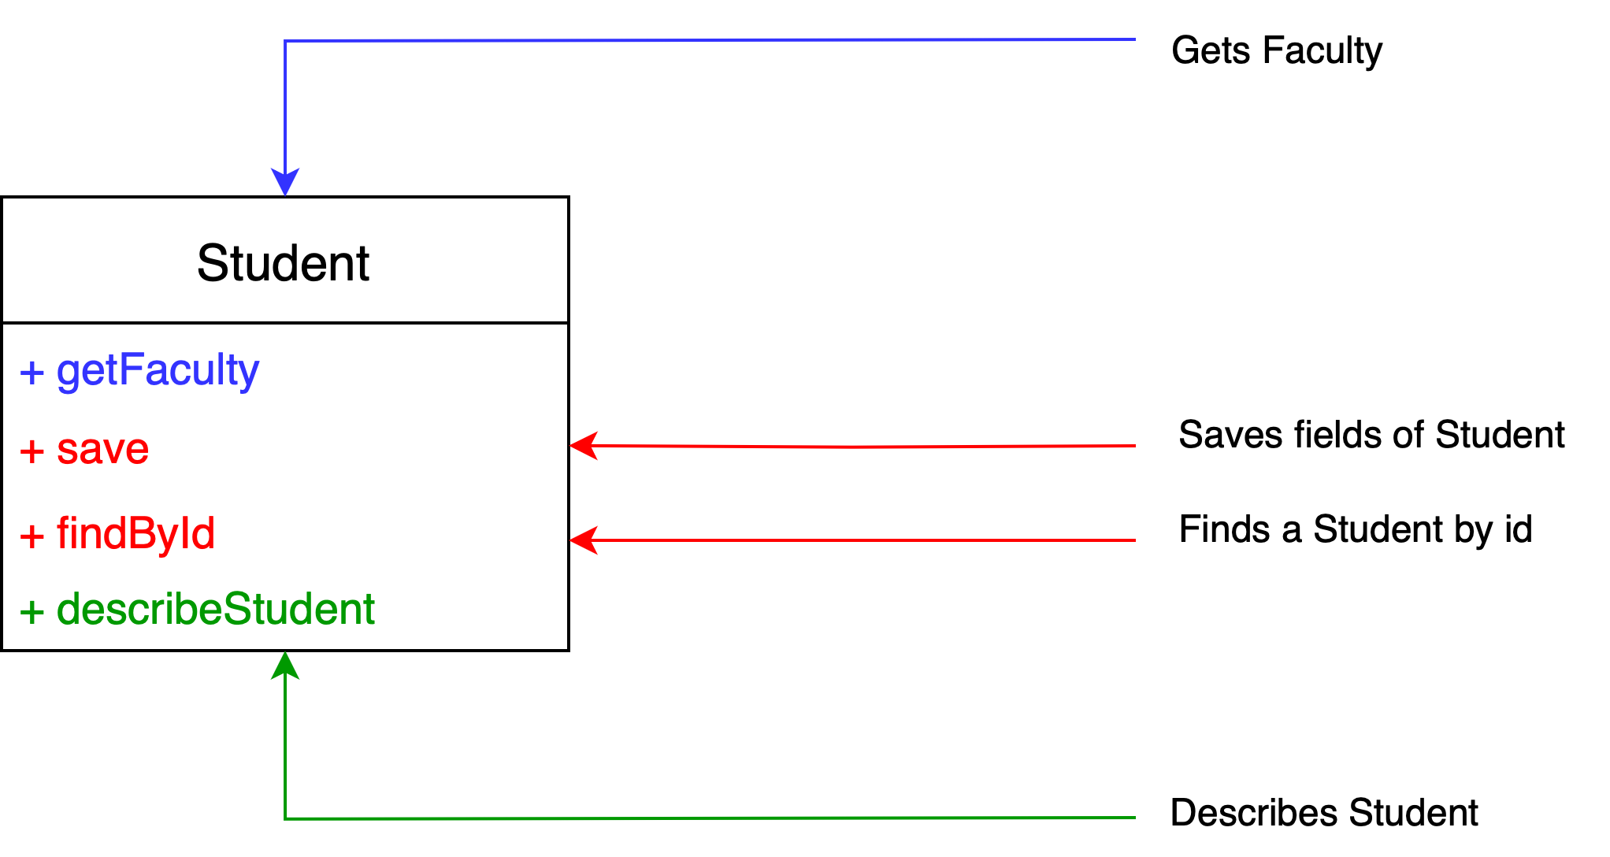
Responsibility
How many responsibilities does this class have? 3
same family as save, both database functions
class OrderService {
fun sendEmail (): = { … }
fun findById (): Order = { … }
fun generateInvoice (): Invoice = { … }
}
Notes:
Similiary >> to getFaculty give me some examples?

Slide 14
CONCLUSION – VIOLATES SRP
The class knows about
  business rules
  databases
  reports and formatting
Responsibilities > 1
Each of these responsibilities will cause
the student class to use other classes
in the system.
class OrderService {
fun sendEmail (): = { … }
fun findById (): Order = { … }
fun generateInvoice (): Invoice = { … }
}
Notes:
Similiary >> to getFaculty give me some examples?

Slide 15
RESPONSIBILiTY – SOURCE OF CHANGE
The SRP is about users
Who are the users, who add changes to that method?
class OrderService {
fun sendEmail (): = { … }
fun findById (): Order = { … }
fun generateInvoice (): Invoice = { … }
}

Slide 16
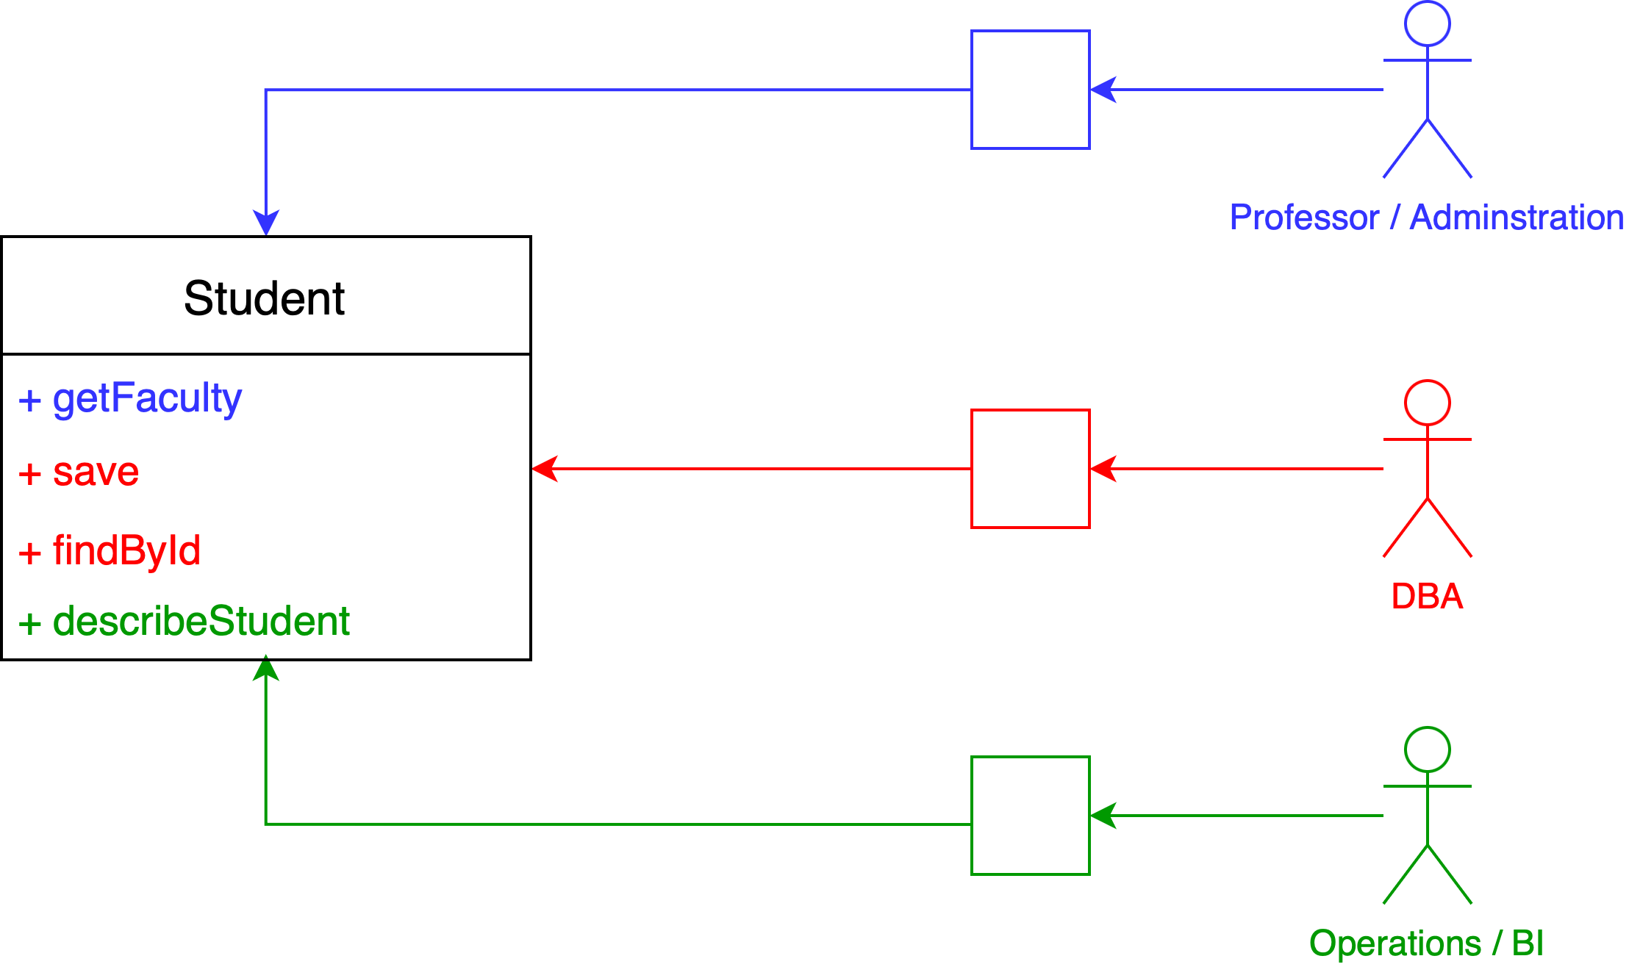
Responsibility
Who are the people, who are the sources of change for the STUDENT class?
class OrderService {
fun sendEmail (): = { … }
fun findById (): Order = { … }
fun generateInvoice (): Invoice = { … }
}

Slide 17
Single Responsibility PRINCIPLE
“A class should have only one reason to change.” - Robert C. Martin
Focuses the left side – classes!
class OrderService {
fun sendEmail (): = { … }
fun findById (): Order = { … }
fun generateInvoice (): Invoice = { … }
}

Slide 18
Single Responsibility PRINCIPLE responsibility is a family of functions that serves one particular actor
Focuses the right side – actors!
class OrderService {
fun sendEmail (): = { … }
fun findById (): Order = { … }
fun generateInvoice (): Invoice = { … }
}

Slide 19
Rephrase
SINGLE RESPONSIBILITY PRINCIPLE
“A class should have only one reason to change.”
Robert C. Martin, 2002
SINGLE OWNERSHIP PRINCIPLE
“A class should serve only one owner, who defines the requirements to create or change it.”
Nodirbek Usmanov, 2023

Slide 20
Rephrase 2
SINGLE RESPONSIBILITY PRINCIPLE
“A class should have only one reason to change.”
Robert C. Martin, 2002
SINGLE OWNERSHIP PRINCIPLE
“A class should serve only one owner, who defines a family of functions (responsibility).”
Nodirbek Usmanov, 2023

Slide 21
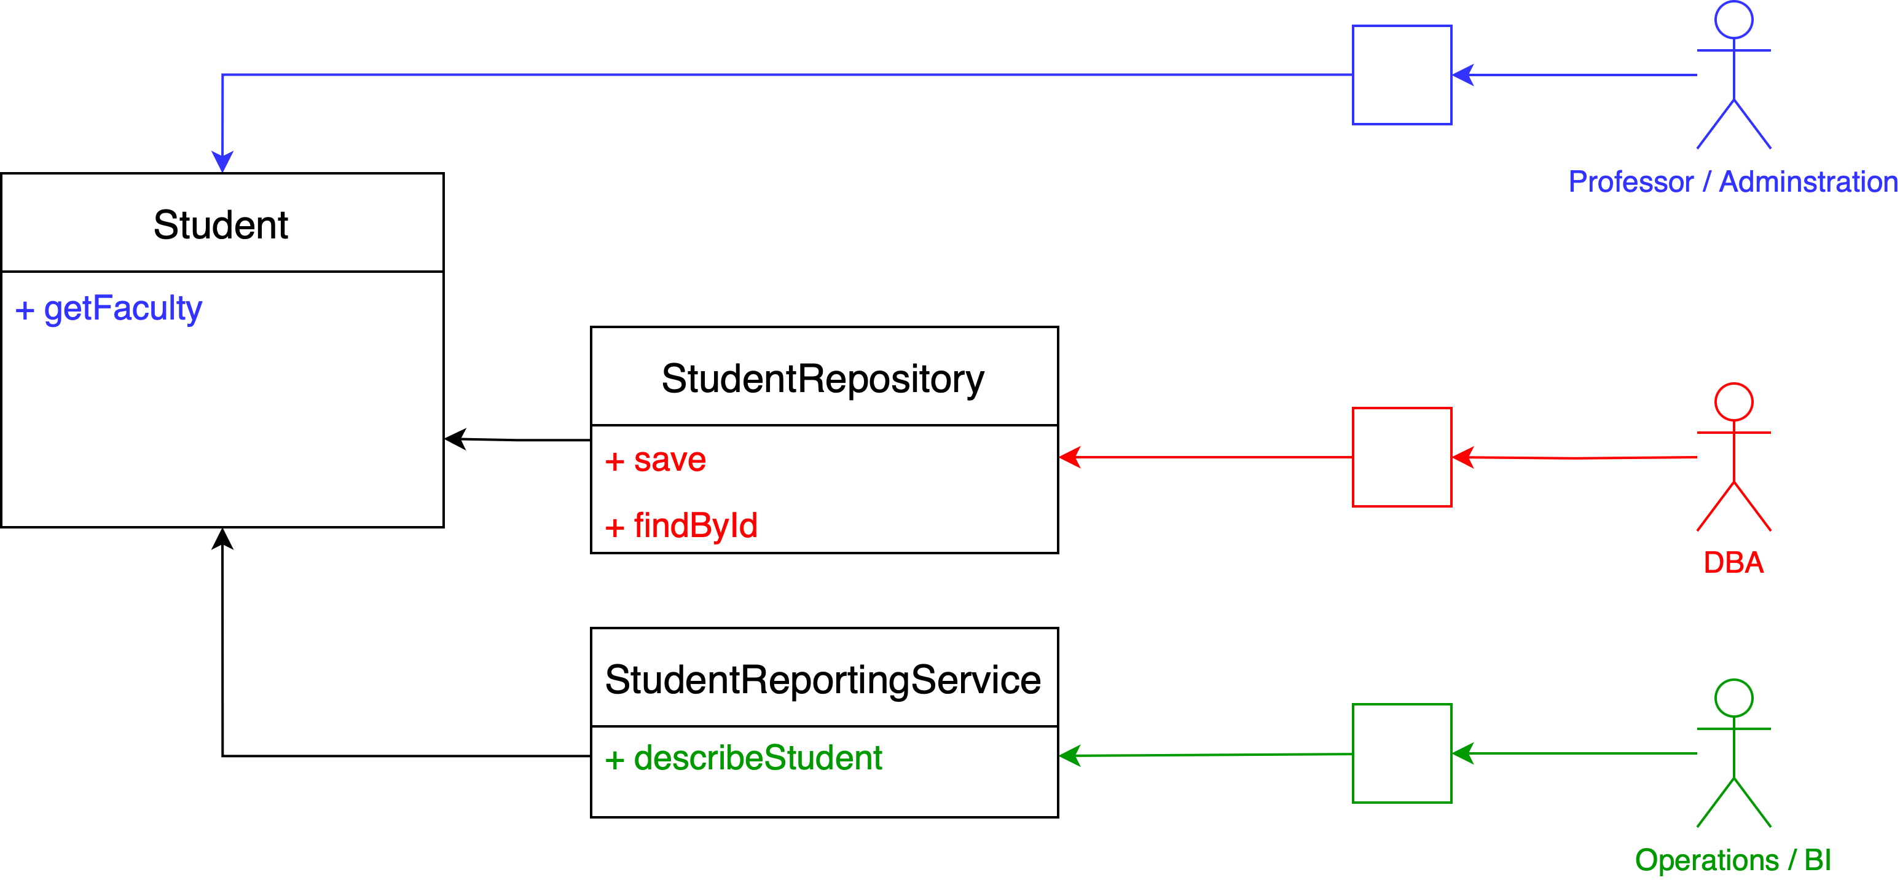
Refactor aware of transitive dependencies
class OrderService {
fun sendEmail (): = { … }
fun findById (): Order = { … }
fun generateInvoice (): Invoice = { … }
}
Notes:
Be aware of transitive dependecies
We realized that none of these solutions were perfect.
Welcome to engineering

Slide 22
TAKE AWAY
A responsibility is a family of functions that serves one particular actor
Increase the cohesion between things that change for same reasons
Decrease the coupling between those things that change change for different reasons
Notes:
the class / module must perform one task or achieve a single objective
adhering to this principle in design of classes and modules, leads to separation of concerns(SoC) and maintainable code
follows the motto – “do one thing and do it well”
a single responsibility of the system, should drive the design of a class or module
the design intent of the class or module must define its behaviour /responsibility
it is against the idea of a class or module having all or multiple groups of the behaviour of the system
such a design would make the system rigid, fragile, and less maintainable

Slide 23
LINKS
The Single Responsibility Principle (08 May 2014), by Robert C. Martin (Uncle Bob), https://blog.cleancoder.com/uncle-bob/2014/05/08/SingleReponsibilityPrinciple.html
Agile Software Development: Principles, Patterns, and Practices, 2002, by Robert C. Martin (Uncle Bob)

Slide 24
THANK YOU
Reviewer Ulugbek Usmanov
Adesso AG Deutschland
Reviewer Marcus Schroeder
flint & sparks GmbH, Berlin
Contact me
https://linkedin.com/in/nodirbek-usmanov
nodirbek@befico.de

