Slide 1
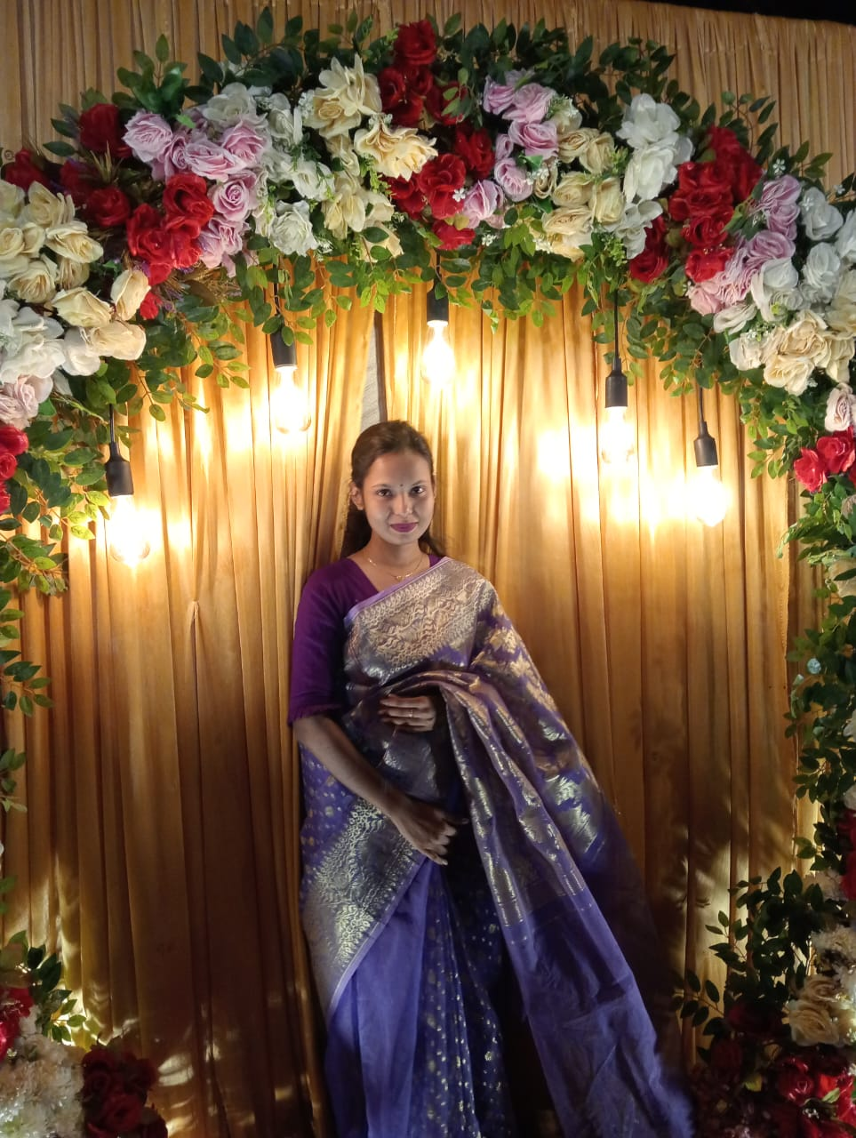
Nusrat jhahan sumaiya
Sociology department

Slide 2
Personal information
Name:Mst. Nusrat jhahan sumaiya
Father Name: Md. Ali hasan kajol
Mother Name:Mst. Monowara khatun
Home distric:Mymenshing
Living place:akhalia,Sylhet

Slide 3
Studying Information
School: DR. Sirajul Islam Academy
Collage: Shambhugonj GKP Degree Collage
University: Shahajal University of Science and Technology,sylhet
Department: Sociology
Year:4th year
Student id:2019232083

Slide 4
HOBBY
Gardening
Singing
Drawing
Cooking

Slide 5
THANK YOU

