Slide 1

Project Presentation on: Data Science Lab
“Heart Attack Risk Prediction using 14 Machine Learning Model”
Presented by:
RunTime_Terr0r
Md.Sharafatullah Jomadder
ID:B190305012
Nusrat Alam Srabanti
ID:B190305045
Niloy Datta
ID:B180305013
Presented to:
Dr. Md. Manowarul Islam, Associate Professor
Dept. of Computer Science & Engineering
Jagannath University,Dhaka
Department of Computer Science and Engineering, Jagannath University, Dhaka

Slide 2
Overview
01
05
09
Abstract
Dataset Attributes
Model Evaluation
02
06
10
Introduction
Tools & Technology
User Interface
03
07
11
Aims & Objectives
Data Pre-Processing
Future Work
04
08
12
Proposed Methodolgy
Exploratory Data Analysis
Conclusion
Department of Computer Science and Engineering, Jagannath University, Dhaka

Slide 3
ABSTRACT
Methodology:
Utilized a comprehensive machine learning approach to predict heart attack using a cleaned and preprocessed healthcare dataset
Outliers were removed using the IQR method, followed by label encoding of categorical variables
Multiple classification algorithms—including Logistic Regression, Random Forest, SVM, XGBoost and others—were trained and evaluated using cross-validation and accuracy metrics
Results:
The best-performing models were identified and further optimized via hyperparameter tuning.
Results demonstrated that ensemble models like XGBoost and Random Forest achieved the highest predictive accuracy
Impact:
Significant implications for early diagnosis, enabling data-driven decision-making in healthcare
Potentially reducing the risk of undetected heart conditions
Methodology
Results
Impact
Department of Computer Science and Engineering, Jagannath University, Dhaka

Slide 4

INTRODUCTION
Heart Attacks, also known as myocardial infarctions, are a leading cause of death worldwide.
Predicting the risk of heart attacks can significantly improve patient outcomes by enabling early intervention and preventive measures.
With the advent of machine learning, we can leverage vast amounts of health data to develop predictive models and web interface that can assist healthcare professionals in identifying individuals at high risk.
Department of Computer Science and Engineering, Jagannath University, Dhaka

Slide 5
AIMS
Develop Predictive Model
Create a machine learning model to accurately predict heart attack risks
Algorithm Comparison
Evaluate and compare different algorithms to find the most accurate model
Identify Risk Factors
Pinpoint significant risk factors to enhance the predictive model
Interactive User Interface
Develop a user-friendly interface for easy data input and clear heart attack risk predictions
Department of Computer Science and Engineering, Jagannath University, Dhaka

Slide 6
OBJECTIVES
Raw Patient Data
Data Preprocessing
Model Training
Model Testing
Performance Comparison
Interpretability Analysis
Informed Clinical Decisions
Department of Computer Science and Engineering, Jagannath University, Dhaka

Slide 7
PROPOSED METHODOLOGY
Exploraory Data Analysis
Dataset identification to describle the problem statement
Preprocessing
Train attributes with traditional ML algorithm
Identification of Problem Statement
Import Dataset
Analysis the performance of ML model
Feedback and Analysis
Kaggle
Update as per suggestion
No
Yes
Deploy Model
Decision
Department of Computer Science and Engineering, Jagannath University, Dhaka

Slide 8
DATASET ATTRIBUTES
The data for the study were retrieved from kaggle.Here we have used 2 different dataset prediction.
Dataset 1: The entire dataset consisted of 918 rows and 12 columns
and consisted of multiple features like Age, Sex, ChestPain, RestingBP, Cholesterol, FastingBS, RestingECG, MaxHR and many more...
Dataset 2: The entire dataset consisted of 1025 rows and 14 columns
and consisted of multiple features like Age, Sex, ChestPain, Slope, Thalach, FastingBS, Oldpeak, Thal and many more...
Department of Computer Science and Engineering, Jagannath University, Dhaka

Slide 9
TOOLS & TECHNOLOGY
HTML, CSS, BOOTSTRAP : Front-End Framework for Styling
Flask: Web Framework for building the Web-Application
Google Colab: For Model Training
Libray: Matplotlib,Numpy,Pandas,Seaborn,Scikit-learn
Department of Computer Science and Engineering, Jagannath University, Dhaka

Slide 10
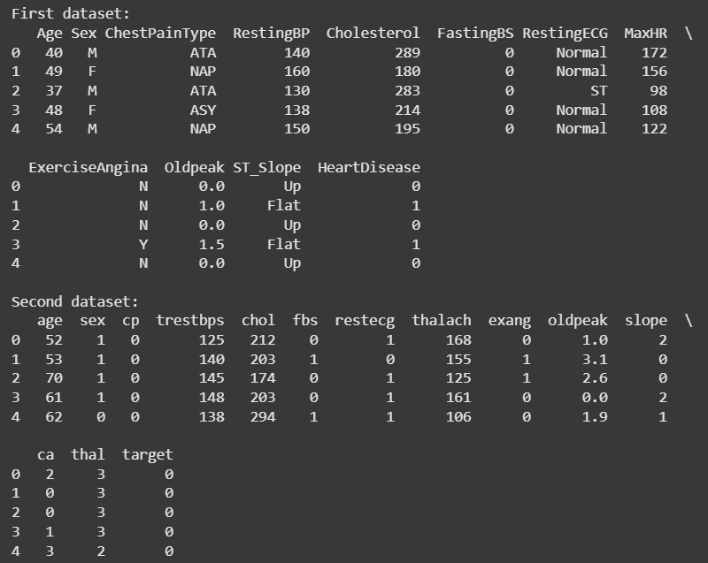
DATA PRE-PROCESSING
Begin by loading the two datasets from their respective CSV files
Fig: Dataset_1 & Dataset_2
Department of Computer Science and Engineering, Jagannath University, Dhaka

Slide 11
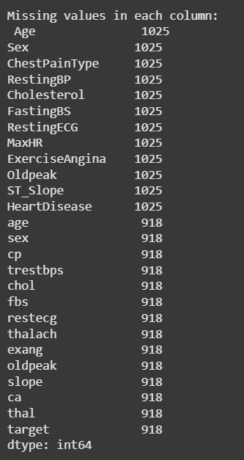
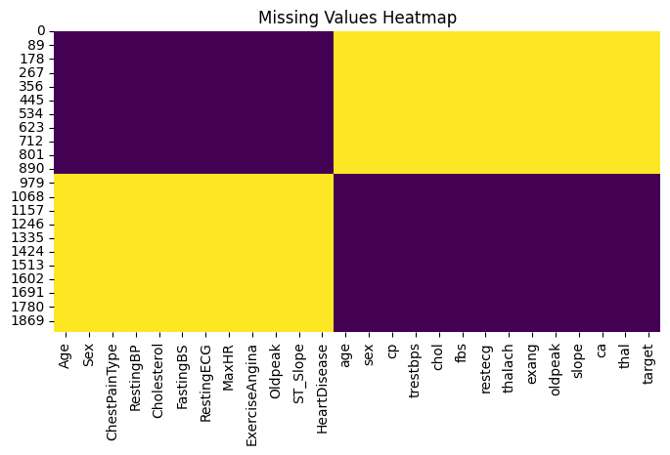
DATA PRE-PROCESSING
After merging the two datasets, a significant number of missing values appeared in the dataset
Fig: Missing Values in Merged Dataset
Fig: Missing Values Heatmap
Department of Computer Science and Engineering, Jagannath University, Dhaka

Slide 12
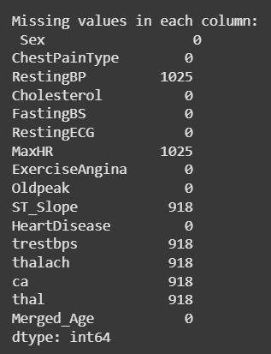
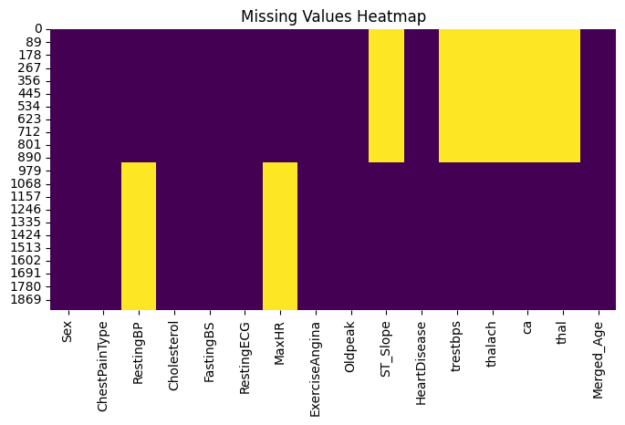
DATA PRE-PROCESSING
Since both datasets contain a similar feature, we need to combine the duplicate columns to eliminate redundancy
Fig: Missing Values in Merged Dataset
Fig: Missing Values Heatmap
Department of Computer Science and Engineering, Jagannath University, Dhaka

Slide 13
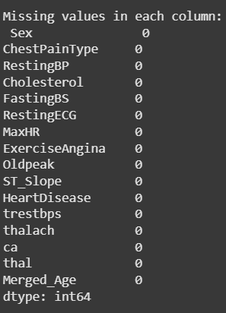
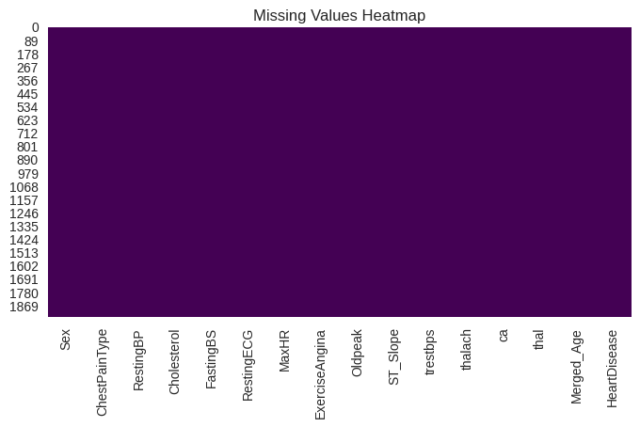
DATA PRE-PROCESSING
Fill NaN values in numerical columns using the mean of each column
Fig: No Missing Values in Merged Dataset
Fig: Missing Values Heatmap
Department of Computer Science and Engineering, Jagannath University, Dhaka

Slide 14
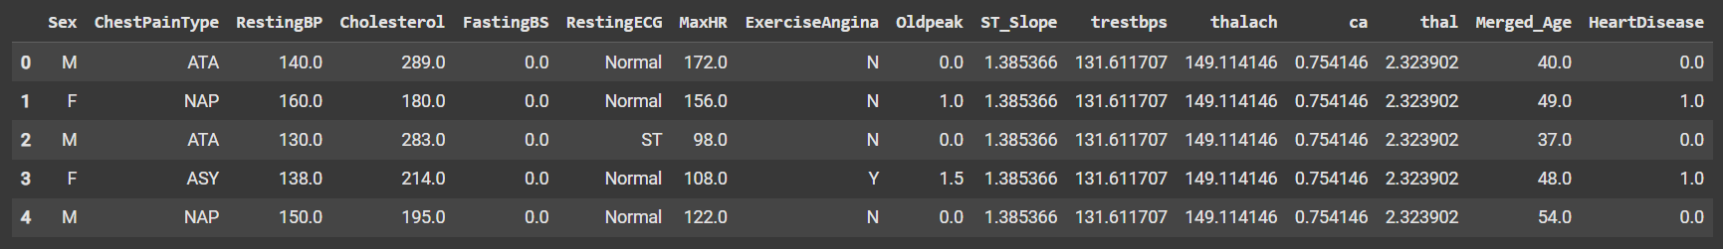
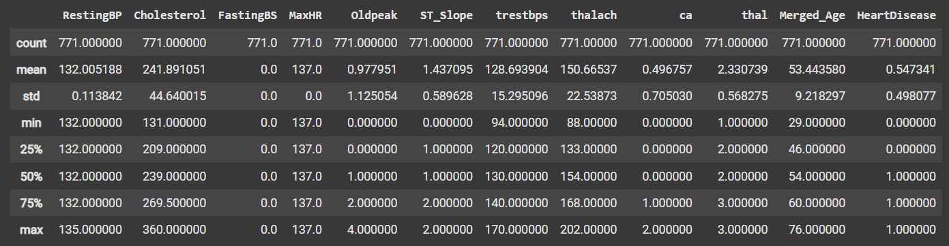
EXPLORATORY DATA ANALYSIS
Statistical description of all features and the data shape is (1943,16) 16)
Fig: Features Description
Department of Computer Science and Engineering, Jagannath University, Dhaka

Slide 15
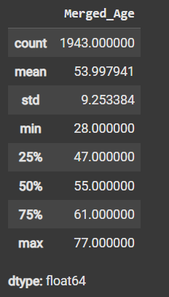
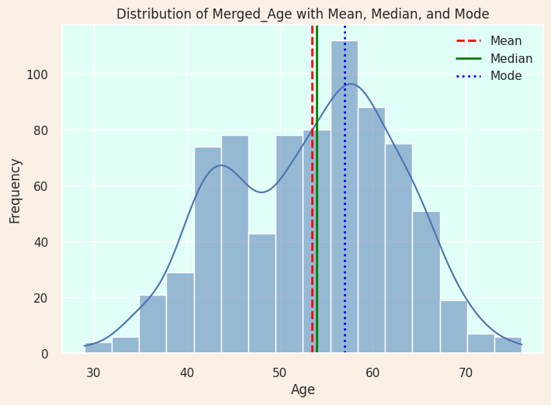
EXPLORATORY DATA ANALYSIS
Exploring Age Column
Fig: Age Column
Fig: Mean, Median and Mode Of Age Column
Department of Computer Science and Engineering, Jagannath University, Dhaka

Slide 16
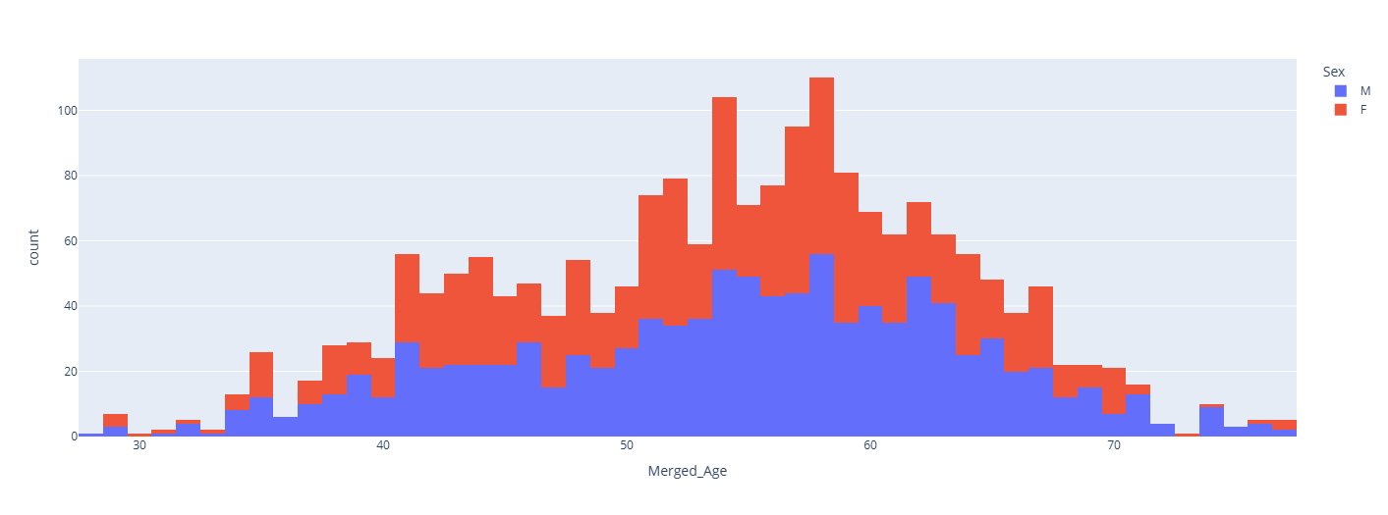
EXPLORATORY DATA ANALYSIS
Fig: Histogram of Age Column Against Sex
Department of Computer Science and Engineering, Jagannath University, Dhaka

Slide 17
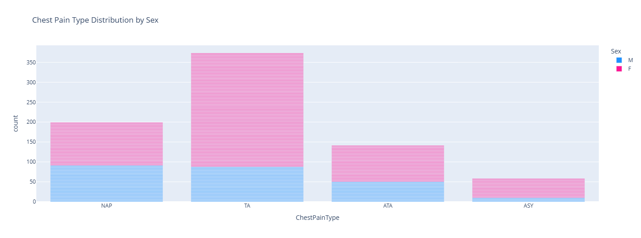
EXPLORATORY DATA ANALYSIS
Exploring ChestPain Column
Fig: Chest Pain Type Distribution By Sex
Department of Computer Science and Engineering, Jagannath University, Dhaka

Slide 18
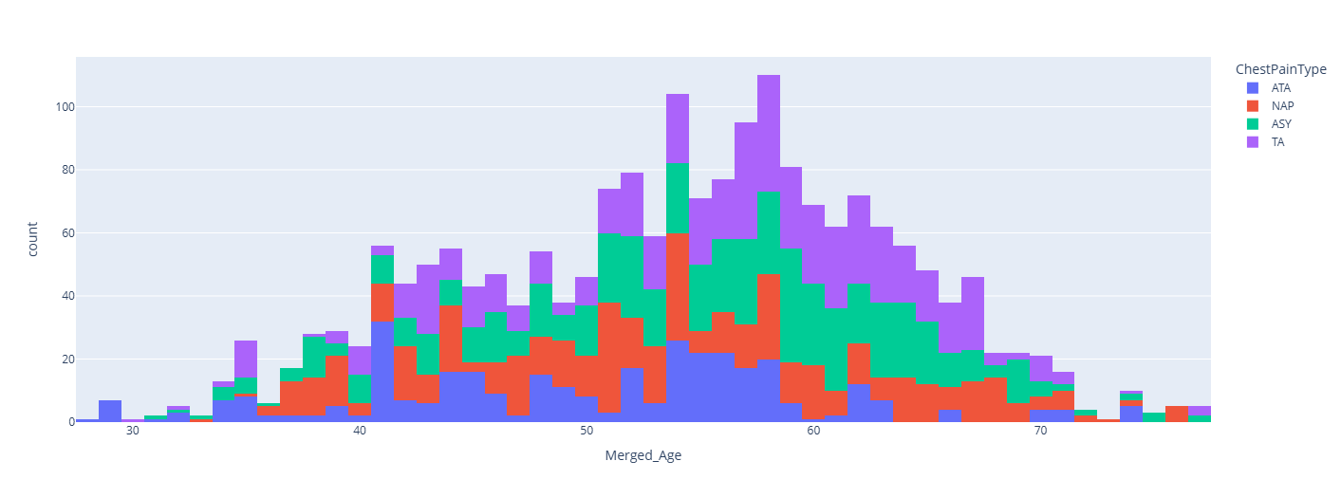
EXPLORATORY DATA ANALYSIS
Fig: Histogram of Chest Pain Against Age
Department of Computer Science and Engineering, Jagannath University, Dhaka

Slide 19
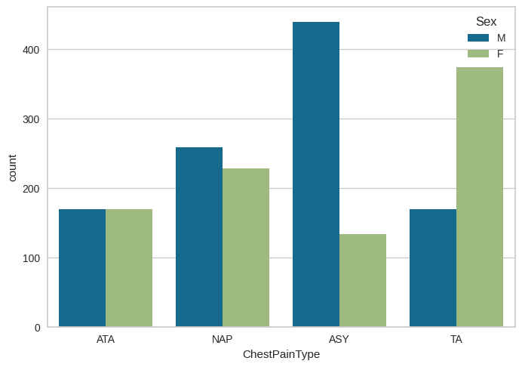
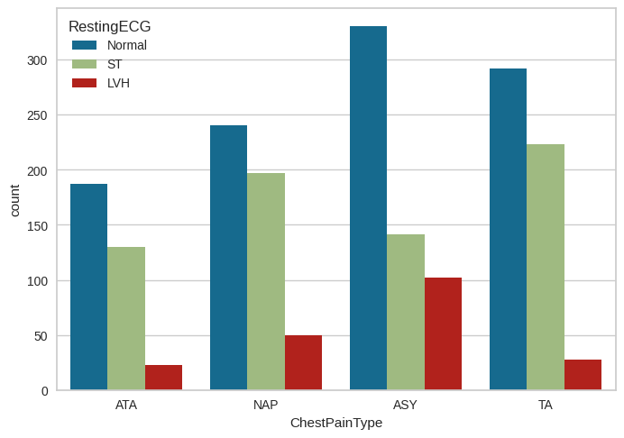
EXPLORATORY DATA ANALYSIS
Fig: Bar Chart of Chest Pain Against Sex
Fig: Bar Chart of Chest Pain Against RestingECG
Department of Computer Science and Engineering, Jagannath University, Dhaka

Slide 20
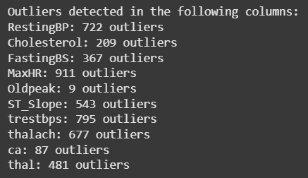
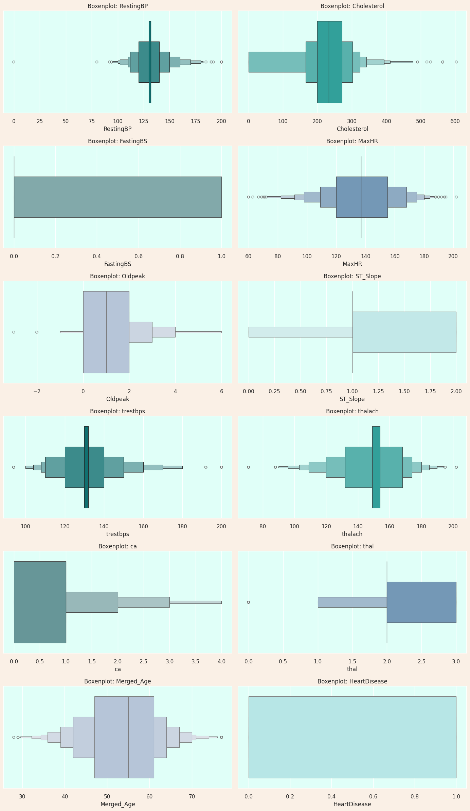
EXPLORATORY DATA ANALYSIS
Dealing With Outliers
Fig: Number Of Outliers
Fig: Visualization Of Outliers With Boxplots
Department of Computer Science and Engineering, Jagannath University, Dhaka

Slide 21

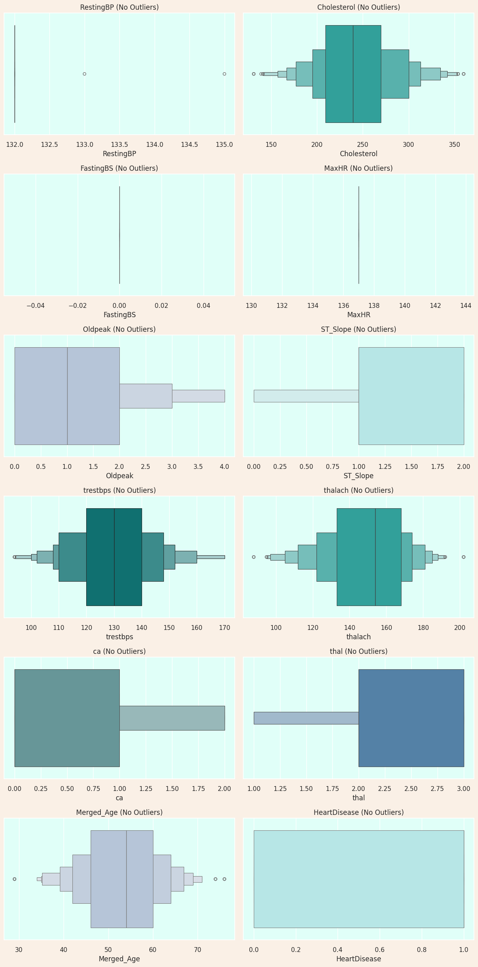
EXPLORATORY DATA ANALYSIS
Removing Outliers:
Fig: Visualization Of Boxplots After Removing Outliers
Department of Computer Science and Engineering, Jagannath University, Dhaka

Slide 22
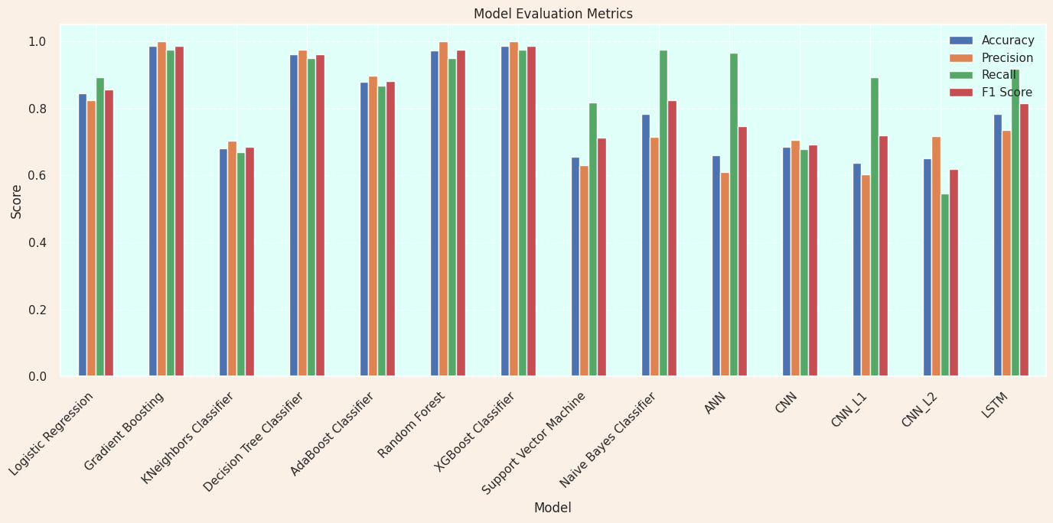

Model Evaluation
Initially, we applied 14 different machine learning models without using label encoding. Among them, Gradient Boosting and XGBoost Classifier delivered the best performance.
Fig: Model Accuracy Without Using Label Encoding
Department of Computer Science and Engineering, Jagannath University, Dhaka

Slide 23
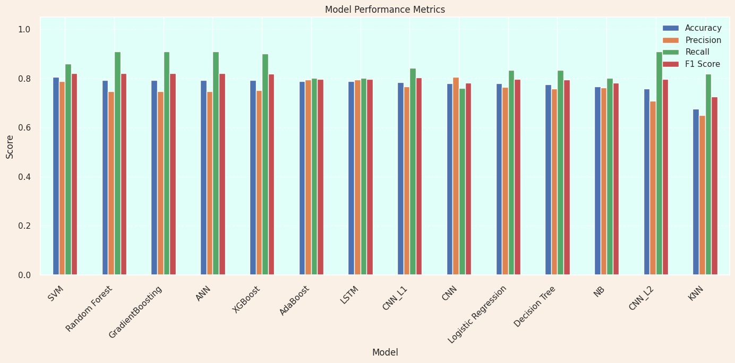

Model Evaluation
In the second phase, we applied categorical encoding to specific features such as 'Sex', 'ChestPainType', 'RestingECG' and 'ExerciseAngina'. After training multiple models with the encoded data, Support Vector Machine (SVM) demonstrated the highest performance.
Fig: Model Accuracy Using Categorical Encoding
Department of Computer Science and Engineering, Jagannath University, Dhaka

Slide 24
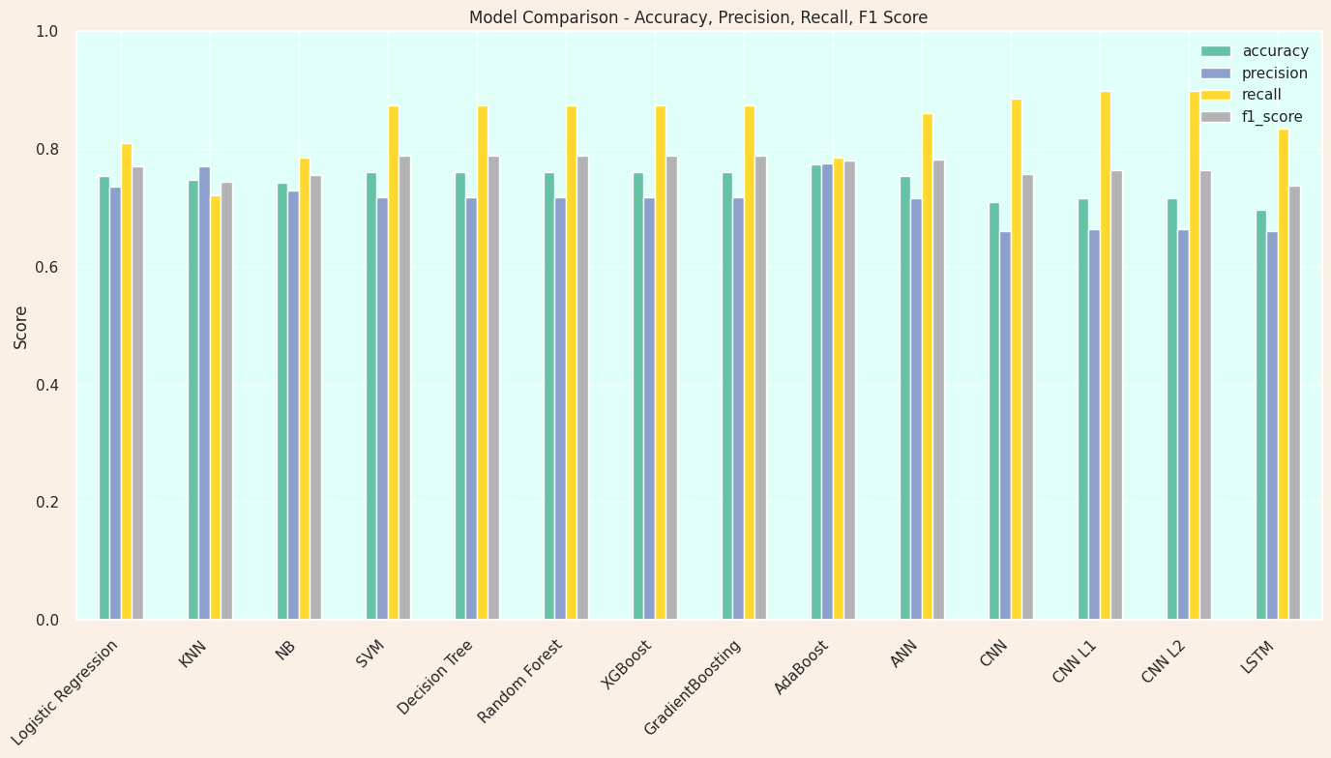

Model Evaluation
In the final phase, we applied hyperparameter tuning across a wide range of models, including traditional machine learning algorithms, deep learning architectures (ANN, CNN, LSTM) and regularized variants. After extensive evaluation using accuracy, precision, recall and F1-score, the AdaBoost model emerged as the top performer with the highest accuracy.
Fig: Model Accuracy Using Hyper Parameter Tuning
Department of Computer Science and Engineering, Jagannath University, Dhaka

Slide 25
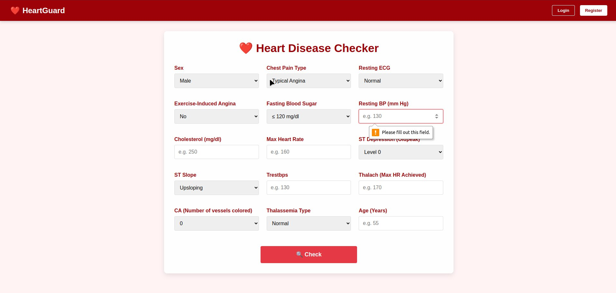
USER INTERFACE
Department of Computer Science and Engineering, Jagannath University, Dhaka

Slide 26
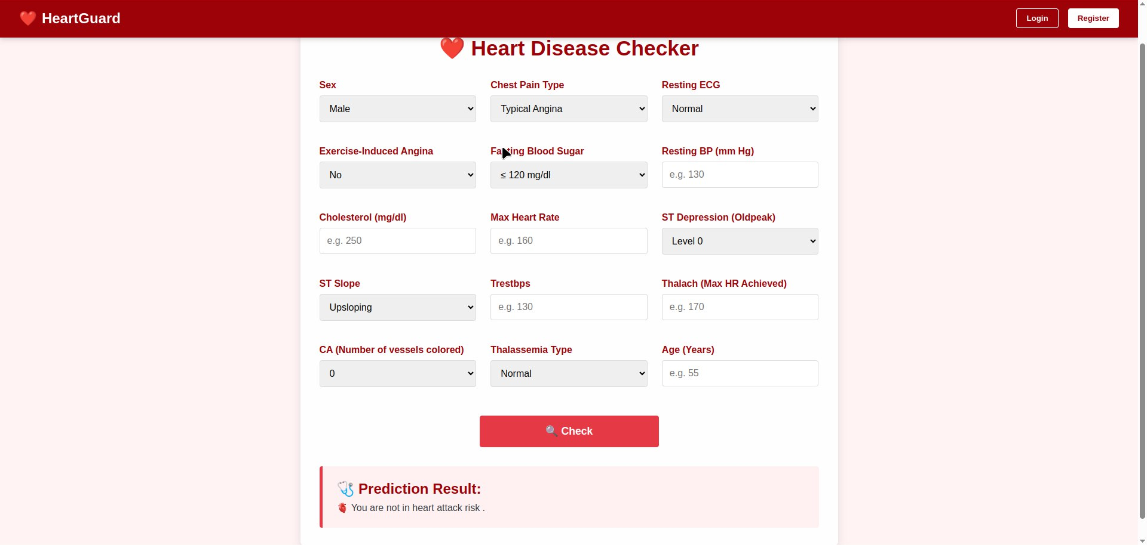
USER INTERFACE
Department of Computer Science and Engineering, Jagannath University, Dhaka

Slide 27
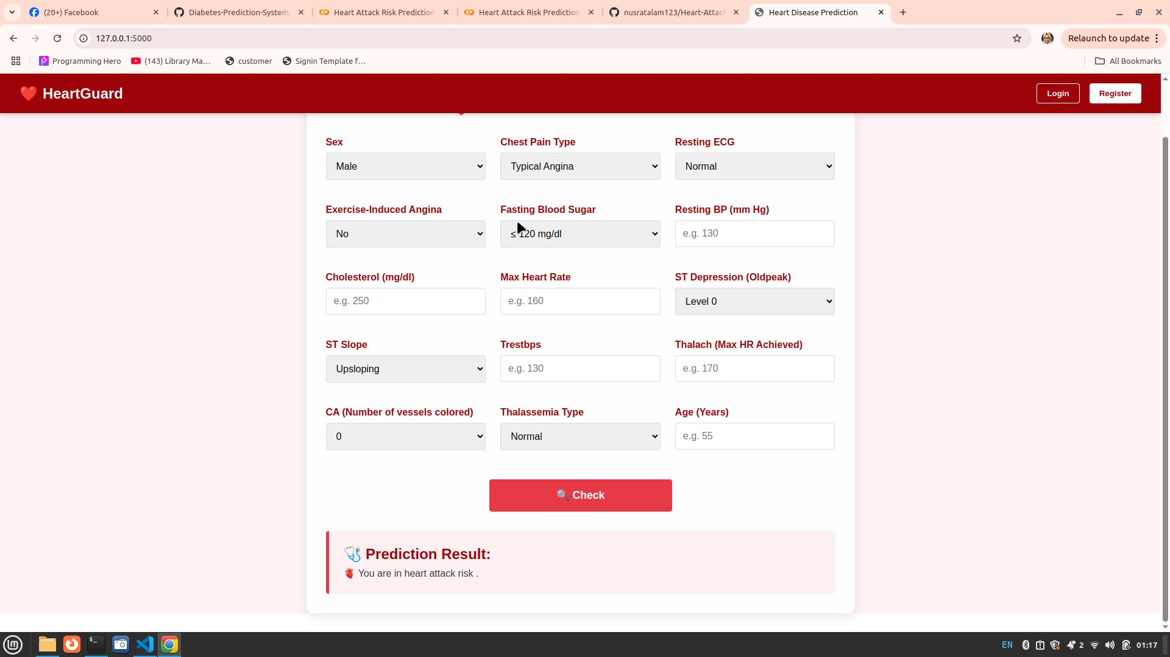
USER INTERFACE
Department of Computer Science and Engineering, Jagannath University, Dhaka

Slide 28
Future Work
Explore advanced ensemble techniques (stacking, blending) to improve predictive performance further.
Integrate interpretability tools like SHAP or LIME to explain model decisions and enhance trust in predictions.
Apply automated feature selection methods (like Recursive Feature Elimination) or generate new composite features.
Use advanced techniques like SMOTE, ADASYN, or cost-sensitive learning for better handling of class imbalance.
Department of Computer Science and Engineering, Jagannath University, Dhaka

Slide 29

Department of Computer Science and Engineering, Jagannath University, Dhaka

