Slide 1
Classes – Inheritance Review
CS 246

Slide 2
Review notes
This is a quick review of inheritance from CS 244
Slides are from the textbook

Slide 3
What Is Inheritance?
Provides a way to create a new class from an existing class
The new class is a specialized version of the existing class

Slide 4
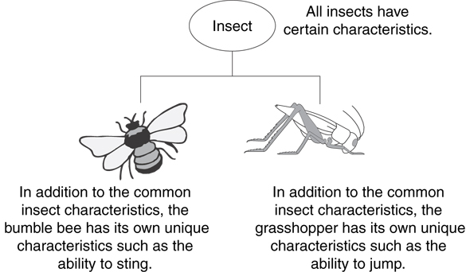
Example: Insects

Slide 5
The "is a" Relationship
Inheritance establishes an "is a" relationship between classes.
A poodle is a dog
A car is a vehicle
A flower is a plant
A football player is an athlete

Slide 6
Inheritance – Terminology and Notation
Base class (or parent) – inherited from
Derived class (or child) – inherits from the base class
Notation:
class Student // base class
{
. . .
};
class UnderGrad : public student
{ // derived class
. . .
};

Slide 7
Back to the ‘is a’ Relationship
An object of a derived class 'is a(n)' object of the base class
Example:
an UnderGrad is a Student
a Mammal is an Animal
A derived object has all of the characteristics of the base class

Slide 8
What Does a Child Have?
An object of the derived class has:
all members defined in child class
all members declared in parent class
An object of the derived class can use:
all public members defined in child class
all public members defined in parent class

Slide 9
Protected Members and Class Access
protected member access specification: like private, but accessible by objects of derived class
Class access specification: determines how private, protected, and public members of base class are inherited by the derived class

Slide 10
Class Access Specifiers
public – object of derived class can be treated as object of base class (not vice-versa)
protected – more restrictive than public, but allows derived classes to know details of parents
private – prevents objects of derived class from being treated as objects of base class.

Slide 11
Inheritance Concept
class Rectangle{
private:
int numVertices;
float *xCoord, *yCoord;
public:
void set(float *x, float *y, int nV);
float area();
};
Polygon
Rectangle
Triangle
class Polygon{
private:
int numVertices;
float *xCoord, *yCoord;
public:
void set(float *x, float *y, int nV);
};
class Triangle{
private:
int numVertices;
float *xCoord, *yCoord;
public:
void set(float *x, float *y, int nV);
float area();
};

Slide 12
Inheritance Concept
class Polygon{
protected:
int numVertices;
float *xCoord, float *yCoord;
public:
void set(float *x, float *y, int nV);
};
Polygon
Rectangle
Triangle
class Rectangle{
protected:
int numVertices;
float *xCoord, float *yCoord;
public:
void set(float *x, float *y, int nV);
float area();
};
class Rectangle : public Polygon{
public:
float area();
};

Slide 13
Inheritance Concept
class Polygon{
protected:
int numVertices;
float *xCoord, float *yCoord;
public:
void set(float *x, float *y, int nV);
};
Polygon
Rectangle
Triangle
class Triangle{
protected:
int numVertices;
float *xCoord, float *yCoord;
public:
void set(float *x, float *y, int nV);
float area();
};
class Triangle : public Polygon{
public:
float area();
};

Slide 14
Inheritance Concept
class Point{
protected:
int x, y;
public:
void set (int a, int b);
};
Point
x
y
Circle
3D-Point
x
y
r
x
y
z
class Circle : public Point{
private:
double r;
};
class 3D-Point: public Point{
private:
int z;
};

Slide 15
Inheritance Concept
Augmenting the original class
Specializing the original class
Polygon
Point
Rectangle
Triangle
Circle
3D-Point
ComplexNumber
real
imag
RealNumber
ImaginaryNumber
imag
real

Slide 16
Why Inheritance ?
Inheritance is a mechanism for
building class types from existing class types
defining new class types to be a
specialization
augmentation
of existing types

Slide 17
Define a Class Hierarchy
Syntax:
class DerivedClassName : access-level BaseClassName
where
access-level specifies the type of derivation
private by default, or
public
Any class can serve as a base class
Thus a derived class can also be a base class

Slide 18
Class Derivation
Point
class Point{
protected:
int x, y;
public:
void set (int a, int b);
};
3D-Point
Sphere
class 3D-Point : public Point{
private:
double z;
… …
};
class Sphere : public 3D-Point{
private:
double r;
… …
};
Point is the base class of 3D-Point, while 3D-Point is the base class of Sphere

Slide 19
What to inherit?
In principle, every member of a base class is inherited by a derived class
just with different access permission

Slide 20
Access Control Over the Members
Two levels of access control over class members
class definition
inheritance type
class Point{
protected: int x, y;
public: void set(int a, int b);
};
class Circle : public Point{
… …
};

Slide 21
More Inheritance vs. Access
class Grade
class Test : public Grade
private members:
char letter;
float score;
void calcGrade();
public members:
void setScore(float);
float getScore();
char getLetter();
private members:
int numQuestions;
float pointsEach;
int numMissed;
public members:
Test(int, int);
private members:
int numQuestions:
float pointsEach;
int numMissed;
public members:
Test(int, int);
void setScore(float);
float getScore();
float getLetter();
When Test class inherits
from Grade class using
public class access, it looks like this:

Slide 22
More Inheritance vs. Access (2)
class Grade
class Test : protected Grade
private members:
char letter;
float score;
void calcGrade();
public members:
void setScore(float);
float getScore();
char getLetter();
private members:
int numQuestions;
float pointsEach;
int numMissed;
public members:
Test(int, int);
private members:
int numQuestions:
float pointsEach;
int numMissed;
public members:
Test(int, int);
protected members:
void setScore(float);
float getScore();
float getLetter();
When Test class inherits
from Grade class using
protected class access, it looks like this:

Slide 23
More Inheritance vs. Access (3)
class Grade
class Test : private Grade
private members:
char letter;
float score;
void calcGrade();
public members:
void setScore(float);
float getScore();
char getLetter();
private members:
int numQuestions;
float pointsEach;
int numMissed;
public members:
Test(int, int);
private members:
int numQuestions:
float pointsEach;
int numMissed;
void setScore(float);
float getScore();
float getLetter();
public members:
Test(int, int);
When Test class inherits
from Grade class using
private class access, it looks like this:

Slide 24
Access Rights of Derived Classes
Type of Inheritance
 | private | protected | public
private | - | - | -
protected | private | protected | protected
public | private | protected | public
Access Control
for Members
The type of inheritance defines the access level for the members of derived class that are inherited from the base class

Slide 25
Inheritance vs. Access
How inherited base class members
appear in derived class
Base class members
private: x
protected: y
public: z
private
base class
x is inaccessible
private: y
private: z
All public and protected members in base class are private in derived class
private: x
protected: y
public: z
protected
base class
x is inaccessible
protected: y
protected: z
All public and protected members in base class are protected in derived class
private: x
protected: y
public: z
public
base class
x is inaccessible
protected: y
public: z
Public members in base class are public in derived class and protected members in base class are protected in derived class

Slide 26
Class Derivation
class mother{
protected: int mProc;
public: int mPubl;
private: int mPriv;
};
class grandDaughter : public daughter {
private: double gPriv;
public: void gFoo ( );
};
private/protected/public
int main() {
/*….*/
}
class daughter : --------- mother{
private: double dPriv;
public: void mFoo ( );
};
class daughter : --------- mother{
private: double dPriv;
public: void dFoo ( );
};
void daughter :: dFoo ( ){
mPriv = 10; //error
mProc = 20;
};

Slide 27
What to inherit?
In principle, every member of a base class is inherited by a derived class
just with different access permission
However, there are exceptions for
constructor and destructor
operator=() member
friends
Since all these functions are class-specific

Slide 28
Constructor Rules for Derived Classes
The default constructor and the destructor of the base class are always called when a new object of a derived class is created or destroyed.
class A {
public:
A ( )
{cout<< “A:default”<<endl;}
A (int a)
{cout<<“A:parameter”<<endl;}
};
class B : public A
{
public:
B (int a)
{cout<<“B”<<endl;}
};
output:
A:default
B
B test(1);

Slide 29
Constructor Rules for Derived Classes
You can also specify an constructor of the base class other than the default constructor
DerivedClassCon ( derivedClass args ) : BaseClassCon ( baseClass args )
{ DerivedClass constructor body }
class A {
public:
A ( )
{cout<< “A:default”<<endl;}
A (int a)
{cout<<“A:parameter”<<endl;}
};
class C : public A {
public:
C (int a) : A(a)
{cout<<“C”<<endl;}
};
output:
A:parameter
C
C test(1);

Slide 30
Define its Own Members
The derived class can also define its own members, in addition to the members inherited from the base class
class Point{
protected:
int x, y;
public:
void set(int a, int b);
};
Point
x
y
x
y
r
Circle
class Circle{
protected:
int x, y;
private:
double r;
public:
void set(int a, int b);
void set_r(double c);
};
class Circle : public Point{
private:
double r;
public:
void set_r(double c);
};

Slide 31
Even more …
A derived class can override methods defined in its parent class. With overriding,
the method in the subclass has the identical signature to the method in the base class.
a subclass implements its own version of a base class method.
class A {
protected:
int x, y;
public:
void print ()
{cout<<“From A”<<endl;}
};
class B : public A {
public:
void print ()
{cout<<“From B”<<endl;}
};

Slide 32
Access a Method
class Point{
protected:
int x, y;
public:
void set(int a, int b)
{x=a; y=b;}
void foo ();
void print();
};
class Circle : public Point{
private: double r;
public:
void set (int a, int b, double c) {
Point :: set(a, b); //same name function call
r = c;
}
void print(); };
Circle C;
C.set(10,10,100); // from class Circle
C.foo (); // from base class Point
C.print(); // from class Circle
Point A;
A.set(30,50); // from base class Point
A.print(); // from base class Point

Slide 33
Putting Them Together
Time is the base class
ExtTime is the derived class with public inheritance
The derived class can
inherit all members from the base class, except the constructor
access all public and protected members of the base class
define its private data member
provide its own constructor
define its public member functions
override functions inherited from the base class
Time
ExtTime

Slide 34
class Time Specification
// SPECIFICATION FILE ( time.h)
class Time{
public :
void Set ( int h, int m, int s ) ;
void Increment ( ) ;
void Write ( ) const ;
Time ( int initH, int initM, int initS ) ; // constructor
Time ( ) ; // default constructor
protected :
int hrs ;
int mins ;
int secs ;
} ;

Slide 35
Class Interface Diagram
Time class
Set
Protected data:
hrs
mins
secs
Increment
Write
Time
Time

Slide 36
Derived Class ExtTime
// SPECIFICATION FILE ( exttime.h)
#include “time.h”
enum ZoneType {EST, CST, MST, PST, EDT, CDT, MDT, PDT } ;
class ExtTime : public Time
// Time is the base class and use public inheritance
{
public :
void Set ( int h, int m, int s, ZoneType timeZone ) ;
void Write ( ) const; //overridden
ExtTime (int initH, int initM, int initS, ZoneType initZone ) ;
ExtTime (); // default constructor
private :
ZoneType zone ; // added data member
} ;

Slide 37
Class Interface Diagram
ExtTime class
Set
Set
Increment
Increment
Protected data:
hrs
mins
secs
Write
Write
ExtTime
Time
ExtTime
Time
Private data:
zone

Slide 38
Implementation of ExtTime
Default Constructor
ExtTime :: ExtTime ( )
{
zone = EST ;
}
ExtTime et1;
et1
hrs = 0
mins = 0
secs = 0
zone = EST
The default constructor of base class, Time(), is automatically called, when an ExtTime object is created.

Slide 39
Implementation of ExtTime
Another Constructor
ExtTime :: ExtTime (int initH, int initM, int initS, ZoneType initZone)
: Time (initH, initM, initS)
// constructor initializer
{
zone = initZone ;
}
ExtTime *et2 =
new ExtTime(8,30,0,EST);
5000
hrs = 8
mins = 30
secs = 0
zone = EST
et2
6000
???
5000

Slide 40
Implementation of ExtTime
void ExtTime :: Set (int h, int m, int s, ZoneType timeZone)
{
Time :: Set (hours, minutes, seconds); // same name function call
zone = timeZone ;
}
void ExtTime :: Write ( ) const // function overriding
{
string zoneString[8] =
{“EST”, “CST”, MST”, “PST”, “EDT”, “CDT”, “MDT”, “PDT”} ;
Time :: Write ( ) ;
cout <<‘ ‘<<zoneString[zone]<<endl;
}

Slide 41
Working with ExtTime
#include “exttime.h”
… …
int main()
{
ExtTime thisTime ( 8, 35, 0, PST ) ;
ExtTime thatTime ; // default constructor called
thatTime.Write( ) ; // outputs 00:00:00 EST
thatTime.Set (16, 49, 23, CDT) ;
thatTime.Write( ) ; // outputs 16:49:23 CDT
thisTime.Increment ( ) ;
thisTime.Increment ( ) ;
thisTime.Write ( ) ; // outputs 08:35:02 PST
}

Slide 42
More Inheritance vs. Access
class Grade
class Test : public Grade
private members:
char letter;
float score;
void calcGrade();
public members:
void setScore(float);
float getScore();
char getLetter();
private members:
int numQuestions;
float pointsEach;
int numMissed;
public members:
Test(int, int);
private members:
int numQuestions:
float pointsEach;
int numMissed;
public members:
Test(int, int);
void setScore(float);
float getScore();
float getLetter();
When Test class inherits
from Grade class using
public class access, it looks like this:

Slide 43
More Inheritance vs. Access (2)
class Grade
class Test : protected Grade
private members:
char letter;
float score;
void calcGrade();
public members:
void setScore(float);
float getScore();
char getLetter();
private members:
int numQuestions;
float pointsEach;
int numMissed;
public members:
Test(int, int);
private members:
int numQuestions:
float pointsEach;
int numMissed;
public members:
Test(int, int);
protected members:
void setScore(float);
float getScore();
float getLetter();
When Test class inherits
from Grade class using
protected class access, it looks like this:

Slide 44
More Inheritance vs. Access (3)
class Grade
class Test : private Grade
private members:
char letter;
float score;
void calcGrade();
public members:
void setScore(float);
float getScore();
char getLetter();
private members:
int numQuestions;
float pointsEach;
int numMissed;
public members:
Test(int, int);
private members:
int numQuestions:
float pointsEach;
int numMissed;
void setScore(float);
float getScore();
float getLetter();
public members:
Test(int, int);
When Test class inherits
from Grade class using
private class access, it looks like this:

Slide 45
Take Home Message
Inheritance is a mechanism for defining new class types to be a specialization or an augmentation of existing types.
In principle, every member of a base class is inherited by a derived class with different access permissions, except for the constructors

Slide 46
Constructors and Destructors in Base and Derived Classes
Derived classes can have their own constructors and destructors
When an object of a derived class is created, the base class’s constructor is executed first, followed by the derived class’s constructor
When an object of a derived class is destroyed, its destructor is called first, then that of the base class

Slide 47
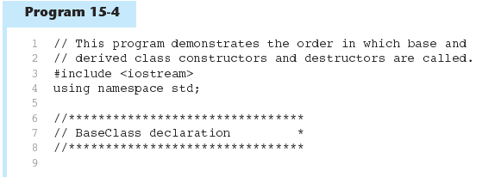
Constructors and Destructors in Base and Derived Classes

Slide 48
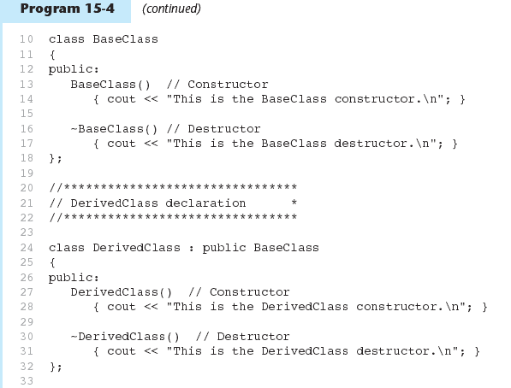

Slide 49
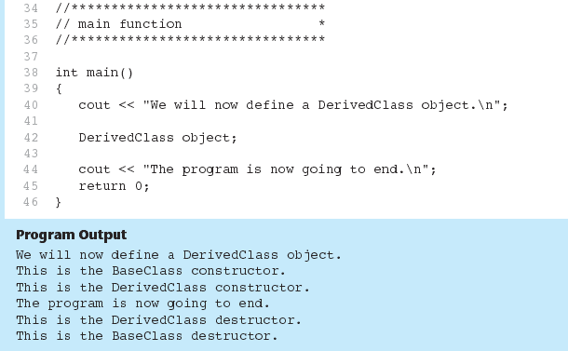
Program 5-14 (Continued)

Slide 50
Passing Arguments to Base Class Constructor
Allows selection between multiple base class constructors
Specify arguments to base constructor on derived constructor heading:
Square::Square(int side) : Rectangle(side, side)
Can also be done with inline constructors
Must be done if base class has no default constructor

Slide 51
Passing Arguments to Base Class Constructor
derived class constructor
base class constructor
Square::Square(int side):Rectangle(side,side)
derived constructor parameter
base constructor parameters

Slide 52
Redefining Base Class Functions
Redefining function: function in a derived class that has the same name and parameter list as a function in the base class
Typically used to replace a function in base class with different actions in derived class
This is referred to as overriding a function in the base class

Slide 53
Redefining Base Class Functions
Not the same as overloading – with overloading, parameter lists must be different
Objects of base class use base class version of function; objects of derived class use derived class version of function

Slide 54
Overriding vs overloading functions
Overriding – derived class has a function with the same name and same parameters as the parent class but different implementation. Overriding is specific to derived classes.
Overloading – two functions have the same name but different parameters. Overloading functions is a feature of C++ and does not need to involve classes.

Slide 55
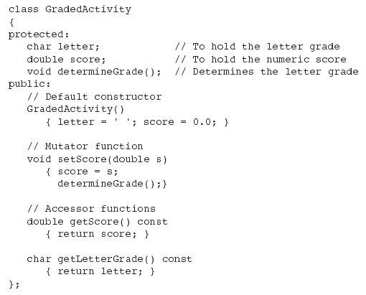
Base Class
Note setScore function

Slide 56
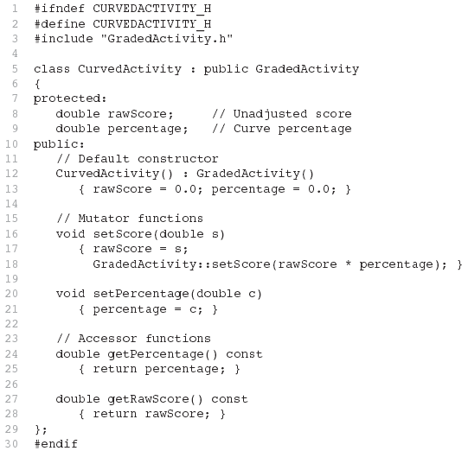
Derived Class
Redefined setScore function

Slide 57
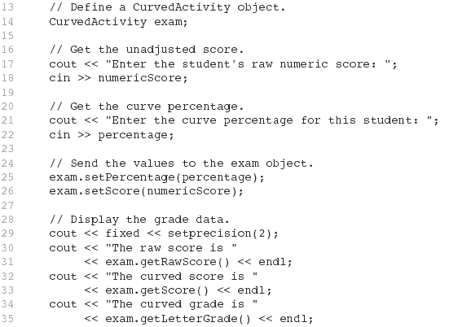

From Program 15-7

Slide 58
Problem with Redefining
Consider this situation:
Class BaseClass defines functions x() and y(). x() calls y().
Class DerivedClass inherits from BaseClass and redefines function y().
An object D of class DerivedClass is created and function x() is called.
When x() is called, which y() is used, the one defined in BaseClass or the the redefined one in DerivedClass?

Slide 59
Problem with Redefining
BaseClass
void X();
void Y();
Object D invokes function X()
In BaseClass. Function X()
invokes function Y() in BaseClass, not function Y() in DerivedClass,
because function calls are bound at compile time. This is static binding.
DerivedClass
void Y();
DerivedClass D;
D.X();

Slide 60
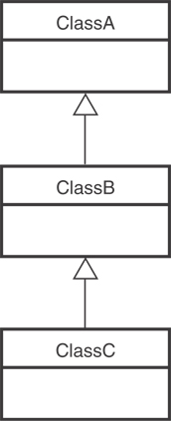
Class Hierarchies
A base class can be derived from another base class.

