Slide 1
Digital Systems CS 260
Maurice McGlashan-Powell

Slide 2
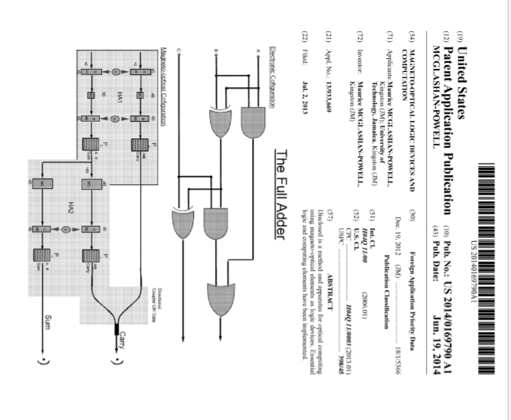

Slide 4
Introduction
Review of some basic electronics
Necessary because logic devices (NAND gate NOR gate XOR gates are electronics devices)
OHMS Law
V = IR
Where
V is Voltage
I is Current
R is resistance

Slide 5
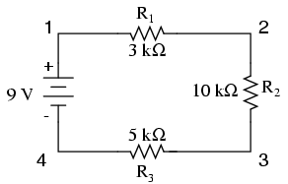
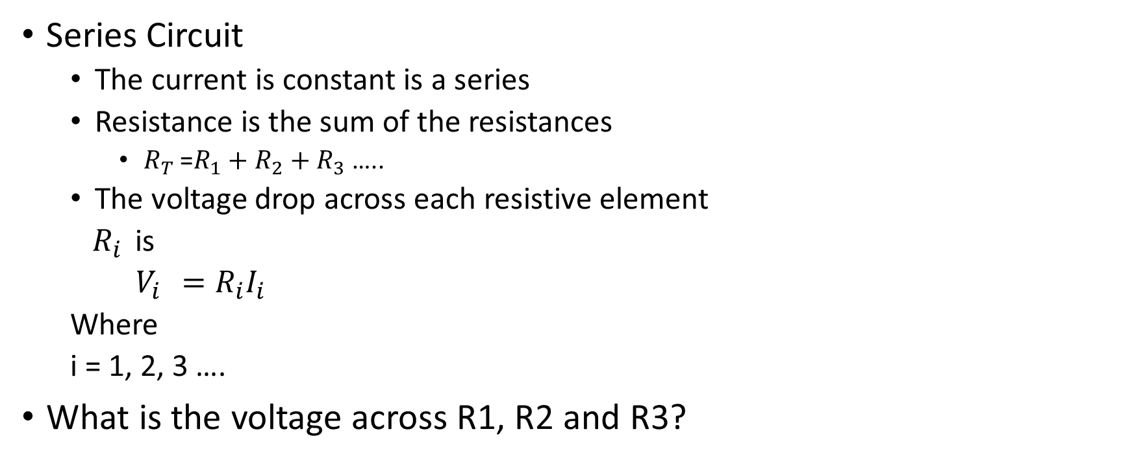
Basic Electrical Circuits
Series Circuit
The current is constant is a series
Resistance is the sum of the resistances
$R_{T }$=$R_{1}+$ $R_{2}+R_{3}$ …..
The voltage drop across each resistive element
$R_{i }$ is
$V_{i }=R_{i}I_{i}$
Where
i = 1, 2, 3 ….
What is the voltage across R1, R2 and R3?

Slide 6
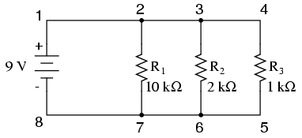
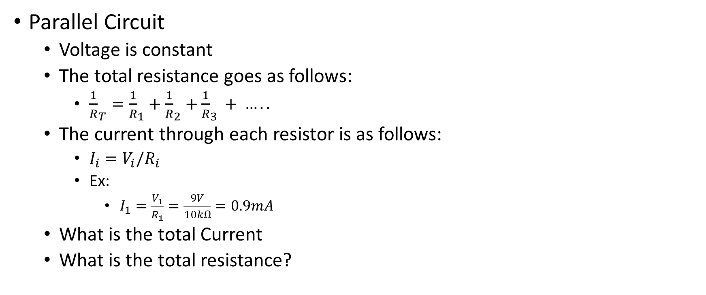
Basic Electrical circuits (continued)
Parallel Circuit
Voltage is constant
The total resistance goes as follows:
${\frac{1}{R}}_{T}={\frac{1}{R}}_{1}+{\frac{1}{R}}_{2}+{\frac{1}{R}}_{3 }+ …..$
The current through each resistor is as follows:
$I_{i}=V_{i}/R_{i}$
Ex:
$I_{1}=\frac{V_{1}}{R_{1}}=\frac{9V}{10kΩ}=0.9mA$
What is the total Current
What is the total resistance?

Slide 7
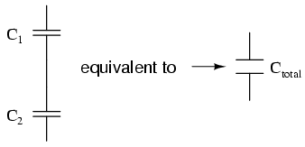

Capacitive circuits
Total capacitance goes at follows:
$\frac{1}{C_{T}}=\frac{1}{C_{1}}+\frac{1}{C_{2}}+\frac{1}{C_{3}}+$
What is the total capacitance of a parallel capacitive circuit?

Slide 8
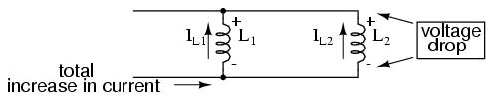

Inductive circuits
Total inductance in a parallel circuit goes at follows:
$\frac{1}{L_{T}}=\frac{1}{L_{1}}+\frac{1}{L_{2}}+\frac{1}{L_{3}}+$ ……
What is the total inductance of a series
inductive circuit?

Slide 9
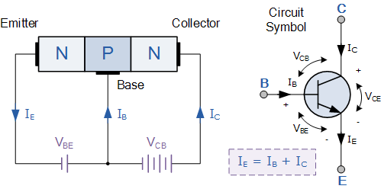
Transistors, Diodes and other Circuit Elements
Transistors
Two main types
Bi-Polar
NPN

Slide 10
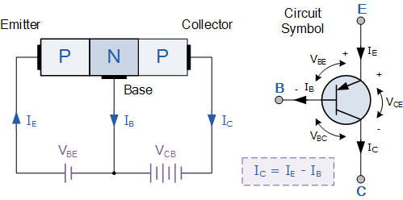
Transistors, Diodes and other Circuit Elements
Transistors
Two main types
Bi-Polar
PNP

Slide 11
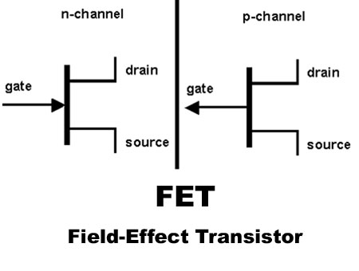
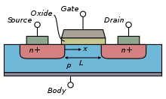
Transistors, Diodes and other Circuit Elements
Transistors
Two main types
Bi-Polar
NPN
PNP
Field Effect

Slide 12
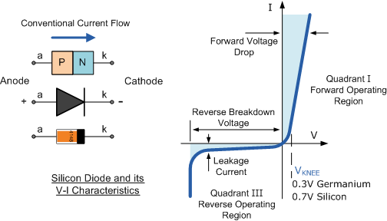
Transistors, Diodes and other Circuit Elements
Diodes
N type – P type semiconductor junction that allows current flow in on direction

Slide 13
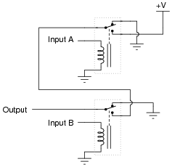
Relay Logic
Relay Logic AND gate

Slide 14
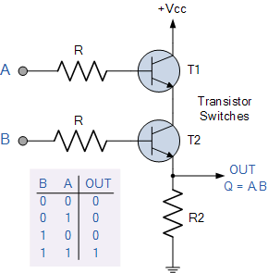

Electronics of Logic Circuit
AND Gate
Symbol | Truth Table
2-input AND Gate | B | A | Q
 | 0 | 0 | 0
 | 0 | 1 | 0
 | 1 | 0 | 0
 | 1 | 1 | 1
Boolean Expression Q = A.B | Read as A AND B gives Q

Slide 15
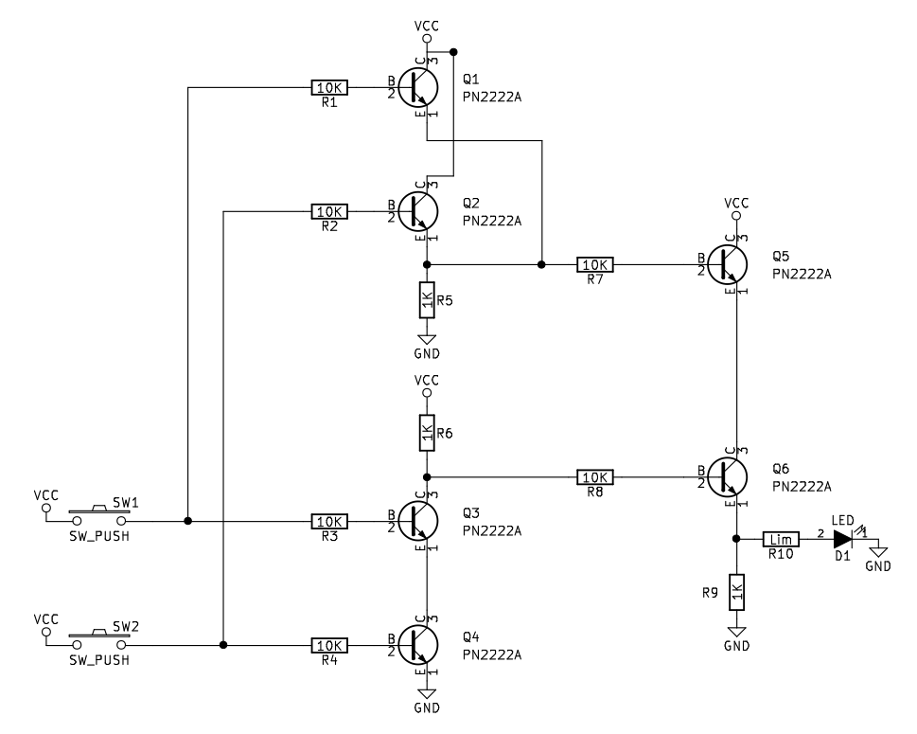
XOR gate transistor Circuit

Slide 16
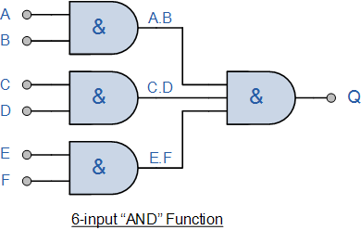
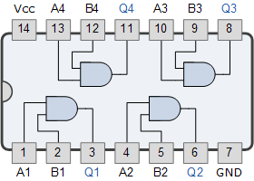
Multiple Input AND gate
CD4082 Dual 4-input
7408 Quad 2-input AND Gate

Slide 17
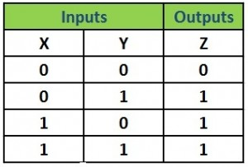
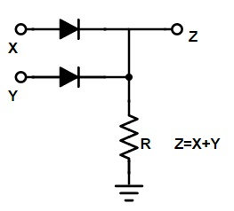
Diode OR gate

Slide 18
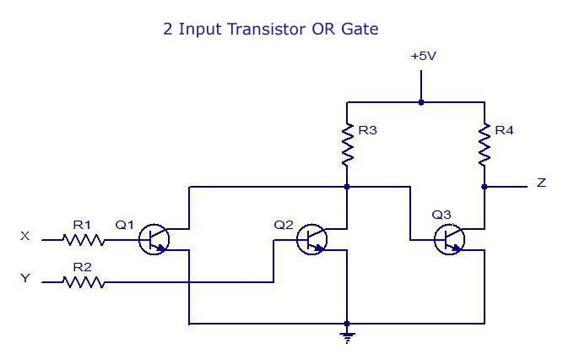
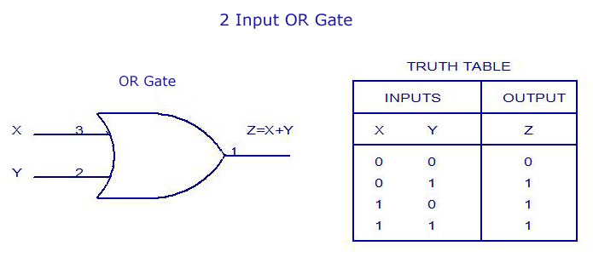
Two Input Transistor OR gate

Slide 19
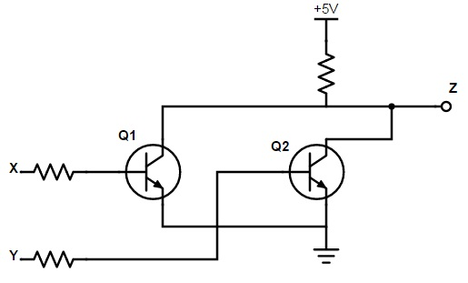
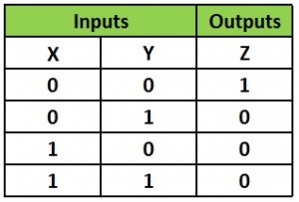
NOR gate

