Slide 1
Digital Systems CS 260
Maurice McGlashan-Powell
Lecture II

Slide 2
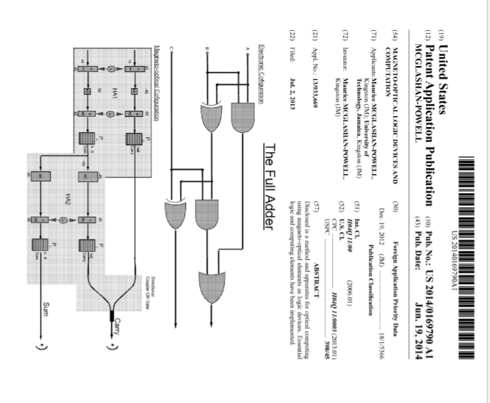

Slide 3
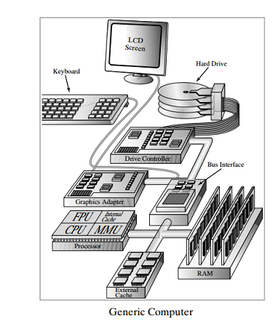
Generic Computer
Block Diagram
CPU
Central Processing Unit
FPU
Floating Point Unit
MMU
Memory Management Unit
Internal Cache
External Cache
RAM – Random Access Memory
On board Memory
Buss Interface
Interface various components (CPU, RAM, Drive controller, etc

Slide 4
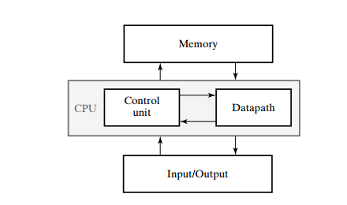
Generic Computer
Memory
Stores program, input and output and intermediate data
Data path
Performs arithmetic and data processing operation specified by program
Control Unit
Supervise flow of information between units
CPU – Central Processing Unit
Data path combined with control unit
Input/Output (IO)
Input
Program and data transferred to memory
Usually a keyboard
Output
Displays results of computation
Usually LCD or other monitor

Slide 5
Other I/O Devices
CD-ROMs
DVD
Scanners
Printers

Slide 6
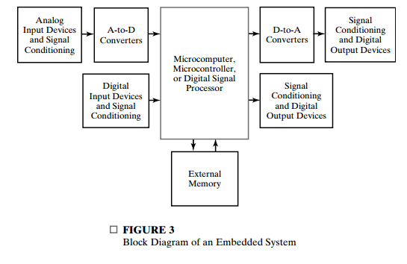
Micro computers, Micro controllers, DSP and Embedded systems
Small computer embedded into every day equipment and often not apparent
Micro controllers, DSP and other embedded system controls:
Temperature, speed, air pressure, etc

Slide 7
Micro computers, Micro controllers, DSP and Embedded systems
Small computer embedded into every day equipment and often not apparent
Micro controllers, DSP and other embedded system controls:
Temperature, speed, air pressure, etc

Slide 8
Binary Numbers
Binary Number system
Base 2 system with two digits or bits (0 and 1)
A bit is a binary digit
Example
Subscript (2) for the binary number (11010) indicates the base of the number (base 2)
Subscript (10) of the decimal number 26 indicates base (10)
Assign 2.1
Show that the decimal (base 10) equivalent of the binary number 110101.11 is equal to 53.75

Slide 9
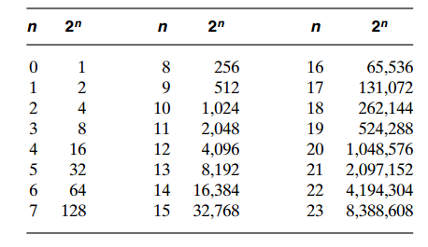
Powers of 2 Table
4K =
The first 24 numbers obtained from 2 to the power of n
Is referred to as K or Kilo
is referred to as M or Mega
is referred to as G or Giga
is referred to as T or Tera
4k
Assign 2.2:
What is 16 M equal to?

Slide 10
Conversion of decimal numbers to Binary
Conversion of a decimal number is achieved by sucesivly subtracting powers of 2 from the decimal number
To convert decimal number N to Binary
Find the greatest number that is a power of 2 that when it is subtracted from N yield a positive difference
Call the difference N1
Find the greatest number that is a power of 2 that when if is subtracted from N1 produces a positive difference N2
Repeat this until the difference is Zero
Example: Convert decimal 625 to binary
625-512 = 113 = N1 , 512 =
113 – 64 = 49 = N2 , 64 =
49 – 32 = 17 = N3 , 32 =
17 – 16 = 1 = N4 , 16 =
1 – 1 = 0 = N5 , 1 =
So 625 =

Slide 11
Boolean Algebra
Branch of mathematics that describes the operational properties of digital circuits
The mathematical notation that specifies the operation of each logic gates and is used to analyze and design logic circuits
Binary Logic
Relates to binary variables which have two discrete values and the operation of mathematical logic that applies to these variables
Binary Variables (A,B,C, X,Y,Z) are assigned to values of 0 or 1
Logical Operations
AND
Inputs binary variables A and B
Output A.B = 1 only if A =1 and B = 1
OR
Input variables A and B
Output A +B = 1 if either A =1 or B = 1 or both A and B =1
NOT
Input variable A
Output = 1 if A =0
Output =0 if A =1

Slide 12

Logical Operators
AND
Represented by dot or no operator at all
Z = A●B or Z = AB
OR
Represented by “ +”
$Z=A+B$
Z = A or B
Z = 1 (True) if and only if
X = 1 or Y = 1 or X = 1 and Y = 1
Z = 0 if
X = 0 and Y = 0

Slide 13

Binary Logic
Binary Logic resembles arithmetic
The logical operators AND and OR are similar to multiplication and addition
BUT
DO NOT confuse binary with binary arithmetic
Arithmetic variables can have many digits
Logical variables and ONLY have values of 0 or 1
Binary Logic Equation that defines the logical OR operator
0 + 0 = 0
If the inputs to and OR gate are A = 0 and B = 0
The output is 0
0 + 1 = 1
If the input to an OR gate is A = 0 and B = 1
The output is 1 (true)
1 + 1 = 1
If the input A =1 and B = 1
The output is 1 (true)
The binary logical equation that defines the logical AND operator
$0$ ● 0 = 1
If input A = 0 and input B = 0
The output is 0
0 ● 1 = 0
If input A = 0 and B =1
Output = 0
1 ● 0 = 0
If input A = 1 and input B = 0
Output = 0
1 ● 1 = 1
Only if input A = 1 and B = 1
Output = 1

Slide 14
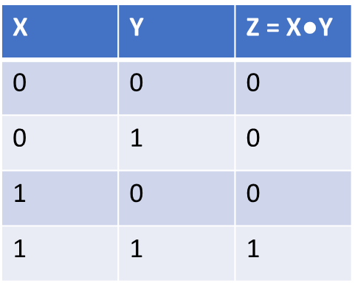
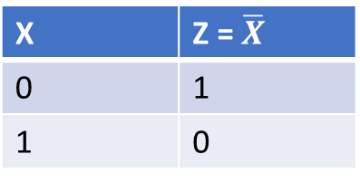
Truth tables for Logical Operators AND, OR and NOT
AND operator
OR operator
NOT operator
X | Y | Z = X + Y
0 | 0 | 0
0 | 1 | 1
1 | 0 | 1
1 | 1 | 1
X | Z = $\overline{X}$
0 | 1
1 | 0

Slide 15
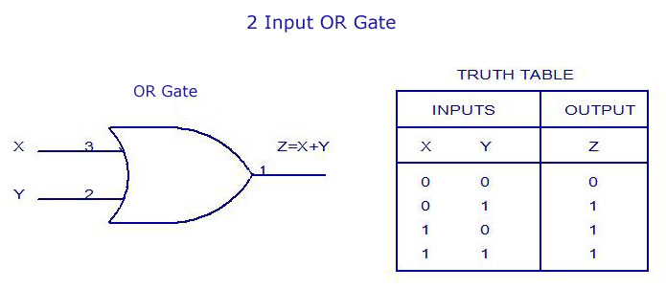
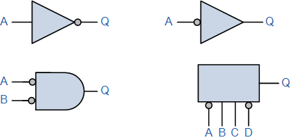


Logic Gates
Logic gates
Electronic circuits that operates on one or more input signal to produce an output signal
Graphical symbols for logic Gates
OR gate
Z = X + Y
AND gate
NOT gate or Inverter
X
Z = X●Y
Y
X
Z = $\overline{X}$

Slide 16
Logical Gates (continued)
Two input signal to AND or OR gates hae four possible combination
00, 01, 10, or 11
Timing Diagram for AND and OR gate
Time
X | 0 | 0 | 1 | 1
Y | 0 | 1 | 0 | 1
X●Y | 0 | 0 | 0 | 1
AND gate
X + Y | 0 | 1 | 1 | 1
OR gate

Slide 17
Boolean Algebra
Algebra relating to binary variables and logic operations
Binary Variables
Represented by letters and the basic logic Operators (AND, OR and NOT)
Boolean expressions
Algebraic expressions formed by using binary variables, constants (0, 1), the basic logic operators symbols and parenthesis
Boolean Functions
Described by a Boolean equation consisting of a binary variable identifying the function followed by a equal sign and a Boolean expression

Slide 18
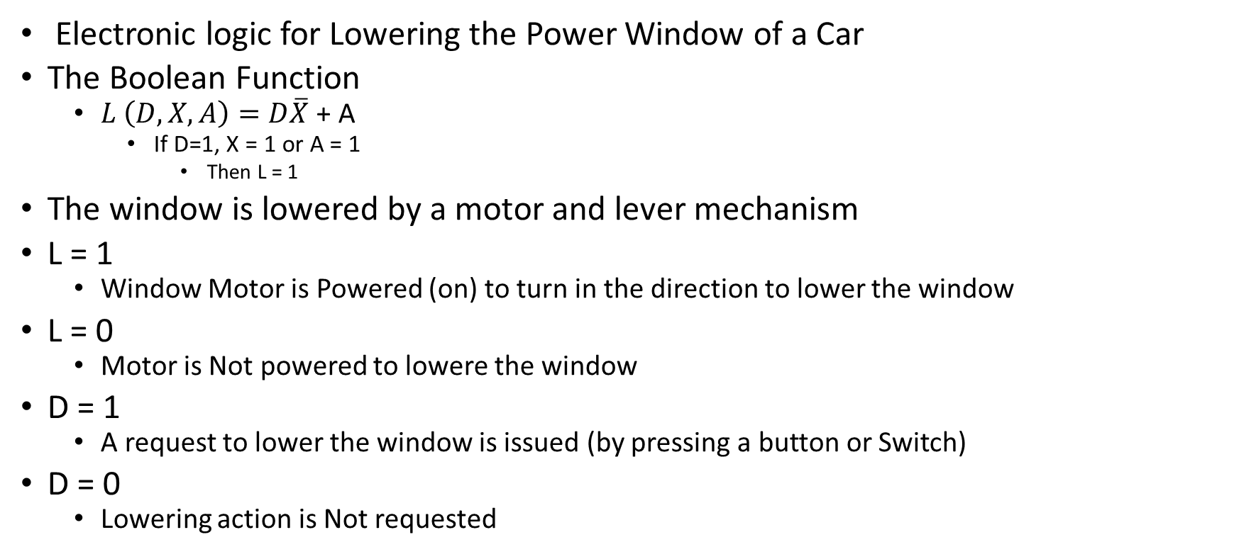
Boolean Function – The Power Window
Electronic logic for Lowering the Power Window of a Car
The Boolean Function
$L \left(D, X, A\right)=D\overline{X}$ + A
If D=1, X = 1 or A = 1
Then L = 1
The window is lowered by a motor and lever mechanism
L = 1
Window Motor is Powered (on) to turn in the direction to lower the window
L = 0
Motor is Not powered to lowere the window
D = 1
A request to lower the window is issued (by pressing a button or Switch)
D = 0
Lowering action is Not requested

Slide 19
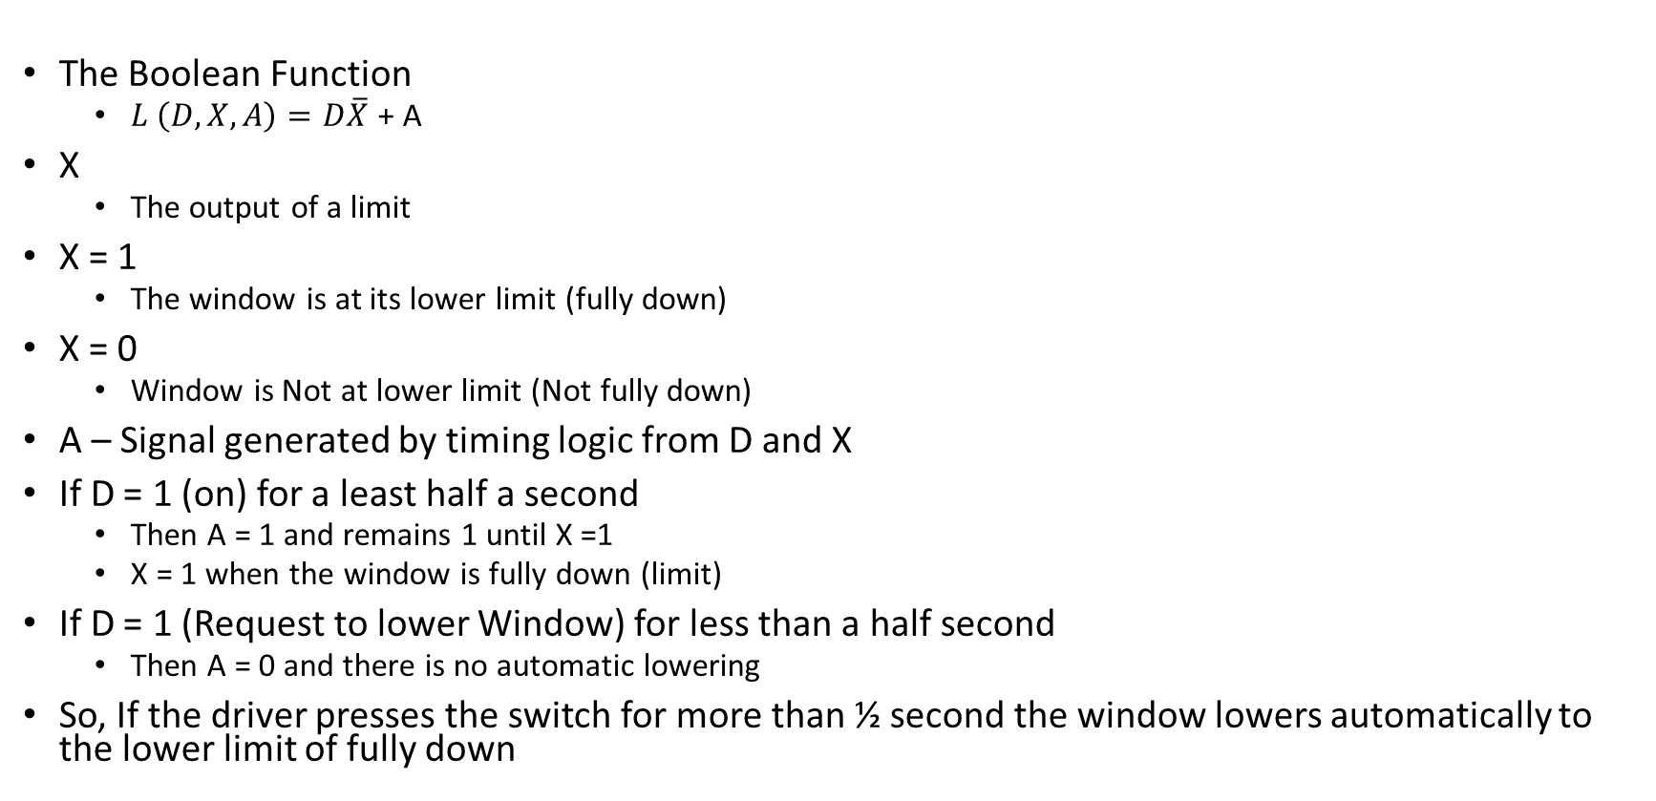
Boolean Function – The Power Window
The Boolean Function
$L \left(D, X, A\right)=D\overline{X}$ + A
X
The output of a limit
X = 1
The window is at its lower limit (fully down)
X = 0
Window is Not at lower limit (Not fully down)
A – Signal generated by timing logic from D and X
If D = 1 (on) for a least half a second
Then A = 1 and remains 1 until X =1
X = 1 when the window is fully down (limit)
If D = 1 (Request to lower Window) for less than a half second
Then A = 0 and there is no automatic lowering
So, If the driver presses the switch for more than ½ second the window lowers automatically to the lower limit of fully down

Slide 20
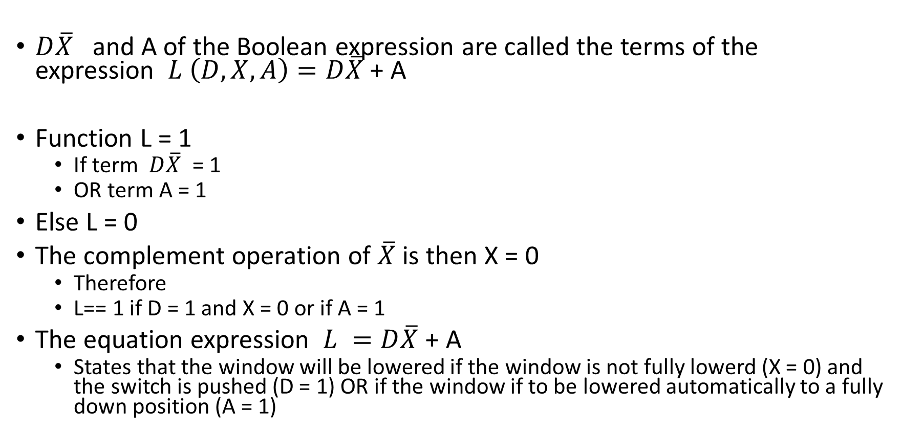
Boolean Function – The Power Window
$D\overline{X}$ and A of the Boolean expression are called the terms of the expression $L \left(D, X, A\right)=D\overline{X}$ + A
Function L = 1
If term $D\overline{X}$ = 1
OR term A = 1
Else L = 0
The complement operation of $\overline{X}$ is then X = 0
Therefore
L== 1 if D = 1 and X = 0 or if A = 1
The equation expression $L =D\overline{X}$ + A
States that the window will be lowered if the window is not fully lowerd (X = 0) and the switch is pushed (D = 1) OR if the window if to be lowered automatically to a fully down position (A = 1)

Slide 21
Boolean Equations
Boolean Equations
Expresses the logical relationship between binary variables
Evaluated by the determining of the binary values of the expression for all possible combination of values for the variables
A Boolean Function can be represented by a truth table
Truth Table for a Boolean function
A list of all combinations of 1`s and 0`s that can be assigned to the binary variables and a lit that shows the value of the function for each binary combination

Slide 22

Truth Table for a Boolean Function
The truth table for the Boolean Function $L =D\overline{X}$ + A
The number of rows in a truth table is $2^{n}$
Where n = the number of variables in the function
There are 8 possible binary combination for the function L
D | X | A | L
0 | 0 | 0 | 0
0 | 0 | 1 | 1
0 | 1 | 0 | 0
0 | 1 | 1 | 1
1 | 0 | 0 | 1
1 | 1 | 0 | 0
1 | 1 | 1 | 1

Slide 23
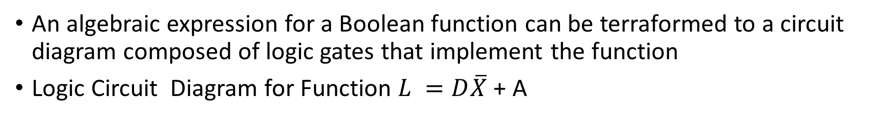
Transformation of Algebraic expression for a Boolean Function
An algebraic expression for a Boolean function can be terraformed to a circuit diagram composed of logic gates that implement the function
Logic Circuit Diagram for Function $L =D\overline{X}$ + A
D
Z = X●Y
X
L
A
A

Slide 24
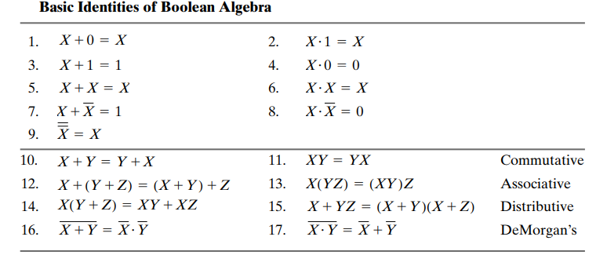
Simplification of Boolean Expressions
Boolean expressions can be simplified using Boolean Algebraic rules
This reduces the number of gates
Basic Identities of Boolean Algebra

Slide 25
Boolean Identities (continued)
Boolean algebra identities 10 through 14
Normal algebraic properties
Dual of a Boolean algebra expression
Obtained by interchanging Boolean operator OR and AND
and by replacing 1’s with 0’s and 0’s with 1’s
Equation from on side of the table of Boolean algebraic identities (odd numbered identities) can be used to generate the expressions on the other side (even numbered identities) by taking the dual of that expression

Slide 26
Boolean Identities (continued)
Any expression can be substituted for X in the identity table
Ex1.
Using identity X + 1 = 1
Let X = 0
Then 0 + 1 = 1
Ex2
Using identity X + 1 = 1
Let X = AB + C
Then
(AB + C) + 1 = 1
Identity 15 is the dual of identity 14
Identity 15 does NOT correspond to ordinary algebraic distribution law

Slide 27
Boolean Identities (continued)
Each variable in the Boolean algebraic identity table can be replaced by a Boolean algebraic expression
For the expression
(A + B)(A + CD)
Let X = A, Y = B and Z = CD
Using the second distributive law (identity # 15) then
A = BCD = (A = B)(A = CD)

Slide 28
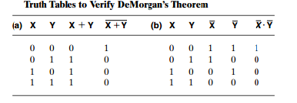
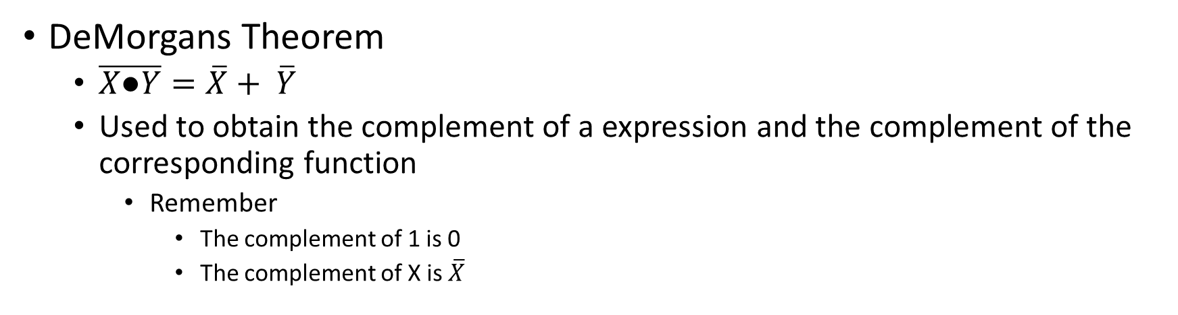
Boolean Identities (continued)
DeMorgans Theorem
$\overline{X\text{●}Y}=\overline{X}+ \overline{Y}$
Used to obtain the complement of a expression and the complement of the corresponding function
Remember
The complement of 1 is 0
The complement of X is $\overline{X}$

Slide 29
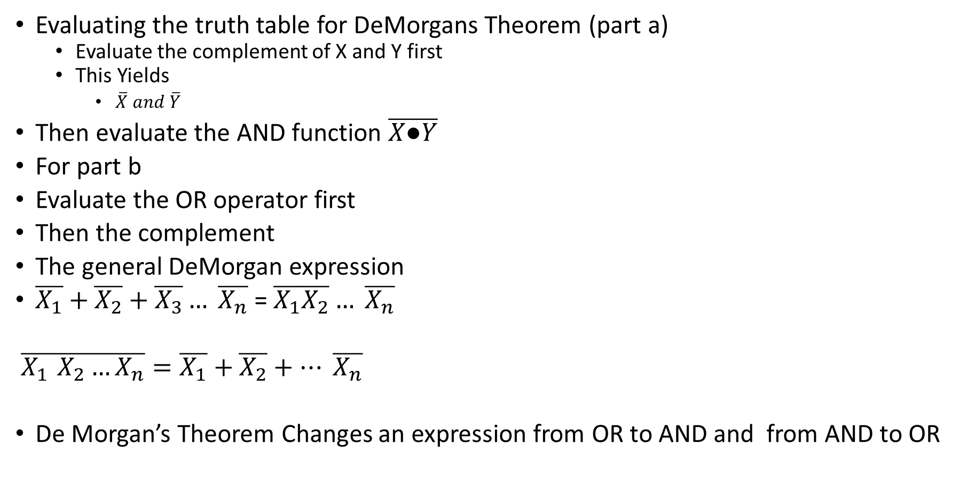
Boolean Identities (continued)
Evaluating the truth table for DeMorgans Theorem (part a)
Evaluate the complement of X and Y first
This Yields
$\overline{X} and \overline{Y}$
Then evaluate the AND function $\overline{X\text{●}Y}$
For part b
Evaluate the OR operator first
Then the complement
The general DeMorgan expression
$\overline{X_{1}}+\overline{X_{2}}+\overline{X_{3}}… \overline{X_{n}}$ = $\overline{X_{1}}\overline{X_{2}}… \overline{X_{n}}$
$\overline{X_{1 }X_{2}…X_{n}}=\overline{X_{1}}+\overline{X_{2}}+… \overline{X_{n}}$
De Morgan’s Theorem Changes an expression from OR to AND and from AND to OR

Slide 30
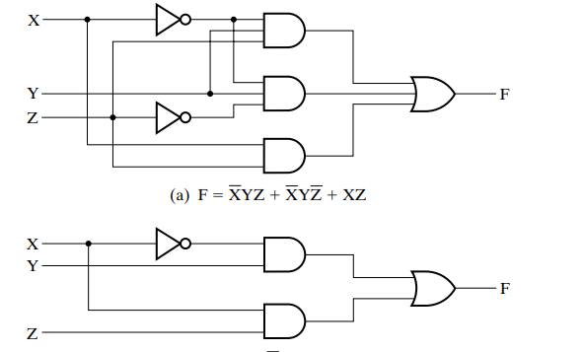
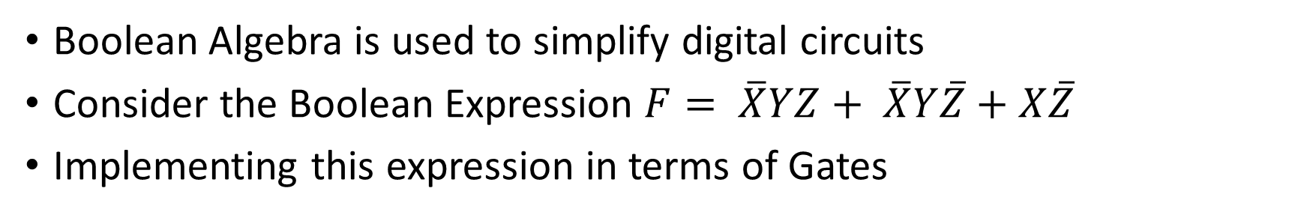
Boolean Algebraic Manipulation
Boolean Algebra is used to simplify digital circuits
Consider the Boolean Expression $F= \overline{X}YZ+ \overline{X}Y\overline{Z}+X\overline{Z}$
Implementing this expression in terms of Gates

Slide 31
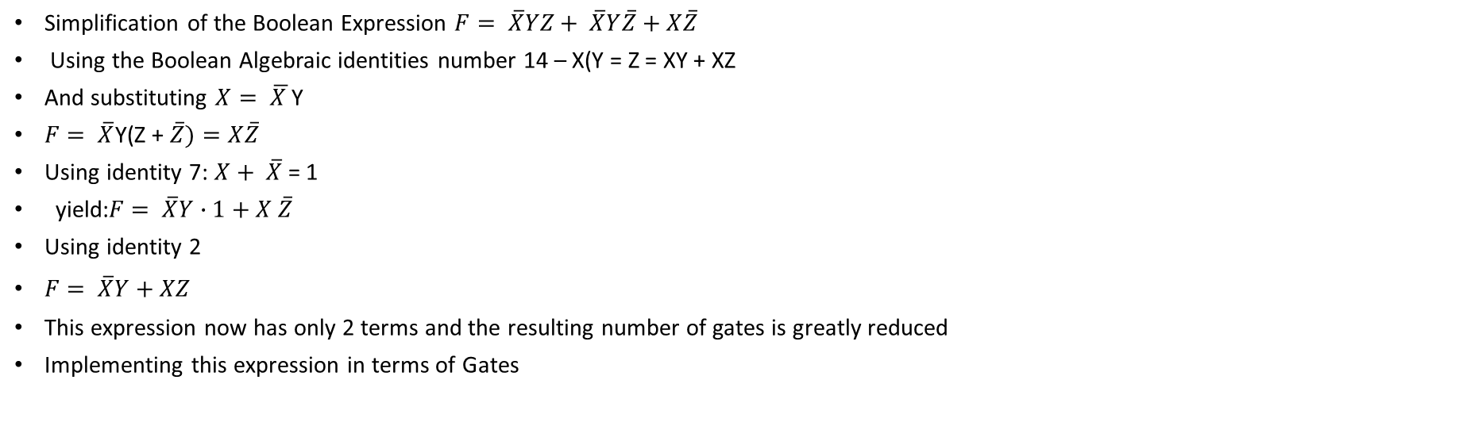
Boolean Algebraic Manipulation
Simplification of the Boolean Expression $F= \overline{X}YZ+ \overline{X}Y\overline{Z}+X\overline{Z}$
Using the Boolean Algebraic identities number 14 – X(Y = Z = XY + XZ
And substituting $X= \overline{X }$Y
$F= \overline{X}$Y(Z + $\overline{Z})=X\overline{Z}$
Using identity 7: $X+ \overline{X}$ = 1
yield:$F= \overline{X}Y∙1+X \overline{Z}$
Using identity 2
$F= \overline{X}Y+XZ$
This expression now has only 2 terms and the resulting number of gates is greatly reduced
Implementing this expression in terms of Gates

Slide 32
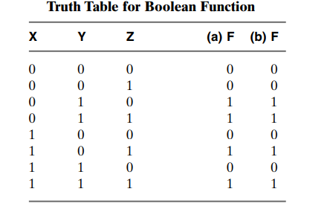
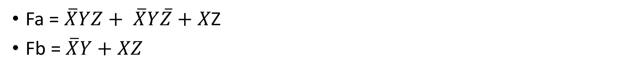
The Truth Table for The Boolean expression Fa and Fb
Fa = $\overline{X}YZ+ \overline{X}Y\overline{Z}+X$Z
Fb = $\overline{X}Y+XZ$
Fa = Fb therefore the circuits are Equivalent

Slide 33
Implementing a Boolean Equation With Gates
Each Term is implemented with a gate
The inputs to the logic gates are the variables of the Boolean expression (X, Y,Z, A, B, C etc)
Literal
A single variable within a term
Reducing the number of terms and variable in a Boolean expression reduces the complexity of the circuit

Slide 34
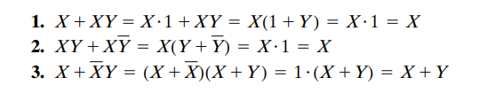

Tools for reducing Boolean Expressions
Using the identity table reduces Boolean expressions
The following expression along with the Identity table are also useful for reducing the Boolean expressions

Slide 35
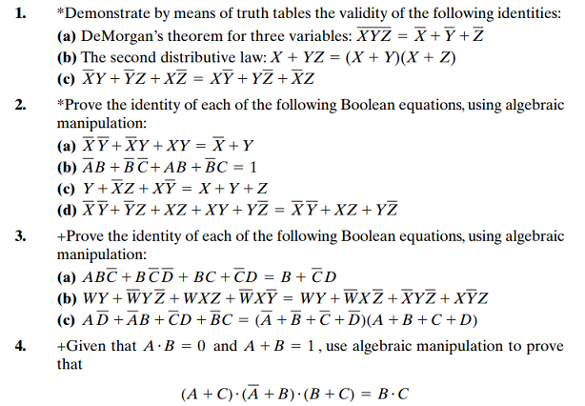
Assignment

Slide 36
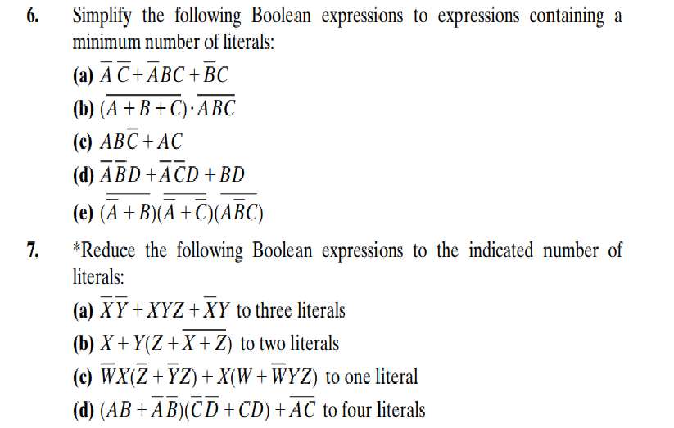
Assignment

Slide 37
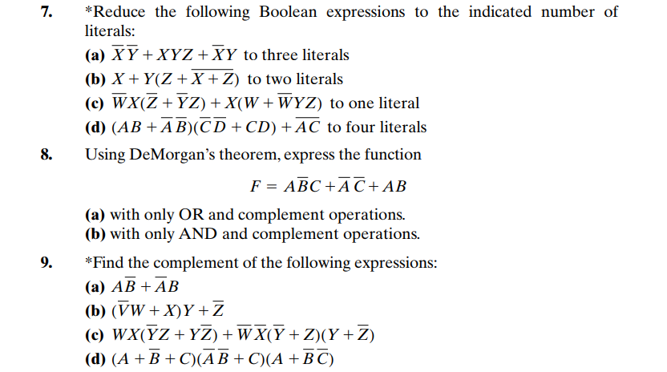
Assignment

