Slide 1
Unused Space Renting Faculty: DR. MD. RAZIB HAYAT KHAN Course: Software Engineering Sec: D Group: 5
Name | ID
1.Emrul Hasan Emon | 19-40357-1
2.Nusrat Jahan | 19-40355-1
3.Sahara Khan Linta | 19-39864-1
4.Tofayet Sultan | 19-40385-1

Slide 2
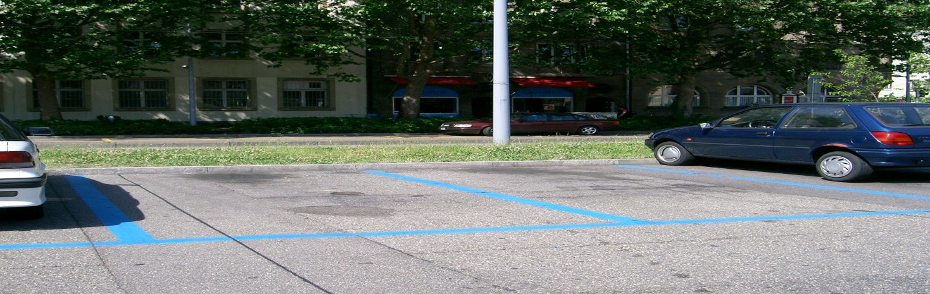
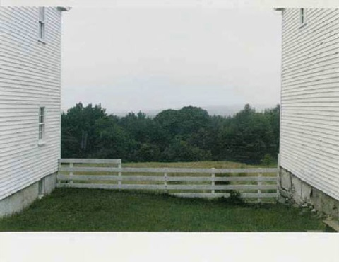

Unused Space Renting
Introduction
Overview
Problems
Solutions

Slide 3
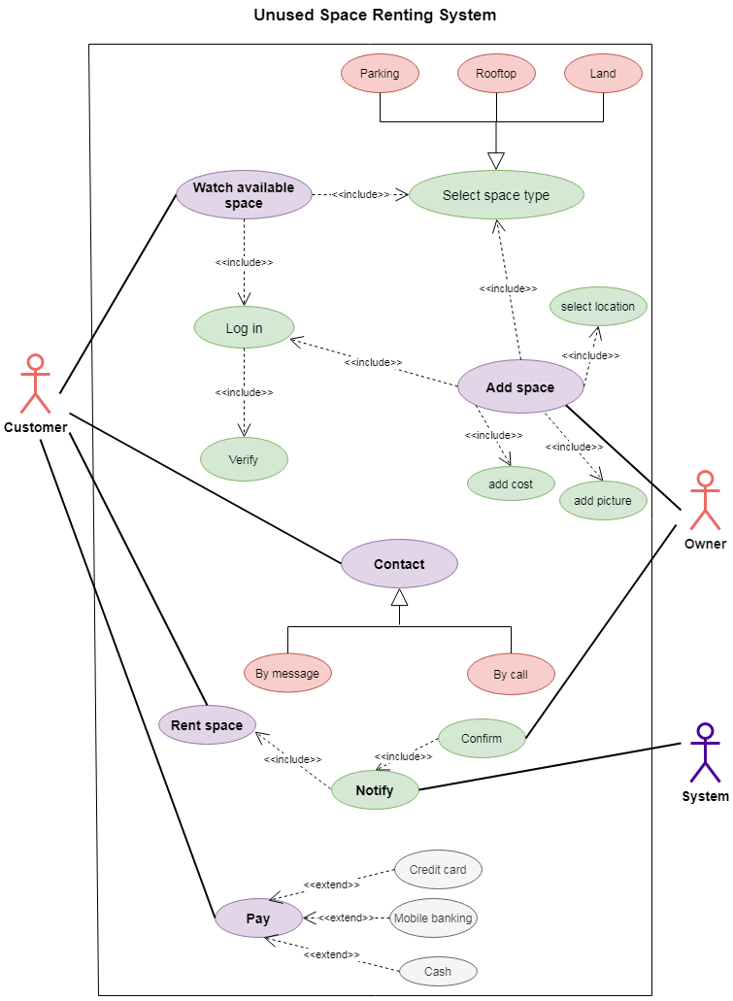
UML-Use Case Diagram
System-
Actor
Use case

Slide 4
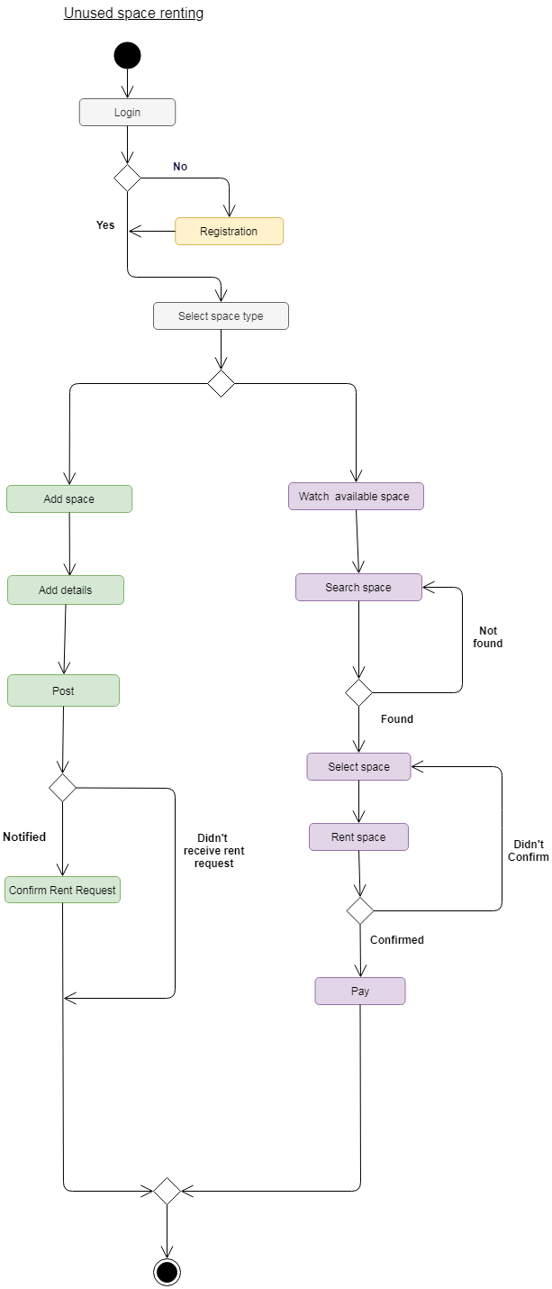
UML-Activity Diagram
Activities

Slide 5
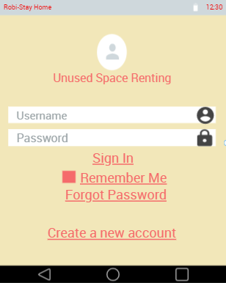
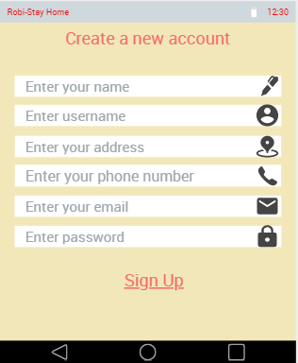
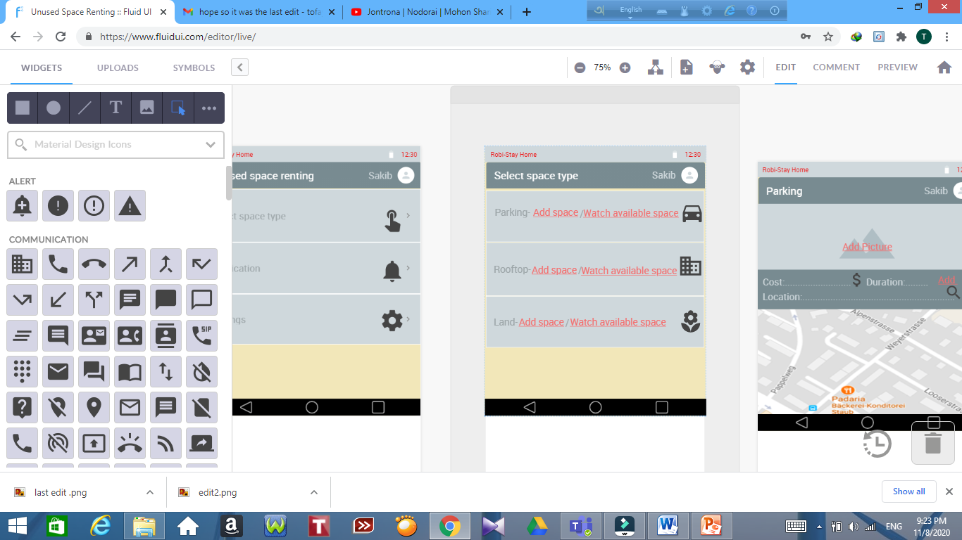
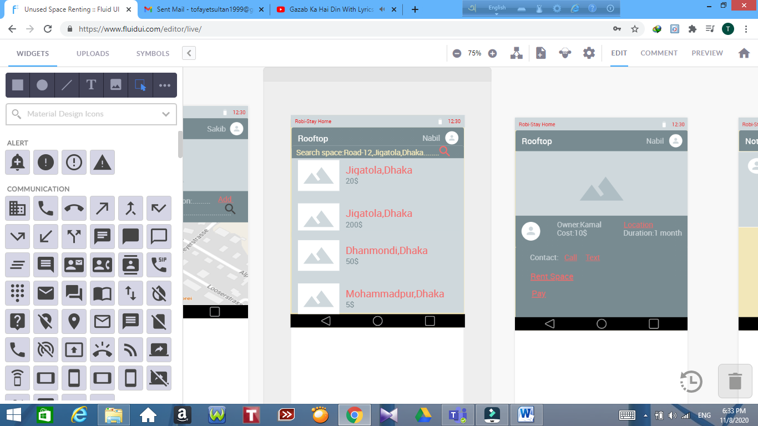
Mockup Design
Mockup design of unused space
renting
Tools
Interface

Slide 6
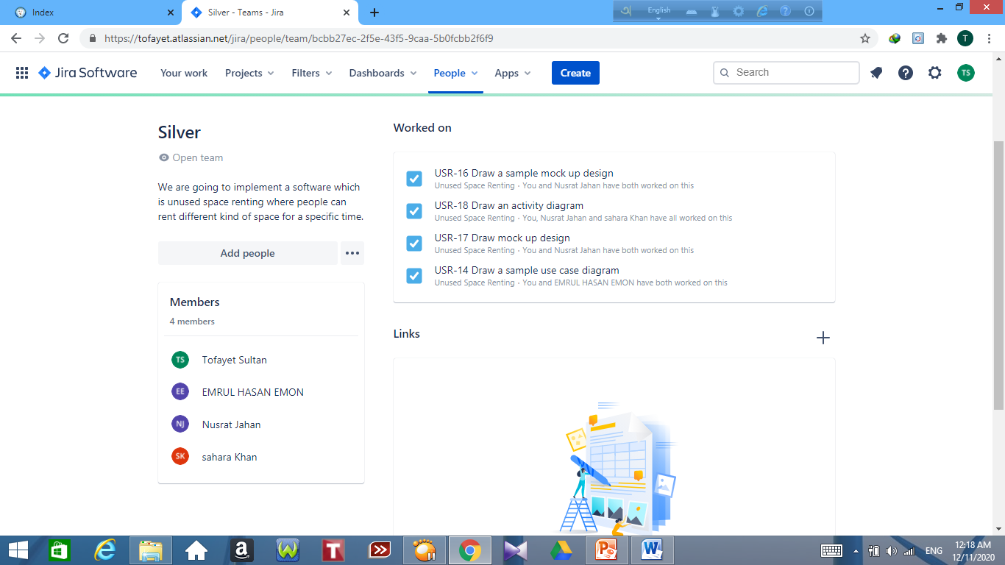
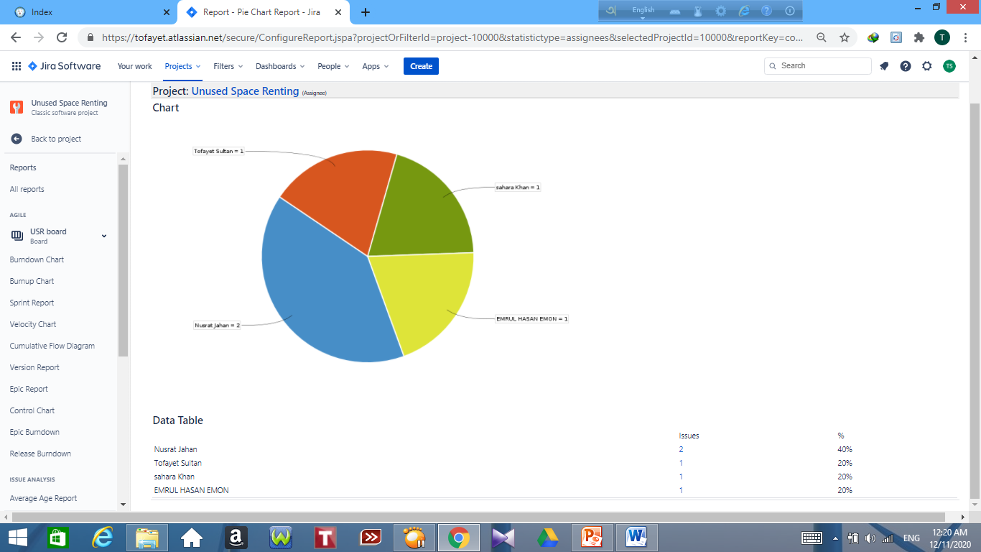
Jira
Team
Task
Report

Slide 7
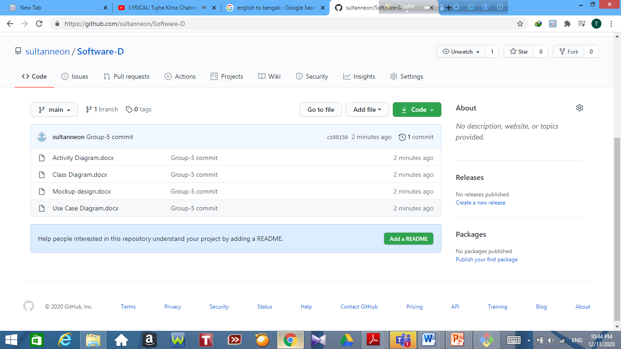
Git
Repository
Group

Slide 8
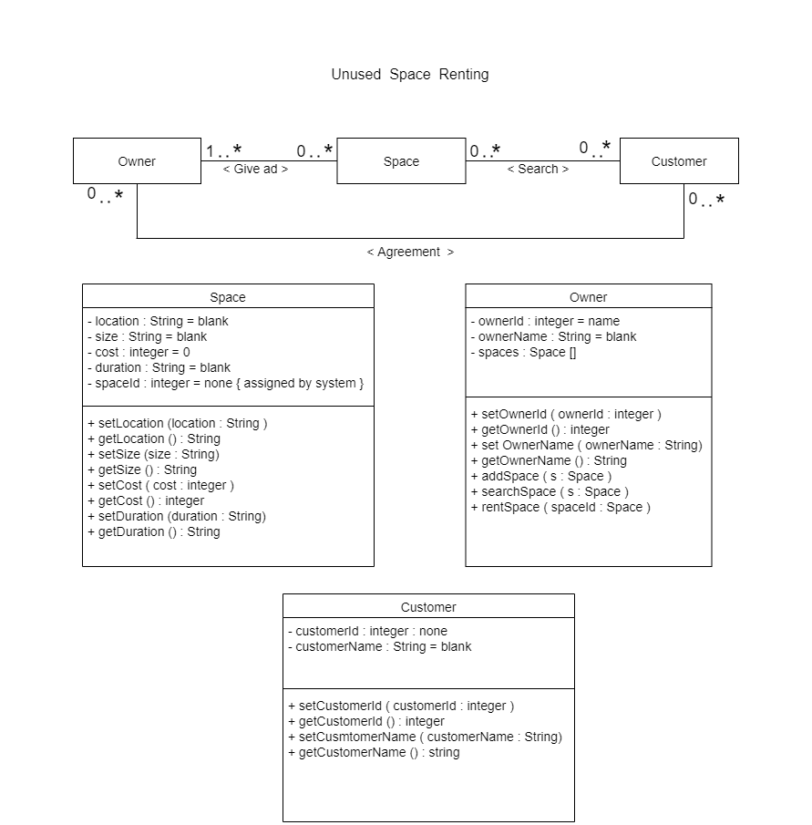
Class Diagram & ER Diagram
Entity Relationship Diagram
Class Diagram

Slide 9
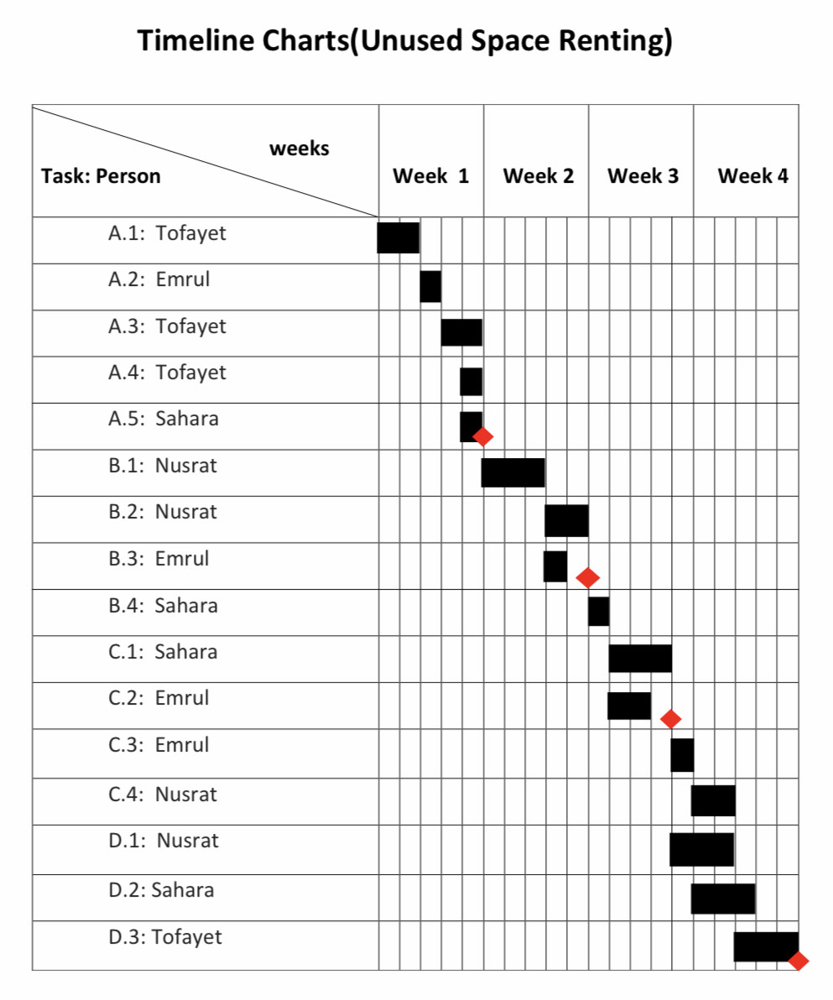
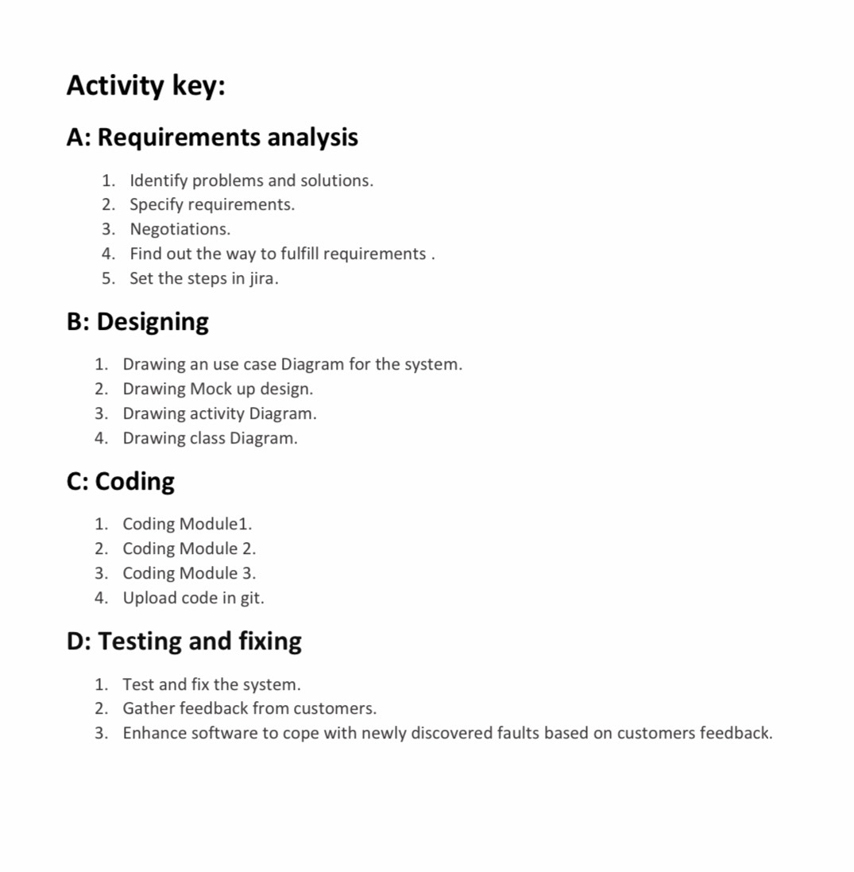
Timeline Charts
Schedule
Activity Key

Slide 10
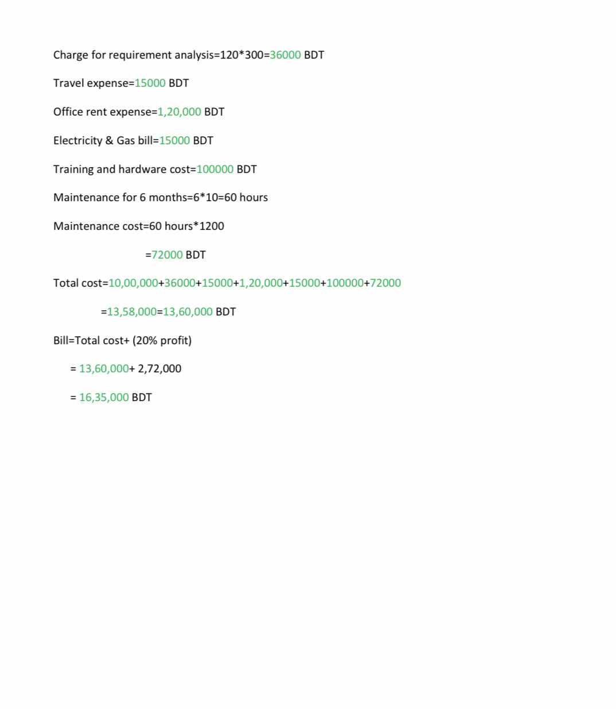
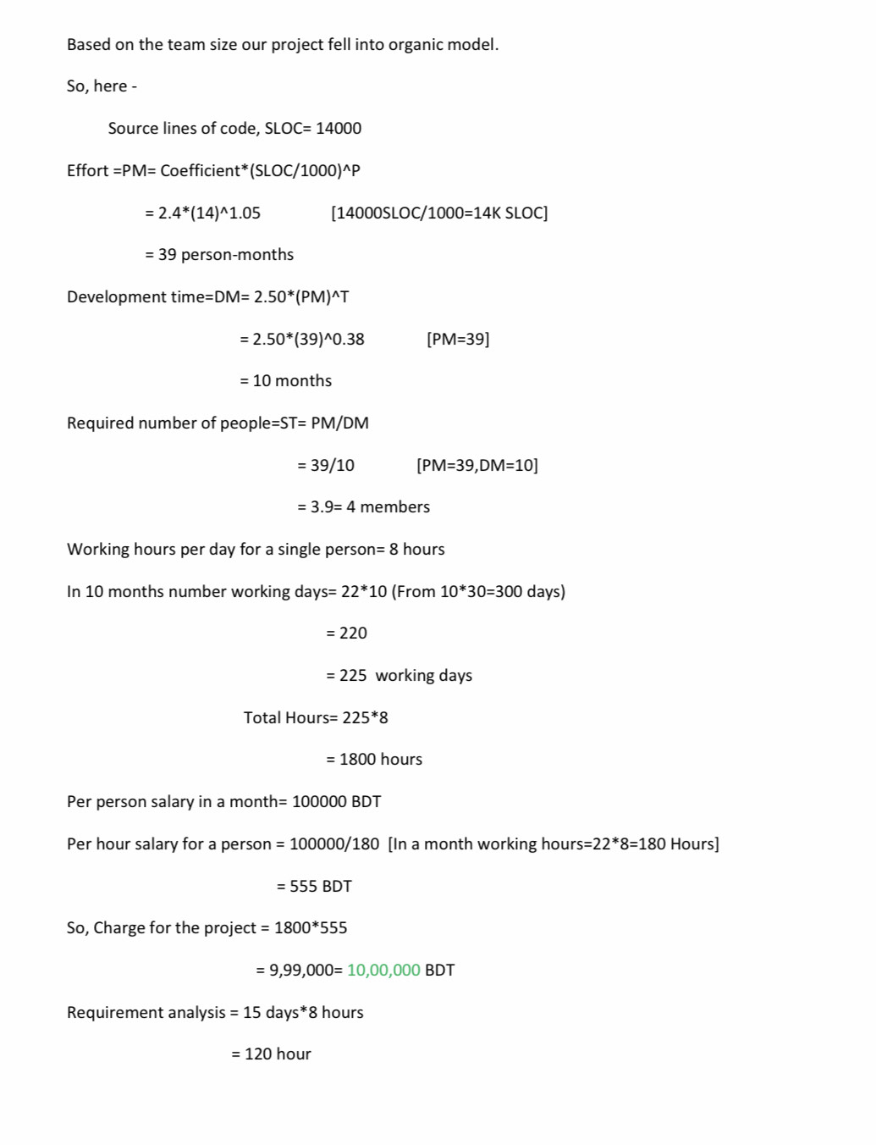
Budget
Effort Estimation
Budget

Slide 11
Conclusion
User
Existing System
Business Value

