Slide 1
PULSE
MONITOR

Slide 2
Contents
Project Objective
What we learnt?
Requirements
End Users
Future enhancement
Reference

Slide 3
Project Objective

Slide 4
What we learnt ?
Technical Learning :
Arduino Programming.
Functionality of Pulse Sensor.
Arduino pin configuration.
LCD Display pin configuration and functionality.
General Learning :
Team Work

Slide 5
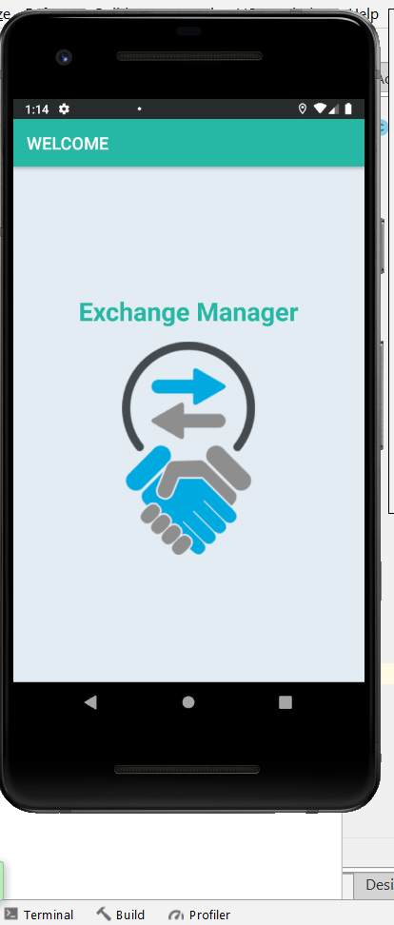
Methods
When we upload the arduino code to the circuit then we see a splash window :

Slide 6
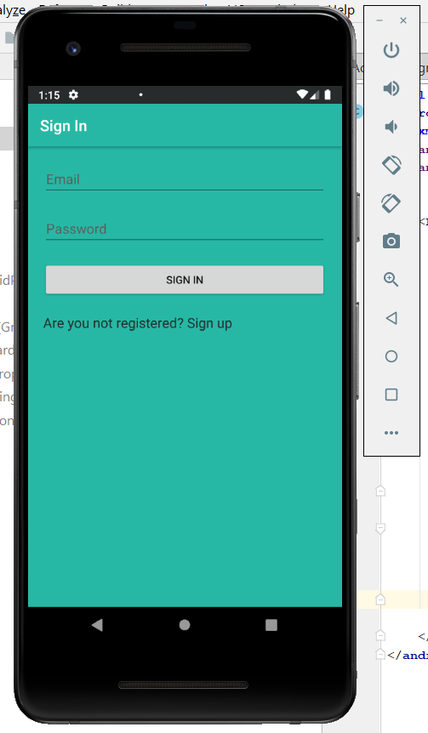
Then we enter the app and we can see the sign in page and if we are not registered yet we can go to the sign up page.

Slide 7
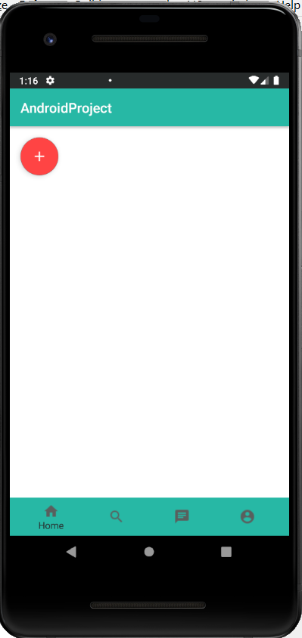
After signing in we can see the navigation bar at the bottom and a floating action button.

Slide 8
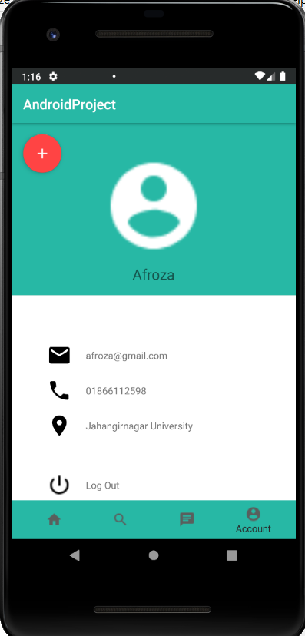
Now if we click on the account option in the navigation bar we can see the user profile.We can also log out from the app by clicking the log out option.

Slide 9
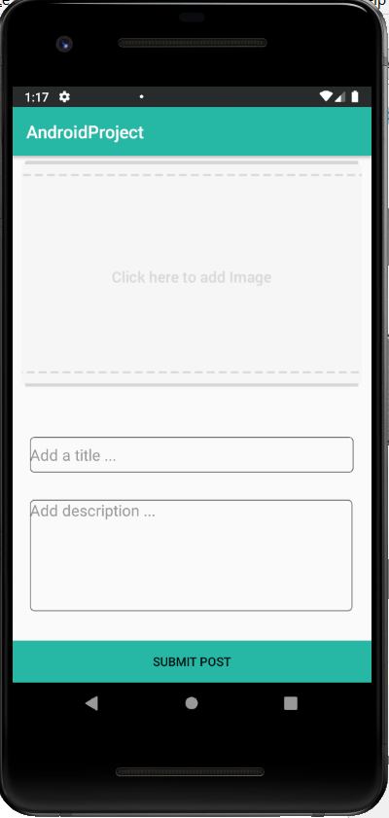
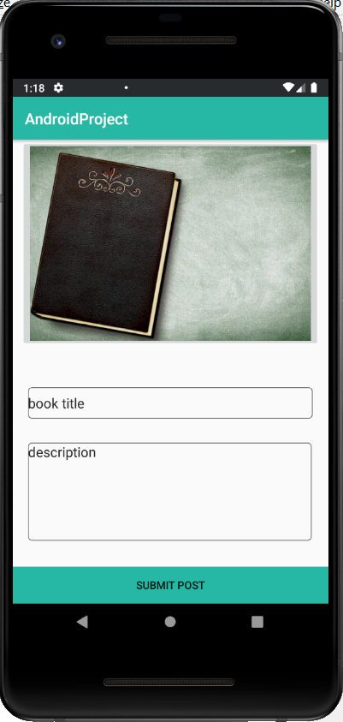
Now if we want to post something we have to click the red floating action button. This will take us to the “Post Activity”. There we can post about the book and store it in the database.

Slide 10
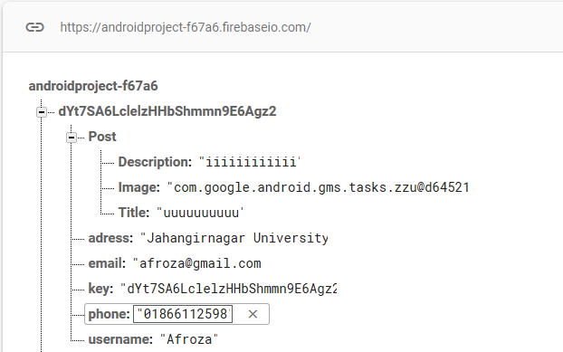
In Firebase database :

Slide 11
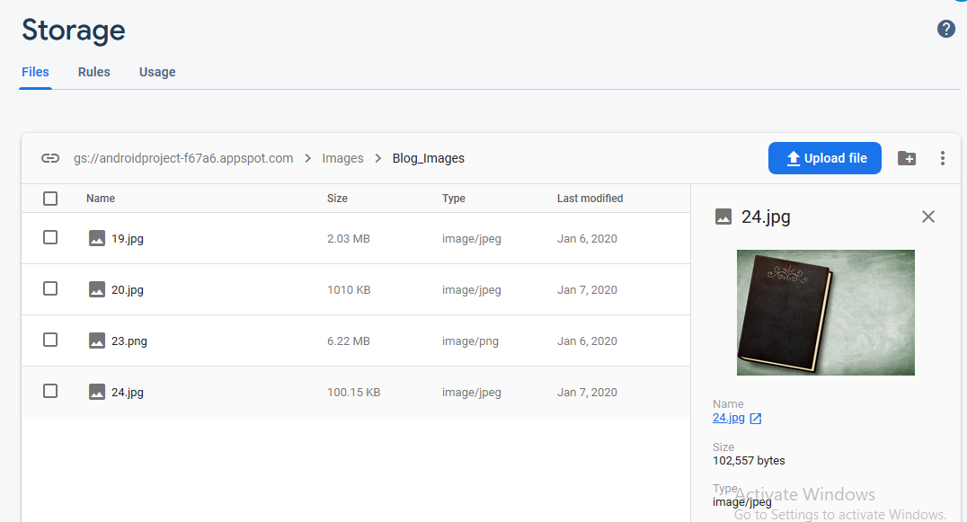
In Firebase storage :

Slide 12
End Users
Programmers
Students
All People

Slide 13
Requirements
Software Requirements :
Arduino IDE

Slide 14
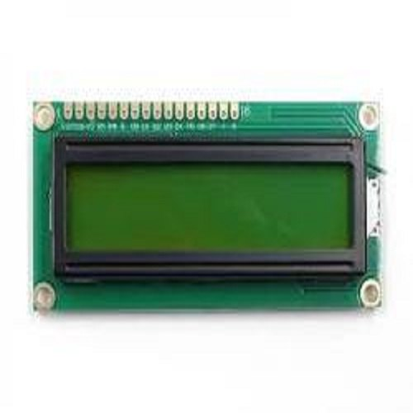
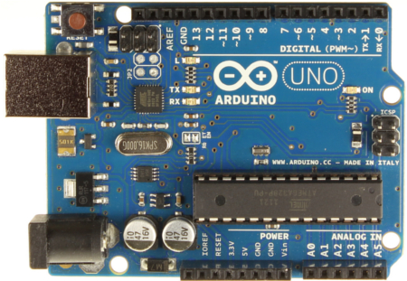
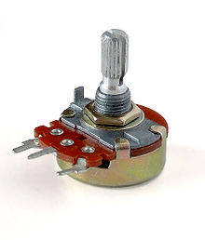
Hardware Requirements :
Arduino Uno Board
16*2 LCD Display
Variable Register

Slide 15
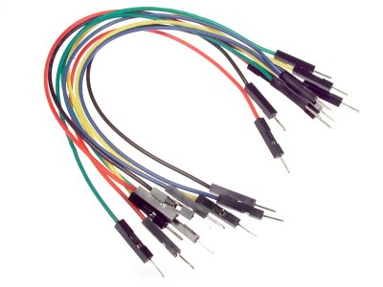
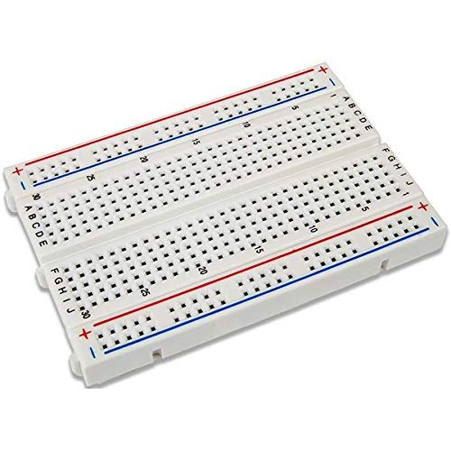
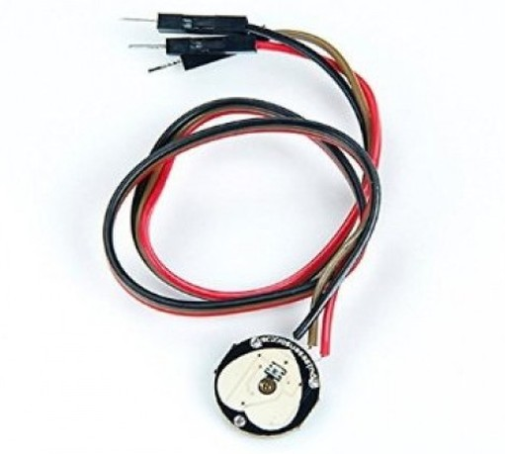
Pulse Monitor
Jumping Ware
Breadboard

Slide 16
Future Enhancement
Adding pulse rate signal.
Adding Green LED to identify the normal pulse rate.
Adding RED LED to identify the fast pulse rate.

Slide 17
Reference
https://www.arduino.cc

