Slide 1
Traveler Software
By: Muhammad Rizwan Khalid & Abdullah Rafaqat

Slide 2
Problem Statement
Going to New City.
Unawareness of Places.
Manual Searching.

Slide 3
Solution
Making User Friendly Software.
Providing Choice of City.
Choice for Places(i.e. Hotels, Landmarks, etc.).
Showing him Schedule.
Admin Login.

Slide 4
Challenges Faced
Linking Combo boxes with the files
Using objects to Store the information of user.
Random access file and Serialization.

Slide 5
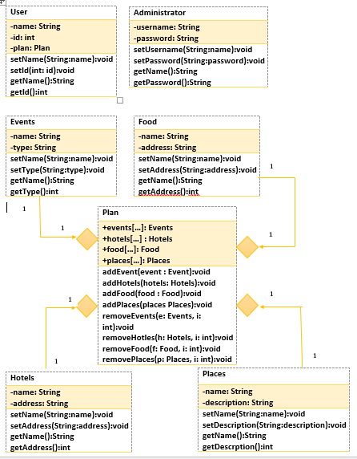
UML Diagram:

