Slide 1
Faculty of Computing and Informatics
Neural Networks
Dharm Singh Jat
Professor of Computer Science
Email: dsingh@nust.na 27.03. 2018

Slide 2

Neural Networks
Introduction
Neural network model : Neuron
Input, hidden, and output layers
Min-max normalization
Prediction
Confusion matrix
Misclassification error
Network repetitions
Example with binary data

Slide 3
Introduction
Big data is everywhere, and storage is affordable.
Big data has become too complex and too dynamic to be able to process, store, analyze and manage with traditional data tools.
Various statistical methods are important tools for big data analysis, but certain assumptions are required.
So, a need emerges to explore an intelligent technique to analysis a large amount of data efficiently.

Slide 4
Introduction
How to analyze large amount of data effectively and easily?
Machine learning deals with variety of methods used for data analysis by using algorithms that allow us
to learn from and predict based on data alone as opposed to following a set of instructions.
Often using iterative approach, learning can be partly automated and simplified.
One of the approaches used in machine learning is to use artificial neural network, which utilizes
the structural architecture of brain by simulating its great number of connections.

Slide 5
Introduction
One of the important approach used in machine learning is an artificial neural network (ANN) and
ANN is used to analysis the big data by using algorithms which allows learning, and
the target value are based on data alone as compared to set of certain assumptions in statistical methods.
Learning process can be simplified and automated by using iterative approach.

Slide 6
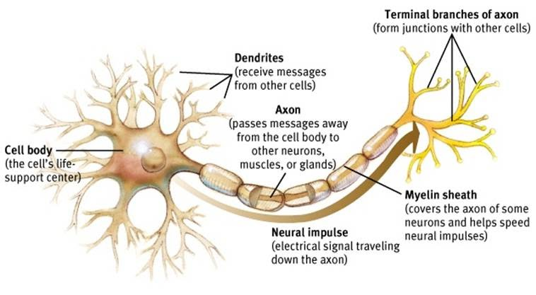
Neuron
Neuron’s membrane has a particularly important role in process of transferring the electric signal.
It maintains an electrical imbalance of negatively and positively charged ions, which creates a potential difference across the membrane and its environment called membrane potential.
https://sites.google.com/site/mrstevensonstechclassroom/hl-topics-only/4a-robotics-ai/neural-networks-computational-intelligence

Slide 7
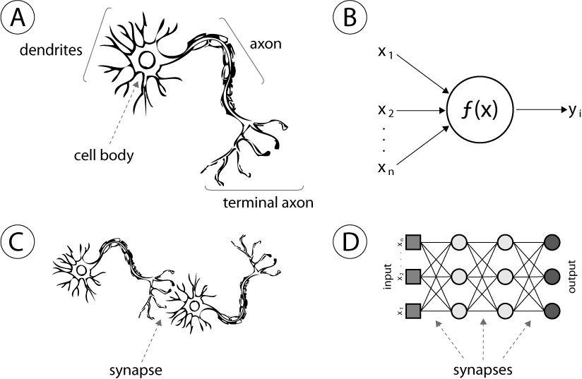
Neuron
The Biological Neuron Model
https://www.google.co.in/url?sa=i&rct=j&q=&esrc=s&source=images&cd=&ved=2ahUKEwje4cq36IraAhUJ6xQKHbgvDJMQjRx6BAgAEAU&url=https%3A%2F%2Fmedium.com%2F%40ivanliljeqvist%2Fthe-essence-of-artificial-neural-networks-5de300c995d6&psig=AOvVaw2STYyfiWYcYD5JUrND9EDP&ust=1522179999293394

Slide 8
Topology Neural Networks
Neural network topology represents how are the neurons in network connected.
It could be described as a relationship between neurons by means of their connections.
Most neural networks have a layered topology and a basic description of network can be given as
number of layers and number of neurons in each respective layer of that network.
Typically, neural network consists of
an input layer,
one or several hidden layers,
an output layer and
can have additional constant values (generally used value is 1) connecting to neurons called biases.
The topology plays a large role in functionality and performance of neural networks.

Slide 9
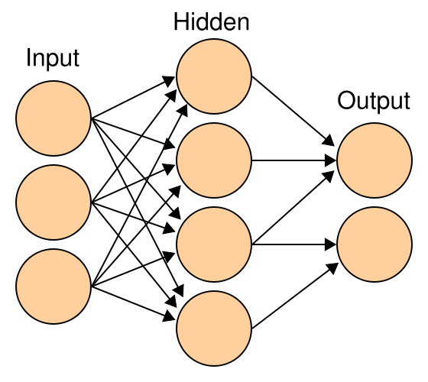
Input, hidden, and output layers
Instead of traditional statistical methods, neural networks are being used for prediction and classification in different types of applications.
An artificial neural network is a set of non-linear data modeling techniques and tools consisting of a various input and output layers plus one or more hidden layers.
https://sites.google.com/site/mrstevensonstechclassroom/hl-topics-only/4a-robotics-ai/neural-networks-computational-intelligence

Slide 10
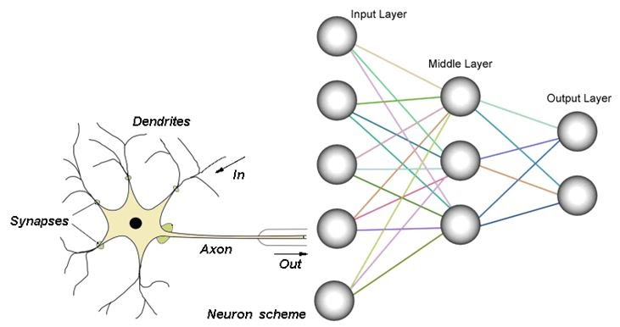
Input, hidden, and output layers
Each processing node ( neuron) has a numeric threshold value.
The nods compares the effective weight to threshold value.
If the effective weight > threshold,
the unit produces an output value of 1 else
it produces an output of 0.
The process of adjusting the weights an threshold values in a neural net is called training.
https://sites.google.com/site/mrstevensonstechclassroom/hl-topics-only/4a-robotics-ai/neural-networks-computational-intelligence

Slide 11
Input, hidden, and output layers
The connections between nodes or neurons in each layer have associated weights.
To minimize error and provide accurate predictions these weights are iteratively adjusted by the training algorithm and
the predicted results are compared with known values of the target variables.

Slide 12
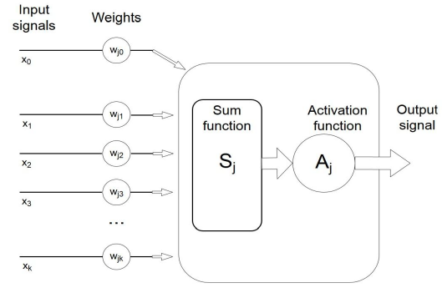
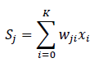
Schematic Representation of Artificial Neuron
Neurons are connected to each other in form of weights
Neuron model also adds bias weight,
which is associated with arbitrary input equal to 1, and can be used for adjustment of neuron’s output independently of current values of neuron’s inputs.
The weights represent the adaptable part of the network, which has the ability to learn.
The input of a neuron Nj can be represented as
Activation function f = Aj = f(Sj)
Fig: Schematic representation of artificial neuron

Slide 13
Neural Networks and RLab
Neural network is an important tool related to analyzing big data or working in data science field.
R language
R is a programming language with general focus on statistical computation.
R is a free software environment for statistical computing and graphics, and is widely used by both academia and industry.
R software works on both Windows and Mac-OS.

Slide 14
neuralnet
neuralnet from CRAN
This implementation is based on neuralnet implementation published in CRAN (The Comprehensive R Archive Network) that can be found at the address:
https://cran.r-project.org/web/packages/neuralnet/index.html
Neuralnet is a package published by Stefan Fritsch, Frauke Guenther, Marc Suling, Sebastian M. Mueller, used for creation, training and computation with ANN.

Slide 15
Application
Example 2. A researcher is interested in how variables, such as GRE (Graduate Record Exam scores), GPA (grade point average) and prestige of the undergraduate institution, effect admission into graduate school. The response variable, admit/don’t admit, is a binary variable.
In this demonstration, data frame has 400 observations with 4 variables .
One of the variables is admitted.
It takes values 0 and 1 it means that whether the student applied to the university is admit or not.

Slide 16
Variables Values
data.frame': 400 obs. of 4 variables:
$ admit: int 0 1 1 1 0 1 1 0 1 0 ...
$ gre : int 380 660 800 640 520 760 560 400 540 700 ...
$ gpa : num 3.61 3.67 4 3.19 2.93 3 2.98 3.08 3.39 3.92 ...
$ rank : int 3 3 1 4 4 2 1 2 3 2 ...

Slide 17
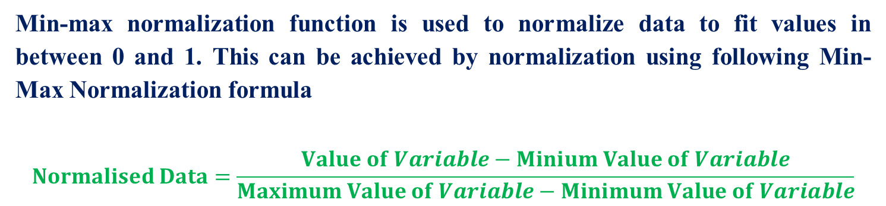
Min-Max Normalization
Min-max normalization function is used to normalize data to fit values in between 0 and 1. This can be achieved by normalization using following Min-Max Normalization formula
$$Normalised Data=\frac{Value of Variable−Minium Value of Variable}{Maximum Value of Variable−Minimum Value of Variable}$$
> data$gre <- (data$gre - min(data$gre))/(max(data$gre) - min(data$gre))
> data$gpa <- (data$gpa - min(data$gpa))/(max(data$gpa) - min(data$gpa))
> data$rank <- (data$rank - min(data$rank))/(max(data$rank)-min(data$rank))

Slide 18
Data Partition
By splitting data into training and testing dataset,
281 observations were under training dataset and
remaining 119 under testing data set.
Partitioning:
can develop neural network using training data set and
assessing the performance of neural network using testing data set.
> set.seed(222)
> ind <- sample(2, nrow(data), replace = TRUE, prob = c(0.7, 0.3))
> training <- data[ind==1,]
> testing <- data[ind==2,]
> library(neuralnet)
Warning message:
package ‘neuralnet’ was built under R version 3.4.4

Slide 19
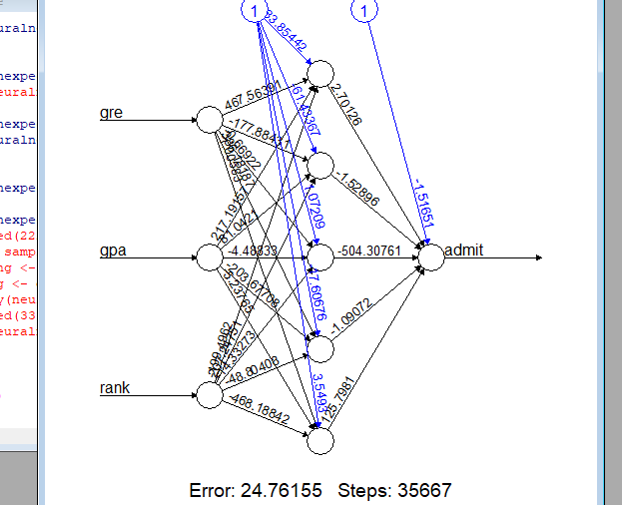
Data Partition

Slide 20
Neural Network Model:
Now a model for predicting admit as a function of all three variables (GRE, GPA and School Rank) where data equal training and we also need to specify how many nodes or neurons we should have in the hidden layer.
In neuralnet package, there are following four critical arguments:
hidden: This is the number of hidden nodes or neurons in each layer. The default value is one and can be extended up three.
The argument “act.fct is the activation function that is used for smoothing the result of the cross product of the neurons and the weights. By default, logistic and tanh are available in the package.
The argument linear.Output: This is a logical attribute if act.fct should not be applied to output neurons set linear output to TRUE otherwise to false. The default value is TRUE. To keep linear output for data, this will need to be FALSE.

Slide 21
Neural Network Model: Cross Entropy(ce) Error Function
The argument “err.fct” defines the error function and used to calculate the error with default sum of squared error (sse).
Error function can be “sse”or cross entropy (ce) and if we are dealing with binary outcomes, we will use the “ce” error function.
> n <- neuralnet(admit~gre+gpa+rank,
+ data = training,
+ err.fct = "ce",
+ linear.output = FALSE)
> plot(n)
>
> output <- compute(n, training[,-1])
> head(output$net.result)

Slide 22
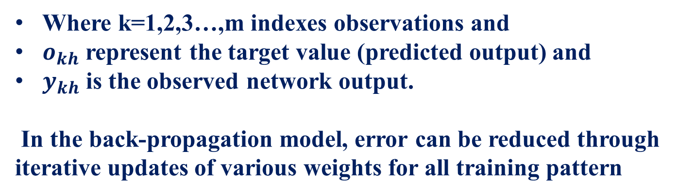

Neural Network Model: Cross Entropy(ce) Error Function
$$E_{sse}=\frac{1}{2}\sum_{k=1}^{m}{{\left(o_{kh−}y_{kh}\right)}^{2}}$$
Where k=1,2,3…,m indexes observations and
$o_{kh}$ represent the target value (predicted output) and
$y_{kh}$ is the observed network output.
In the back-propagation model, error can be reduced through iterative updates of various weights for all training pattern

Slide 23
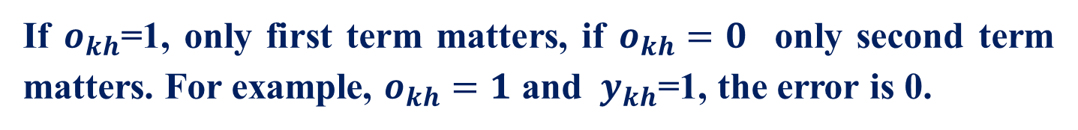
Neural Network Model: Cross Entropy(ce) Error Function
$E_{ce}=\frac{1}{2}\sum_{K=1}^{m}{[o_{kh}}log{ (y}_{kh})+(1−o_{kh}$) log (1-${ y}_{kh}$)]
If $o_{kh}$=1, only first term matters, if $o_{kh}=0$ only second term matters. For example, $o_{kh}=1$ and ${ y}_{kh}$=1, the error is 0.

Slide 24
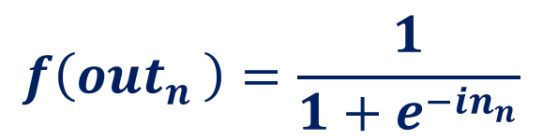
Node Output Calculation
Node Output Calculation with Sigmoid Activation Function
There are many activation functions like rectifier, maxout, hyperbolic (tanh), and sigmoid function.
A sigmoid function which is a special case of the logistic function where by applying a threshold values it scales in between 0 to 1.
$$f\left({out}_{n }\right)=\frac{1}{{1+e}^{−{in}_{n}}}$$
The value of sigmoid function never reaches 0 nor exceed 1

Slide 25
Activation Function
Figure 1 Sign function
Figure 2 Logistic function
Figure 3 Hyperbolic tangent function
Some of the most commonly used activation functions in neural networks

Slide 26
NUST
THANK YOU
Contact:
Prof Dharm Singh Jat (dsingh@nust.na)

