Slide 1


INTRODUCTION TO THE BAYESIAN MODEL
PRESENTED BY: Isak Neema
Executive Data Quality Assurance and NSS Coordination
Machine Learning Training Indaba, NUST 27 March 2018

Slide 2

Layout
Basic Concepts
Bayesian Models
Genesis of Bayes approach
Bayesian Set-up
Inferences
Conclusion
Key References

Slide 3
Basic Concepts

Slide 4

What is Machine Learning?
Machine learning, a branch of artificial intelligence, concerns the construction and study of systems that can learn from data.

Slide 5
What is Machine Learning….
Machine learning is programming computers to optimize a performance criterion using example data or past experience. -- Ethem Alpaydin
The goal of machine learning is to develop methods that can automatically detect patterns in data, and then to use the uncovered patterns to predict future data or other outcomes of interest. -- Kevin P. Murphy

Slide 6
What is Machine Learning….
The field of pattern recognition is concerned with the automatic discovery of regularities in data through the use of computer algorithms and with the use of these regularities to take actions. -- Christopher M. Bishop
Machine learning is about predicting the future based on the past. -- Hal Daume III

Slide 7
What is Machine Learning….
past
future
predict
learn
Training
Data
model/
predictor
Testing
Data
model/
predictor
-- Hal Daume III

Slide 8
Example
Root
Weather outlook
sunny
overcast
rainy
Sprit node
Leaf node
Y
windy
humidity
high
normal
false
true
Leaf node
N
Y
Y
N

Slide 9
Example….
Is James fit?
Age <30
Yes?
No?
Eat a lot of pizza?
Exercise in the morning?
Yes?
No?
No?
Yes?
Unfit
Fit
Unfit
Fit

Slide 10
Example….more complex situations

Slide 11
Bayesian Models

Slide 12
What are Bayesian models?
Bayesian models are statistical models for fitting complex situations
They are probabilistic in nature
Takes into account conditional dependences
Can fit both fixed effects and random effects

Slide 13
Area of use
Medicine/epidemiology
Genetics
Ecology
Environmental sciences
Social and political sciences
Information technology
Finance
Archeology
Engineering
……..

Slide 14
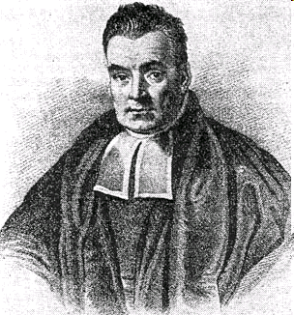
Genesis of Bayesian Models
Derived on a theorem invented by an english reverend Thomas Bayes (1701-1761) and published posthumously (1763).

Slide 15
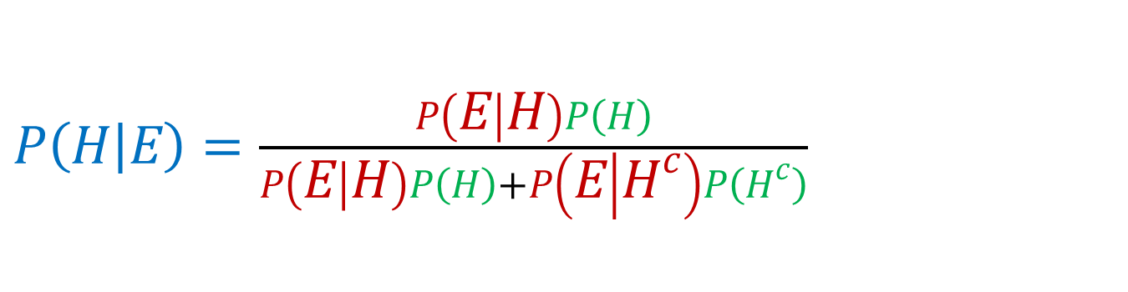
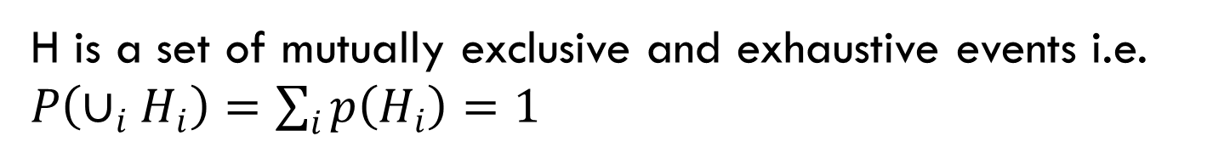
Genesis ….
The essence of Bayesian inference is in the rule, known as Bayes' theorem, that tells us how to update our initial probabilities P(H) of event H, if we see evidence E, in order to find out P(H|E).
A priori probability
Conditional probability
Posteriori probability
$P\left(H | E\right)=\frac{P\left(E | H\right)P\left(H\right)}{P\left(E | H\right)P\left(H\right)+P\left(E | H^{c}\right)P\left(H^{c}\right)}$
H is a set of mutually exclusive and exhaustive events i.e. $P\left(∪_{i}H_{i}\right)=\sum_{i}{p\left(H_{i}\right)=1}$

Slide 16
Bayesian Set-up
Problem: Namibia is faced with a problem of crime, which has been on the rise for a quite a number of years now. In particular, incidences of burglary is worrisome. In understanding these incidences a number of factors playing a role: region, constituency, area, town, suburb, time, season, month, area-specific population density, ....
What is the best way to predict these incidences and deliver better interventions and or planning?

Slide 17

Bayesian Set-up…..
Using a normal regression model we fit
$Y=β_{0}+β_{1}x_{1}+…+β_{n}x_{n}+E$ ……(Equ.1)
$Y$- Burglary cases
$β_{i}$- parameter estimates
$x_{i}$ - covariates (predictors)
$E$ – error term
But, is this the correct way to do it?

Slide 18

Bayesian Set-up…..
This is a classical Bayesian problem, level of complexity is evident
Burgraly incidences are counts (0,1,2,3...20...)
Count model will be appropriate
Poisson (finite number)
Negative Binomial (excess zeros)
Assuming a finite number:
$O\sim dpoisson\left(λ\right)$

Slide 19


Bayesian Set-up…..
$e$- expected cases of Burglary
$X=\left(x_{1},x_{2},….,x_{n}\right)$ - vector of covariates
$λ$ - Rate of incidences
Then the mixed Poisson regression is:
$$log\left(λ\right)=η$$
$η=log\left(e\right)+β_{0}+β_{1}x_{1}+…+β_{k}x_{k}$ ……..(<Equ.2)
$$O\left|λ\right., e, X\sim Po\left(λe\right)$$

Slide 20

Bayesian Set-up…
Other issues to consider
Other unexplained effects to consider
E.g. Space, time effects, intercorrelation or interdependency effects e.t.c.
Effects that are structured and others are random
E.g. From the problem, suppose: region-$r$ and time- $t$are the variables to model:

Slide 21

Bayesian Set-up…
Other issues to consider
Other unexplained effects to consider
E.g. Space, time effects, intercorrelation or interdependency effects e.t.c.
Effects that are structured and others are random
E.g. From the problem, supposed variables of interest are:
Buglary cases -$O$
region-$r$ , time- $t$ & population density-$x$
random effects- $u$ & structured effects- $v$

Slide 22












Bayesian Set-up…
$$σ_{u}$$
$$σ_{v}$$
$$τ_{u}$$
$$τ_{v}$$
$$β_{0}$$
$$β_{d}$$
$$u\left[r,t\right]$$
$$v\left[r,t\right]$$
$$e\left[r,t\right]$$
$$x\left[r,t\right]$$
$$θ\left[r,t\right]$$
$$O\left[r,t\right]$$

Slide 23

Bayesian Set-up…
What are we modeling:
$$log\left(λ_{rt}\right)=log\left(e_{rt}\right)+β_{0}+β_{d}x_{rt}+u_{rt}+v_{rt}+{tt}_{t}+γ_{rt}$$
Break it down:
$+u_{rt}+v_{rt}+{tt}_{t}+γ_{rt}$ - random effects
$β_{d}x_{rt}$ - fixed effects
$β_{0}$ - intercept term
$log\left(e_{rt}\right)$ - model offset

Slide 24

Bayesian Set-up…
Model specifications via priors and hyper-priors i.e.
Priors:
$β_{0}\sim$ flat prior
$\left.β_{d}\right|τ_{β_{d}}^{−1}\sim N\left(0,τ_{β_{d}}^{−1}\right)$
$\left.u_{rt}\right|{\overline{u}}_{rt},τ_{u}^{−1}\sim N\left({\overline{u}}_{rt},τ_{u}^{−1}\right)$
$\left.v_{rt}\right|τ_{v}^{−1}\sim indep.N\left(0,τ_{v}^{−1}\right)$
$\left.{tt}_{t}\right|τ_{tt}^{−1}\sim N\left(0,τ_{tt}^{−1}\right)$ , $t=1$ and $\left.{tt}_{t}\right|{tt}_{t−1},τ_{tt}^{−1}\sim N\left({tt}_{t−1},τ_{tt}^{−1}\right)$, $t=2,3,..,T$
$\left.γ_{rt}\right|τ_{γ}^{−1}\sim N\left(0,τ_{γ}^{−1}\right)$

Slide 25


Bayesian Set-up…
Taking into account that $σ_{i}^{2}=\frac{1}{τ_{i}}$
For ease of interpretation $σ$ is calculated
Hyper-priors:
$τ_{i}\sim Γ\left(a_{i},b_{i}\right),$ $i=β_{d},u,v,tt, γ$

Slide 26
Inferences
Markov Chain Monte Carlo (MCMC) is used
MCMC implement Likelihood approach
Two sampling approach for the posterior can be used:
Metropolis and Metropolis – Hastings algorithm
Gibbs sampling
Convergence of parameter a Gelman Rubin approach can be used

Slide 27
Conclusion
Compare to traditional models, Bayesian models are:
More flexible and very adaptable to unique situations
More efficient in using all available evidences
More useful in providing relevant quantitative summaries
Provide accurate predictions of events

Slide 28
Key References
[1] Congdon, P. (2003). Applied Bayesian modelling. Wiley Series in Probability and Statistics. Chichester, England: John Wiley and Sons.
[2] Ntzoufras, I. (2009). Bayesian modelling using WinBUGS. Hoboken, New Jersey: John Wiley and Sons.
[3] Lawson, A.B et al (1999). Disease mapping and risk assessment for public health. New York: John Wiley and Sons.
[4] Lawson, A.B et al (2003). Disease mapping with WinBUGS and MLwiN. Chichester, England: John Wiley and Sons.

Slide 29


