Slide 1
CAPACITY AND AGGREGATE PLANNING
WEEK : 4

Slide 2
CAPACITY PLANNING

Slide 3
INTRODUCTION
Capacity is the rate of productive capability of a facility. The capacity planning is process of determining the production capacity needed by an organization to meet the changing demand for its products.
The capacity is usually expressed as volume of output per time period.
The objective of capacity management ( i. e. planning and control of capacity) is to match the level of operations to the level of demand.
The effective management of capacity is the most important responsibility of operation management, since managers seek a good return on investment, both the cost and revenues of a capacity planning decision must be carefully evaluated.

Slide 4
NEED FOR CAPACITY PLANNING :
Capacity planning is to be carried out keeping in mind future growth and expansion plans, market trends, sales forecasting, etc.
It is a simple task to plan the capacity in case of stable demand.
But in practice the demand will be unstable.
Fluctuation of demand creates problems regrading the procurement of resources to meet the customer demand.
Capacity decisions are strategic in nature.
Capacity is the rate of productive capability of a facility.
Capacity is usually expressed as volume of output per period of time.

Slide 5
Production managers are more concerned about the capacity for the following reasons :
Sufficient capacity is required to meet the customers demand in time.
Capacity affects the cost efficiency of operations.
Capacity affects the scheduling system.
Capacity creation requires an investment.
Capacity planning is the first step when an organisation decides to produce more or new products.

Slide 6
MEASUREMENT OF CAPACITY :
* It is simple to measure the capacity of a unit manufacturing homogeneous tangible products which can be counted.
* The capacity of such units can be expressed in number of units of output per period.
* For example, the capacity of an automobile unit can be expressed as number of vehicles produced per month.
* The capacity of a steel plant can be expressed as millions of tones per annum.
* The capacity of a textile mill is expressed as meters of cloth per day.
It is difficult to express capacities when the company manufactures multiple products and some of the products requiring common facilities and others specialised facilities . In this situation measuring capacity is more complicated.

Slide 7
PROCESS OF CAPACITY PLANNING :
Capacity planning is concerned with defining the long –term and the short-term capacity needs of an organisation and determining how those needs will be satisfied.
Capacity planning decisions are taken based upon the consumer demand (market) and this is merged with the human, material and financial resources of the organisation.
The process of capacity planning is shown in block diagram.

Slide 8
Environmental Scanning
Demand Forecasting
Estimation of Present Capacity
Alternative capacity plans to meet demand
Quantitative and Economic Analysis of various plans
Select the Best Plan
Implementation

Slide 9
CAPACITY EXPANSION STRATEGIES :
Capacity expansions can be evaluated from two strategies;
Long-term capacity strategies
Short-term capacity strategies
1). LONG TERM CAPACITY STRATEGIES:
Long term capacity requirement are more difficult to determine because the future demand and technology are uncertain.
Forecasting for five or ten years into future is more risky and difficult.
Even sometimes company’s today’s products may not be existing in the future.

Slide 10
Long term capacity strategies :
Long term capacity planning is concerned with accommodating major changes that affect overall level of the output in long-term (more than one year).
Marketing environmental assessment and implementing the long-term capacity plans in a systematic manner are the major responsibilities of management.
Multiple Products :
Company’s produce more than one product using the same facilities in order to increase the profit.
The manufacturing of multiple products will reduce the risk of failure.
Having more than one product helps the capacity planners to do a better job.

Slide 11
Phasing in capacity :
In high technology industries, and in industries where technology developments are very fast, the rate of obsolescence is high.
The products should brought into the market quickly.
The time to construct the facilities will be long and there is no much time as the products should be introduced into the market quickly.
Phasing out capacity :
The outdated manufacturing facilities cause excessive plant closures and down time.
The impact of closures are not limited to only fixed costs of plant and machinery.

Slide 12
2). SHORT TERM CAPACITY STRATEGIES :
Managers often use forecasts of products demand to estimate the short-term workload the facility must handle.
Managers looking a head up to 12 months, anticipate output requirements for different products, and services.
Managers then compare requirements with existing capacity and then take decisions as to when the capacity adjustments are needed.
For short term periods of up to one year, fundamental capacity is fixed.
Major short term adjustments for increasing or decreasing capacity are possible.
The adjustments to be required depend upon the conversion process.

Slide 13
The short-term capacity strategies are as follows :
Inventories : Stock finished goods during slack periods to meet the demand during peak periods.
Backlogs : During peak periods, the willing customers are requested to wait, and their orders are fulfilled after the peak demand period.
Employment level (hiring and firing): Here additional employees during peak demand periods and layoff employees as demand decreases.
Employee training : Develop multi-skilled employees through training so that they can be rotated among different jobs. The multi-skilling helps as an alternative to hiring employees.

Slide 14
Workforce utilisation : Employees are made to work over time during peak hours and work fewer hours during slack hours (flexible work hours).
Subcontracting : During peak periods, hire the capacity of other firms temporarily to make the component parts or products.
Process design : Change job content by redesigning the job.
Maintenance : Temporarily discontinue routine maintenance so that this time can be utilised for production.

Slide 15
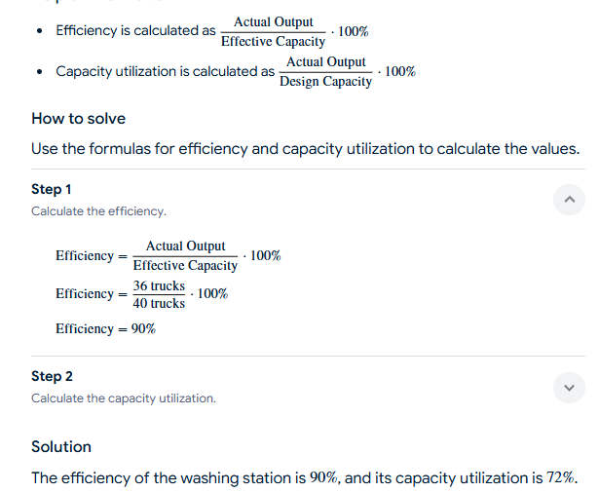
A washing station is designed to wash 50 trucks a day, but its effective capacity is 40 trucks a day But one day it has washed 36 trucks . calculate its efficiency and capacity utilization

Slide 16
AGGREGATE PLANNING

Slide 17
INTRODUCTION OF AGGREGATE PLANNING :
When an organisation carries out demand forecasting it will come to know of the possible demand for its products in the market.
Once when the likely demand is known, the organisation gears up all its activities to meet the demand.
Here aggregate planning comes into the picture.
Aggregate planning is nothing but deciding the ways and means of utilizing the resources to produce the output in order to meet likely demand.
Aggregate planning is always done over an intermediate time horizon i.e, 3 months to 1 year.

Slide 18
OBJECTIVE OF AGGREGATE PLANNING :
The basic aim of aggregate planning is to balance the demand against capacity by various methods.
Aggregate plan has to provide the overall levels of output, inventory and backlogs as per the forecasting and business plan of the organisation.
An aggregate plan should be consistent with the company’s goals and policies regarding its employee’s.
Aggregate plans should be flexible to take care of market fluctuations.
Aggregate planning should make optimum use of strategies to modify demands capacity.

Slide 19
AGGREGATE PLANNING STRATEGIES :
Three pure planning strategies (Internal to the organisation).
Other pure strategies (External to the organisation).
THREE PURE PLANNING STRATEGIES :
When strategies aim to modify the capacity to meet the demand only with the help of internal resources of the organization. They are known as ‘Pure planning strategies’.

Slide 20
Strategy No. 1 :- Vary the size of the work force :
In this pure strategy, the company varies the number of employees in response to varying output requirements.
Output is controlled by hiring or firing the workers in proportion to changes in demand.
Strategy No. 2 :- Vary the time of the work force :
In this strategy, the organisation maintains a constant work force but varies the utilisation of the work force.

Slide 21
Strategy No. 3 :- Vary the inventory levels :
In this strategy, the organisation maintains a constant work force and also a constant rate of production but will carry sufficiently large amounts of inventory to absorb all demand fluctuations.

Slide 22
OTHER PURE STRATEGIES :
Some organizations aim to monthly either the demand or the supply with strategies which take the help of factors which are external to the organization.
Back Ordering :
This is a method of modifying the demand.
Backorders are nothing but outstanding of unfulfilled customer orders.
In other words customers are asked to wait by the organizations before fulfilling their demand in a future period.

Slide 23
Sub contracting :
This is a very widely used method of modifying the supply.
In sub contracting, organizations off load some of the jobs to outside vendors thus hiring external capacity to meet the demand especially during peak periods.
Product Promotion :
This is a method of modifying the demand by vigorous advertisement, by giving off-season discounts, development of complimentary products offering schems such as ‘buy one taken one’ free etc.

Slide 24
AGGREGATE PLANNING METHODS :
There are many mathematical, graphical and analytical to help us in cost computations in the course of aggregate planning.
Cost computation are required while comparing the different strategies for effective selection of any one of them or for any form of mixed strategy.
AGGREGATE PLANNING GUIDELINES :
Determine corporate policy regrading usage of resources.
Select a good forecasting technique as a basis for planning.
Plan in appropriate units of capacity.
Maintain a stable workforce.

Slide 25
Have good control over inventories.
Be always flexible to change .
Respond to demand in a controlled manner.
Evaluate and check plans on a regular basis.

Slide 26

Manufacturing produces a product which has a 6 month demand cycle, as shown. Each unit requires 10 worker-hours to be produced, at a labor cost of Rs6 per hour regular rate (for Rs9 per hour overtime). The total cost per unit is estimated at Rs200, but units can be subcontracted at a cost of Rs208 per unit. There are currently 20 workers employed in the subject dept., and hiring and training costs for additional workers are Rs300 per person, whereas layoff costs are Rs400 per person. Company policy is to retain a safety stock equal to 20 percent of monthly forecast., and each month's safety stock becomes the beginning inventory for the next month. There are currently 50 units in stock carried at a cost of Rs2 per unit-month. Stockouts have been assigned a cost of Rs20 per unit-month.
Three aggregate plans are proposed.
PLAN 1. Vary the work-force size to accommodate demand.
PLAN II: Maintain a constant workforce of 20, and use overtime and idle time to meet demand.
PLAN III: Maintain a constant workforce of 20, and build inventory or incur a stockout cost. The firm must begin January with the 50 unit inventory on hand. Compare thre costs of the three plans and Suggest cheapest one

Slide 27
A washing station is designed to wash 50 trucks a day, but its effective capacity is 40 trucks a day A washing station is designed to wash 50 trucks a day, but its effective capacity is 40 trucks a day
But one day it has washed 36 trucks . calculate its efficiency and capacity utilization
A washing station is designed to wash 50 trucks a day, but its effective capacity is 40 trucks a day

Slide 28
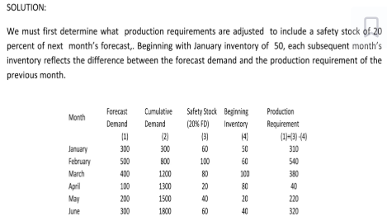
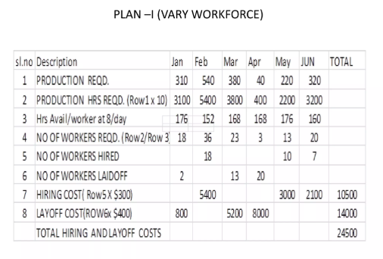
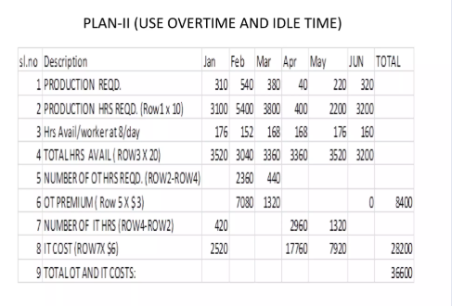
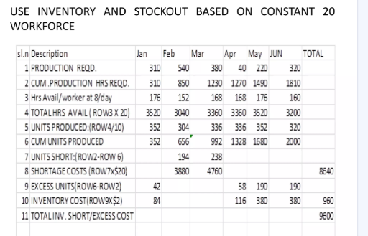

Slide 29
