Slide 1

DEPARTMENT OF COLLEGIATE AND TECHNICAL EDUCATION
QUALITY MANAGEMENT (WEEK 12)
QUALTY MANAGEMENT SYSTEM
QUALITY TOOLS
OPERATIONS MANAGEMENT
(IV SEMESTER)
MECHANICAL ENGINEERING.

Slide 2
Tools and Techniques of QMS
Pareto Chart
1. Pareto Analysis is a technique used to identify quality problems based on their degree of importance.
2. Pareto chart can be used to detect and present quality problems in increasing order of percentage of defects.
3. The Pareto Analysis suggests that most of the problems arise from relatively few defects or causes.
4. Pareto Analysis is called as 80:20 Rules indicating that 80% of the problems emerge from hardly 20% of the causes such as machine failure, service delay etc.
5. Pareto Chart helps to locate most important problem that needs to be given immediate action.

Slide 3
QC TOOL EXERCISE
A team working on improvement of OPD turnaround time collected the following data on 500 patients, for the various reasons for this problem. Use Pareto chart qc tool analyze these issue

Slide 4
Tools and Techniques of QMS
Cause and Effect Diagram
The Cause and Effect Diagram are used to detect and present the potential cause for particular quality problem by sorting the potential causes in to various categories due to which problems may arise also process dispersions can be analyzed using cause and effect diagram.
Specific causes of problems can be explored through brainstorming.
The quality problem is shown along the horizontal axis.
All causes emerge towards horizontal axis diagonally and coupled with specific issues.
Cause and effect diagram often called as Fish bone Diagram because it look like a bones of fish.
It is also called as Ishikawa Diagram as it is developed by Prof. Ishikawa of Japan.

Slide 5
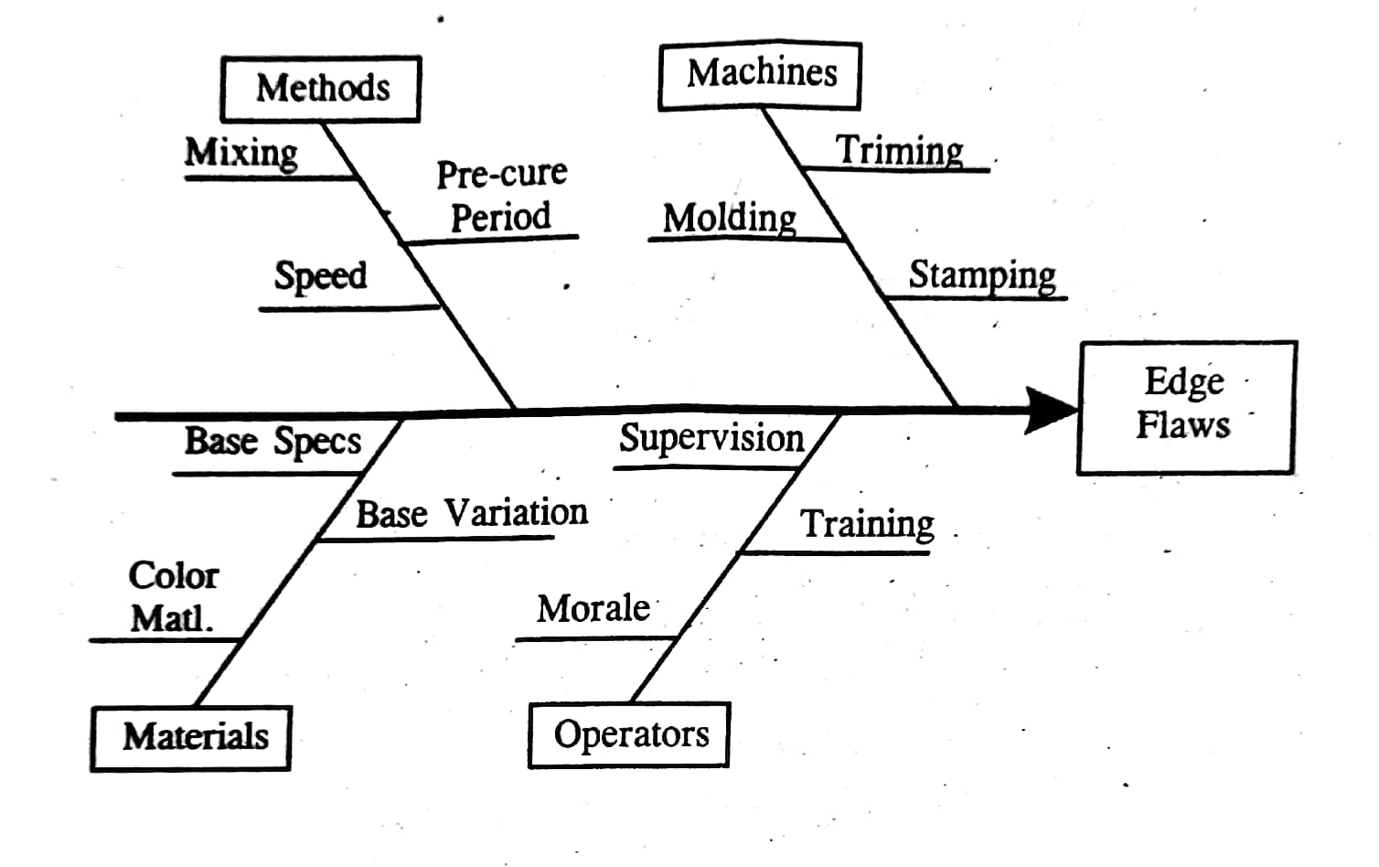
Tools and Techniques of QMS
Example: Cause and effect diagram for edge flaws.

Slide 6
Tools and Techniques of QMS
Check Sheet
A check sheet is a data recording form that has been designed to readily or instantly interpret results from the form itself.
It is used for the collection of quantitative, qualitative, repetitive data.
Check sheet helps in decision making since it presents essential data in a tabular form.
A defining characteristic of a check sheet is that data is recorded by making marks ("checks") on it. A typical check sheet is divided into regions, and marks made in different regions have different significance. Data is read by observing the location and number of marks on the sheet.

Slide 7
Tools and Techniques of QMS
Check Sheet
It is used when
When data can be observed and collected repeatedly by the same person or at the same location.
When collecting data on the frequency or patterns of events, problems, defects, defect location, defect causes, or similar issues.

Slide 8
Tools and Techniques of QMS
Procedure to prepae check sheet:
Decide what event or problem will be observed. Develop operational definitions.
Decide when data will be collected and for how long.
Design the form. Set it up so that data can be recorded simply by making check marks or X's or similar symbols and so that data do not have to be recopied for analysis.
Label all spaces on the form.
Test the check sheet for a short trial period to be sure it collects the appropriate data and is easy to use.
Each time the targeted event or problem occurs, record data on the check sheet.

Slide 9
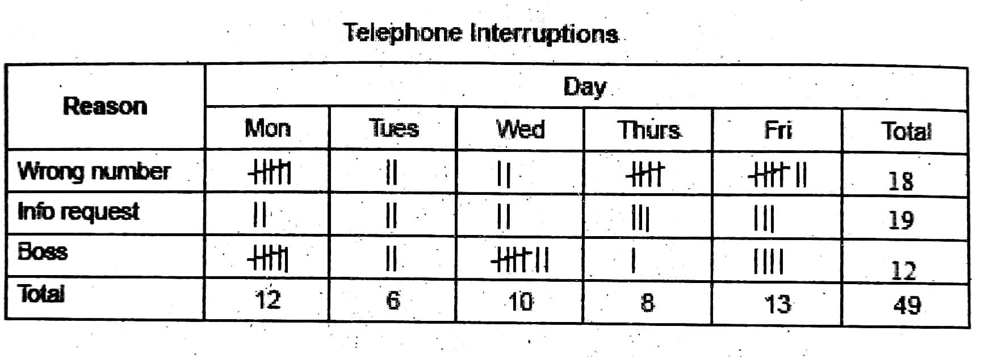
Tools and Techniques of QMS
Example:
Check sheet used to collect the data on telephone interruption.

Slide 10
QC TOOL EXERCISE
An assistant at a doctor's office is frustrated. Patients have not been following the proper procedure for filling their prescriptions; often calling the day they run out of their medicines to request refills. Each time the assistant needs to stop her work to spend time looking up patient records, getting the doctor's approval and calling pharmacies. To determine how much of a problem the last-minute phone calls are becoming, she decides to keep track of the types of phone calls she receives in week. What type of quality control tool would be ideal?

Slide 11
SOLUTION
Check sheet would be the most ideal quality control tool to use in this situation. Since the secretary will be the only person collecting the data and will be stationed in the same location throughout the week, she can be assured that the data collection will be consistent. Additionally, since the secretary is looking for frequency data, this tool will provide a quick and easy way to determine how frequently the short-notice phone calls are being received.

Slide 12
Tools and Techniques of QMS
Scatter Diagram
Scatter Diagram can be used to study the degree of co relationship exists between the two variables of cause and effect during manufacturing process.
Scatter diagram is plotted by taking the cause variable on X-axis and effect variable on Y axis.
If greater the degree of co-relation, the more linearity is observed in diagram.
If co-relation is weaker, the plotted points will scatter.
MECHANICAL ENGINEERING -20M41P

Slide 13
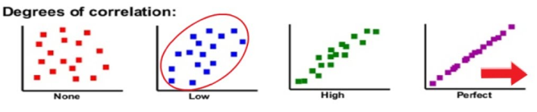
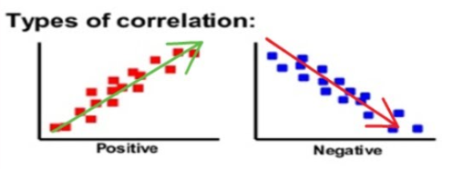
Tools and Techniques of QMS
Example:
1. As production speed increases, so number of defects increases. This is Positive Co relation
2. As worker training increases, so number of defects decreases. This is Negative Co relation.
MECHANICAL ENGINEERING -20M41P

Slide 14
QC TOOL EXERCISE:
Bill, a sixth-grade student, needs to select a science fair project. While shopping with his mother, he notices that she always buys the most expensive paper towels. She says that these absorb the most liquid when cleaning. Bill wants to see if this relationship between cost and absorbency exists, so he decides to design a science fair project around this question. In his experiment, he examines the relationship between the cost of paper towels and their absorbency capabilities. What type 00 quality control tool would be ideal for analyzing this?
MECHANICAL ENGINEERING -20M41P

Slide 15
SOLUTION
A scatter diagram would be the best choice for comparing two variables to determine if there is a logical relationship. In this case, Bill should be able to determine if there is, in fact, a positive correlation between paper towel cost and absorbency as his mother suggests, by using a scatter diagram
MECHANICAL ENGINEERING -20M41P

Slide 16
Tools and Techniques of QMS
Five Whys:
It is an iterative interrogative technique used to explore the cause and effect relationship underlying a particular problem.
The primary goal of technique is to determine the root cause of a defect or problem repeating the question “Why?” Each answer forms the basis of the next question.
Sakichi Toyoda, the Japanese industrialist developed this technique in 1930.
5 whys are used for troubleshooting, quality improvement, and problem solving, but it is most effective when used to resolve simple or moderately difficult problems.
To develop a better and more detailed understanding of the problem.
MECHANICAL ENGINEERING -20M41P

Slide 17
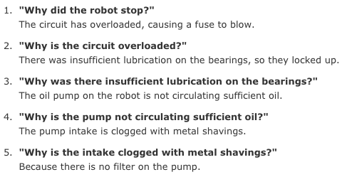
Tools and Techniques of QMS
Procedure
1. Form a team
2. Define the problem.
3. Ask Why?
Example:
MECHANICAL ENGINEERING -20M41P

Slide 18
Kaizen and Continuous Improvement :
Kaizen is as continuous improvement and is originally a Japanese management concept for incremental change.
Kaizen literally means 'change' (kai) to become 'Good' (Zen).
It is culture of sustained continuous improvement focusing on eliminating waste, in all systems and processes of an organization.
How does Kaizen work?
Employees at all levels work together to identify problems and eliminate their root causes
Small, incremental changes are made over time to create big results
The PDCA (Plan-Do-Check-Act) cycle is used to systematically test solutions, assess results, and implement the best ones

Slide 19
The three key elements of kaizen are :
1 Elimination of waste and inefficiency.
2 The kaizen 5s framework for good house keeping.
Seiri/Sort (organize). Separate necessary workplace items from unnecessary ones and remove unnecessary items.
Seiton/Set in order (create orderliness). Arrange items to allow for easy access in the way that makes the most sense for work.
Seiso/Shine (cleanliness). Keep the workspace clean and tidy.
Seiketsu/Standardize (standardized cleaning). Systematize workplace cleanup best practices.
Shitsuke/Sustain (discipline). Keep the effort going.
3. Standardization.

Slide 20
Classification of Kaizen :
Kaizen is classified into kaizen workshop, kaizen blitz and kaizen event.
All the three are team based rapid improvement workshops.
Kaizen events and kaizen workshops are 5 day long : kaizen blizes are shorter kaizen workshops are promoted by Gemba research "GEMBA" is a Japanese word meaning 'real place' where real action takes place.
Therefore, Kaizen applied to GEMBA is called "GEMBAKAIZEN"
Kaizen events refers to consultants. A kaizen blitz is an intensive and focussed approach to process improvement.

Slide 21
Steps in Implementation of Kaizen Blitz :
Defining the project goal and identifying the problem.
Formation of a team.
Gathering basic information and measures.
Performing brainstorming.
Implementation and evaluation of variable alternatives.
Selection of the best alternative.
Implementation of the best solution.

Slide 22
Kaizen benefits:
Improves productivity
Eliminates waste
Once kaizen invented it is implemented permanently
Creates a culture of innovation and progress
Improves efficiency
Ensures maximum quality
Improves work procedures

Slide 23
Quality Circle :
A quality circle is a small group of employees in the similar work area who voluntarily meet regularly and whose assignment is to identify the problems related to quality improvement, formulate solutions and present their results to management with suggestions for implementation.

Slide 24
Following Things should be Avoided While Practicing Quality Circles :
Selection of QC members by the management.
Giving the problems to qc by the management.
Involvement of management personnel in QC.
Circle leader dominated by management.
Mandatory rotation of members.
Emphasis on short-term financial gains.

Slide 25
Features Quality Circles :
Qc is A philosophy not A technique.
Qc have a bottom-to-up approach.
Qc are voluntary but not coerced or compulsory.
Qc are management supported but not management directed.
Qc are truly participative.
Qc are team work.
Qc involves task performers not the top bosses.

Slide 26
Six Sigma :
Six sigma is a federally registered trade mark of motorola, used as a management tool for quality control.
Definition :
As defined by general electrical company which has adopted six sigma, six sigma is a vision of quality which equates with only 3.4 defects per million opportunities for each product or service transaction and it strives for perfection.
Six sigma level indicates that we are 99.99966% confident that the product/service delivered by us is defect free. This means that only 0.00034% of the times the product/service delivered is defect prone. When 0.0000034 is multiplied by one million, it comes to 3.4 defects per million opportunities (DPMO).

Slide 27
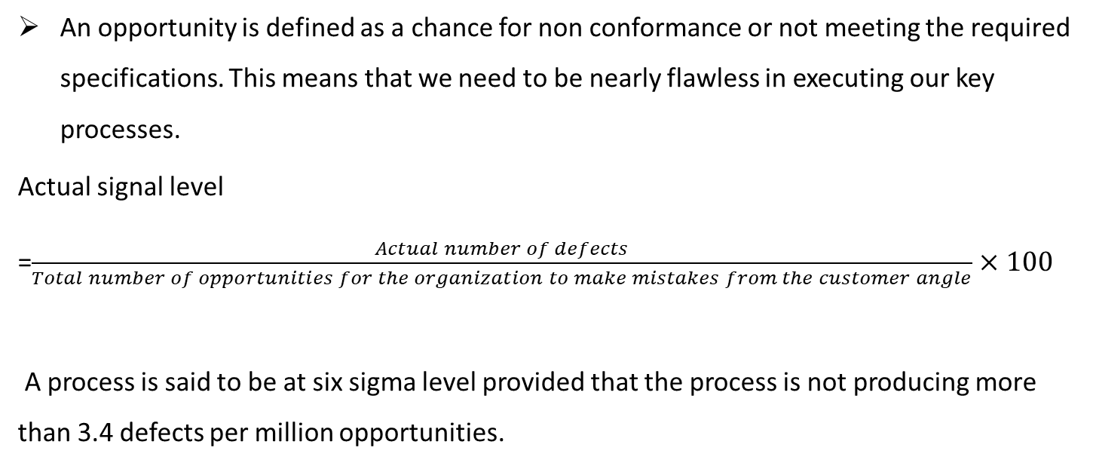
An opportunity is defined as a chance for non conformance or not meeting the required specifications. This means that we need to be nearly flawless in executing our key processes.
Actual signal level
=$\frac{Actual number of defects}{Total number of opportunities for the organization to make mistakes from the customer angle}$ $×100$
A process is said to be at six sigma level provided that the process is not producing more than 3.4 defects per million opportunities.

Slide 28
Objectives :
The fundamental objectives of six sigma are .
Process improvement.
Reducation of variation.
Simplification of the process.
Elimination of non-value adding tasks.
Flow charting the revised process.

Slide 29
Types of Six Sigma Belts :
There are
Green belts.
Black belts
Master black belts.

Slide 30
Approach for Six Sigma :
There are two approaches for achieving six sigma. These are
DMAIC - Define, Measure, Analyse, Improve and Control.
DMADV - Define, Measure, Analyse, Design and Verify.

Slide 31
DMAIC (Define, Measure, Analyze, Improve, Control):
Define: Identify the problem, project goals, and customer requirements.
Measure: Collect data to quantify the problem and measure performance.
Analyze: Use data to investigate and understand the variables impacting the problem.
Improve: Implement solutions to eliminate the root cause of the defect.
Control: Measure performance to ensure the improved process is successful and create a quality control plan to maintain improvements.

Slide 32
DMADV (Define, Measure, Analyze, Design, Verify):
Define: Identify the problem, project goals, and customer requirements.
Measure: Measure the customer requirements and the current process.
Analyze: Analyze the requirements and the current process to identify gaps and opportunities.
Design: Design a new process or product to meet the customer requirements.
Verify: Verify that the new design meets the customer requirements and is robust.

Slide 33
Benefits of six sigma :
The benefits of six sigma are listed below
It ensures enhanced product quality.
It enables predictable delivery of the products.
It helps to achieve productivity improvement.
It helps to have rapid response to changing needs of customers.
It also facilitates the development and introduction of new products into the market place.

