Slide 1
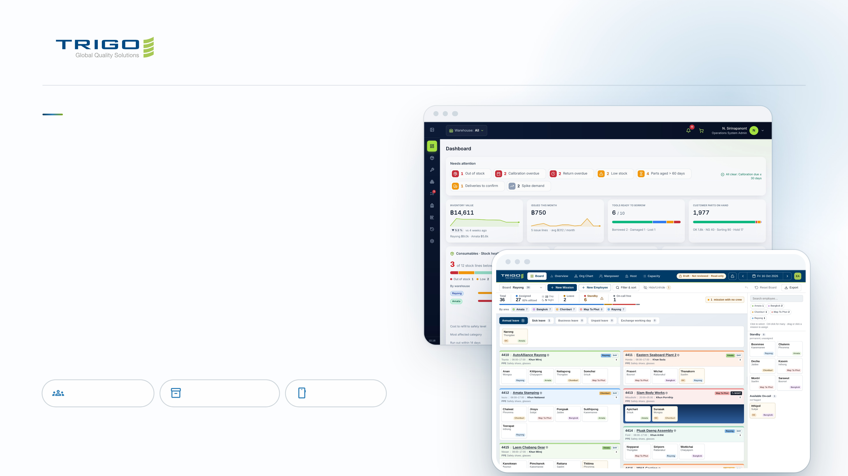
GLOBAL QUALITY SOLUTION
Two apps for
the work we
do every day.
The Manpower Board plans who goes where. The
Inventory & Quality System tracks tools, parts
and consumables. Both run in the browser and on
your phone.
Manpower Board
Inventory & Quality
On your phone
Notes:
12 · The two apps
Two internal tools, built for our sites. Same sign-in domain, same look, both installable on a phone.

Slide 2
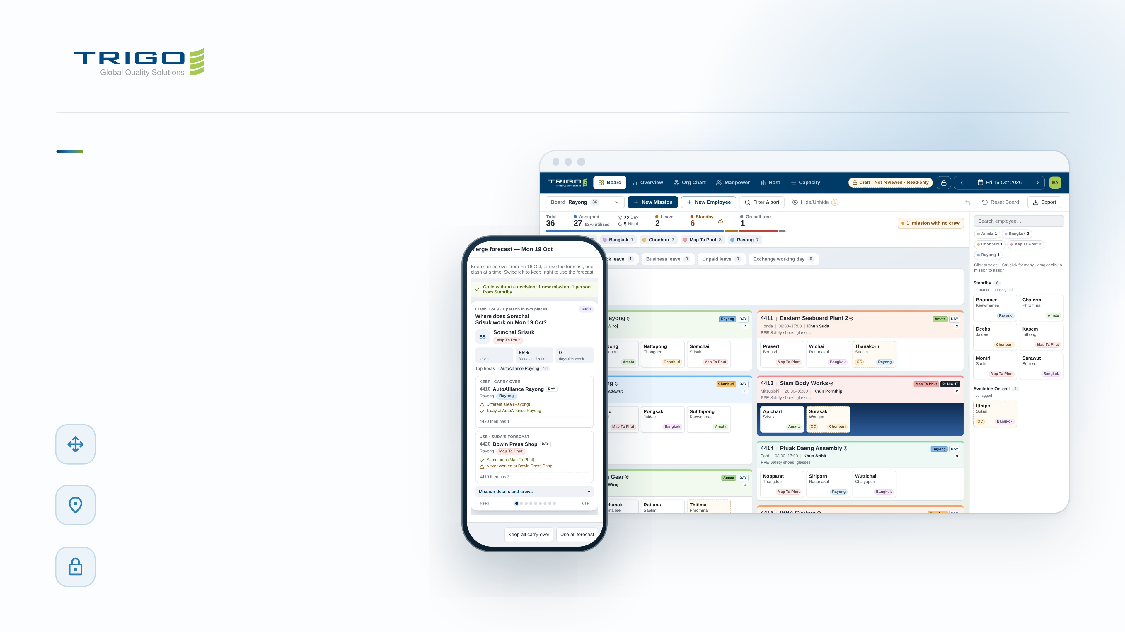
MANPOWER BOARD
Tomorrow's
crew, planned
on one board.
The magnet board, made digital. Drag people
onto missions, leave or standby, and
everyone sees the same plan, live.
Drag and drop planning
One board per site, one card per person
Where to go, what to wear
The host name opens Google Maps; PPE is on the
card
Lock a finished plan
Nobody bumps it by accident
Notes:
13 · Manpower: the daily board
Each card is a person, each column a mission with host, customer, shift and engineer. The tiles on top always add up: assigned plus leave plus standby equals total. The phone shows a forecast day being merged, one clash at a time: keep the carried-over plan or use the forecast.

Slide 3
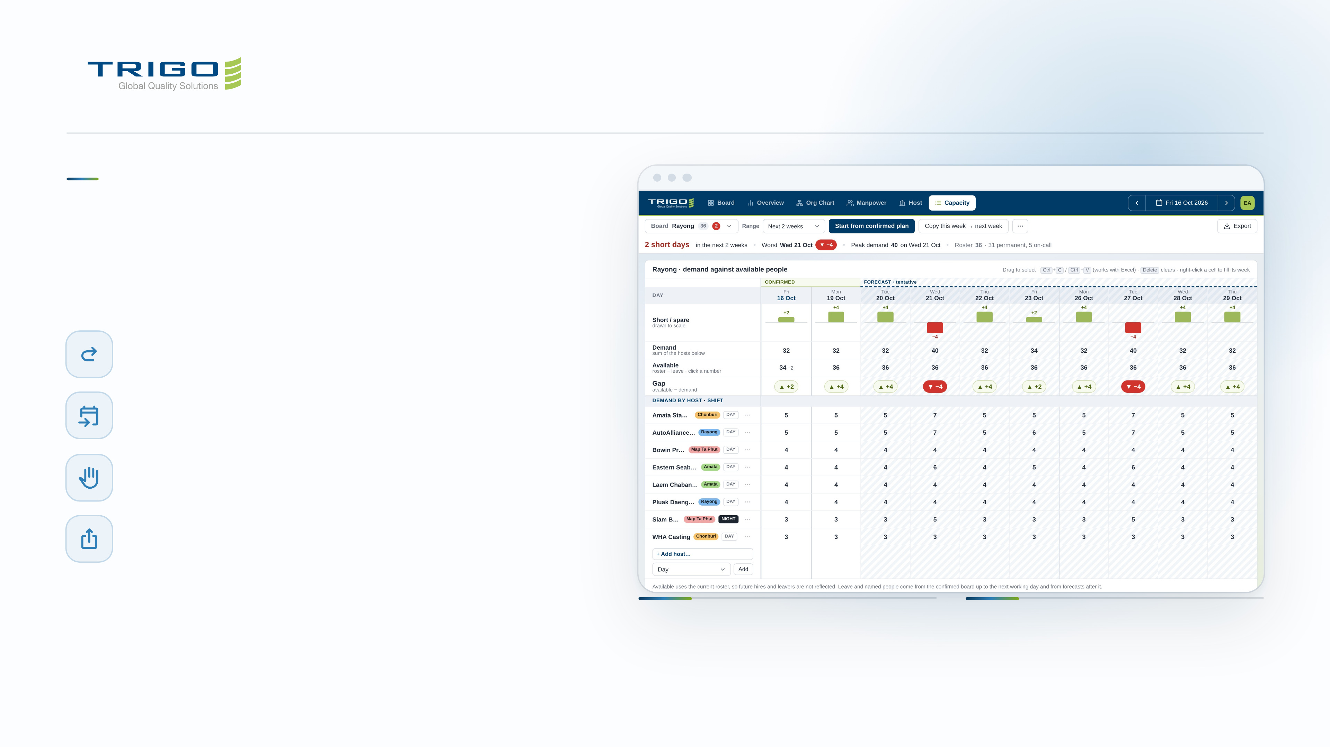
MANPOWER BOARD
Plan weeks ahead,
not just tomorrow.
Carry over the last working day
One click, then change only what moved
Forecast days
Tentative plans kept apart, merged with a side-by-side review
Holds
Take someone another engineer planned and they are told
Export
JPG, PDF and Excel, plus the org chart as PowerPoint
FOR ENGINEERS
FOR MANAGEMENT
Enter the people each host needs per day.
The grid shows every short day as you
type.
Short days show in red weeks before they
happen, with the worst day and peak
demand on top.
Notes:
14 · Manpower: planning ahead
Capacity compares demand per host with the people available. In the example, Wednesday 21/10 needs 40 against 36, so it shows 4 short.

Slide 4
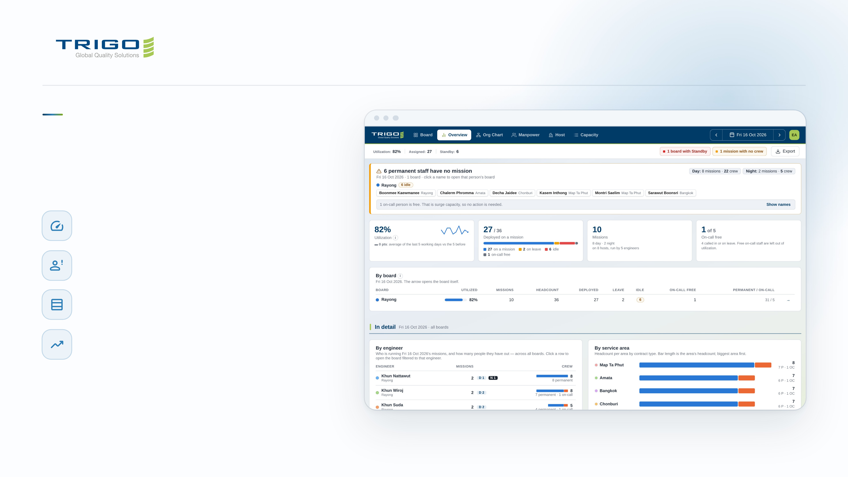
MANPOWER BOARD
The whole crew
in one view.
Utilization you can trust
On-call staff who were not called stay out of the figure
Idle staff named
Permanent staff with no mission, listed by board
By board
Missions, headcount, leave and idle side by side
History and workload
Utilization over time and missions per engineer
Notes:
15 · Manpower: what managers see
Overview answers "is everyone placed?" first, then the numbers. Every chart has the exact figures on hover.

Slide 5
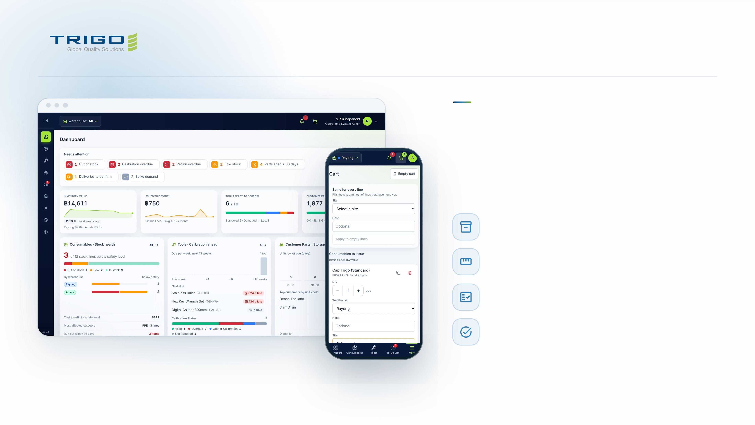
INVENTORY & QUALITY
Every tool, part
and consumable,
accounted for.
Consumables
Stock per warehouse against its safety level
Tools & Calibration
Borrow, return and calibration due dates
Customer Parts
OK, NG, Sorting and Hold per lot
To-Do and Audit Trail
Approvals in one queue, every change on record
Notes:
16 · Inventory: the system
Rayong and Amata warehouses, one at a time or both. The dashboard opens on what needs attention: out of stock, calibration overdue, returns late, parts aged over 60 days.

Slide 6
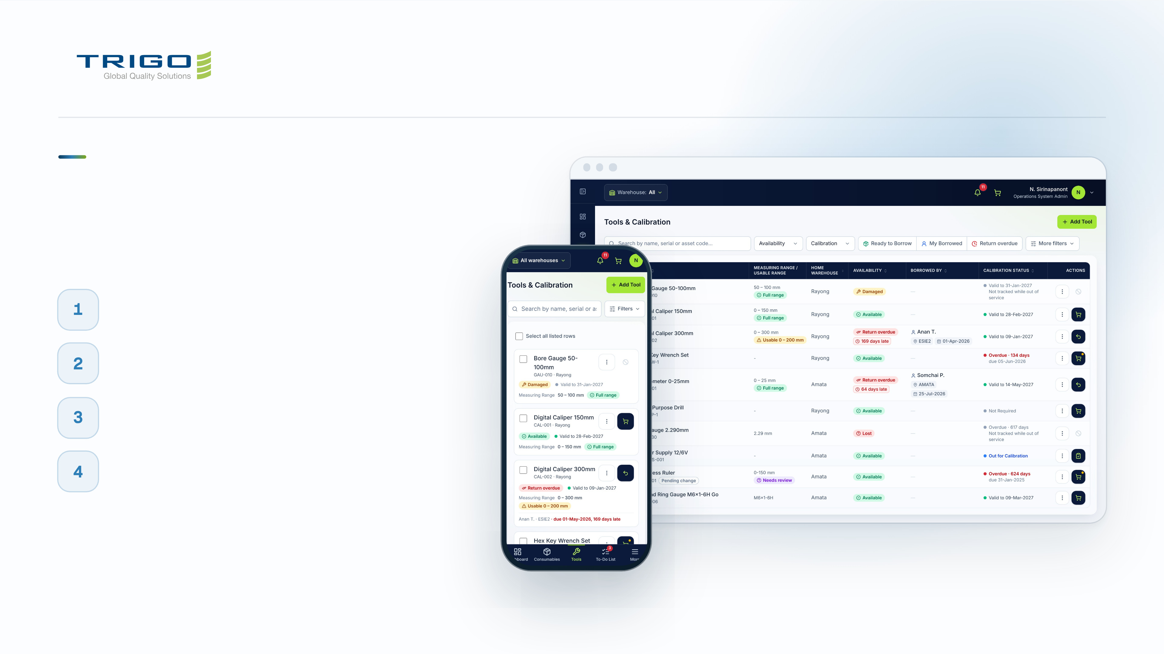
INVENTORY & QUALITY
Borrow a tool
in a minute.
Find it
Search, or scan the barcode with your phone camera
Check it
Calibration valid-to date and usable range on every tool
Request it
Add to the cart and send one request
Return it
Overdue returns are flagged, so nothing goes missing
Notes:
17 · Inventory: the engineer's day
The same flow works for consumables (issue from stock) and customer parts (deliveries in and out). Camera scanning works in Chrome and Edge; a handheld scanner works everywhere.

Slide 7
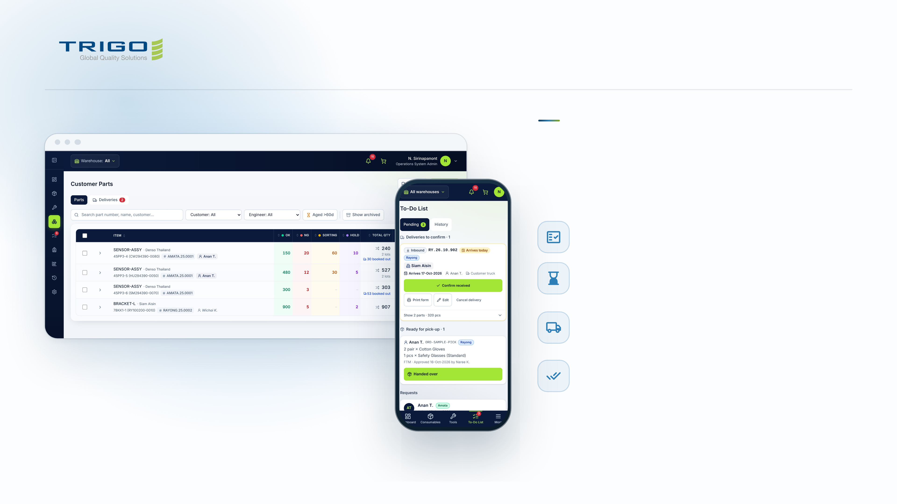
INVENTORY & QUALITY
Customer
parts, lot by lot.
Inspection status per lot
OK, NG, Sorting and Hold, with the total and the lots
Aged parts flagged
Amber past the aged threshold, red past twice it
Deliveries in and out
Several parts on one Asset In-Out Form; booked stock is
reserved
Confirm what really arrived
Actual quantities per line; any difference goes in the log
Notes:
18 · Inventory: customer parts
Parts are tracked by the customer's part number, mission number and responsible engineer. A delivery due today shows on the To-Do list and in the bell until someone confirms it.

Slide 8
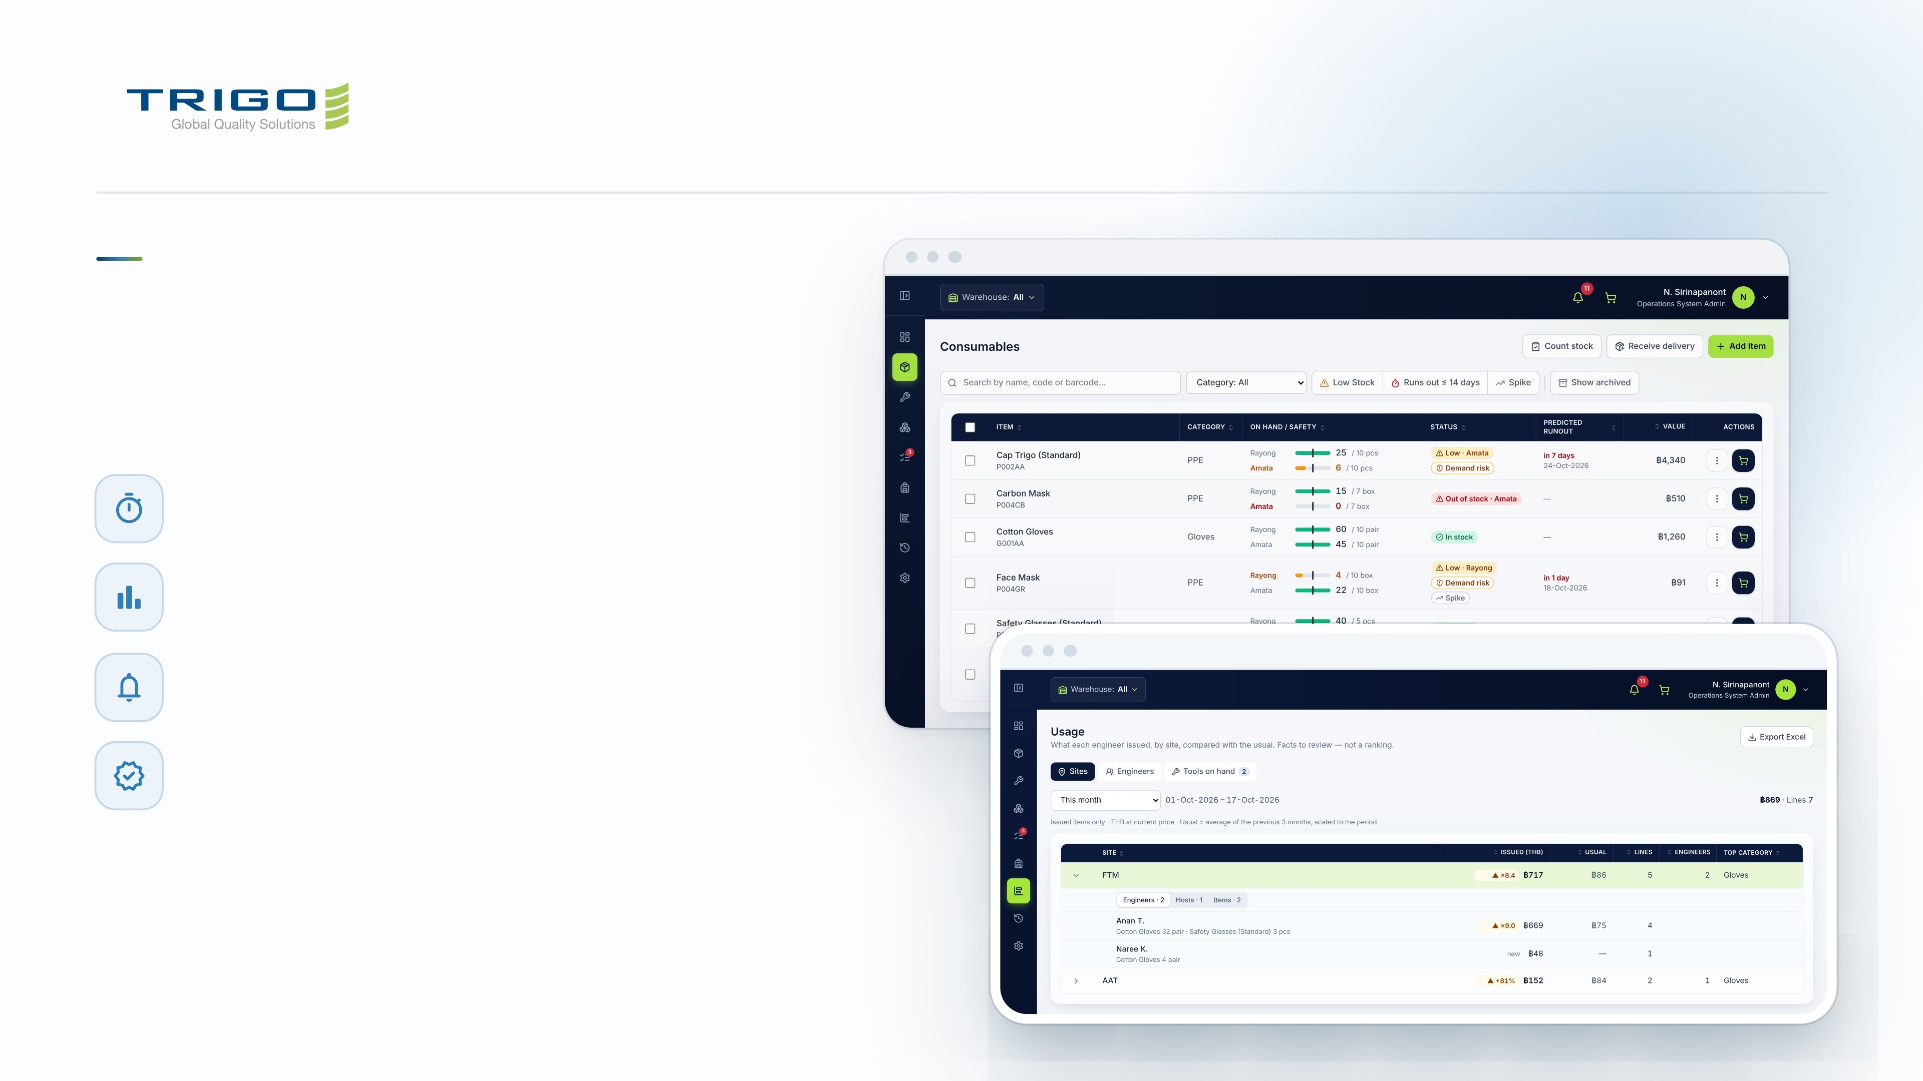
INVENTORY & QUALITY
Catch problems before
they become findings.
Predicted run-out
Low stock and spikes in demand, per warehouse
Usage against the usual
By site and engineer, exported to Excel
Approvals and alerts
One To-Do queue, with phone notifications
Audit trail for ISO 9001
Who changed what, and when
Notes:
19 · Inventory: for management
Usage compares this period with the average of the previous three months. Open a site to see who issued what there. It is a fact to review, not a ranking of people.

Slide 9
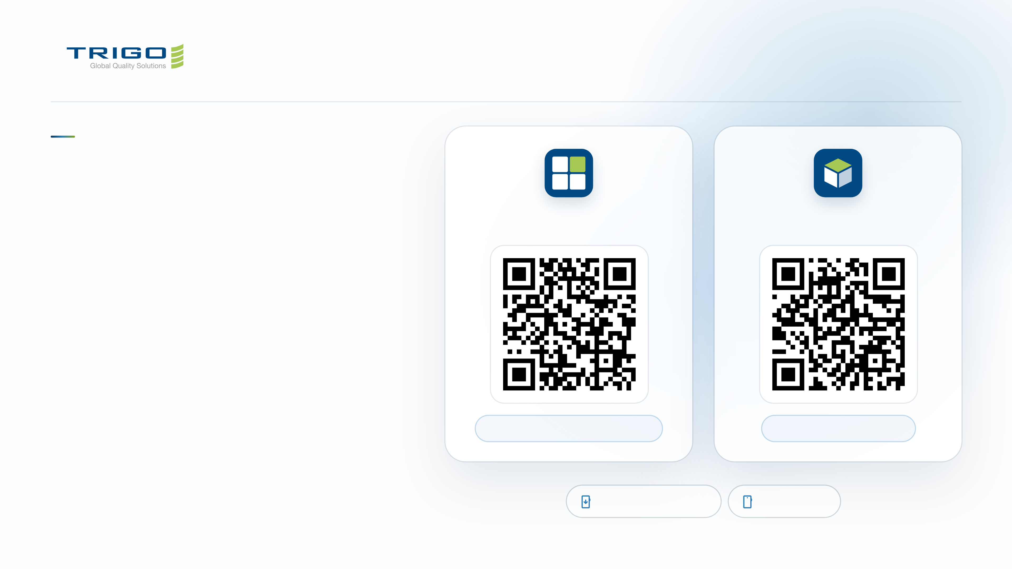
ON YOUR PHONE
Both apps fit in
your pocket.
Manpower Board
Inventory & Quality
Each app has its own phone layout and installs
from the browser like a native app. No app
store needed.
01
Scan the code and sign in with your @trigo-group.com
email.
02
iPhone: in Safari tap Share, then Add to Home Screen.
trigoth-manpowerboard.netlify.app
trigoth-inventory.pages.dev
03
Android: in Chrome tap the menu, then Install app.
Installable app (PWA)
Phone layout
Notes:
20 · On your phone
New accounts are approved once by an admin. After installing, the app opens full screen from the home screen.

