Slide 1
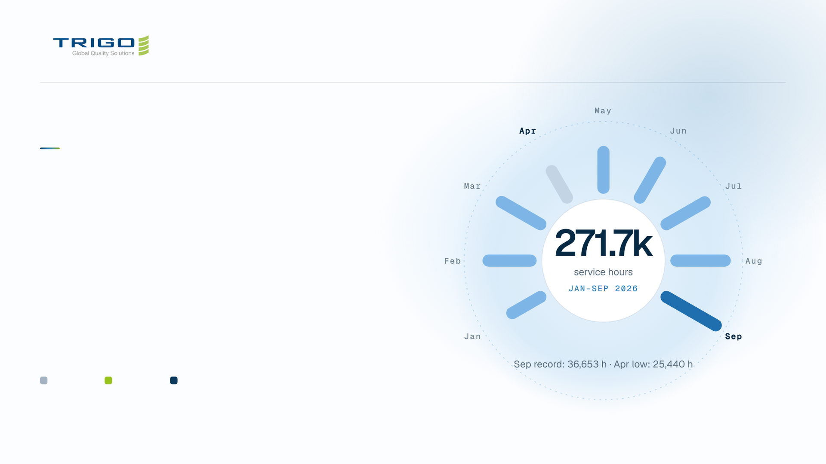
JAN–SEP 2026
Non-Rayong
overview 2026.
Service hours, site mix and customers, then cost
reduction and operation excellence, across our three non-Rayong
sites.
LCBTH
BANGN
AMATA
Notes:
1 · Opening
Non-Rayong overview for January to September 2026: LCBTH, BANGN and AMATA.

Slide 2
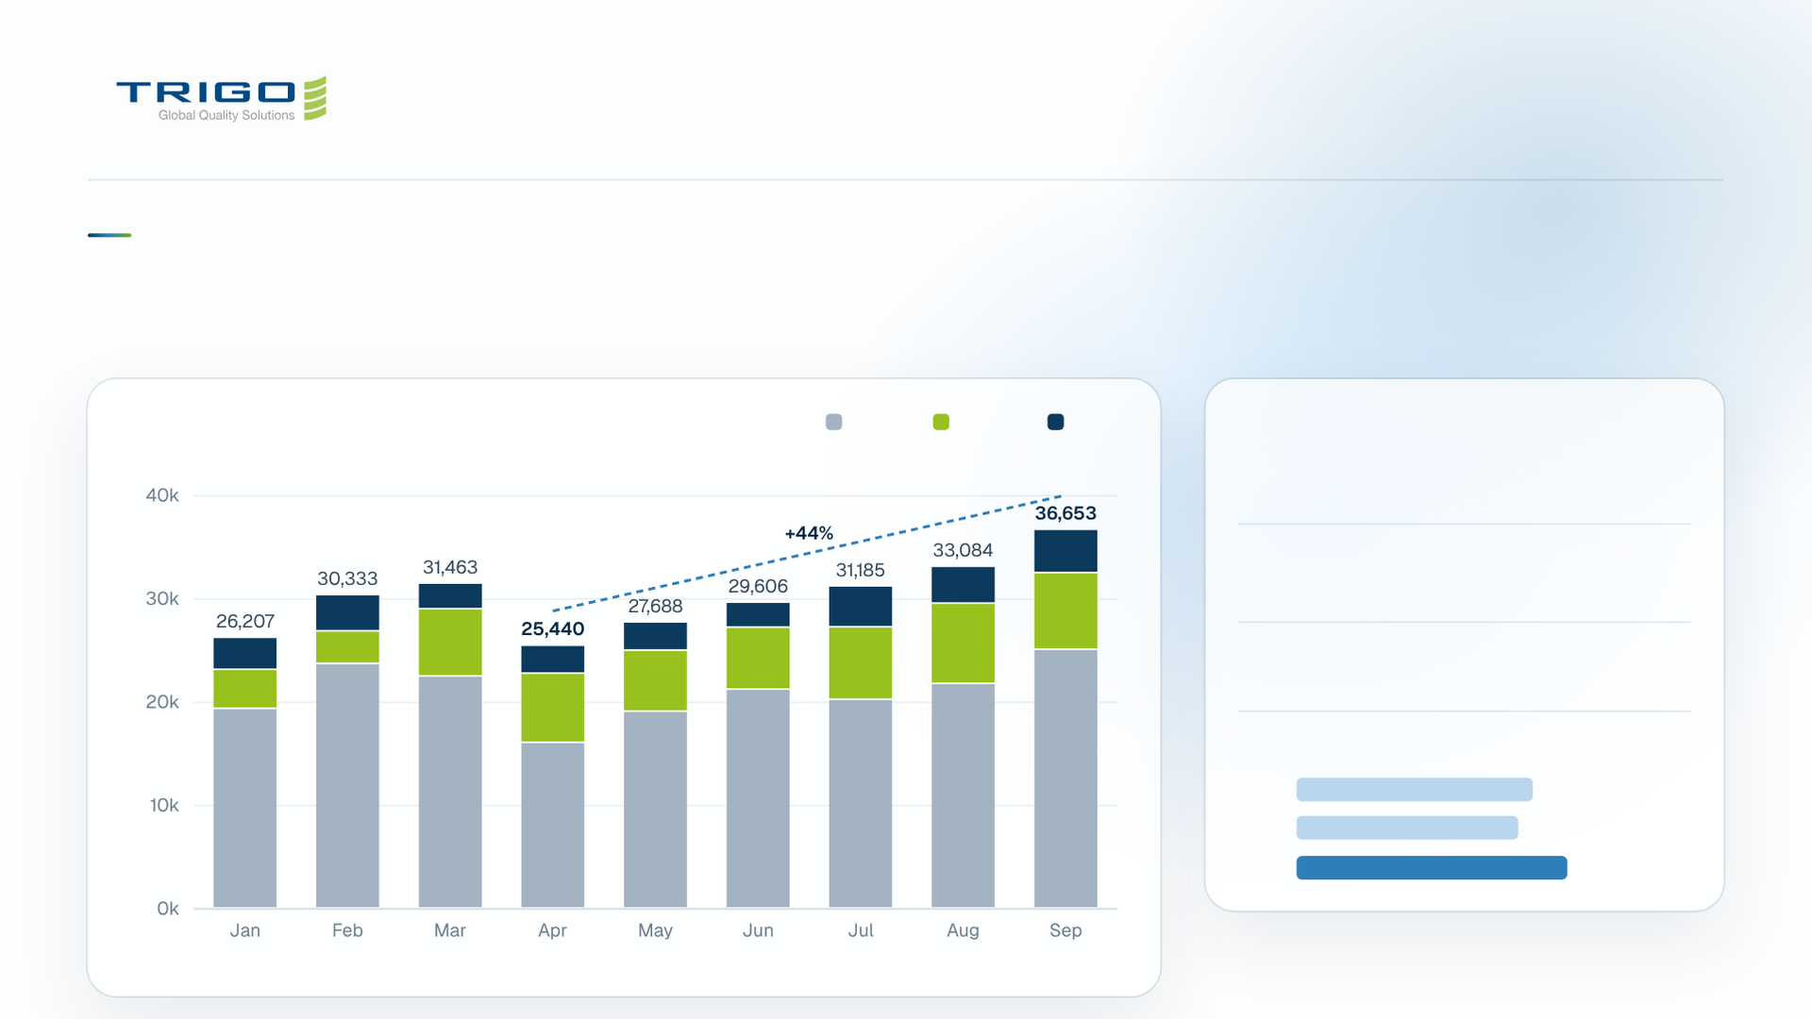
PERFORMANCE
September set a record after the April dip.
Monthly service hours by site
LCBTH
BANGN
AMATA
WHAT HAPPENED
−19%
Apr low vs Mar, 25,440 h; LCBTH
−29%
+44%
Apr to Sep: 25,440 h to a record
36,653 h
176
FTE in Sep vs 141 Jan–Aug avg
QUARTERLY SERVICE HOURS
Q1
88.0K h
Q2
82.7K h
Q3
100.9K h
Notes:
2 · Performance
Hours fell 19% in April, then climbed 44% to a record 36,653 h in September. Q3 is the strongest quarter at 100.9K h.

Slide 3

SITE MIX · JAN–SEP 2026
LCBTH leads hours; BANGN leads missions.
LCBTH
BANGN
AMATA
Service hours
188,739
Service hours
54,235
Service hours
28,687
Share of hours
69.5%
Share of hours
20.0%
Share of hours
10.6%
Customers
20
Customers
53
Customers
31
271.7k
Missions
76
Missions
140
Missions
45
service hrs
Hours / mission
2,483
Hours / mission
387
Hours / mission
637
Mgmt fee days
2,004
Mgmt fee days
1,200
Mgmt fee days
663
Per-piece units
5,985
Per-piece units
23,533
Per-piece units
4,160
Sep vs Jan hours
+30%
Sep vs Jan hours
+96%
Sep vs Jan hours
+35%
69.5%
20.0%
10.6%
LCBTH = scale
BANGN = breadth
Ford + AutoAlliance + Mitsubishi port/plant
inspection. ~2,500 hrs per mission; only 10
hosts.
140 missions, 53 customers, 70% of per-piece
units. Many short sorting jobs (~390
hrs/mission).
BANGN = growth
Hours up 96% from Jan to Sep, the fastest
growth of the three sites.
Notes:
3 · Site mix
Hours per mission = billable hours / distinct mission numbers (base number, ignoring monthly extension suffix). Per-piece units are pieces invoiced per unit of work.

Slide 4
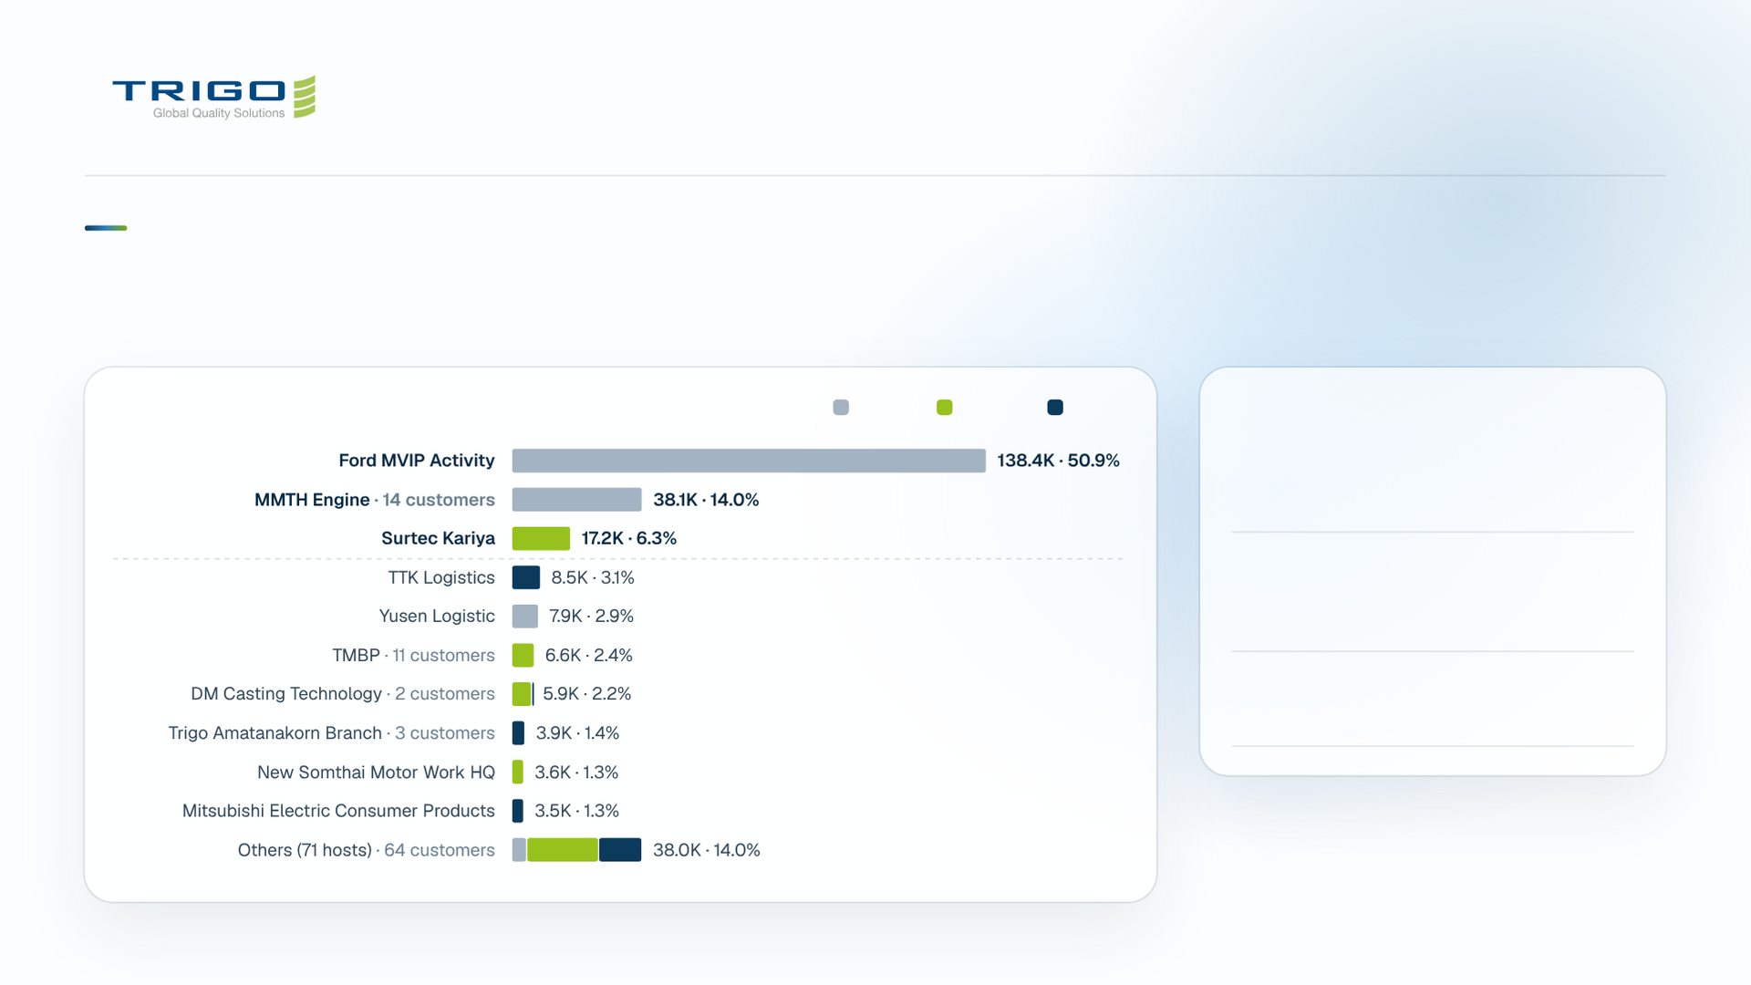
CUSTOMERS & HOSTS
Three major hosts account for 71% of service hours.
Service hours by host and site, Jan–Sep
LCBTH
BANGN
AMATA
HOST HIGHLIGHTS
51%
Ford MVIP activity: 138.4K h
across the Ford and Auto
Alliance plants
14
Customers at MMTH Engine:
largest host, 38.1K h; TMBP
serves 11
4.5×
Yusen Logistic growth: 331 h in
Jan → 1,488 h in Sep
Notes:
4 · Customers and hosts
Ford MVIP, MMTH Engine and Surtec Kariya together make up 71% of hours. The other 71 hosts share 14%.

Slide 5
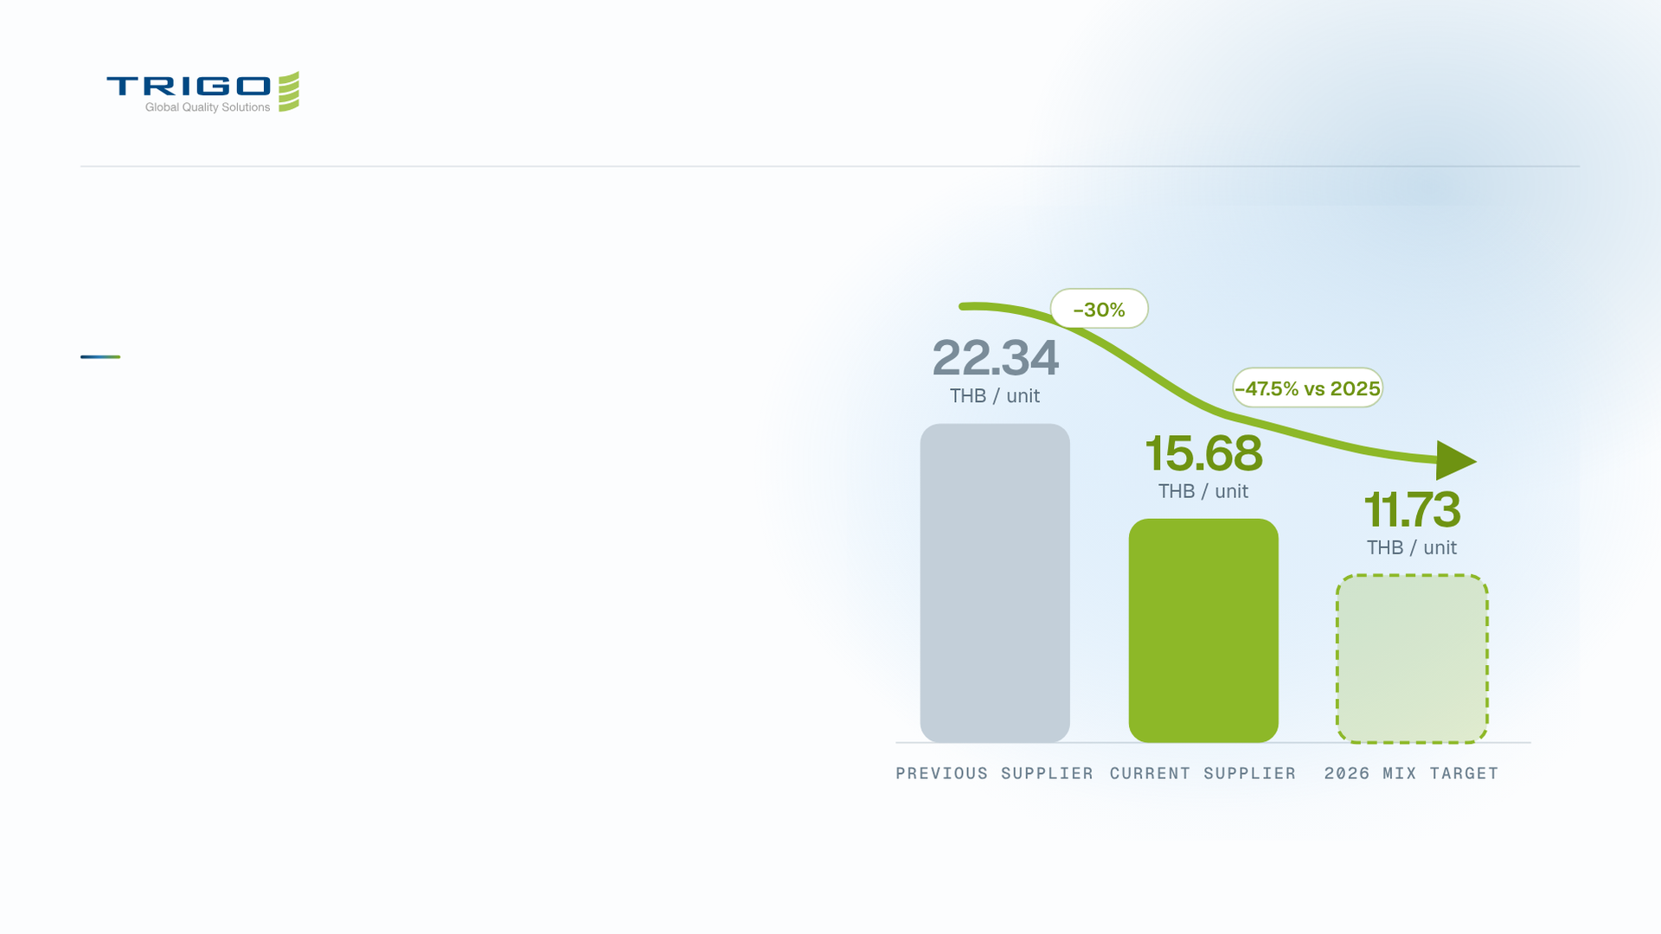
NON-RAYONG OVERVIEW 2026
Cost reduction.
A new beverage supplier, and a 2026 drink mix that
lowers the cost per unit.
Notes:
5 · Section: Cost reduction
Two slides: the supplier change and the 2026 drink mix.

Slide 6
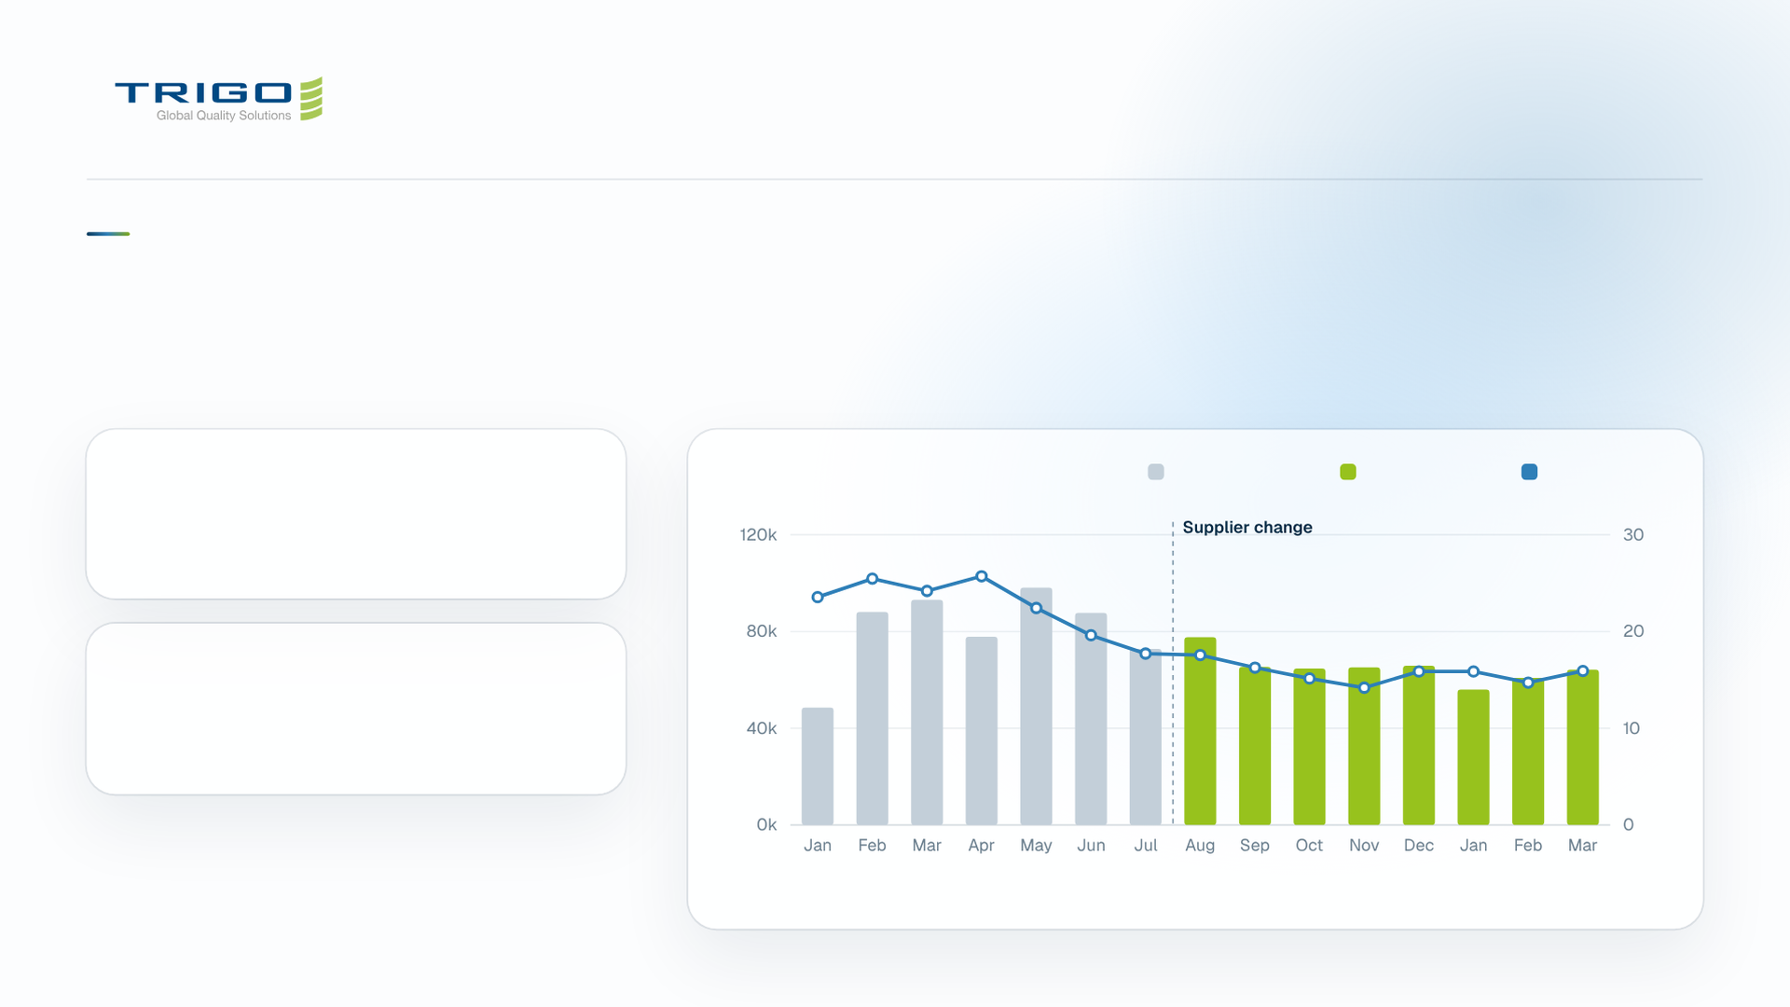
COST REDUCTION / BEVERAGE SUPPLIER
Supplier change reduced unit cost by 30%.
Lower purchase cost, with the monthly operating trend kept in view.
PREVIOUS SUPPLIER
Total cost and cost / HC
Previous supplier
Current supplier
Cost / HC, right
22.34 THB / unit
Monthly avg. 80,899.75 THB
CURRENT SUPPLIER
15.68 THB / unit
Monthly avg. 64,983.03 THB
Monthly sequence as supplied · Supplier change from Aug onward
Notes:
6 · Cost reduction: beverage supplier
Unit cost fell from 22.34 to 15.68 THB, and the monthly average from 80,899.75 to 64,983.03 THB. Cost per headcount trends down from August.

Slide 7
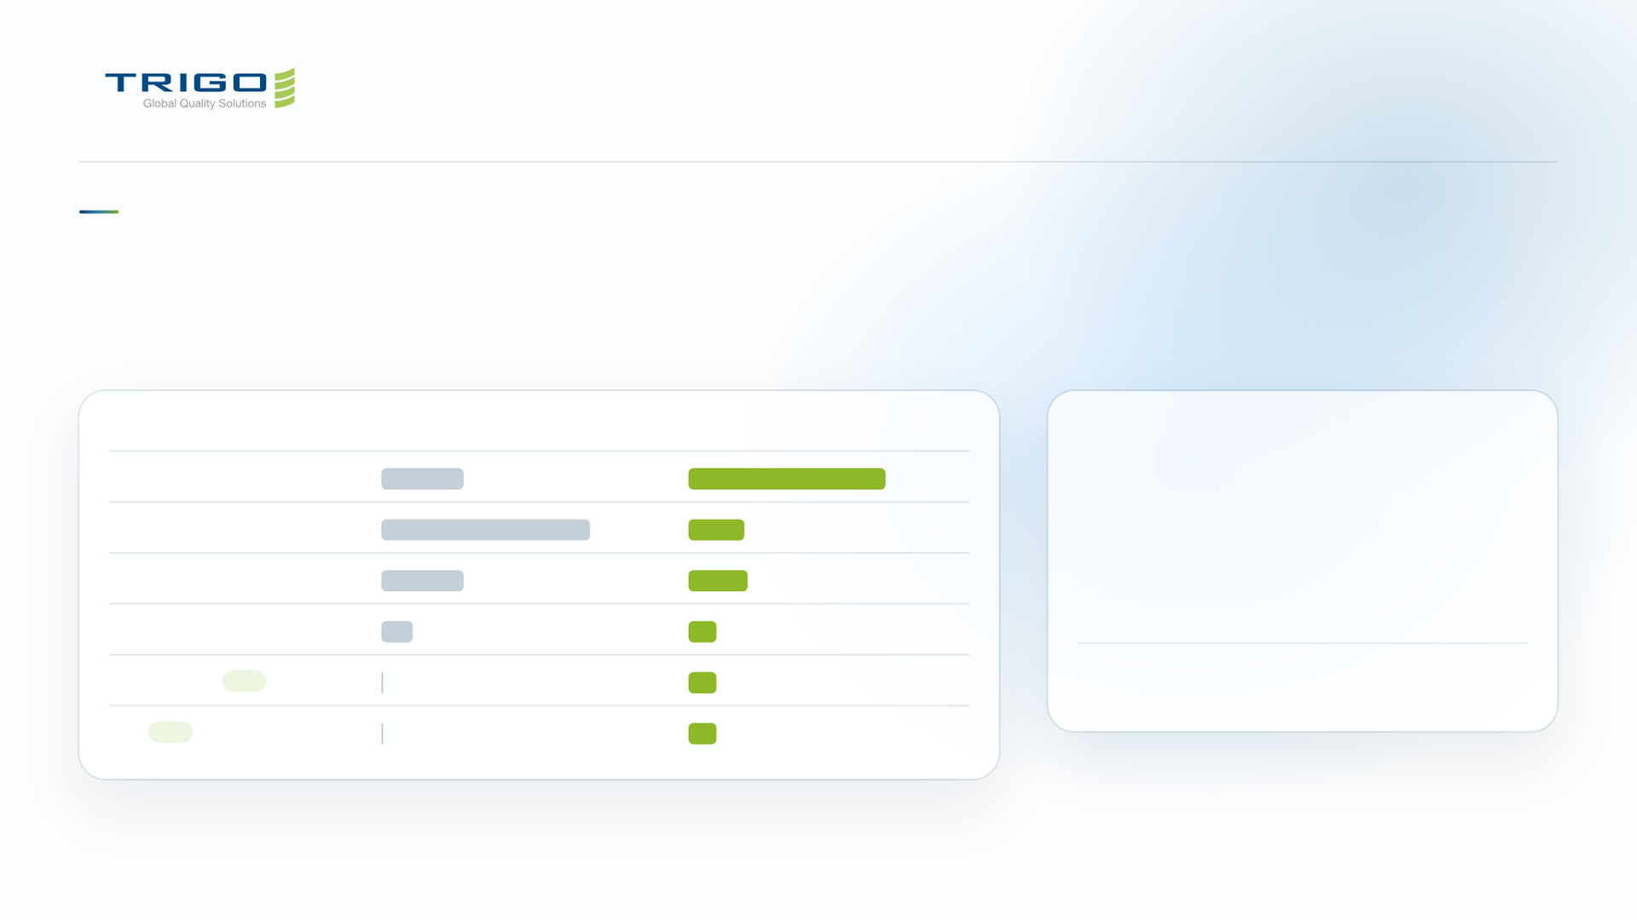
COST REDUCTION / BEVERAGE DISTRIBUTION
2026 drink mix targets 47.5% lower unit cost.
Redistribute the beverage mix and introduce herbal drinks and tea.
BEVERAGE ALLOCATION
Y2025
Y2026
EXPECTED COST / UNIT
Electrolyte drink
21%
50%
11.73
Soft drink
53%
14%
THB / unit
Energy drink
21%
15%
10.61
THB saved per unit
Ready to drink coffee
8%
7%
Herbal drink New
-
7%
47.5%
below 2025
Tea New
-
7%
Source check required: 2025 electrolyte allocation is 21% in the table but 18% in the source pie. 2025 table totals 103%; all supplied allocations are retained pending confirmation.
Notes:
7 · Cost reduction: drink mix
Moving the mix toward electrolyte drinks, and adding herbal drinks and tea, targets 11.73 THB per unit. The 2025 figures still need a source check.

Slide 8
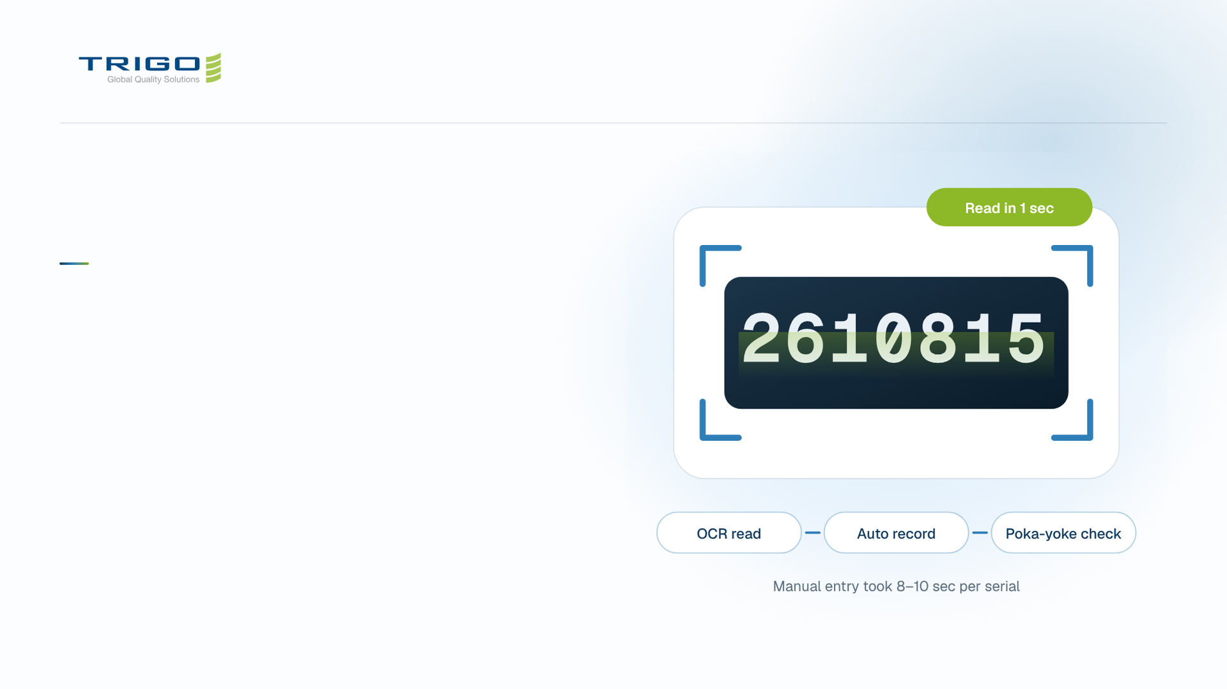
NON-RAYONG OVERVIEW 2026
Operation
excellence.
Handheld OCR, a hybrid online and offline workflow,
and four poka-yoke controls.
Notes:
8 · Section: Operation excellence
Three slides: handheld OCR, the hybrid workflow and the poka-yoke controls.

Slide 9
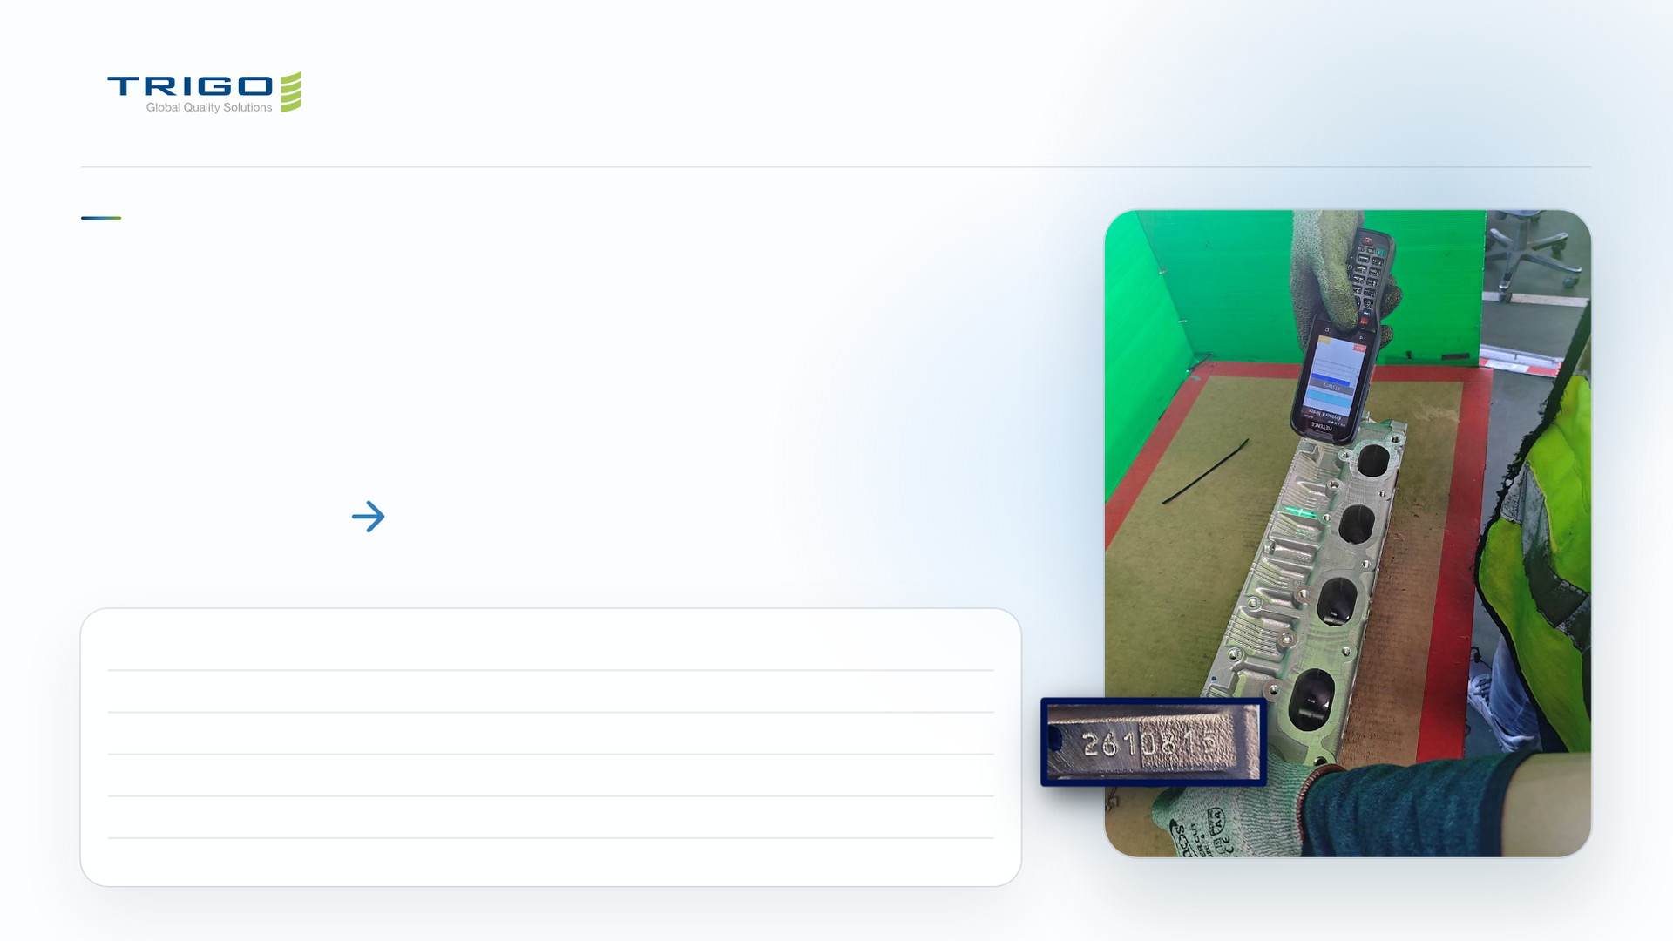
OPERATION EXCELLENCE / HANDHELD OCR
Handheld OCR replaces manual
serial-number recording.
Read part serials with handheld OCR and automatically record inspection data in Google Sheets.
8–10 sec
1 sec
MANUAL
OCR + AUTO RECORD
MISSION
MARKING
MANUAL
OCR + AUTO
RECORD
LCBTH.26.0005
Dot peen
8 sec
1 sec
LCBTH.26.0002
Dot peen
8 sec
1 sec
LCBTH.26.0027
Stamped
10 sec
1 sec
LCBTH.26.0007
Embossed
9 sec
1 sec
Dot peen / stamped / embossed · Barcode / Data Matrix · Internal configuration; supplied mission comparisons.
Shopfloor OCR in use
KEYENCE BT-A1000 · LCBTH.26.0005
Notes:
9 · Operation excellence: handheld OCR
Source: supplied shopfloor OCR example and mission inspection-time comparisons. Reading a serial drops from 8 to 10 seconds by hand to 1 second.

Slide 10
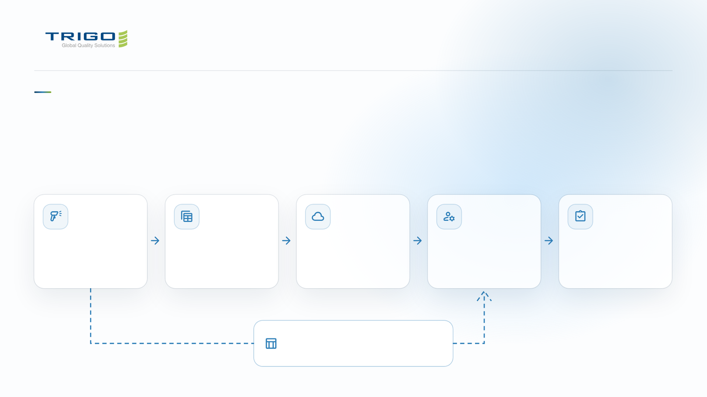
OPERATION EXCELLENCE / HYBRID WORKFLOW
A hybrid workflow connects shopfloor
capture to customer reports.
Online cloud records + offline Excel support → administrator review → customer report.
Shopfloor
Google Sheets
Google Drive
Administrator
Customer report
Handheld OCR / QR
Auto-record data
Shared online files
Review online data
Reviewed results
Serial + Good / NG
Real-time access
Supervisor access
Reconcile Excel
Submit final report
Excel offline
Reconcile offline and online records
Local serial + status record
Source: supplied OCR capture and MMTH hybrid workflow. Generic icons denote functions, not product logos.
Notes:
10 · Operation excellence: hybrid workflow
Data captured on the shopfloor lands in Google Sheets and Drive. An offline Excel record covers gaps, and the administrator reconciles both before the customer report.

Slide 11
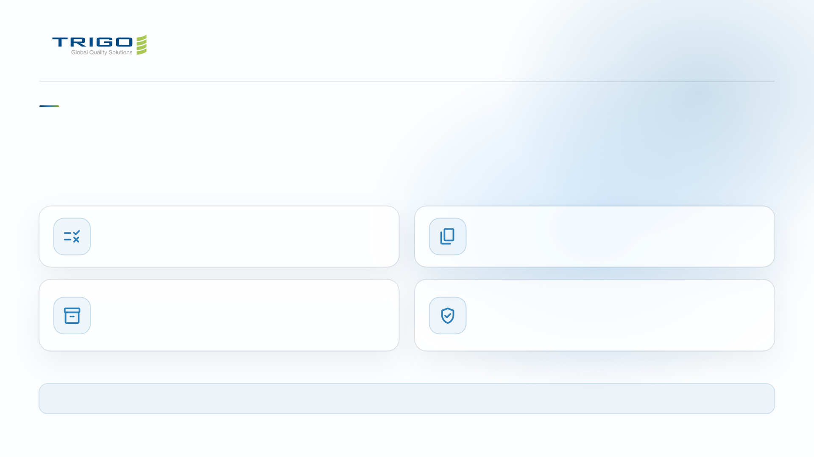
OPERATION EXCELLENCE / POKA-YOKE
Four controls protect every inspection record.
Visual + voice guidance at capture. Administrator review before customer reporting.
Wrong part / serial
Duplicate scan
Validate against customer list / production plan. Warn on mismatch.
Lock out repeated scans. Prevent duplicate counting.
Full box
Review & release
Voice + popup notification when target quantity is reached.
Administrator checks offline + online records before submitting the
customer report.
Linked data: Customer • Material • Batch • Order | Missions 04, 29, 31 · Internal configuration + Text-to-Speech support shopfloor use.
Source: supplied error-prevention workflow. Next: two web apps supporting Non-Rayong operations.
Notes:
11 · Operation excellence: poka-yoke
Two controls stop bad data at capture, one tells the operator when a box is full, and the administrator reviews before release. Next: the two web apps.

Slide 12
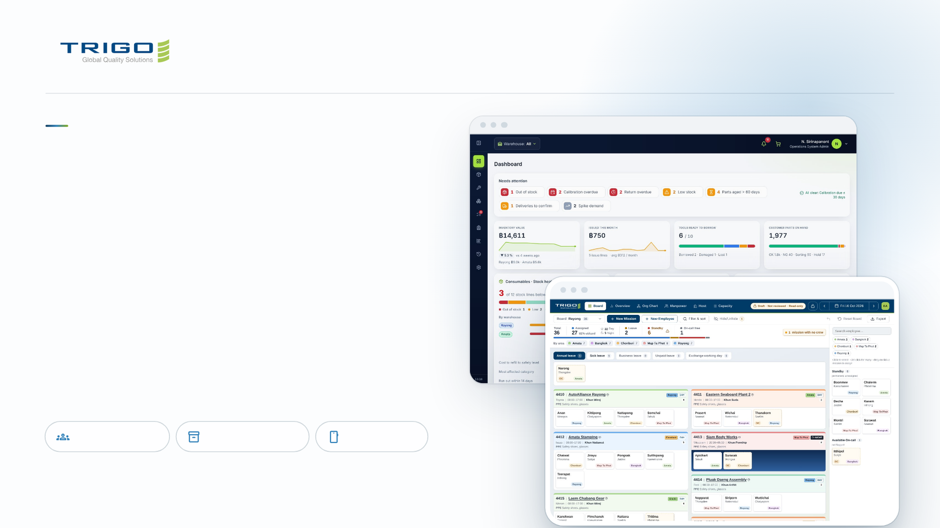
GLOBAL QUALITY SOLUTION
Two apps for
the work we
do every day.
The Manpower Board plans who goes where. The
Inventory & Quality System tracks tools, parts
and consumables. Both run in the browser and on
your phone.
Manpower Board
Inventory & Quality
On your phone
Notes:
12 · The two apps
Two internal tools, built for our sites. Same sign-in domain, same look, both installable on a phone.

Slide 13
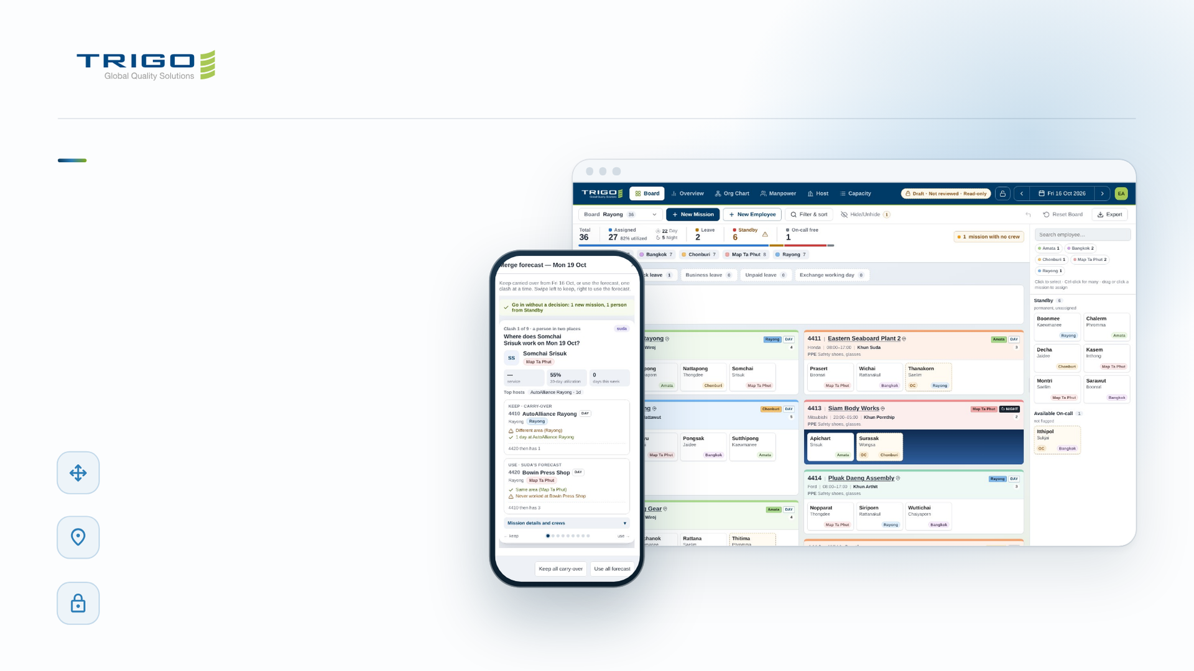
MANPOWER BOARD
Tomorrow's
crew, planned
on one board.
The magnet board, made digital. Drag people
onto missions, leave or standby, and
everyone sees the same plan, live.
Drag and drop planning
One board per site, one card per person
Where to go, what to wear
The host name opens Google Maps; PPE is on the
card
Lock a finished plan
Nobody bumps it by accident
Notes:
13 · Manpower: the daily board
Each card is a person, each column a mission with host, customer, shift and engineer. The tiles on top always add up: assigned plus leave plus standby equals total. The phone shows a forecast day being merged, one clash at a time: keep the carried-over plan or use the forecast.

Slide 14
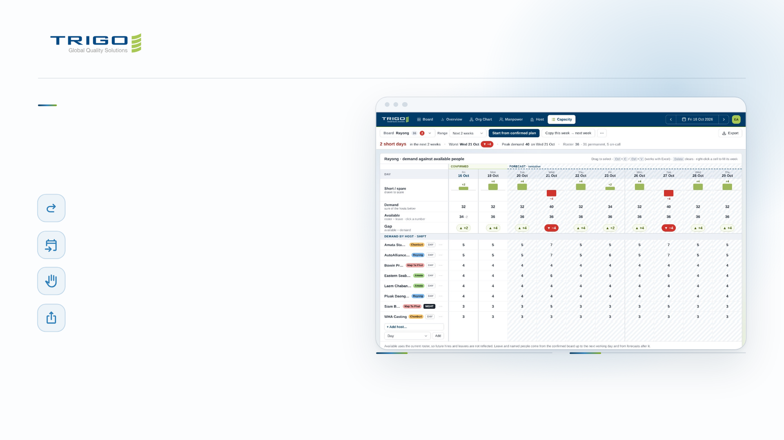
MANPOWER BOARD
Plan weeks ahead,
not just tomorrow.
Carry over the last working day
One click, then change only what moved
Forecast days
Tentative plans kept apart, merged with a side-by-side review
Holds
Take someone another engineer planned and they are told
Export
JPG, PDF and Excel, plus the org chart as PowerPoint
FOR ENGINEERS
FOR MANAGEMENT
Enter the people each host needs per day.
The grid shows every short day as you
type.
Short days show in red weeks before they
happen, with the worst day and peak
demand on top.
Notes:
14 · Manpower: planning ahead
Capacity compares demand per host with the people available. In the example, Wednesday 21/10 needs 40 against 36, so it shows 4 short.

Slide 15
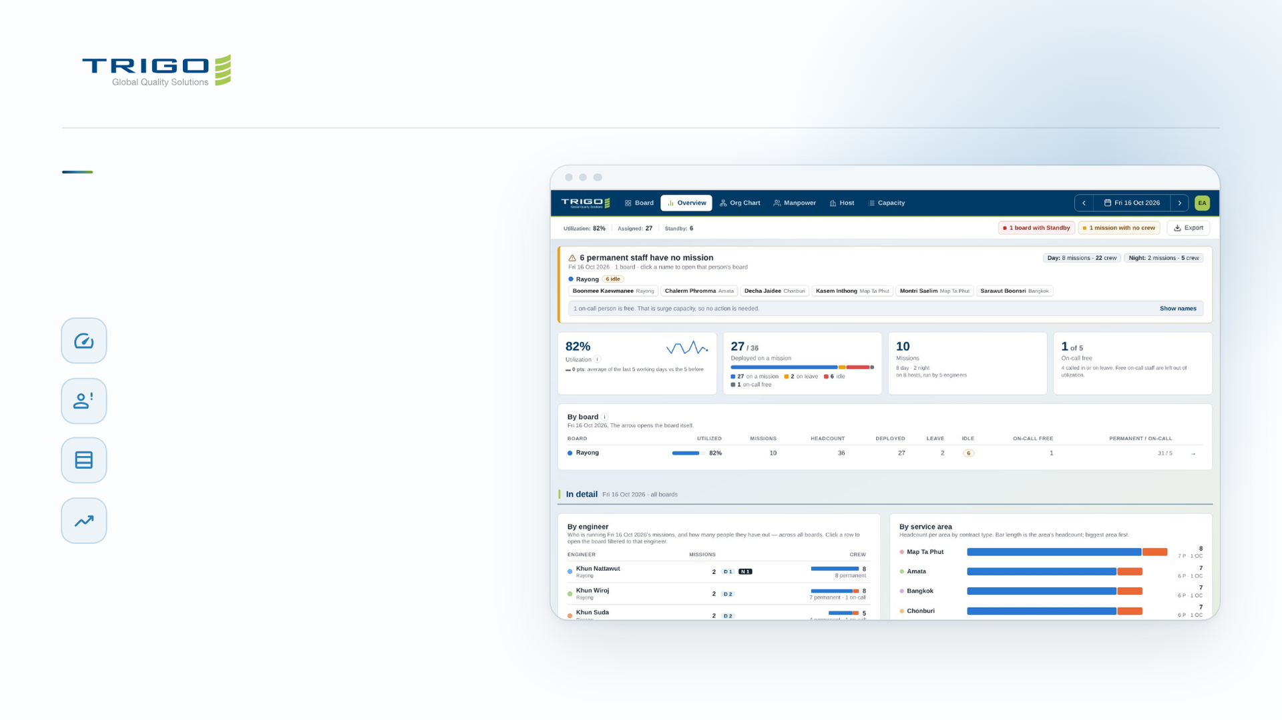
MANPOWER BOARD
The whole crew
in one view.
Utilization you can trust
On-call staff who were not called stay out of the figure
Idle staff named
Permanent staff with no mission, listed by board
By board
Missions, headcount, leave and idle side by side
History and workload
Utilization over time and missions per engineer
Notes:
15 · Manpower: what managers see
Overview answers "is everyone placed?" first, then the numbers. Every chart has the exact figures on hover.

Slide 16
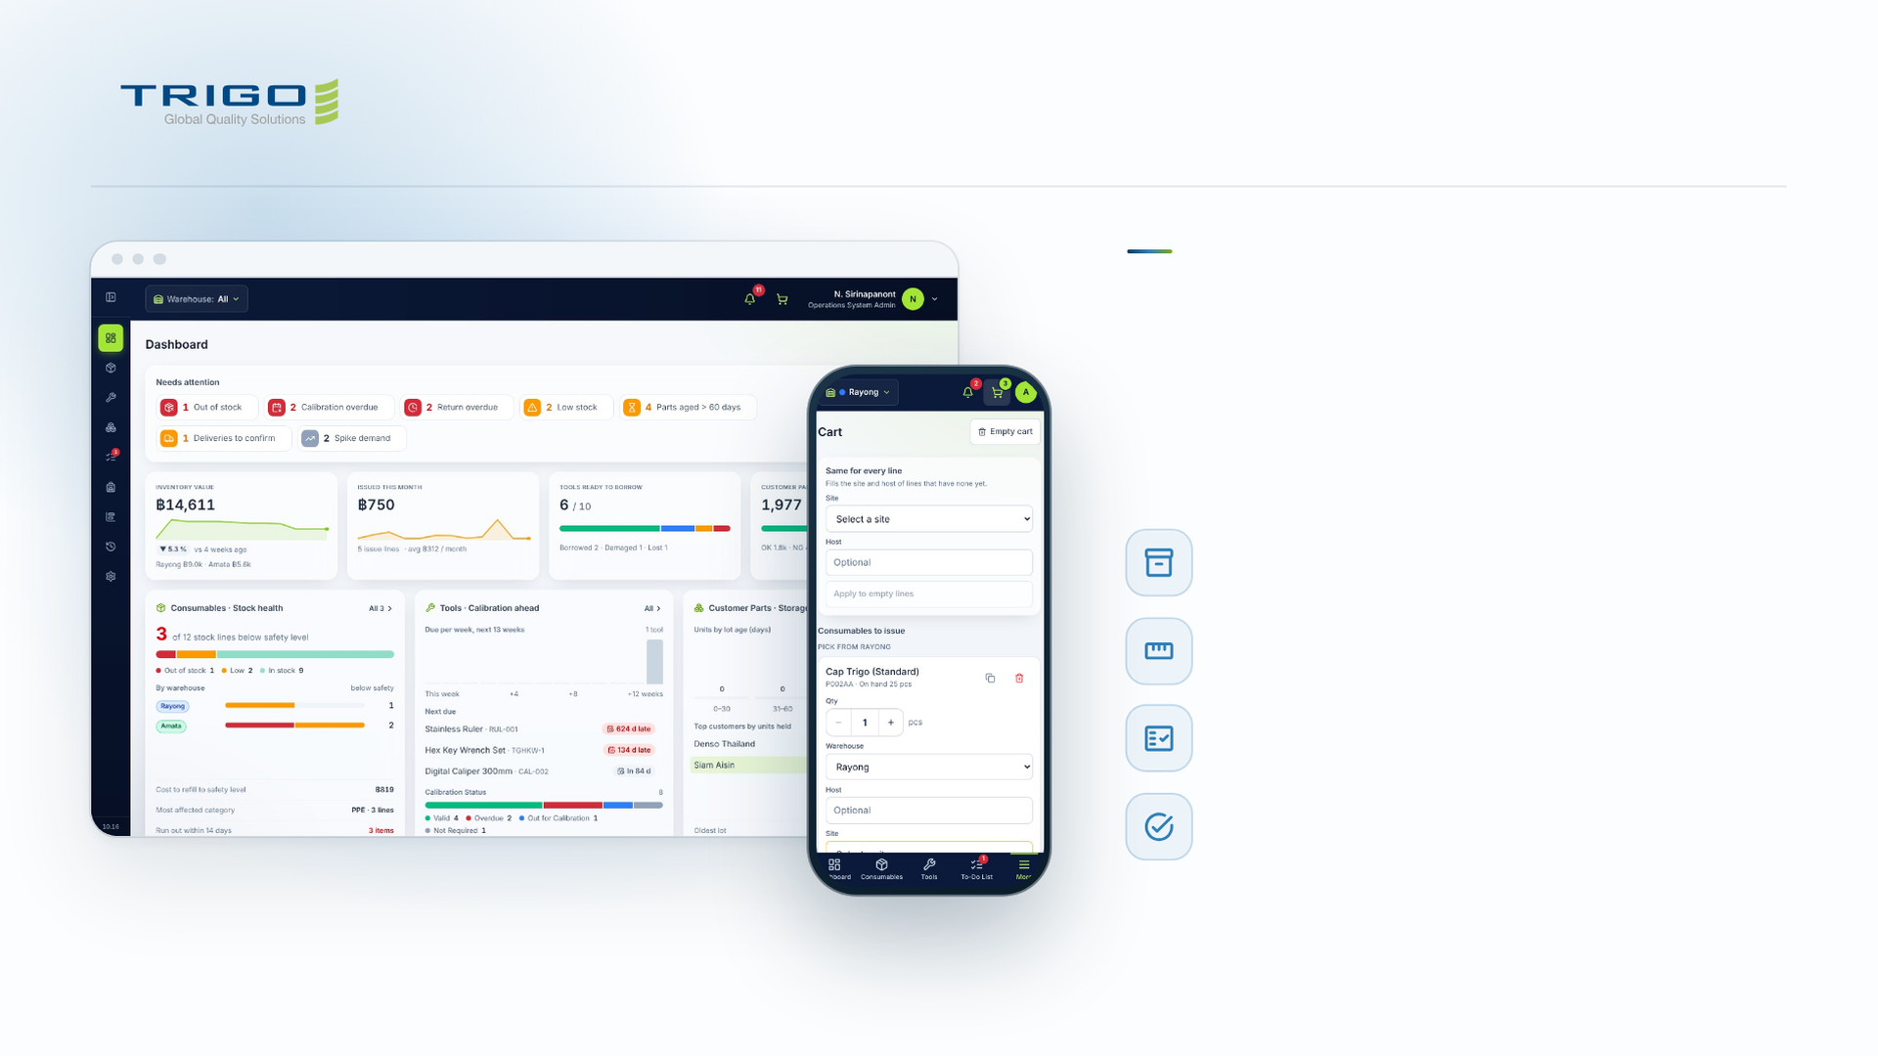
INVENTORY & QUALITY
Every tool, part
and consumable,
accounted for.
Consumables
Stock per warehouse against its safety level
Tools & Calibration
Borrow, return and calibration due dates
Customer Parts
OK, NG, Sorting and Hold per lot
To-Do and Audit Trail
Approvals in one queue, every change on record
Notes:
16 · Inventory: the system
Rayong and Amata warehouses, one at a time or both. The dashboard opens on what needs attention: out of stock, calibration overdue, returns late, parts aged over 60 days.

Slide 17
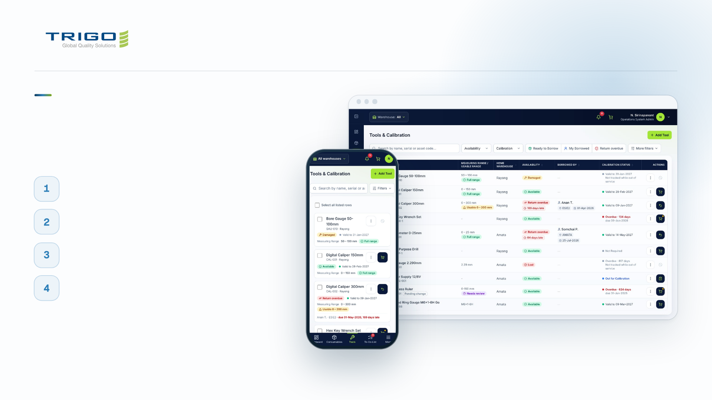
INVENTORY & QUALITY
Borrow a tool
in a minute.
Find it
Search, or scan the barcode with your phone camera
Check it
Calibration valid-to date and usable range on every tool
Request it
Add to the cart and send one request
Return it
Overdue returns are flagged, so nothing goes missing
Notes:
17 · Inventory: the engineer's day
The same flow works for consumables (issue from stock) and customer parts (deliveries in and out). Camera scanning works in Chrome and Edge; a handheld scanner works everywhere.

Slide 18
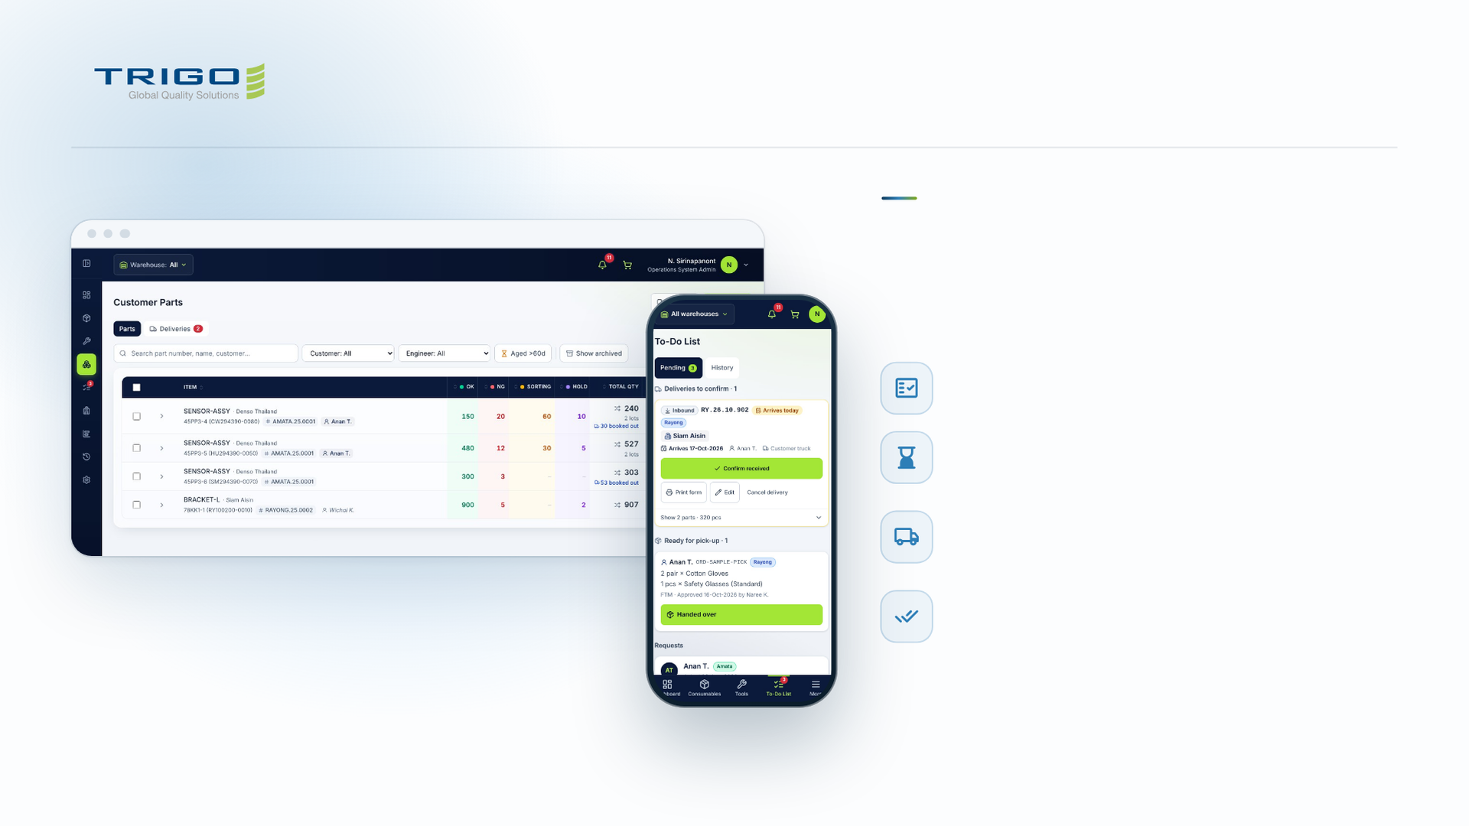
INVENTORY & QUALITY
Customer
parts, lot by lot.
Inspection status per lot
OK, NG, Sorting and Hold, with the total and the lots
Aged parts flagged
Amber past the aged threshold, red past twice it
Deliveries in and out
Several parts on one Asset In-Out Form; booked stock is
reserved
Confirm what really arrived
Actual quantities per line; any difference goes in the log
Notes:
18 · Inventory: customer parts
Parts are tracked by the customer's part number, mission number and responsible engineer. A delivery due today shows on the To-Do list and in the bell until someone confirms it.

Slide 19
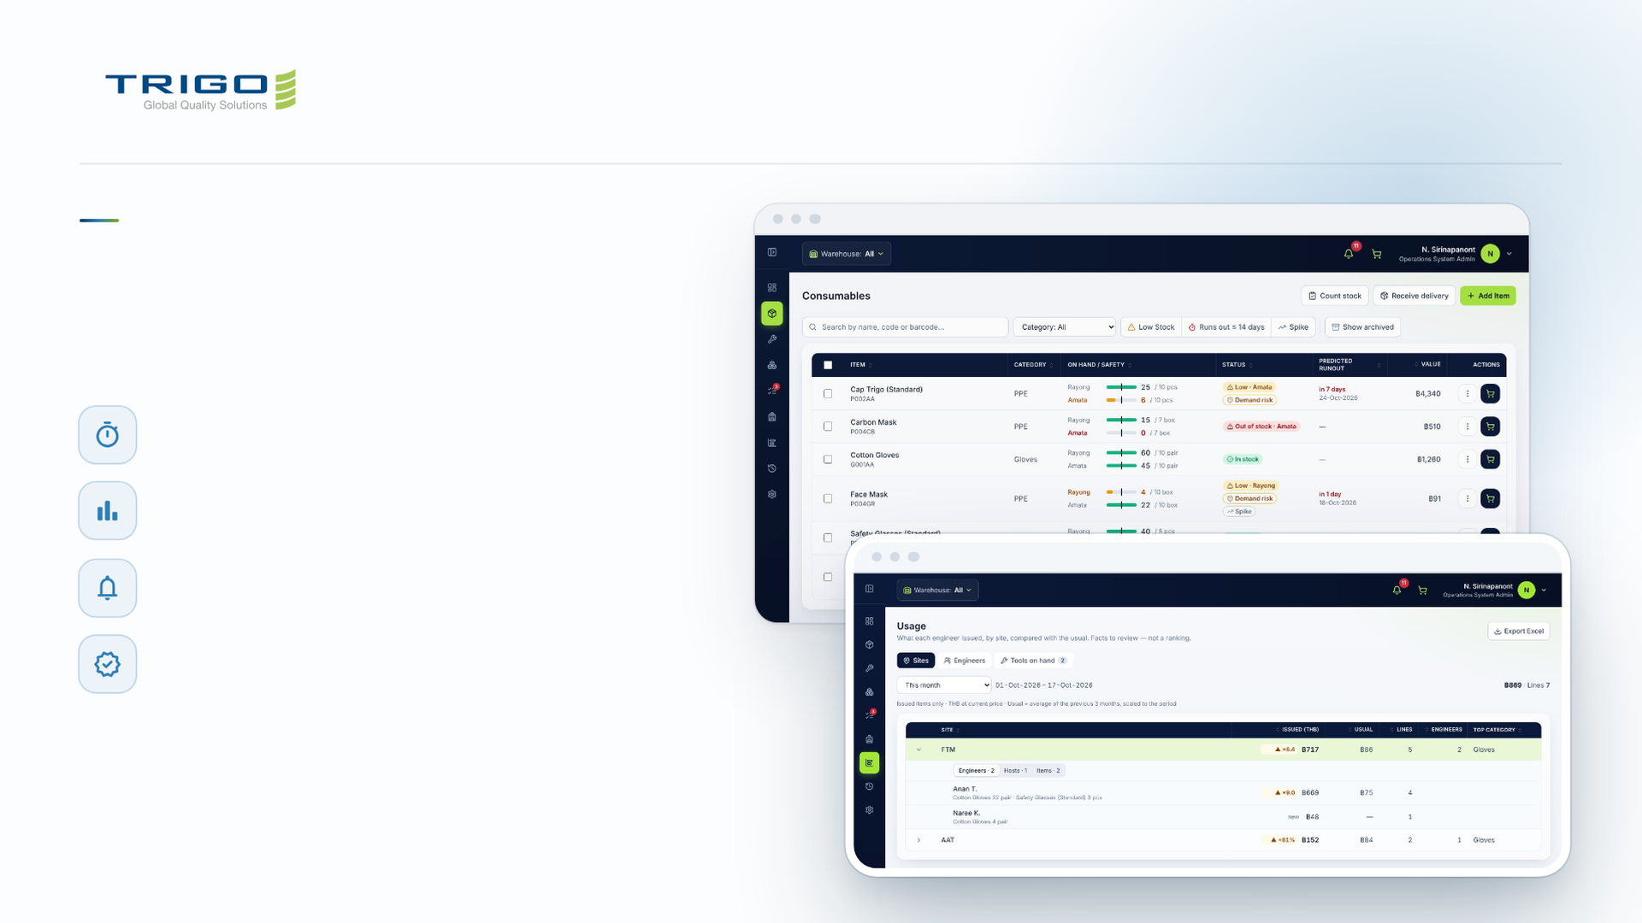
INVENTORY & QUALITY
Catch problems before
they become findings.
Predicted run-out
Low stock and spikes in demand, per warehouse
Usage against the usual
By site and engineer, exported to Excel
Approvals and alerts
One To-Do queue, with phone notifications
Audit trail for ISO 9001
Who changed what, and when
Notes:
19 · Inventory: for management
Usage compares this period with the average of the previous three months. Open a site to see who issued what there. It is a fact to review, not a ranking of people.

Slide 20
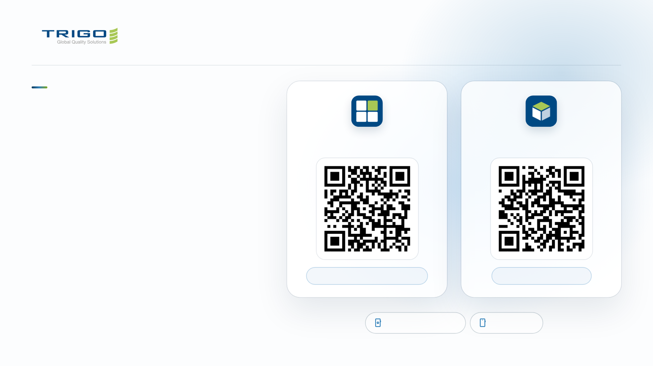
ON YOUR PHONE
Both apps fit in
your pocket.
Manpower Board
Inventory & Quality
Each app has its own phone layout and installs
from the browser like a native app. No app
store needed.
01
Scan the code and sign in with your @trigo-group.com
email.
02
iPhone: in Safari tap Share, then Add to Home Screen.
trigoth-manpowerboard.netlify.app
trigoth-inventory.pages.dev
03
Android: in Chrome tap the menu, then Install app.
Installable app (PWA)
Phone layout
Notes:
20 · On your phone
New accounts are approved once by an admin. After installing, the app opens full screen from the home screen.

