Slide 1
Deep Learning Practice Lab 04
Hyemi Jang & Jisoo Mok

Slide 2
Table of Contents
Introduction to Image Captioning
Show, Attend, and Tell Design Components
CNN Encoder
LSTM Decoder with Attention

Slide 3
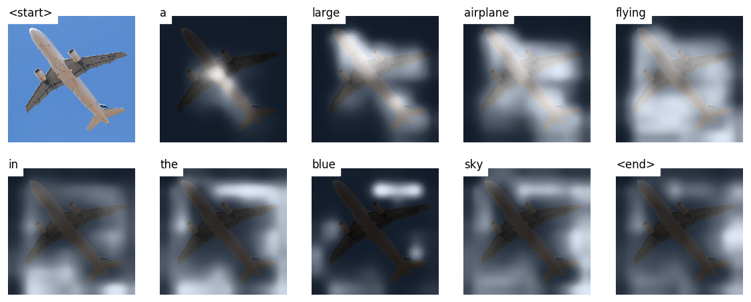
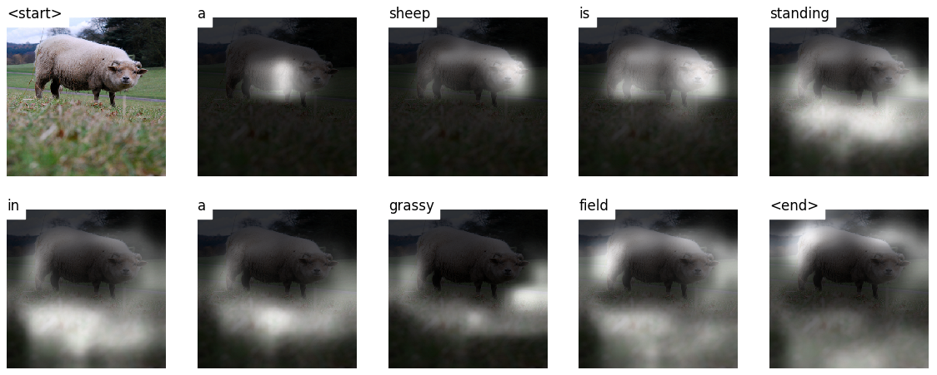
Image Captioning
Build a model that can generate a descriptive caption for an image
Notes:
Figure reference

Slide 4
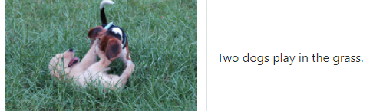
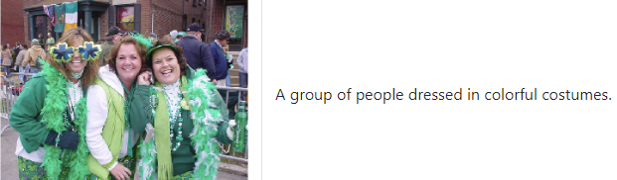
Image Captioning – Flickr8k Dataset
8091 images / 5 captions for each image.
We provide VALIDATION / TEST sets processed following Andrej Karpath’s training, validation, and test splits.

Slide 5
Image Captioning – BLEU Score
BLEU (BiLingual Evaluation Understudy)
Modified n-gram precision metric
Combine the modified metric with geometric mean
Add brevity penality
Evaluates a generated caption against reference caption (s).
The authors report that the correlation between the loss and the BLEU score breaks down after a point, so they recommend stop training early when the BLEU score begins to degrade.
Reference: https://www.aclweb.org/anthology/P02-1040.pdf
Notes:
Bleu formula 설명 추가

Slide 6
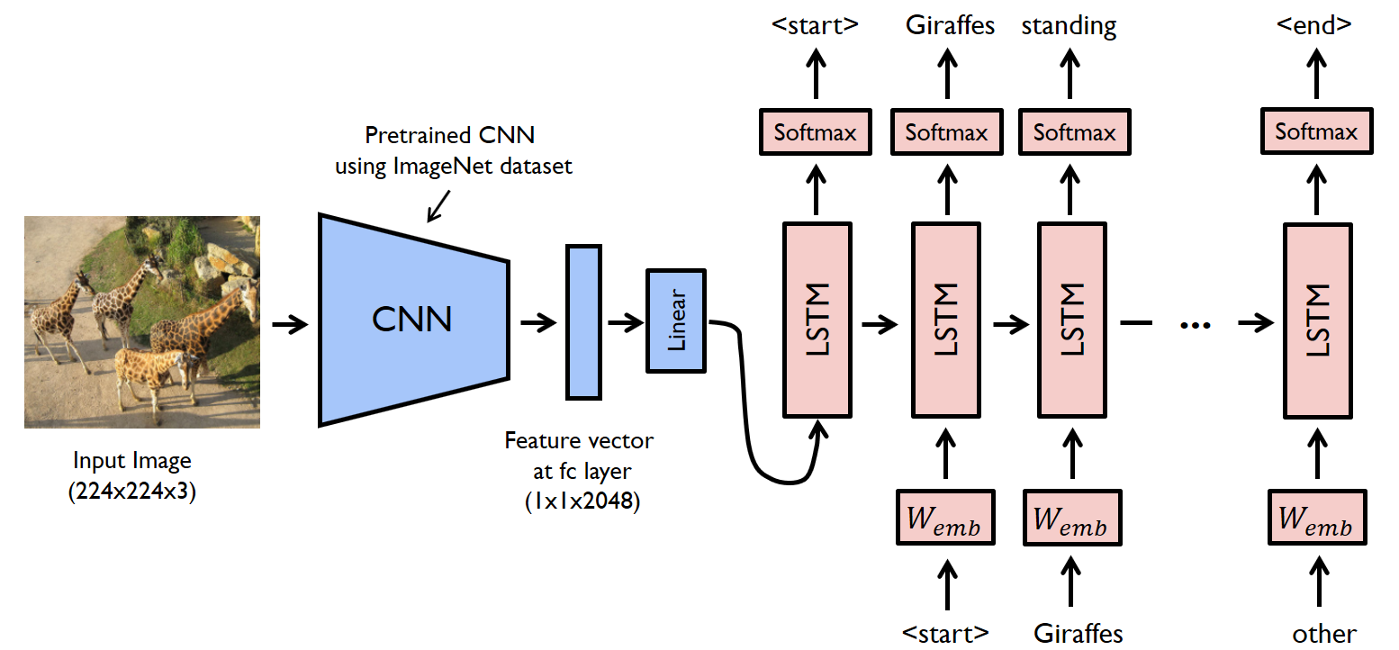
Naïve Image Captioning Model
Uses CNN + LSTM model [Encoder-Decoder architecture]
Pretrained CNN: extract the feature vector [Encoder]
LSTM: a language model conditioned on the feature vector. [Decoder]
Notes:
Figure reference

Slide 7
Show, Attend, and Tell
We will be implementing the Show, Attend, and Tell paper.
https://arxiv.org/pdf/1502.03044.pdf
Key Ideas:
Encoder-Decoder Architecture
Attention: model learns where to look. In our case, the model will consider some pixels more important than others.
Transfer learning: adopt a pretrained model for a different task.
Beam search: algorithm to search for the output sequence
Notes:
Beam search explanation 추가

Slide 8
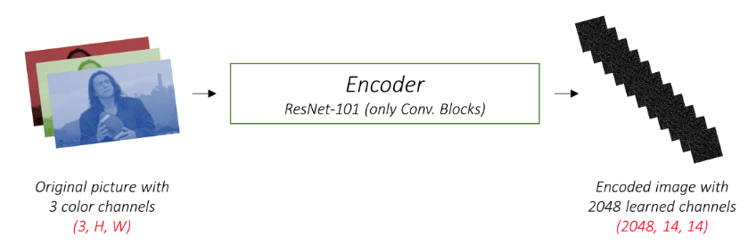
Show, Attend, and Tell – Encoder
Encode the input image with 3 color channels into a smaller image with “learned” channels.
Generate a meaningful feature map.
Notes:
Encoder -> 아무모델 사용가능

Slide 9
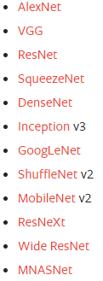
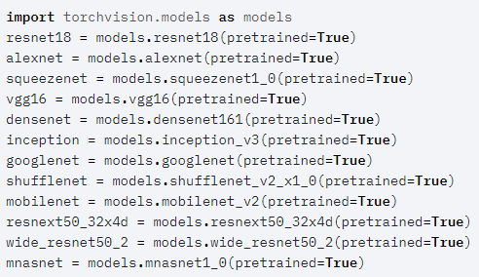
Show, Attend, and Tell – Encoder
You can choose any deep CNN model as a CNN encoder.
We highly recommend using one of the pretrained models available on Pytorch.

Slide 10
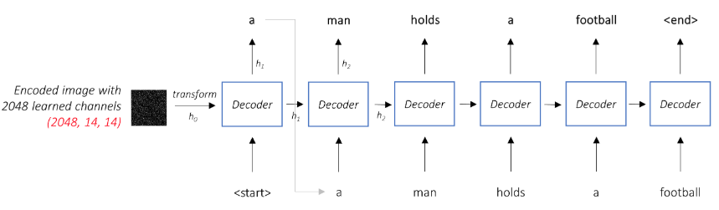
Show, Attend, and Tell – Decoder
Looks at the encoded image and generates a caption word by word.
In a setting without attention:
Average the encoded image across all pixels.
Feed this with or without linear transformation into Decoder as its first hidden state.
Each predicted word is used to generate the next word.

Slide 11
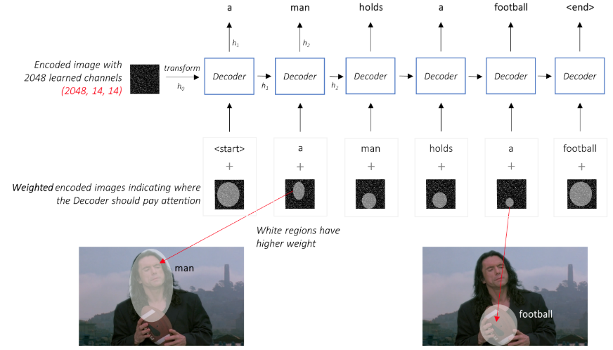
Show, Attend, and Tell – Attention
We want the Decoder to be able to attend to different parts of the image at different points in the sequence.

Slide 12
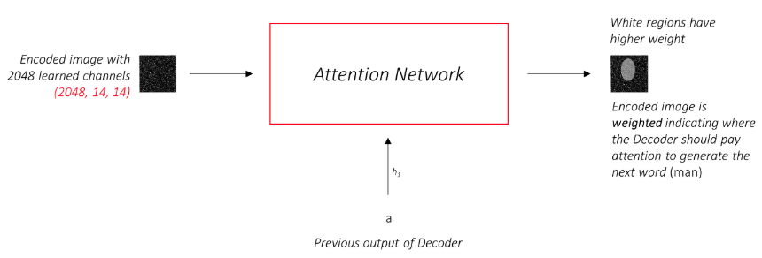
Show, Attend, and Tell – Attention
We want the Decoder to be able to attend to different parts of the image at different points in the sequence.
Now we add attention:
We use the weighted average of pixels.
The attention network learns these weights.

Slide 13
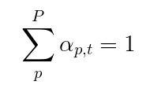
Show, Attend, and Tell – Attention
We want the Decoder to be able to attend to different parts of the image at different points in the sequence.
Now we add attention:
We will be using soft Attention (weights add up to 1).
Given p pixels in the encoded image, at each time step t
Notes:
Slide 11->12 넘어갈때 바뀐 부분이나 수식 하이라이트해서 보여주기

Slide 14
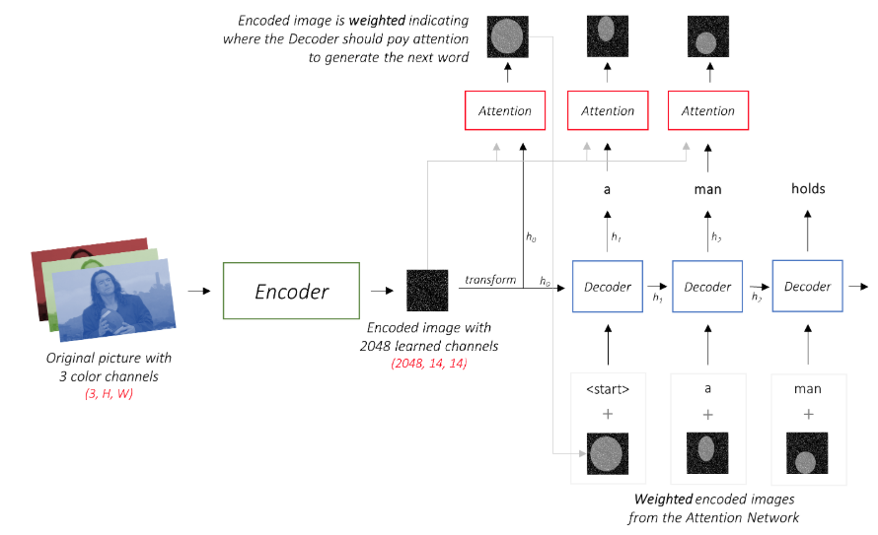
Show, Attend, and Tell – Putting it all together…
Attention Network
CNN of Your Choice
LSTM Network

Slide 15
실습 #4
Encoder Implementation
Attention Implementation
Decoder with Attention Implementation
Train Loop Implementation
Training and Visualization
Notes:
볼드체 부분 -> training technique 해볼 수 있는 거 추가

Slide 16
Train Loop Implementation
The decoder started with <start>, so the targets are all words after <start>, up to <end>.
Scores, target: pack_padded_sequence
Pad timesteps that we didn’t decode at
Add doubly stochastic attention regularization
Notes:
볼드체 부분 -> training technique 해볼 수 있는 거 추가

