Slide 1
Deep Learning Practice Lab 03 – GAN
Hyemi Jang & Jisoo Mok

Slide 2
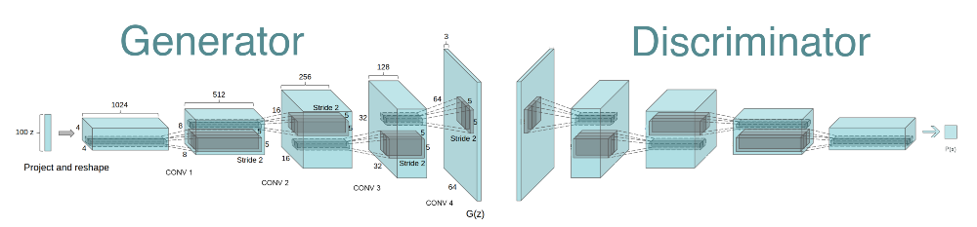
Generative Adversarial Networks (GAN)
Teaching a deep learning model to capture the training data’s distribution.
We can generate new data from the learned distribution.
Composed of two distinct models:
Generator: generate fake images
Discriminator: determine whether the input is real or fake
Notes:
Tutorial reference

Slide 3

Generative Adversarial Networks (GAN)
Task: Face Generation
Dataset: celebA
Referenced Paper: Unsupervised Representation Learning with Deep Convolutional Generative Adversarial Networks
https://arxiv.org/pdf/1511.06434.pdf
Notes:
Figure reference

Slide 4
DCGAN – Generator
Use convolutional-transpose layers
Last layer: Need a different activation function
Hyperbolic Tan (Tanh)

Slide 5
DCGAN – Generator
Layer 1
Input C: nz
Output C: ngf * 8
Kernel_size: 4
Stride: 1
Padding: 0

Slide 6
DCGAN – Generator
Layer 2
Input C: output of Layer 1
Output C: ngf * 4
Kernel_size: 4
Stride: 2
Padding: 1

Slide 7
DCGAN – Generator
Layer 3
Input C: output of layer 2
Output C: ngf * 2
Kernel_size: 4
Stride: 2
Padding: 1

Slide 8
DCGAN – Generator
Layer 4
Input C: output of layer 3
Output C: ngf
Kernel_size: 4
Stride: 2
Padding: 1

Slide 9
DCGAN – Generator
Layer 5
Input C: output of layer 4
Output C: # of channels in training images
Kernel_size: 4
Stride: 2
Padding: 1

Slide 10
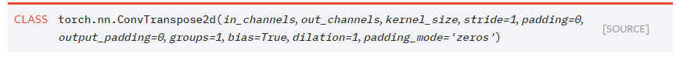
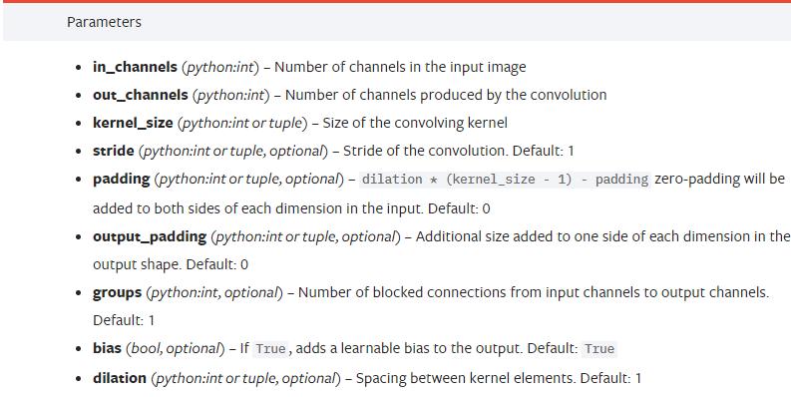
DCGAN – Generator
torch.nn.ConvTranspose2d
Combines the upscaling of an image with a convolution.
Notes:
Example 달기, input dim -> output dim (이거 아웃푹을 stride, paddin으로 어떻게 계산하는지)

Slide 11
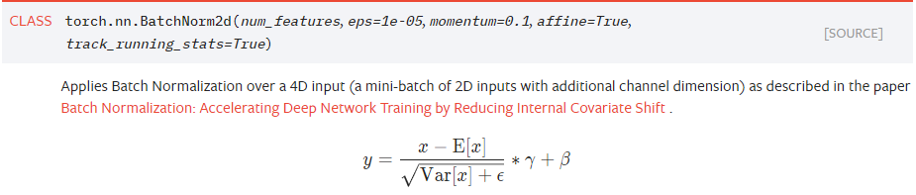
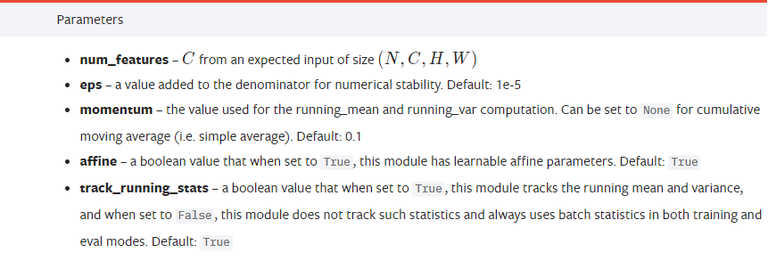
DCGAN – Generator
torch.nn.BatchNorm2d
Apply a batch normalization layer to accelerate training

Slide 12
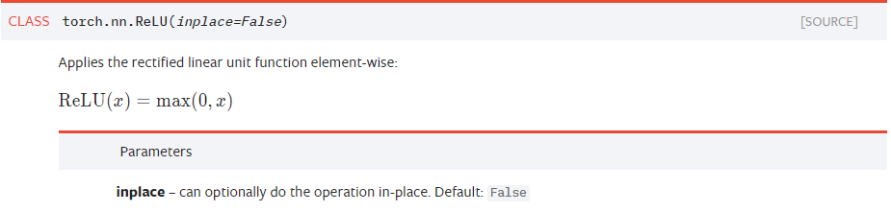
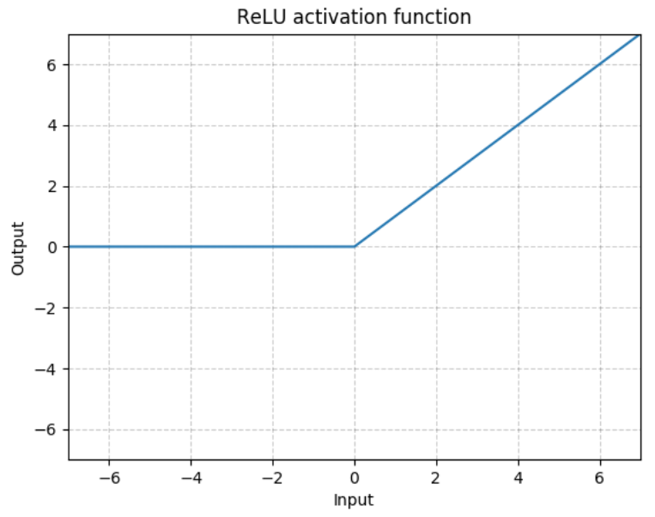
DCGAN – Generator
torch.nn.ReLU
Activation function

Slide 13
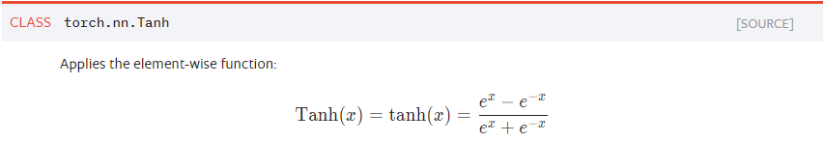
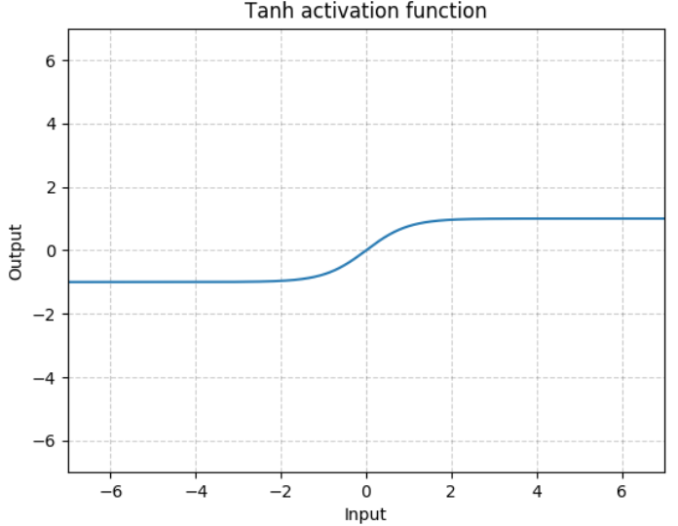
DCGAN – Generator
torch.nn.Tanh
Activation function

Slide 14
DCGAN – Discriminator
Use basic convolutional layers
Use a different activation function
Leaky ReLU
Last layer: needs Sigmoid function for binary classification

Slide 15
DCGAN – Discriminator
Layer 1
Input C: # of channels in training images
Output C: ndf
Kernel_size: 4
Stride: 2
Padding: 1

Slide 16
DCGAN – Discriminator
Layer 2
Input C: output of layer 1
Output C: ndf * 2
Kernel_size: 4
Stride: 2
Padding: 1

Slide 17
DCGAN – Discriminator
Layer 3
Input C: output of layer 2
Output C: ndf * 4
Kernel_size: 4
Stride: 2
Padding: 1

Slide 18
DCGAN – Discriminator
Layer 4
Input C: output of layer 3
Output C: ndf * 8
Kernel_size: 4
Stride: 2
Padding: 1

Slide 19
DCGAN – Discriminator
Layer 5
Input C: output of layer 4
Output C: 1
Kernel_size: 4
Stride: 1
Padding: 0

Slide 20
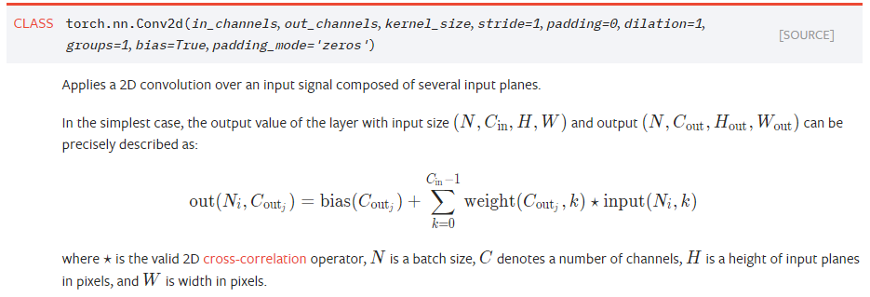
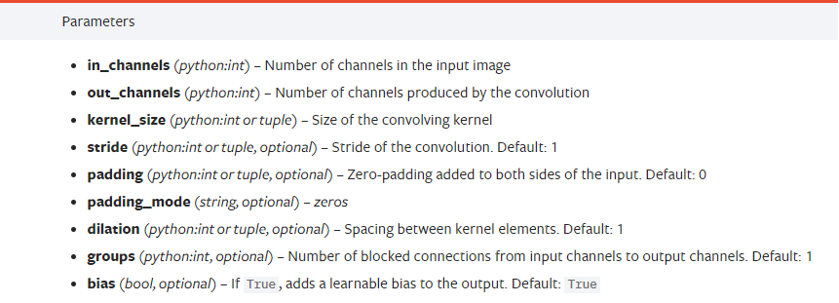
DCGAN – Discriminator
torch.nn.Conv2d
A basic 2D convolution operator

Slide 21
DCGAN – Discriminator
torch.nn.BatchNorm2d
Apply a batch normalization layer to accelerate training

Slide 22
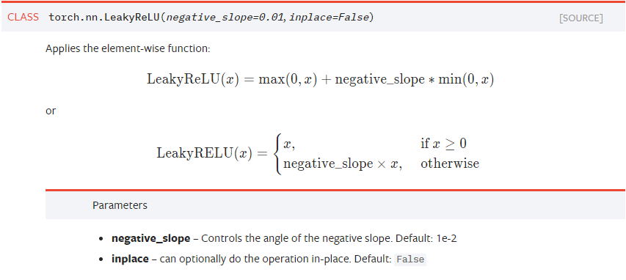
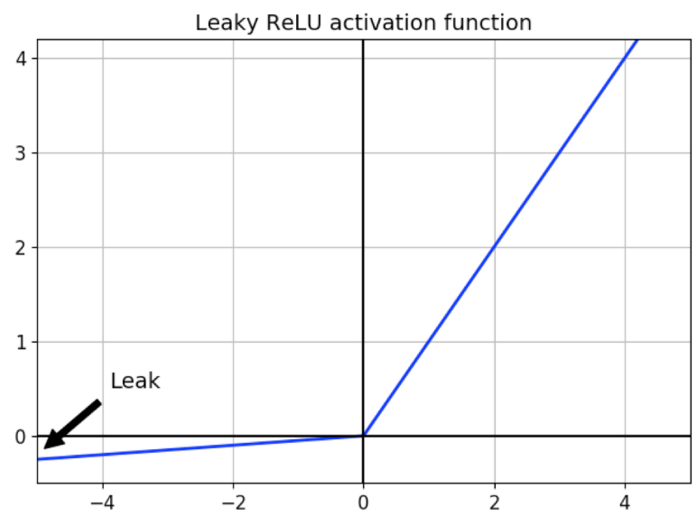
DCGAN – Discriminator
torch.nn.LeakyReLU
Activation function
negative_slope = 0.2
Notes:
Figure reference

Slide 23
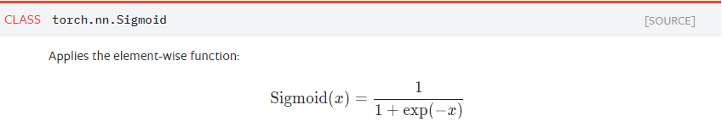
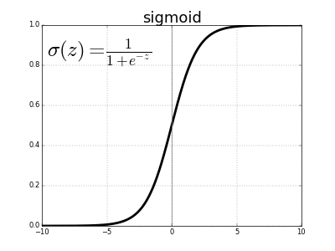
DCGAN – Discriminator
torch.nn.Sigmoid
Activation function
Notes:
Figure reference

Slide 24
Training Procedure – Discriminator
Train discriminator with real data
Create “real (1)” labels and “fake (0)” labels.
Forward pass real images through discriminator.
Calculate the loss between real output and real labels. (real loss)
Train discriminator with fake data
Create fake images by forward passing random noise through generator.
Forward pass fake images through discriminator.
Calculate the loss between fake output and fake labels. (fake loss)
Calculate the discriminator loss (= real loss + fake loss) and backprop

Slide 25
Training Procedure – Generator
Create random noise.
Forward pass random noise through generator.
Forward pass the output of generator through discriminator.
Calculate the loss between fake output and real labels.
Backprop.

Slide 26
실습
DCGAN Implementation
Generator
Discriminator
Training loop implementation
Comparing real vs. fake images

