Slide 1
Deep Learning Practice Quiz Review
Hyemi Jang & Jisoo Mok

Slide 2
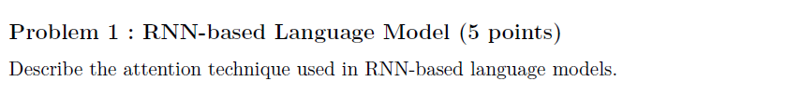
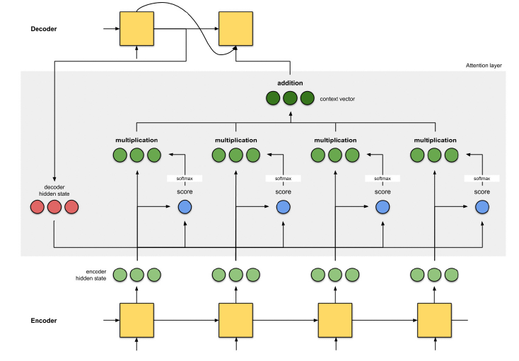
Quiz Review

Slide 3
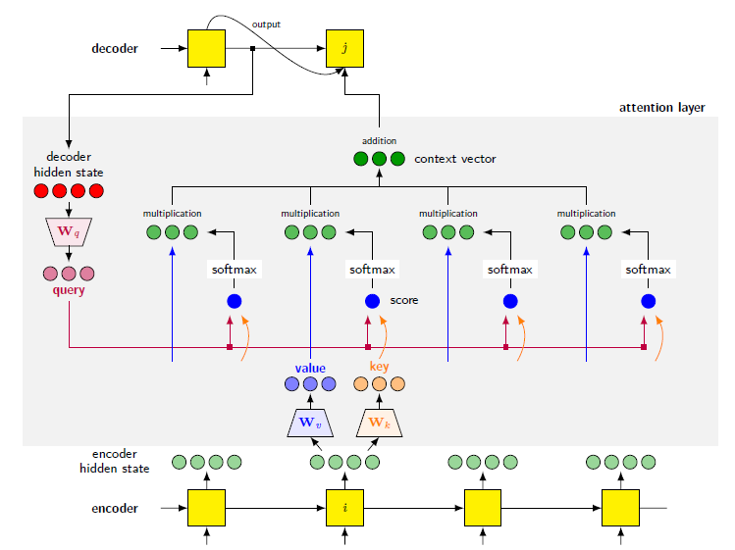
Quiz Review

Slide 4

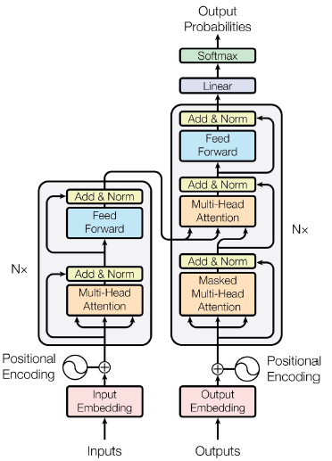
Quiz Review

Slide 5
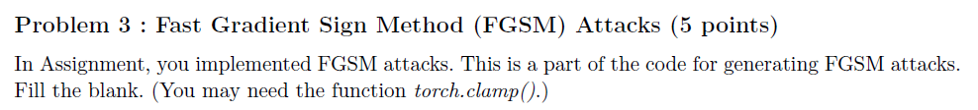
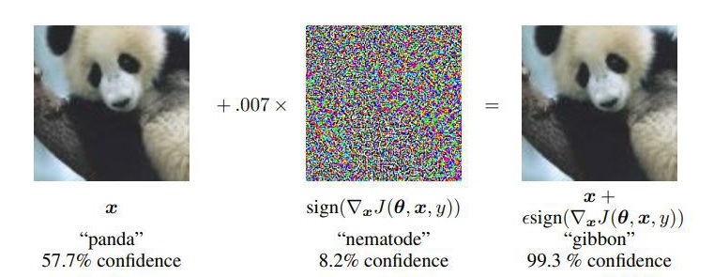
Quiz Review

Slide 6
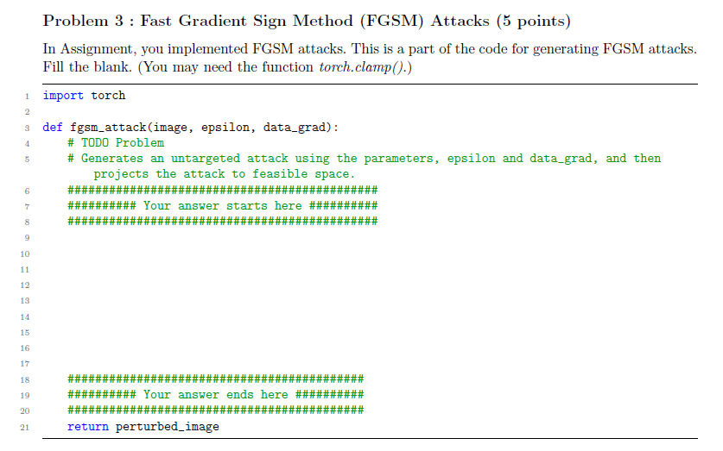

Quiz Review

Slide 7
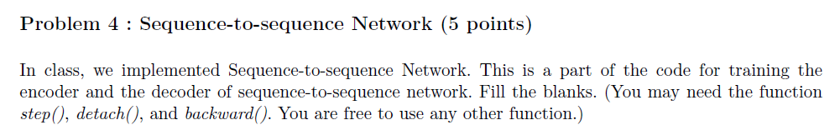
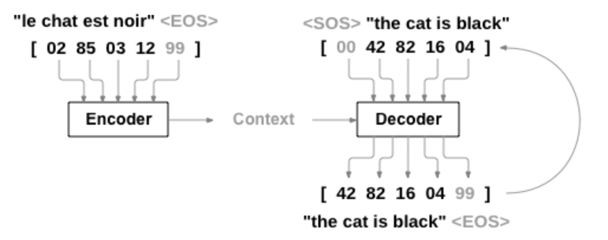
RNN + seq-to-seq
Sutskever, Ilya, Oriol Vinyals, and Quoc V. Le.
"Sequence to sequence learning with neural networks."
Advances in neural information processing systems. 2014.

Slide 8
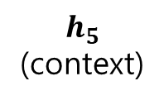

RNN + seq-to-seq
Encoder
$$h_{0}$$
GRU
GRU
GRU
GRU
GRU
$$h_{5}$$
(context)
emb
emb
emb
emb
emb
02
le
85
chat
03
east
12
noir
99
<EOS>

Slide 9







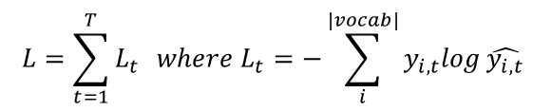
RNN + seq-to-seq
Decoder
$$L=\sum_{t=1}^{T}{L_{t}} where L_{t}=−\sum_{i}^{\left|vocab\right|}{y_{i,t}log}\hat{y_{i,t}}$$
42
the
82
cat
16
is
04
black
99
<EOS>
$$L_{1}$$
$$L_{2}$$
$$L_{3}$$
$$L_{4}$$
$$L_{5}$$
pred
pred
pred
pred
pred
$$h_{0}$$
$$\text{(}\text{context}\text{)}$$
GRU
GRU
GRU
GRU
GRU
$$h_{5}$$
emb
emb
emb
emb
emb
00
<SOS>
42
the
82
cat
16
is
04
black

Slide 10
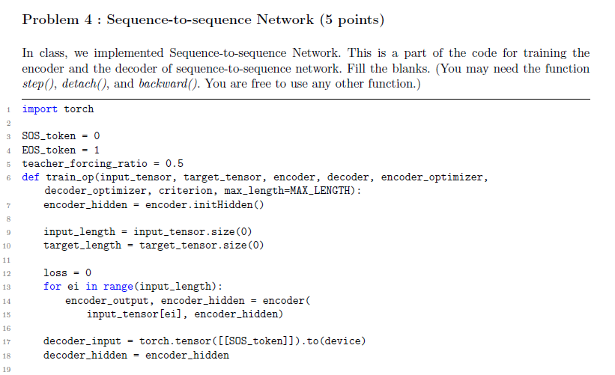
Quiz Review

Slide 11
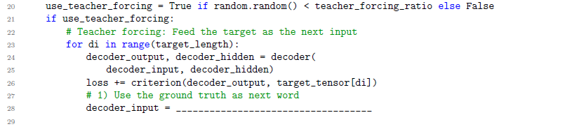
Quiz Review

Slide 12
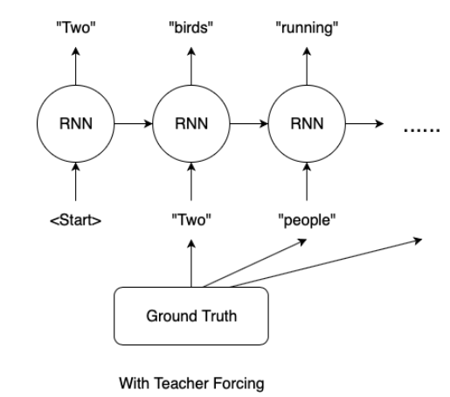
RNN + seq-to-seq
Teacher forcing
Use true target as a next input
https://towardsdatascience.com/
what-is-teacher-forcing-3da6217fed1c

Slide 13
Quiz Review
target_tensor[di]

Slide 14
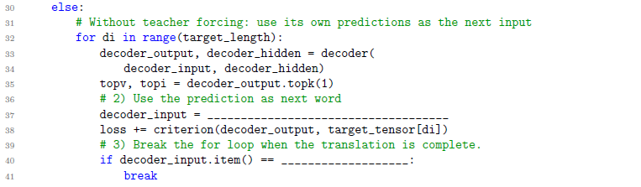
Quiz Review

Slide 15
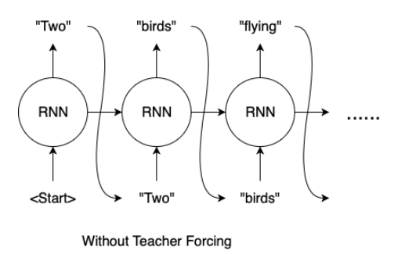
RNN + seq-to-seq
Teacher forcing
Use true target as a next input
https://towardsdatascience.com/
what-is-teacher-forcing-3da6217fed1c

Slide 16
Quiz Review
topi.squeeze().detach()
EOS_token

Slide 17

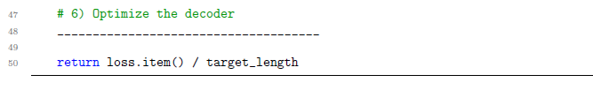
Quiz Review
loss.backward() encoder_optimizer.step()
decoder_optimizer.step()

