Slide 1
Deep Learning Practice Lab 03 - RNN
Hyemi Jang & Jisoo Mok

Slide 2
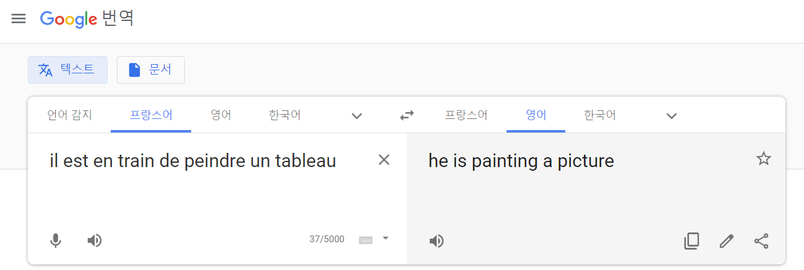
RNN + seq-to-seq
Task
Translation from French to English
https://translate.google.com/
Notes:
Google translate capture 넣기

Slide 3
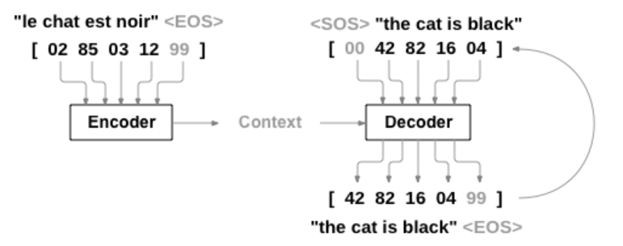
RNN + seq-to-seq
Sequence to sequence network
Encoder : condenses an input sequence into a vector
Decoder : unfolds that vector into a new sequence
Sutskever, Ilya, Oriol Vinyals, and Quoc V. Le.
"Sequence to sequence learning with neural networks."
Advances in neural information processing systems. 2014.

Slide 4
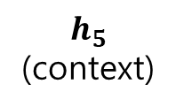

RNN + seq-to-seq
Encoder
$$h_{0}$$
GRU
GRU
GRU
GRU
GRU
$$h_{5}$$
(context)
emb
emb
emb
emb
emb
02
le
85
chat
03
east
12
noir
99
<EOS>

Slide 5







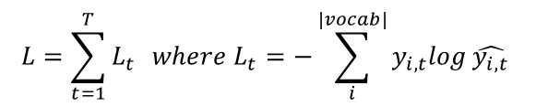
RNN + seq-to-seq
Decoder
$$L=\sum_{t=1}^{T}{L_{t}} where L_{t}=−\sum_{i}^{\left|vocab\right|}{y_{i,t}log}\hat{y_{i,t}}$$
42
the
82
cat
16
is
04
black
99
<EOS>
$$L_{1}$$
$$L_{2}$$
$$L_{3}$$
$$L_{4}$$
$$L_{5}$$
pred
pred
pred
pred
pred
$$h_{0}$$
$$\text{(}\text{context}\text{)}$$
GRU
GRU
GRU
GRU
GRU
$$h_{5}$$
emb
emb
emb
emb
emb
00
<SOS>
42
the
82
cat
16
is
04
black

Slide 6
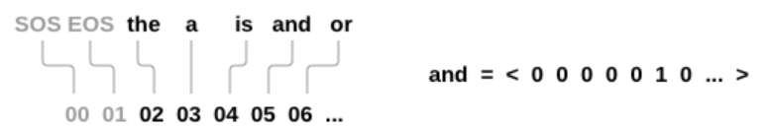
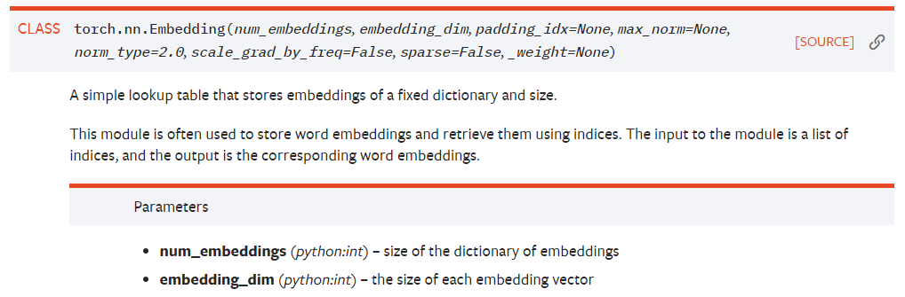
RNN + seq-to-seq
torch.nn.Embedding
Lookup table that stores embedding vectors of a fixed size

Slide 7
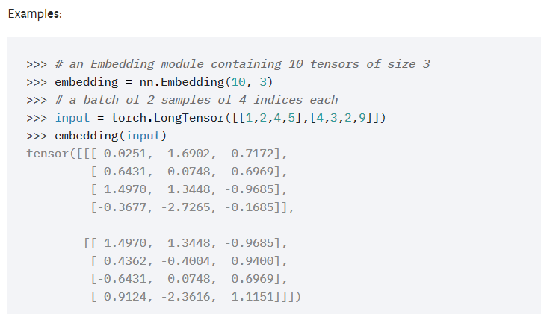
RNN + seq-to-seq
torch.nn.Embedding
Lookup table that stores embedding vectors of a fixed size

Slide 8
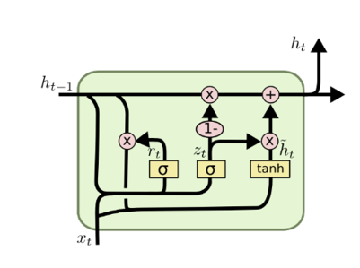
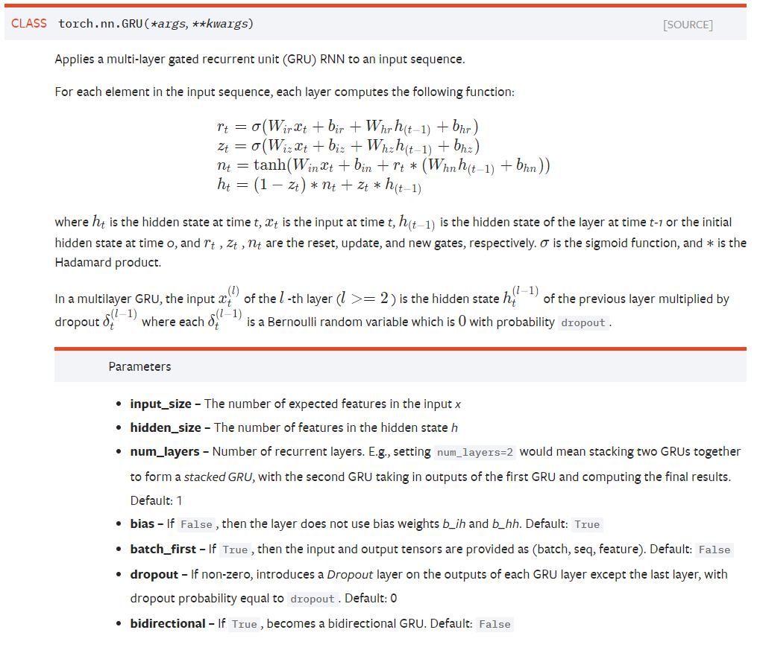
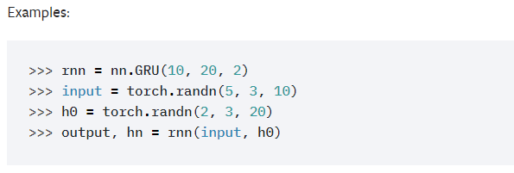
RNN + seq-to-seq
torch.nn.GRU

Slide 9
RNN + seq-to-seq
Encoder
$$h_{0}$$
GRU
GRU
GRU
GRU
GRU
$$h_{5}$$
(context)
emb
emb
emb
emb
emb
02
le
85
chat
03
east
12
noir
99
<EOS>

Slide 10
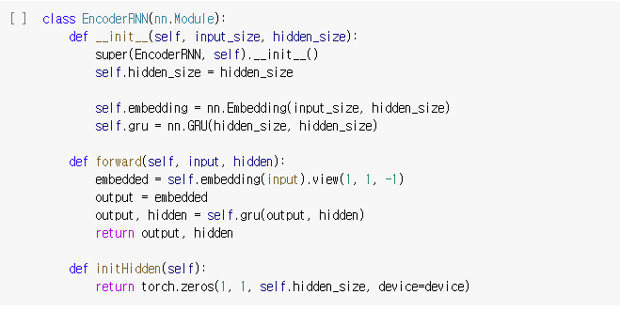
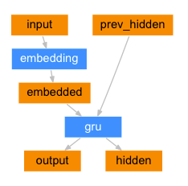
RNN + seq-to-seq
EncoderRNN
Encoding input sequence (French sentence)
Encoder

Slide 11
RNN + seq-to-seq
Decoder
$$L=\sum_{t=1}^{T}{L_{t}} where L_{t}=−\sum_{i}^{\left|vocab\right|}{y_{i,t}log}\hat{y_{i,t}}$$
42
the
82
cat
16
is
04
black
99
<EOS>
$$L_{1}$$
$$L_{2}$$
$$L_{3}$$
$$L_{4}$$
$$L_{5}$$
pred
pred
pred
pred
pred
$$h_{0}$$
$$\text{(}\text{context}\text{)}$$
GRU
GRU
GRU
GRU
GRU
$$h_{5}$$
emb
emb
emb
emb
emb
00
<SOS>
42
the
82
cat
16
is
04
black

Slide 12
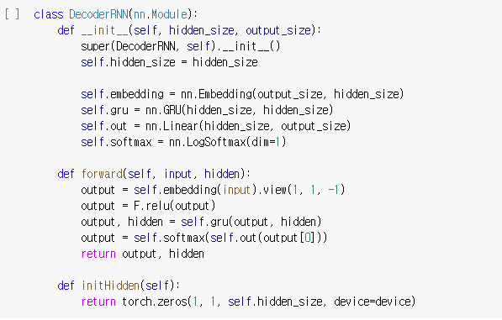
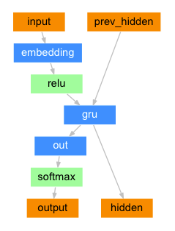
RNN + seq-to-seq
DecoderRNN
Decoding embedding to target sentence (English sentence)
Decoder

Slide 13

RNN + seq-to-seq
Sequence to sequence network
Sutskever, Ilya, Oriol Vinyals, and Quoc V. Le.
"Sequence to sequence learning with neural networks."
Advances in neural information processing systems. 2014.

Slide 14
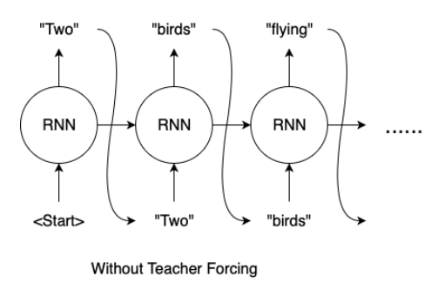
RNN + seq-to-seq
Teacher forcing
Use true target as a next input
https://towardsdatascience.com/
what-is-teacher-forcing-3da6217fed1c

Slide 15
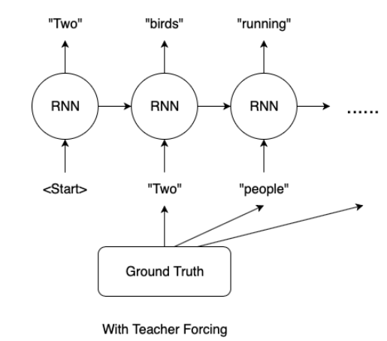
RNN + seq-to-seq
Teacher forcing
Use true target as a next input
https://towardsdatascience.com/
what-is-teacher-forcing-3da6217fed1c

Slide 16
실습 #3
Train function
With teacher forcing
Without teacher forcing
Test function
Notes:
37 refer 해라

Slide 17
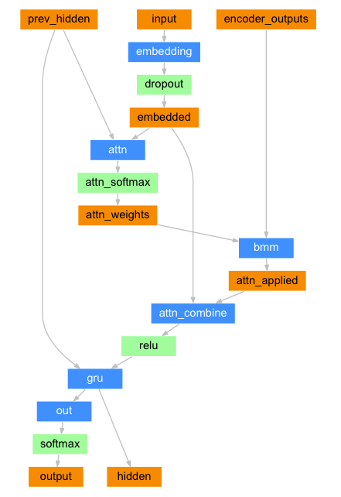
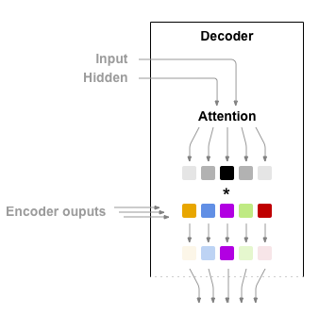
RNN + seq-to-seq
Sequence to sequence network with attention
Use attention mechanism to improve the sequence to sequence network
Decoder learn to focus over a specific range of the input sequence
Bahdanau, Dzmitry, Kyunghyun Cho, and Yoshua Bengio.
"Neural machine translation by jointly learning to align and translate."
arXiv preprint arXiv:1409.0473 (2014).
Notes:
Paper reference

Slide 18
RNN + seq-to-seq
Encoder
Decoder
AttnDecoder

Slide 19
실습 #3
Decoder with attention implementation
Train function with AttnDecoder
Test function with AttnDecoder
Reference:https://pytorch.org/tutorials/
Decoder
AttnDecoder
Notes:
37 refer 해라

