Slide 1
Deep Learning Practice Lab 01 - MLP
Hyemi Jang & Jisoo Mok

Slide 2
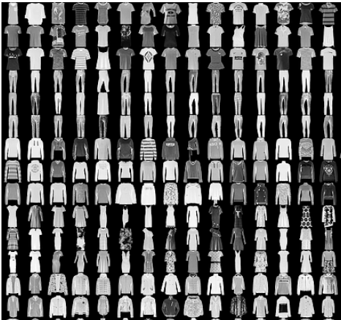
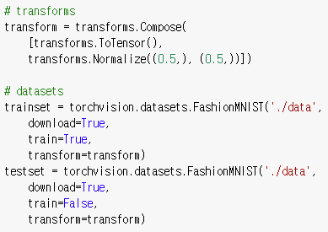
MLP + Tensorboard
Classification of Fashion-MNIST
Fashion-MNIST
28x28 gray scale image
Train set size : 60,000 (6000 per class)
Test set size : 10,000 (1000 per class)
Class # : 10
T-shirt/top, Trouser, Pullover, Dress, Coat, Sandal, Shirt, Sneaker, Bag, Ankle boot
https://github.com/zalandoresearch/fashion-mnist
Notes:
Fmnist reference

Slide 3
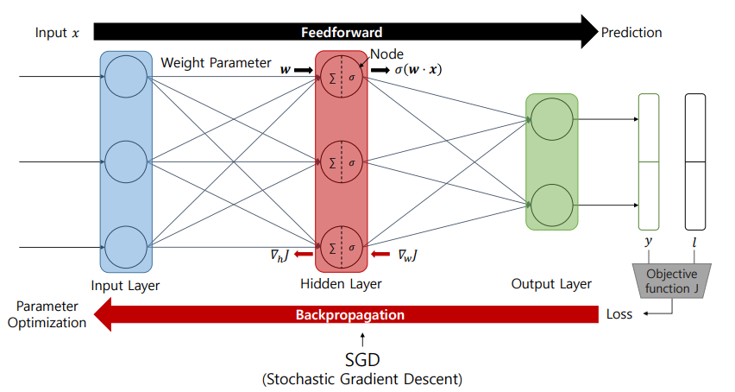
MLP + Tensorboard
Bae, Ho, et al. "Security and privacy issues in deep learning.“
arXiv preprint arXiv:1807.11655 (2018).
Notes:
Figure reference

Slide 4
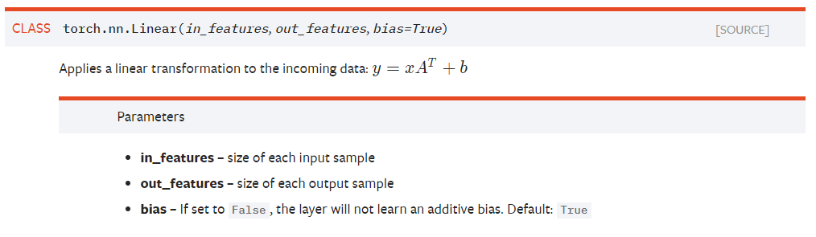
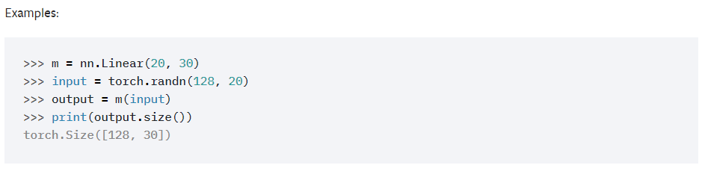
MLP + Tensorboard
Linear layer
Linear transformation from an input space to an output space

Slide 5
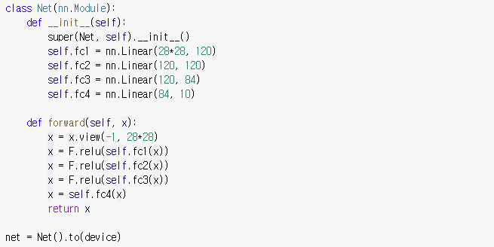
MLP + Tensorboard
Network class
Network structure : 4 linear layer
Activation : ReLU
Input dimension : (batch, 28, 28, 1)
Output dimension : (batch, 10)
Define a model
Forward pass
It is executed when net(x) is called

Slide 6
MLP + Tensorboard
Train the network
Define loss and optimizer

Slide 7
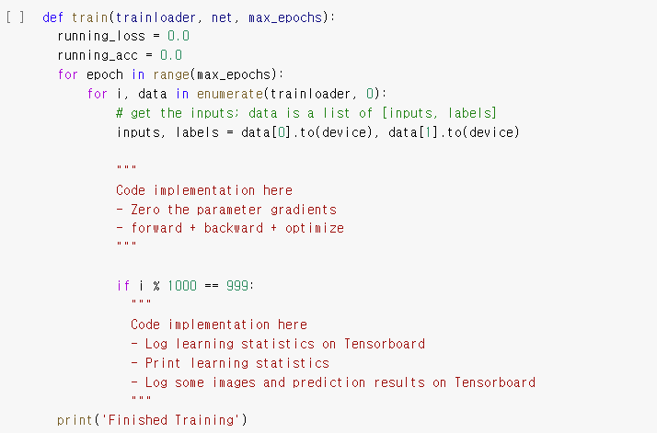
MLP + Tensorboard
Train the network
Define loss and optimizer
Train the network through multiple optimization
Train loop
Log learning statistics

Slide 8
MLP + Tensorboard
Tensorboard
Visualization tool for machine learning experiments
Tracking metrics such as loss and accuracy
Visualizing the model graph
Viewing histograms of weights and biases
Displaying images, text, and audio data
Link: https://pytorch.org/docs/stable/tensorboard.html
Notes:
Tensorboard reference

Slide 9
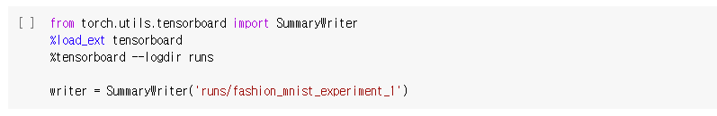
MLP + Tensorboard
Tensorboard
Visualization tool for machine learning experiments
Tracking metrics such as loss and accuracy
Visualizing the model graph
Viewing histograms of weights and biases
Displaying images, text, and audio data
Link: https://pytorch.org/docs/stable/tensorboard.html
Launch Tensorboard on colab
1. Execute Tensorboard
2. Make writer to log running statistics
Notes:
Tensorboard reference

Slide 10
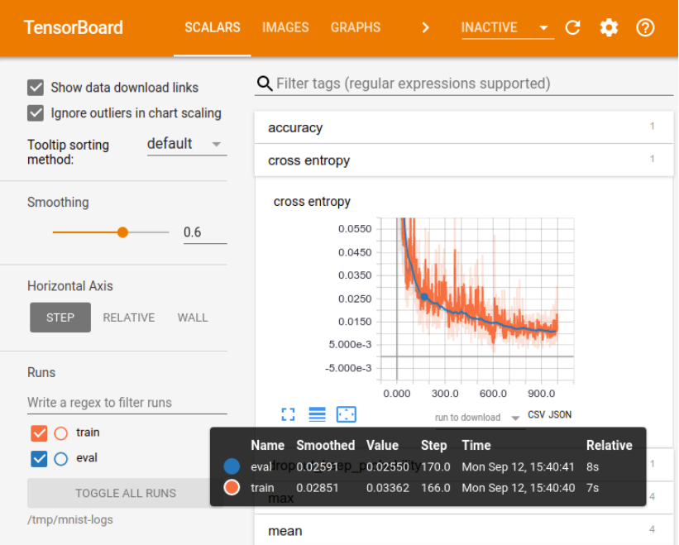
MLP + Tensorboard

Slide 11
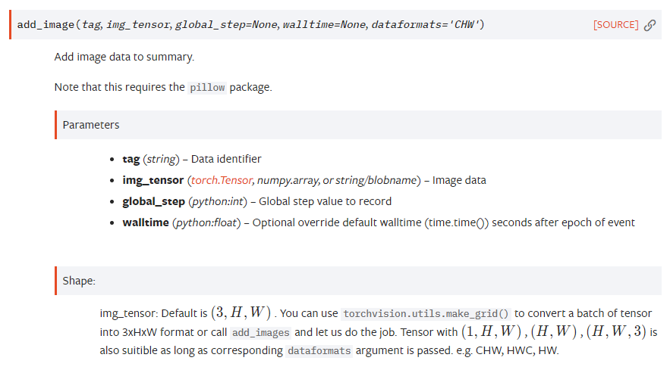
MLP + Tensorboard
torch.utils.tensorboard
add_image : uploads an image on Tensorboard

Slide 12
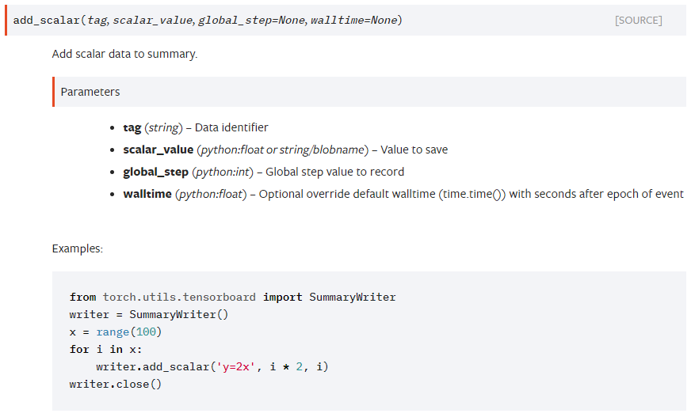
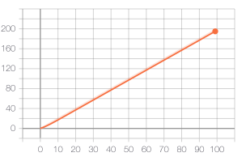
MLP + Tensorboard
torch.utils.tensorboard
add_scalar : uploads a scalar on Tensorboard

Slide 13
실습 #1
Train function
Train loop
Log training statistics using Tensorboard
Loss and accuracy
Image samples
Test function
Estimate the accuracy of the neural network on test data
Improve the performance of the network
Change epoch, batch_size, loss and network structure

