Slide 1
Deep Learning Practice Assignment
Hyemi Jang & Jisoo Mok

Slide 2
Table of Contents
Part A. ResNet Training
Part B. Adversarial Attack

Slide 3
Part A. ResNet Training
There are several hyperparameters that need tuning to obtain higher accuracy.
Learning rate
Choice of optimizer
# of epochs
Batch size…
We have provided you with the architecture (ResNet)
Competition for the highest possible accuracy!
Approximate range of ResNet accuracy on CIFAR-100:
75.61% ~ 77.69%

Slide 4
Introduction to Adversarial Examples/Attack
We add carefully constructed noise to the input.
Humans can tell that both images look like a pig.
But the neural network recognizes the perturbed image as an airliner.
“Optical illusion” for neural networks!
Source: https://medium.com/attentive-ai/fooling-cnns-via-adversarial-examples-877a9e0ee84e
Notes:
Resnet paper reference

Slide 5
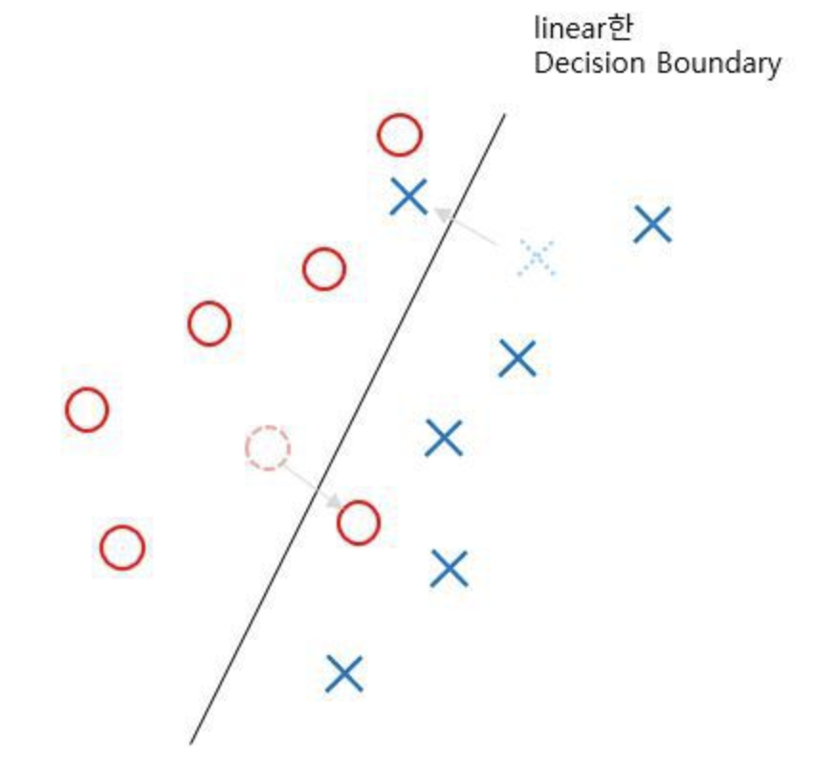
Why does this work?
Primary interpretation: because of linearities in neural networks.
Even with very small amount of perturbation, the image can be placed on the wrong side of this boundary.
Source: https://leedakyeong.tistory.com/entry/%EB%85%BC%EB%AC%B8-FGSM-%EB%A6%AC%EB%B7%B0-EXPLAINING-AND-HARNESSING-ADVERSARIAL-EXAMPLES

Slide 6
Categories of Adversarial Attack
White Box vs. Black Box
White box: we know the target neural network
Black box: we have no knowledge of the target neural network
Untargeted Attack vs. Targeted Attack
Targeted Attack: we have a specific target classification
Untargeted attack: output classification is wrong; does not care about whatthe new classification actually is.

Slide 7
Part B. Attack the trained ResNet with FGSM Attack
Assuming that you have completed Part A, we have a fairly well-trained ResNet with a reasonable accuracy.
Now we will try to attack this model.
Reference: https://pytorch.org/tutorials/beginner/fgsm_tutorial.html

Slide 8
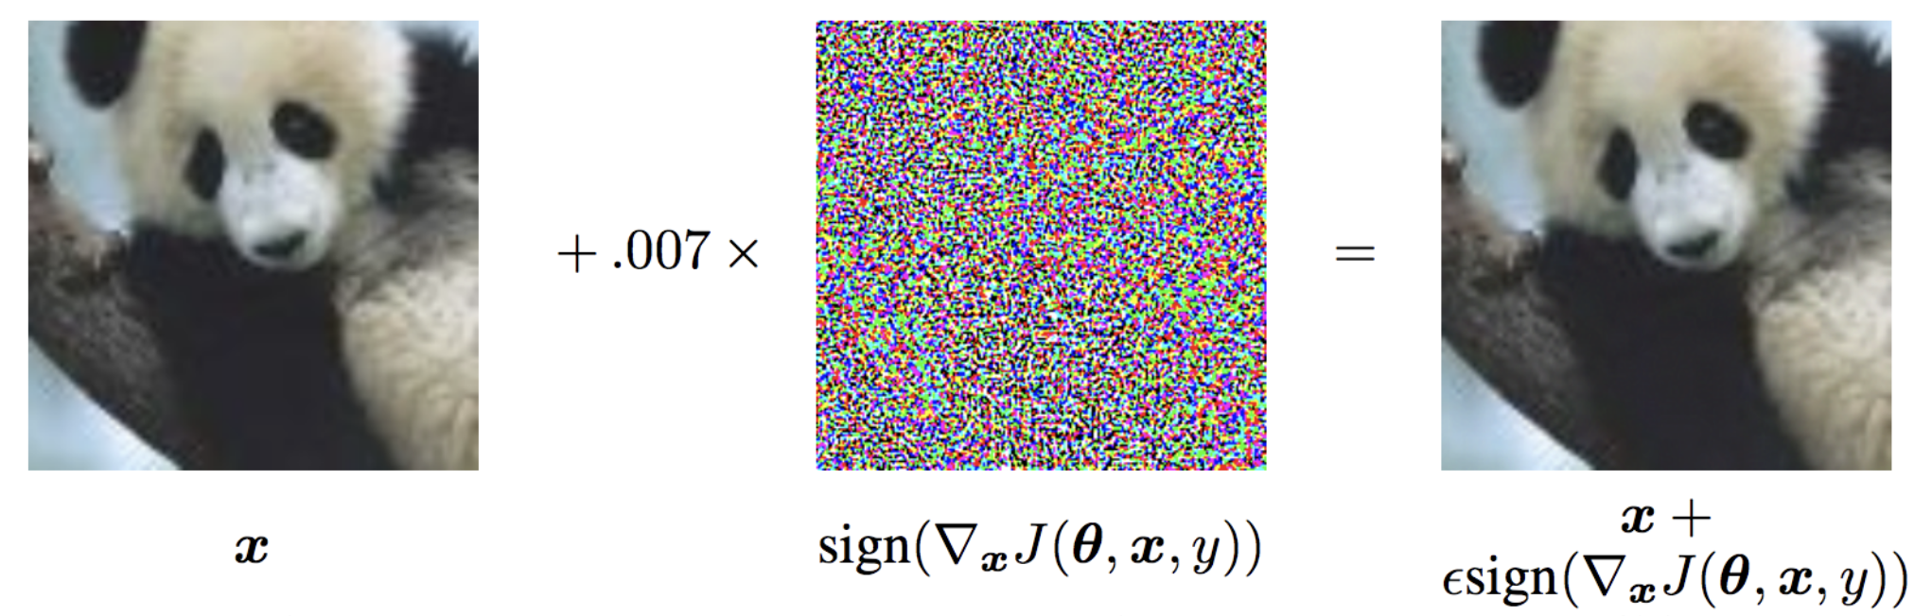
FGSM (Fast Gradient Sign Method) Attack
White Box and Untargeted Attack
Take the gradient with respect to the input data.
Take the element-wise sign of the data gradient.
Multiply the sign of the data gradient with a small epsilon value.
ADD this noise to the input image.
Source: https://pytorch.org/tutorials/

Slide 9
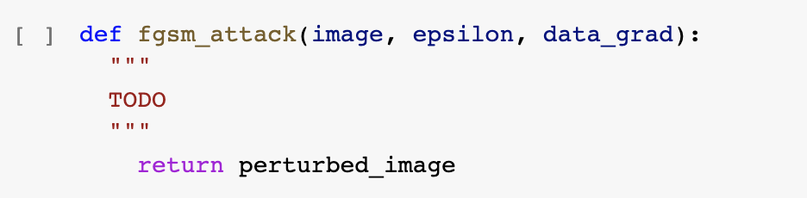
fgsm_attack function
Implement the above equation.
Inputs: clean image, user-set epsilon value, computed gradient
Output: perturbed image
Source: https://pytorch.org/tutorials/

Slide 10
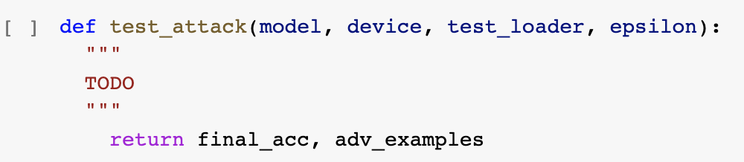
test_attack function
We are going to loop over examples in test set.
Send data and label to GPU.
data.requires_grad = True : because we want gradient w.r.t. data
Forward pass data through the model.
Calculate the loss.
data_grad = data.grad.data : collect data gradient.
Call fgsm_attack function with correct inputs.
Forward pass the perturbed image through the model.
Calculate the accuracy to check if the attack has worked.
Source: https://pytorch.org/tutorials/

Slide 11
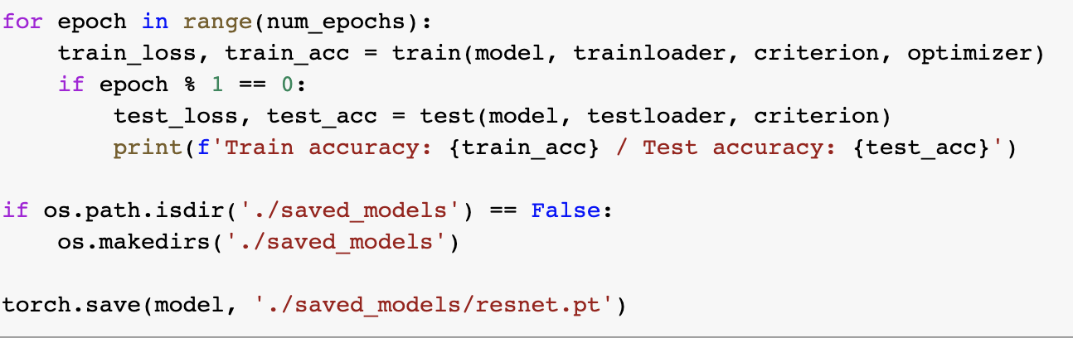
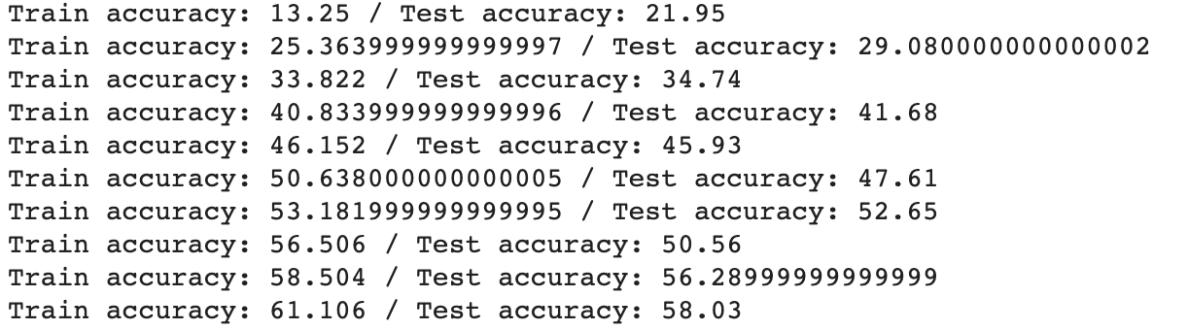
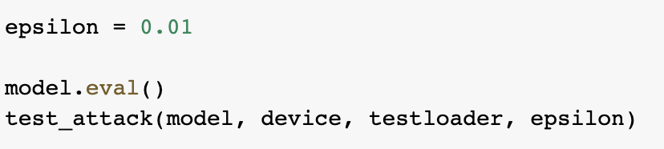
Important Warning
Part A
Part B
You will be evaluated based on the results of these two cells.
Therefore, it is important that you do NOT clear the outputs of these two cells.

Slide 12
Submission Files
Assignment.ipynb
Your code with all the training logs.
model_name.pt
After saving the model in colab, you can download this file onto your local device.
Please submit this file, so that we can make sure that you didn’t print some string to fool us!
Zip the above files and send .zip file to:
jmok908@gmail.com and wkdal9512@gmail.com
이메일 제목: [LG전자실습] 영문성함
파일이름: 영문성함.zip

Slide 13
Grading
Total available points: 50 pt
Part A: 40 pt,
Part B: 10 pt
Part A. ResNet Competition
1~4등 | 40 pt
5~8등 | 35 pt
9~12등 | 30 pt
13~16등 | 25 pt
17~20등 | 20 pt
21~24등 | 15 pt
수행 x | 0 pt
Part B. Adversarial Attack
Attack works | 10 pt
Attack does not work | 0 pt

