Slide 1
Deep Learning Practice Lab 05 - Transformer
Hyemi Jang & Jisoo Mok

Slide 2
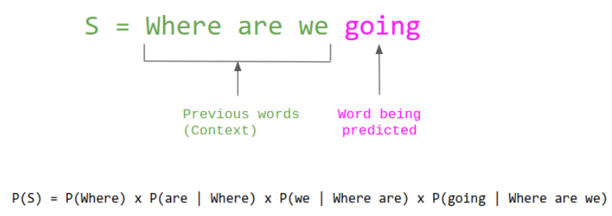
Task
Language Modeling
Predict the next word in a sentence
https://thegradient.pub/understanding-evaluation-metrics-for-language-models/

Slide 3
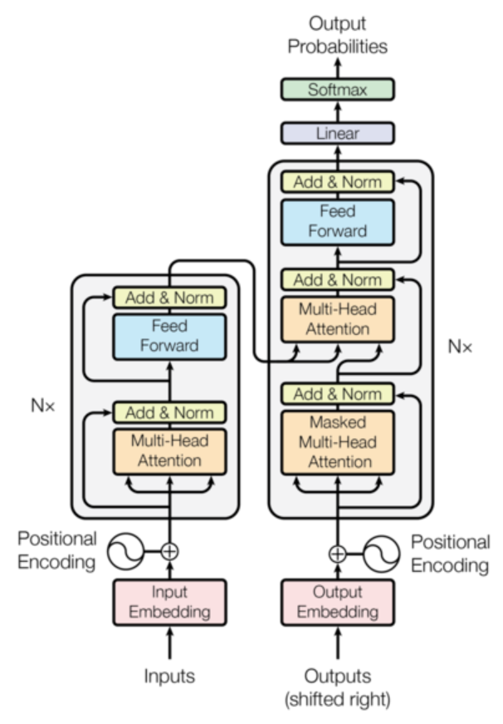
Transformer
Transformer
Doesn’t use the architecture, sequence-to-sequence
Components
Encoder : generating an embedded vector from an input
Decoder : decoding target from the target word and the embedded vector (we doesn’t use target input)
Link: http://papers.nips.cc/paper/ 7181-attention-is-all-you-need.pdf

Slide 4
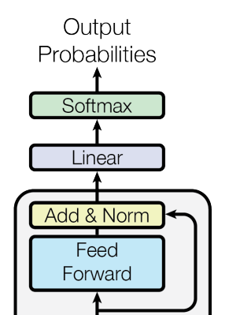

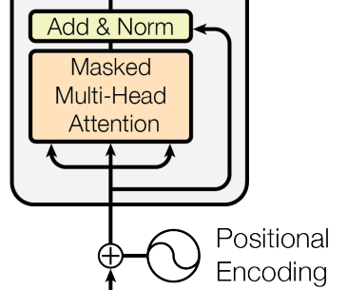
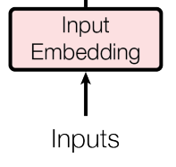
Transformer
The Architecture for Language Modeling
Linear layer predicts the next word from the embedding which is the output of the Transformer encoder
Masked Multi-Head Attention
Mask is used to prevent positions from attending to subsequent positions.

Slide 5
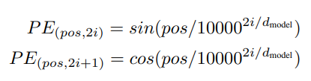
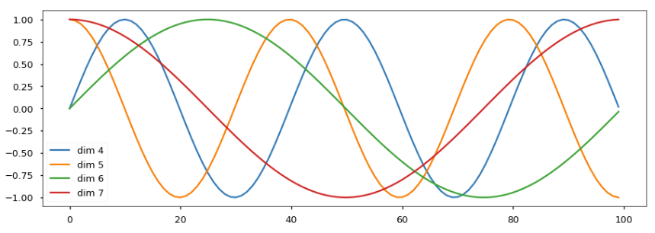
Positional Encoding
Representing the location of each words in sentences because Transformer does not enter input sequentially

Slide 6
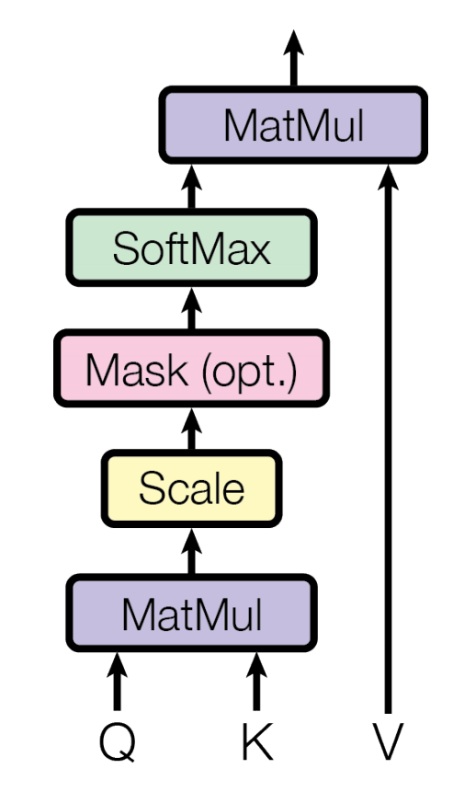
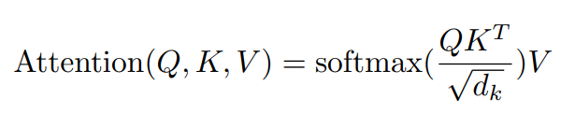
Scaled Dot-Product Attention
Scaled Dot-Product Attention
(Q, K, V) = (Query, Key, Value)
Self-attention
Focuses on the relationship between the words in the same sentence

Slide 7
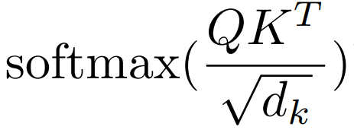

Self-attention
<Key>
I
am
a
student
I
I
am
am
<Query>
a
a
student
student

Slide 8
Self-attention
<Key>
I
am
a
student
I
I
am
am
<Query>
a
a
student
student

Slide 9
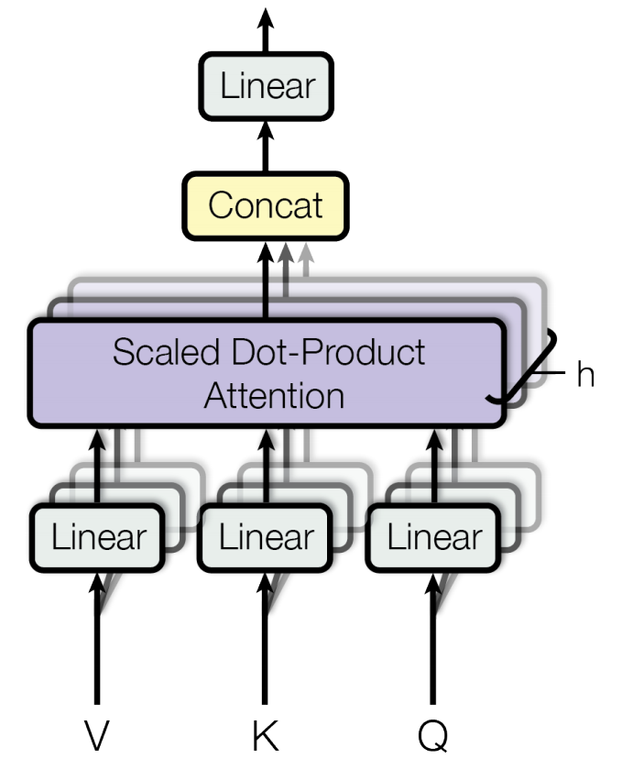
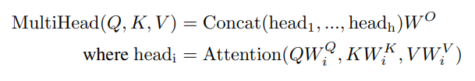
Multi-Head Attention
Allows the model to jointly attend to information from different representation subspaces at different positions.

Slide 10
Transformer
Input embedding
Positional encoding
Masked multi-head attention
Feed forward network
Linear decoder layer
Compute loss function using the prediction and target
Backpropagation and Optimize

Slide 11
실습
Mask Generation
Poisitional Encoding
EncoderLayer
Multi-head Attention

